Slide 1
“Walk In Newness Of Life” Text: Romans 6
Notes:
Prepared by Nathan L Morrison
All Scripture given is from NASB unless otherwise stated
For further study or if questions, Call: 804-277-1983, or Visit: www.courthousechurchofchrist.com

Slide 2
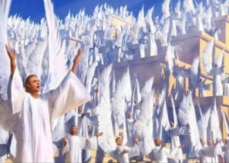
Intro
“New life” gives great joy! (Ps. 127: 3-5)
While physical new life gives great joy on earth,
the angels in Heaven rejoice over a spiritual
“new life!”
Luke 15:7, 10
"I tell you that in the same way, there will be more joy in heaven over one sinner who repents than over ninety-nine righteous persons who need no repentance.
"In the same way, I tell you, there is joy in the presence of the angels of God over one sinner who repents."

Slide 3
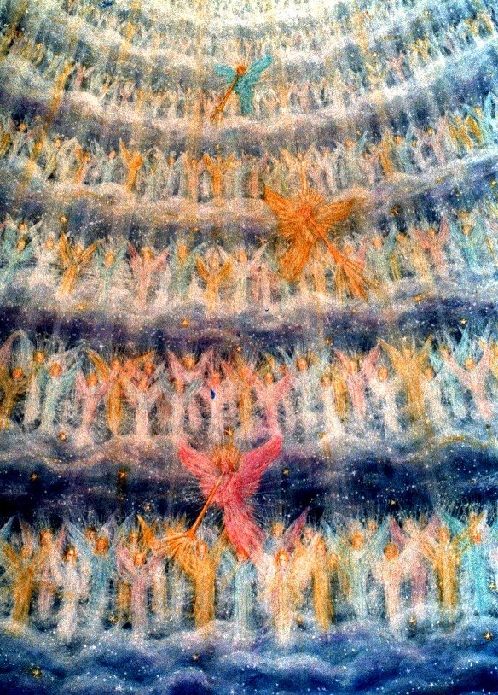
Intro
Romans 6:3-4
3. Or do you not know that all of us who have been baptized into Christ Jesus have been baptized into His death?
4. Therefore we have been buried with Him through baptism into death, so that as Christ was raised from the dead through the glory of the Father, so we too might walk in newness of life.
What is the “newness of life”
that causes angels in
Heaven to rejoice?

Slide 4
New Life of Eternal Deliverance
Rom. 6:1-10 (vss. 1-4)
1. What shall we say then? Are we to continue in sin so that grace may increase?
2. May it never be! How shall we who died to sin still live in it?
3. Or do you not know that all of us who have been baptized into Christ Jesus have been baptized into His death?
4. Therefore we have been buried with Him through baptism into death, so that as Christ was raised from the dead through the glory of the Father, so we too might walk in newness of life.

Slide 5
New Life of Eternal Deliverance
Rom. 6:1-10 (vss. 5-10)
5. For if we have become united with Him in the likeness of His death, certainly we shall also be in the likeness of His resurrection,
6. knowing this, that our old self was crucified with Him, in order that our body of sin might be done away with, so that we would no longer be slaves to sin;
7. for he who has died is freed from sin.
8. Now if we have died with Christ, we believe that we shall also live with Him,
9. knowing that Christ, having been raised from the dead, is never to die again; death no longer is master over Him.
10. For the death that He died, He died to sin once for all; but the life that He lives, He lives to God.

Slide 6
New Life of Eternal Deliverance
Old Self – Rom. 6:5-7
The sinner – Eph. 4:22-24
Corrupt – Eph. 4:22
Deeds are evil (corrupt) – Col. 3:9
Body of sin – Rom. 6:6
All the sins we commit in our lives – Rom. 6:23: Death!
(Heb. 8:12: God forgives and forgets)
Slaves to sin – Rom. 6:6, 16 (John 8:34)
Sin dominates, controls, and reigns if we let it (Rom. 6:12)

Slide 7
New Life of Eternal Deliverance
New Life of Eternal Deliverance – Rom. 6:2-7
Old Self: Crucified with Christ (Rom. 6:6)
Body of Sin: Done away with, buried (Rom. 6:4)
Slaves to sin: Death with Christ through baptism frees one from sin! (Rom. 6:6-7; Jn. 8:34-36)
Once obedient to the gospel, we are dead to sin and live in “newness of life!”
“Newness of life” begins
with the death of our old
self and a new life with
Christ!

Slide 8
New Life of Different Decisions
Rom. 6:11-20 (vss. 11-15)
11. Even so consider yourselves to be dead to sin, but alive to God in Christ Jesus.
12. Therefore do not let sin reign in your mortal body so that you obey its lusts,
13. and do not go on presenting the members of your body to sin as instruments of unrighteousness; but present yourselves to God as those alive from the dead, and your members as instruments of righteousness to God.
14. For sin shall not be master over you, for you are not under law but under grace.
15. What then? Shall we sin because we are not under law but under grace? May it never be!

Slide 9
New Life of Different Decisions
Rom. 6:11-20 (vss. 16-18)
16. Do you not know that when you present yourselves to someone as slaves for obedience, you are slaves of the one whom you obey, either of sin resulting in death, or of obedience resulting in righteousness?
17. But thanks be to God that though you were slaves of sin, you became obedient from the heart to that form of teaching to which you were committed,
18. and having been freed from sin, you became slaves of righteousness.

Slide 10
New Life of Different Decisions
Rom. 6:11-20 (vss. 19-20)
19. I am speaking in human terms because of the weakness of your flesh. For just as you presented your members as slaves to impurity and to lawlessness, resulting in further lawlessness, so now present your members as slaves to righteousness, resulting in sanctification.
20. For when you were slaves of sin, you were free in regard to righteousness.

Slide 11
New Life of Different Decisions
Do not let sin reign – Rom. 6:12
To reign is to control or rule.
No longer to obey our lusts & sinful desires – Rom. 6:12; Js. 1:14-15
Sin not to be master over our lives – Rom. 6:14, 16 (John 8:34)
Not to present body to unrighteousness but to
righteousness – Rom. 6:13
This means we must make different decisions in our lives.
I Pet. 4:1-4: After being delivered from sin, now is the time to live for God!
We are no longer to crave evil things, or give in to the lusts of the world!

Slide 12
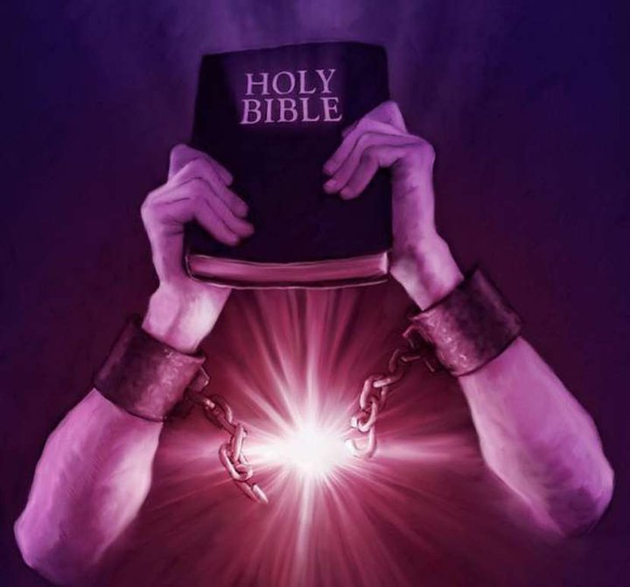
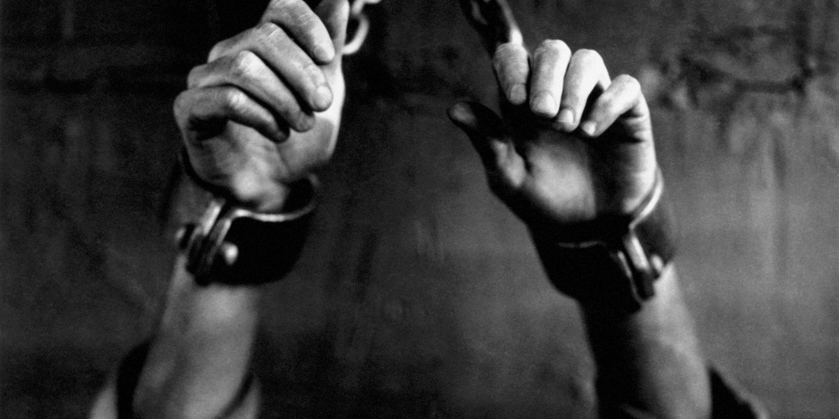
New Life of Different Decisions
Slaves of sin to slaves of righteousness –
Rom. 6:16-18
We will obey the lusts of the world (sin) which results in death OR we will become obedient to the will of God, resulting in righteousness!
Obedience comes from the heart; meaning a change of thinking, reasoning, decision making, and focus on things of God.

Slide 13
New Life of Different Decisions
Different Decisions – Rom. 6:12-13
We are to be “instruments of righteousness to God.”
Rom. 12:9: “Abhor what is evil; cling to what is good.”
I Thess. 5:21-22: “Hold fast” to what is good; “Abstain from every appearance of evil.” (Think before we act!)
That means we need to be conscious of the “will of God”
(I Pet. 4:2) in the decisions we make!
“Newness of life” entails living as “instruments of righteousness to God!”

Slide 14
New Life of Eternal Reward
Rom. 6:21-23
21. Therefore what benefit were you then deriving from the things of which you are now ashamed? For the outcome of those things is death.
22. But now having been freed from sin and enslaved to God, you derive your benefit, resulting in sanctification, and the outcome, eternal life.
23. For the wages of sin is death, but the free gift of God is eternal life in Christ Jesus our Lord.

Slide 15
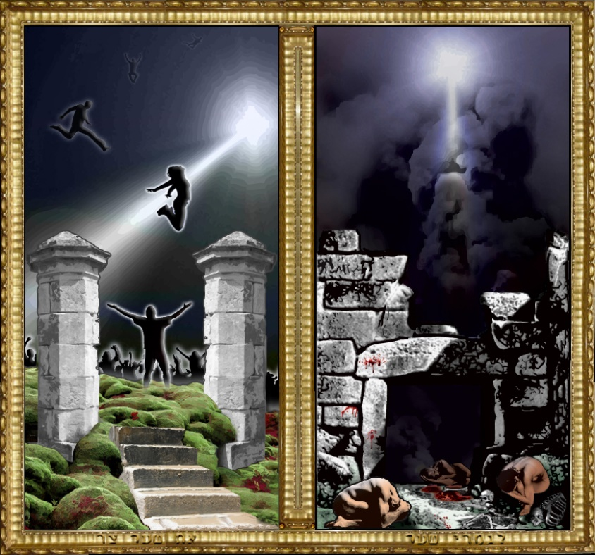
New Life of Eternal Reward
One possible destiny: Death – Rom. 6:21, 23
Death is separation: physical (bodies from spirit) and spiritual (soul from God)
Separation from God is the 2nd death of eternal punishment
(II Thess. 1:9; Rev. 20:14-15)!
Old self was on road to death –
Rom. 6:20-21 (Mt. 7:13-14)
The old way of life was futile and its outcome was death!

Slide 16
New Life of Eternal Reward
Another possible destiny: Eternal life –
Rom. 6:22-23
The free gift of God is eternal life found in Christ (Rom. 6:8-10: Christ broke the bonds of death so that we may live with Him!)
New life is on road to eternal
life with Christ –
Rom. 6:22-23 (Mt. 7:13-14)
Rom. 6:8, 11: If our old self died (and was buried) then our new self is to live for Christ so that we may live with Him!
I Pet. 1:3-5: We were “born again” to receive an imperishable inheritance, a reservation in Heaven!

Slide 17
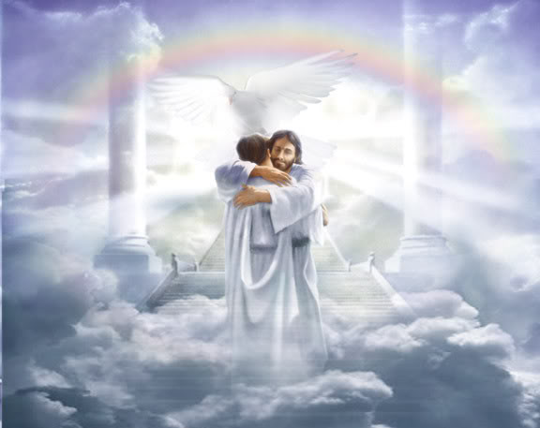
New Life of Eternal Reward
The reward – Rom. 2:7; Rev. 21:3-7; Rev. 22:1-7
Glory, honor, and eternal life in the presence of God Almighty!
“Newness of life” leads to eternal life with Christ our
King and Savior!

Slide 18
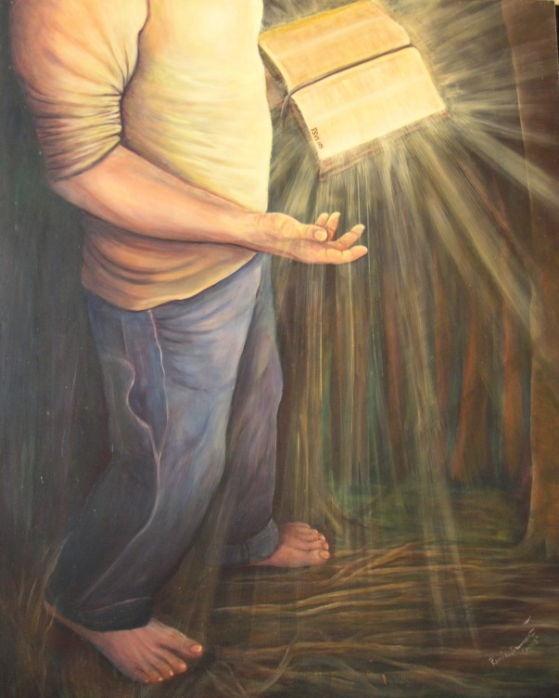
Conclusion
If you have this “newness of life,” enjoy it!
Continue to walk in it!
If you don’t, NOW is your chance to obtain it!
Jesus came to give life
(Jn. 10:10)

Slide 19
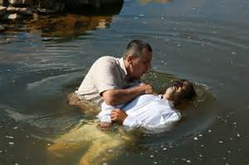
Conclusion
You can have the “newness of life” that leads to
eternal life if you obey “from the heart” the
Lord’s commands to:
Hear the gospel – Rom. 10:17; Jn. 5:24
Believe in Jesus – Rom. 10:8-14; Jn. 8:24
Repent – Rom. 2:4-8; Acts 2:38
Confess the Lord as the Son of God – Rom. 10:9-10; Acts 8:37
Be baptized – Rom. 6:3-7; Acts 2:38
Walk in obedience – Rom. 6:4; Jn. 8:31-32; 15:10

Slide 20
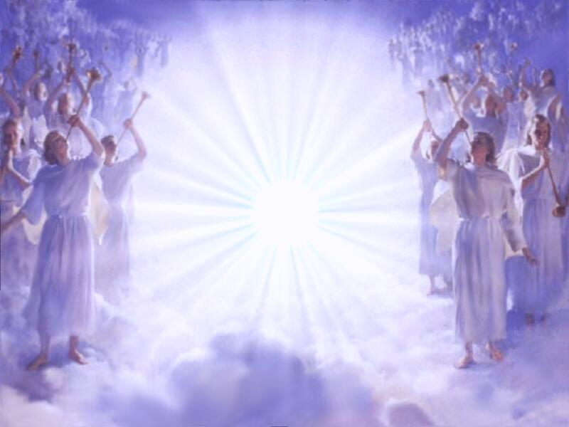
Conclusion
We choose to be obedient either to sin or to
righteousness! (Rom. 6:16)
Sin leads to death, righteousness to eternal life!
The angels rejoice in Heaven over the sinner who repents and begins a “new life!”
YOU

Slide 21
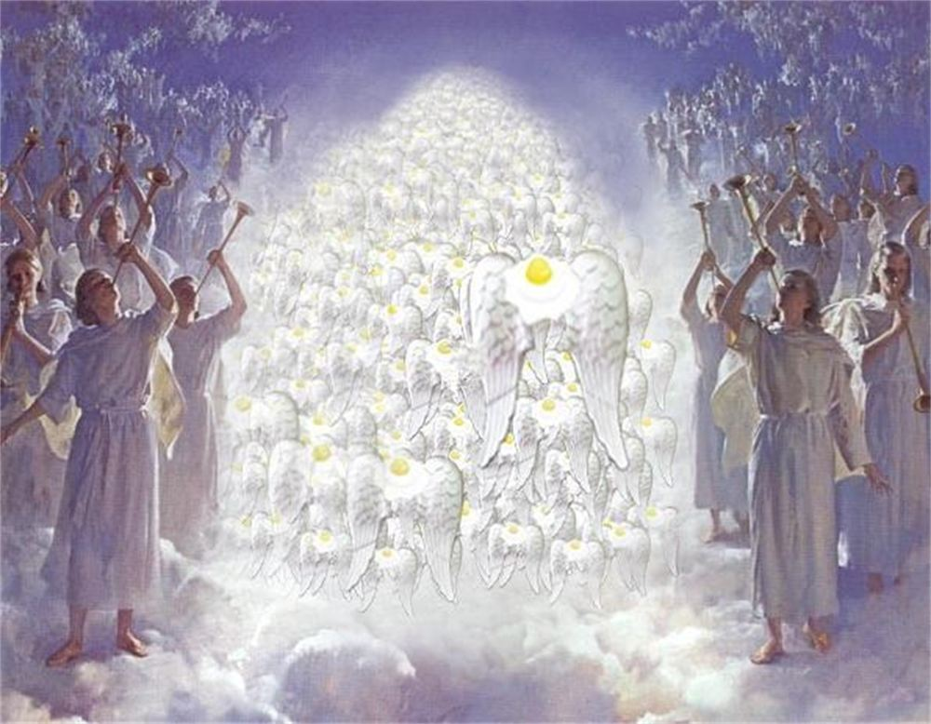
Conclusion
Choose the death of your old self so that you may live for Christ in “newness of life!”

Slide 22
“What Must I Do To Be Saved?”
Hear The Gospel (Jn. 5:24; Rom. 10:17)
Believe In Christ (Jn. 3:16-18; Jn. 8:24)
Repent Of Sins (Lk. 13:35; Acts 2:38)
Confess Christ (Mt. 10:32; Rom. 10:10)
Be Baptized (Mk. 16:16; Acts 22:16)
Remain Faithful (Jn. 8:31; Rev. 2:10)
For The Erring Saint:
Repent (Acts 8:22), Confess (I Jn. 1:9),
Pray (Acts 8:22)

