Slide 1
“Even The Noble Homer Nods” Text: II Pet. 1:19-21
Notes:
By Nathan L Morrison
All Scripture given is from NASB unless otherwise stated
For further study or if questions, Call: 804-277-1983, or Visit: www.courthousechurchofchrist.com
Based on an article by B.C. Goodpasture, 1970

Slide 2
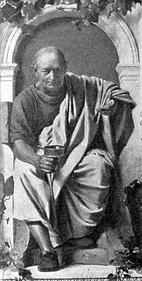
Intro
“Sometimes even the
noble Homer nods”
(Ars Poetica I.359)
Quintus Horatius Flaccus; AKA Horace
(8 December 65 BC – 27 November 8 BC)
Homer was the blind Greek poet of the eighth century B.C., well known for his works, The Iliad and The Odyssey (which contained errors in his own stories).
Horace said: As accomplished as Homer was, he sometimes erred with reference to the facts of the incidents he mentioned (“Homeric Nod”)
It is true of every human author
Regardless of their genius and skills, they are still fallible.
In spite of great care, they will “nod” or “slip” on occasion.
Horace, painting by
Anton von Werner
Notes:
Image: Horace painting by Anton von Werner

Slide 3
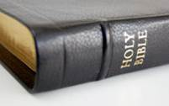
Intro
Contrast this to the authors of God’s Word:
They were not all great scholars – Acts 4:13
They wrote with great precision – Is. 44:28-45:1 (Cyrus named before birth)
So amazing is their accuracy that we can only conclude that God oversaw the work

Slide 4
Intro
II Pet. 1:19-21
19. So we have the prophetic word made more sure, to which you do well to pay attention as to a lamp shining in a dark place, until the day dawns and the morning star arises in your hearts.
20. But know this first of all, that no prophecy of Scripture is a matter of one's own interpretation,
21. for no prophecy was ever made by an act of human will, but men moved by the Holy Spirit spoke from God.
A poet once said, “To err is human . . .”
People err, God does not!

Slide 5
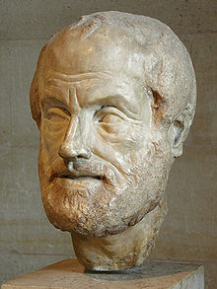
To Err Is Human
Aristotle (384 BC – 322 BC), famous Greek
scholar, was renowned for his knowledge
In his work titled Parts of Animals, he argued that within the human body, man’s soul is “lodged in some substance of a fiery character.”
He contended that the brain “is a compound of earth and water.”
He further suggested that sleep is caused by the blood flowing into the brain, thus making it heavy.
This, he declared, “is the reason why drowsy persons hang the head” (Book II, Chapter 3).
Notes:
Image: Bust of Aristotle

Slide 6
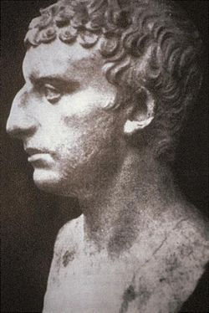
To Err Is Human
Titus Flavius Josephus (37 – c. 100 AD) was
a Jewish historian – Highly respected
He declared that during the siege of Jerusalem in A.D. 70, a heifer, being led to be sacrificed in the temple, gave birth to a lamb (Wars, 6.3).
He spoke of a place in Egypt where fierce serpents ascend out of the ground and fly through the air (Antiquities, 2.10.2).
Notes:
Image: Bust of Josephus

Slide 7
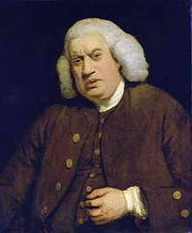
To Err Is Human
Samuel Johnson (18 Sept. 1709 – 13 Dec.
1784), author of 1st complete English
dictionary, published 1755
He also produced A Grammar of the English Tongue.
In that work, he stated that the letter “H seldom, perhaps never, begins any but the first syllable” of a word.
Regrettably he had not noticed that “h” was the second syllable in “perhaps.”
Notes:
Image: Samuel Johnson, portrait by Joshua Reynolds

Slide 8
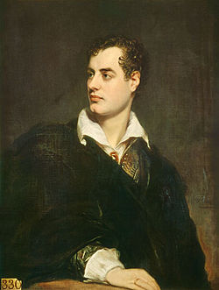
To Err Is Human
Lord Byron (22 Jan. 1788 – 19 Apr. 1824),
the famous poet and author of Don Juan
He wrote a magnificent composition that he titled, “The Destruction of Sennacherib.”
He dramatically told of the devastating deaths of the 185,000 Assyrian soldiers, along with their king, who besieged Jerusalem in the days of King Hezekiah.
The poet slipped, though, because the king was several miles away at Lachish when the destruction occurred.
He returned to his home in the east and was slain by his own sons—in fulfillment of prophecy (II Kings 19:7, 36-37).
Notes:
Image: Lord Byron, portrait by Thomas Phillips

Slide 9
To Err Is Human
Aristotle (384 BC – 322 BC)
Josephus (37 – c. 100 AD)
Samuel Johnson (1709 – 1784)
Lord Byron (1788 – 1824)
Knowledgeable men, despite their great wisdom,
are known to “nod” (slip up)!

Slide 10
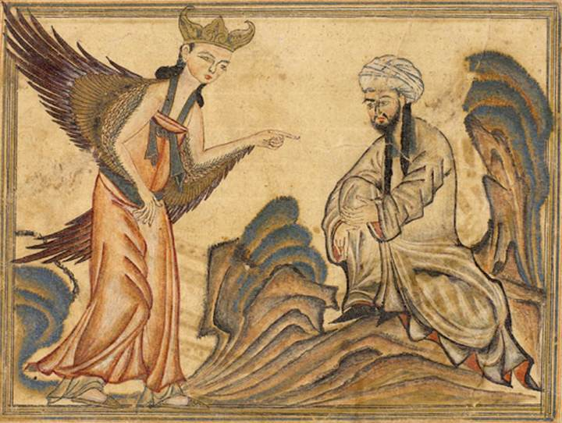
Religious Writers Also “Nodded”
Muhammad (c. 26 April 570 – 8 June 632)
founded Islam, wrote the Qur’an
The religion of Islam claims that the Qur’an is inspired of God (Allah).
It is not for it is flawed by many examples of “nodding.”
One example: the Qur’an suggests that the human fetus results from “sperm” (no mention of an egg) that changes into “a clot of congealed blood,” which then becomes bones, later to be covered with flesh (Surah 23:14).
This hardly is an accurate description of fetal development!
Notes:
Image: Muhammad receiving the revelation from the angel Gabriel

Slide 11
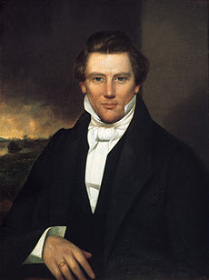
Religious Writers Also “Nodded”
Joseph Smith, Jr. (Dec. 23, 1805 – June 27,
1844) wrote The Book of Mormon
It claims to be an infallible revelation from God.
In Alma 7:10 it is said that Jesus Christ was born in Jerusalem. The Lord was born in that “little town of Bethlehem” (Micah 5:2; Matthew 2:1).
A man by the name of Nephi was using a “compass” to find his direction in the sixth century B.C. (1 Nephi 16:10; 2 Nephi 5:12). The mariner’s compass was not in use until 960-1279 AD.
Joseph Smith Jr. also taught that there were people living on the Moon—six feet tall, dressed like Quakers, and with a life span of 1,000 years (Huntington, 1892, 3:263). Brigham Young, Smith’s successor, when asked about this matter, concurred, suggesting that such beings lived on the Sun as well (Young, 13:271).
Notes:
Image: Joseph Smith, Jr. portrait

Slide 12
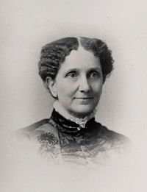
Religious Writers Also “Nodded”
Mary Baker Eddy (July 16, 1821 – Dec. 3,
1910) founded “Christian Science”
She produced a book, Science and Health with Key to the Scriptures, which she claimed was co-authored by God.
She wrote: “Man is not matter—made up of brains, blood, bones, and other material elements.... Man is spiritual and perfect; and because of this, he must be so understood in Christian Science.... Man is incapable of sin, sickness, and death” (1934, p. 475).
In spite of her denial of human mortality, she died December 3, 1910!
Notes:
Image: Mary Baker Eddy, portrait

Slide 13
Religious Writers Also “Nodded”
Muhammad (570 – 632)
Joseph Smith, Jr. (1805 – 1844)
Mary Baker Eddy (1821 – 1910)
Many others who claimed to write for God are known
to have “nodded” (slip up)!

Slide 14
Accuracy of the Scriptures
In glaring contrast, the writers of the Biblical records
never “nodded”
Universe
Consistent with 1st and 2nd Laws of Thermodynamics (Gen. 2:1-3; Heb. 1:10-11): Nothing is being created today, and the world is decaying, which means a beginning.
Biblical account is perfectly in harmony with the known laws of genetics.
Medical
The ancient world’s knowledge of medicine was based on myths and superstitions.
No other law code in the whole of ancient history came anywhere near rivaling God’s health regulations! (IE: Disease, and Leprosy treatment)

Slide 15
Accuracy of the Scriptures
In glaring contrast, the writers of the Biblical records
never “nodded”
Geography
The Bible contains literally hundreds of references to geography and topography.
Many archaeologists and historians have used the Scriptures to navigate the old world to find and locate ancient cities and artifacts!
Psalm 8:8: Paths of the Seas – Discovered by Matthew F. Maury, 1840-1860 AD, he said, “If God said it’s there I will find it!”

Slide 16
Accuracy of the Scriptures
In glaring contrast, the writers of the Biblical records
never “nodded”

Slide 17
Accuracy of the Scriptures
In glaring contrast, the writers of the Biblical records
never “nodded”
Universe
Medical
Geography
Known Scientific Facts!
There are many other areas where the Scriptures have
been proven right throughout time, despite the
“modern wisdom” of the time! (I Cor. 1:19-21, 25)

Slide 18
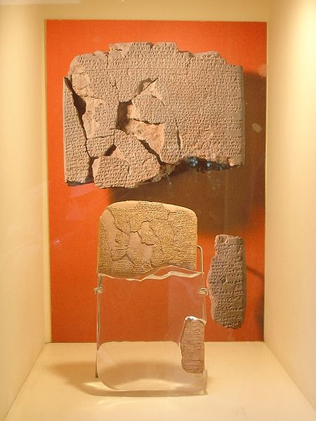
Alleged Slips
Over a span of many centuries, hostile critics of the Bible
have charged the sacred writers with “nodding”
Time after time, however, when the true facts have come
to light, the Scriptures have been vindicated!
Hittites
The Bible mentions the Hittites 47 times, but there was no physical or historical evidence found till 1876 & 1906.
1876: Archibald Sayce found tablets in Turkey and Syria
1906: Hugo Winckler excavated and found:
5 temples, a fortified citadel, many monumental sculptures, over 10,000 clay tablets, and whole libraries were found along with complete genealogies of the people of the city!
It became one of the largest ancient discoveries ever made!
Notes:
Image: Hittite-Egyptian peace treaty between King Hattusili III and Ramesses II (circa 1258 BC)
Hittites: http://en.wikipedia.org/wiki/Hittites ; https://www.gotquestions.org/Hittites.html ; http://apologeticspress.org/apcontent.aspx?category=13&article=888 ; http://christianapologeticsalliance.com/2013/08/07/convince-me-theres-a-god-archaeology-2/

Slide 19
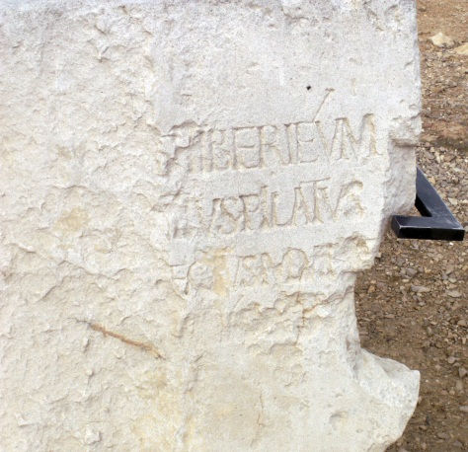
Alleged Slips
Over a span of many centuries, hostile critics of the Bible
have charged the sacred writers with “nodding”
Time after time the Scriptures have been vindicated!
Pilate
Pilate is called “Governor” in the gospels – Mt 27:2
Was he governor, prefect or procurator?
Josephus calls him all 3: governor, prefect & procurator (written after 44 AD). Why important?
Procurators didn’t have authority to sentence anyone to death before 44 AD. Prefects did (4 BC – 44 AD).
1961: A block of limestone was found in the Roman theatre at Caesarea, the capital of the province of Judea, bearing a damaged dedication by Pilate to a Tiberieum.
It read, “Pontius Pilate, prefect of all Judea.”
Notes:
Image: The “Pilate Inscription” or “Pilate Stone,” found in 1961 by Italian archaeologists led by Dr. Antonio Frova
http://en.wikipedia.org/wiki/Pilate_Stone

Slide 20
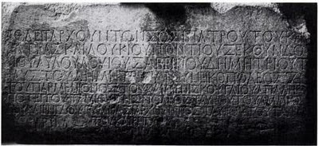
Alleged Slips
Over a span of many centuries, hostile critics of the Bible
have charged the sacred writers with “nodding”
Time after time the Scriptures have been vindicated!
Politarchs
Politarch Inscription on the Vardar Gate in Thessalonica (spanned the Ignatia Way).
Acts 17:6-8 (ESV, NAS): Luke uses the Greek word G4173 politarchēs [pol-it-ar'-khace] for “city authorities” (ASV, KJV, NKJ: “the rulers of the city”).
It occurs here twice but nowhere else in extant Greek literature. This led to a claim that Luke was in error.
1867: An inscription was found on the city gate, known as the Vardar Gate that says, “In the time of the Politarchs…”
Notes:
http://en.wikipedia.org/wiki/Historical_reliability_of_the_Acts_of_the_Apostles
http://www.macedoniantruth.org/forum/showthread.php?t=5630
http://bethyada.blogspot.com/2010/10/politarches-and-vardar-gate-inscription.html

Slide 21
Alleged Slips
Hittites
Pilate
Politarchs
Many, many others…
The Word of God has been said to be inaccurate, but time
after time, it has been proven true!

Slide 22
Conclusion
Even the noble Homer may “nod,” but those guided by the
Spirit of God never did!
You can trust the word of God!
II Tim. 3:16
16. All Scripture is inspired by God and profitable for teaching, for reproof, for correction, for training in righteousness;

Slide 23
Conclusion
Let us not put our trust in the fallible words of men but in the infallible, eternal word of God!
Mt. 24:35
35. "Heaven and earth will pass away, but My words will not pass away.
Jn. 12:48
48. "He who rejects Me and does not receive My sayings, has one who judges him; the word I spoke is what will judge him at the last day.
I Pet. 1:24-25 (Quotes from Is. 40:6-8)
24. For, "ALL FLESH IS LIKE GRASS, AND ALL ITS GLORY LIKE THE FLOWER OF GRASS. THE GRASS WITHERS, AND THE FLOWER FALLS OFF,
25. BUT THE WORD OF THE LORD ENDURES FOREVER." And this is the word which was preached to you.

Slide 24
“What Must I Do To Be Saved?”
Hear The Gospel (Jn. 5:24; Rom. 10:17)
Believe In Christ (Jn. 3:16-18; Jn. 8:24)
Repent Of Sins (Lk. 13:35; Acts 2:38)
Confess Christ (Mt. 10:32; Rom. 10:10)
Be Baptized (Mk. 16:16; Acts 22:16)
Remain Faithful (Jn. 8:31; Rev. 2:10)
For The Erring Saint:
Repent (Acts 8:22), Confess (I Jn. 1:9),
Pray (Acts 8:22)

