Slide 1

Agrippa's Family
Grandfather - Herod
Killed Babies
Matthew 2:16
Father – Herod
Killed James
Acts 12:1-4
Uncle – Herod
Killed John
Matt. 14:9-10
Herod Agrippa
Acts 26

Slide 2
Paul and Agrippa
Now as he thus made his defense, Festus said with a loud voice, “Paul, you are beside yourself! Much learning is driving you mad!” But he said, “I am not mad, most noble Festus, but speak the words of truth and reason. For the king, before whom I also speak freely, knows these things; for I am convinced that none of these things escapes his attention, since this thing was not done in a corner. King Agrippa, do you believe the prophets? I know that you do believe.” Then Agrippa said to Paul, “You almost persuade me to become a Christian.” And Paul said, “I would to God that not only you, but also all who hear me today, might become both almost and altogether such as I am, except for these chains” (Acts 26:24-29).

Slide 3


Bible Alone = Christian
1 Peter 1:22-23
James 1:21
Some Bible + Baptist Manual = Baptist
+
=
Baptist

Slide 4

Baptist Manual
“It is most likely that in the apostolic age when there was but ‘one Lord, one faith, and one baptism,’ and no differing denominations existed, the baptism of a convert by that very act constituted him a member of the church, and endowed him with all the rights and privileges of full membership. In that sense baptism was the door into the church. Now it is different...”
(Edward T. Hiscox, p. 22, 1960 edition, The Standard Manual For Baptist Churches).

Slide 5
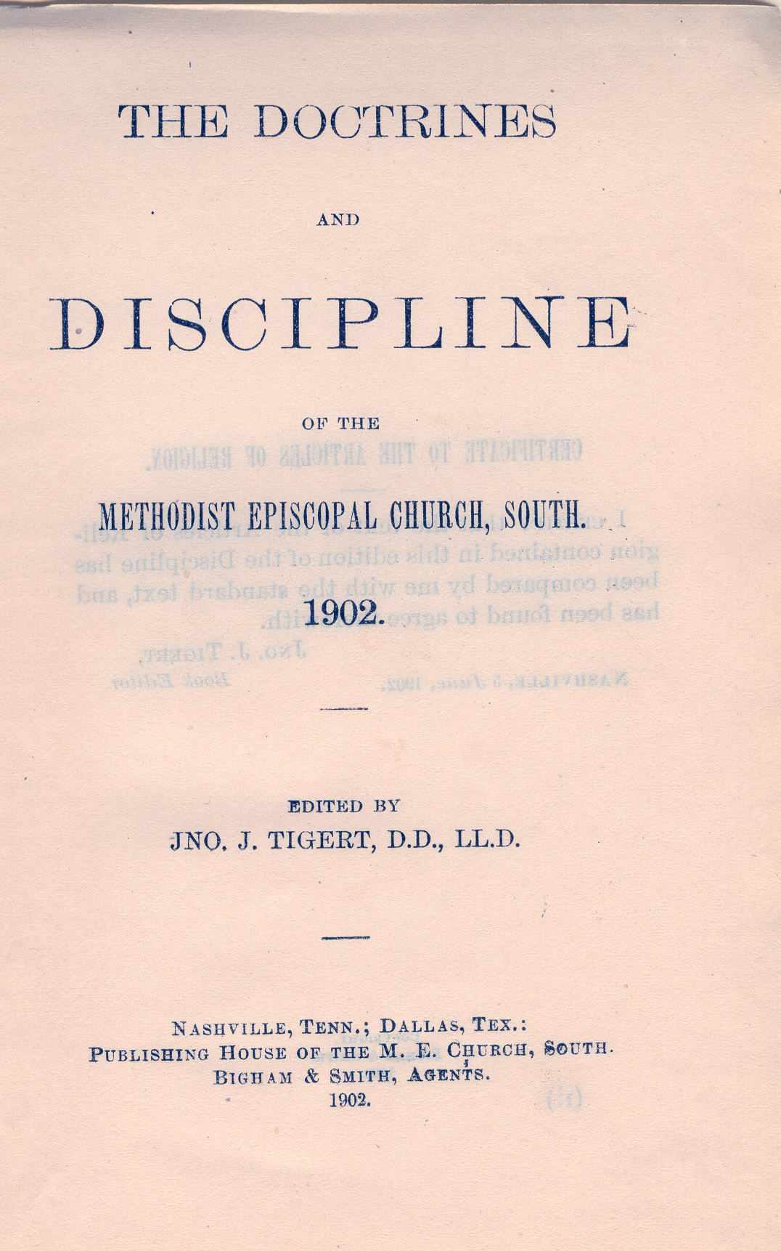
Bible Alone = Christian
1 Peter 1:22-23
James 1:21
+
=
Methodist

Slide 6
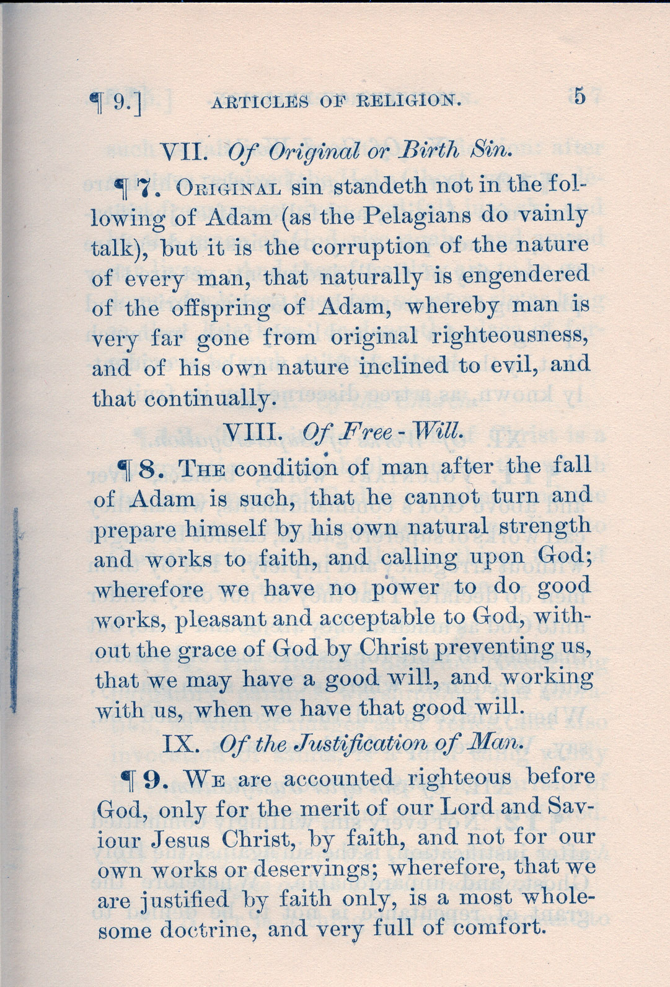
Methodist Discipline
The soul who sins shall die. The son shall not bear the guilt of the father, nor the father bear the guilt of the son… (Ezekiel 18:20).
And the Spirit and the bride say, “Come!” And let him who hears say, “Come!” And let him who thirsts come. Whoever desires, let him take the water of life freely (Rev. 22:17).
You see then that a man is justified by works, and not by faith only (James 2:24).

Slide 7
Bible Alone = Christian
1 Peter 1:22-23
James 1:21
Some Bible + Baptist Manual = Baptist
Some Bible + Methodist Discipline = Methodist
Some Bible + Luther’s Catechisms = Lutheran
Some Bible + Book of Mormon = Latter Day Saint
Some Bible + Book of Common Prayer = Episcopal
Some Bible + Blue Book = Mason
Some Bible + Watchtower = Jehovah’s Witness
Some Bible + Confession of Faith = Presbyterian

Slide 8
PERSUADE
Acts 2:40
Acts 17:30-31
To move by argument; to plead with
Urge to a belief or course of action
“Knowing, therefore, the terror of the Lord, we persuade men…” (2 Cor. 5:11)
“that at that time you were without Christ, being aliens from the commonwealth of Israel and strangers from the covenants of promise, having no hope and without God in the world.” (Eph. 2:12)

Slide 9
Only Hope IN Christ
Eph. 2:12
But now in Christ Jesus you who once were far off have been brought near by the blood of Christ. For He Himself is our peace, who has made both one, and has broken down the middle wall of separation, having abolished in His flesh the enmity, that is, the law of commandments contained in ordinances, so as to create in Himself one new man from the two, thus making peace, and that He might reconcile them both to God in one body through the cross, thereby putting to death the enmity. (Eph.2:13-16).

Slide 10
Almost Persuaded
Love of Sin – 2 Thess. 2:12; Heb. 11:25
Fear of Persecution – John 6:66
Fear Men – Lk. 12:4-5; Jn. 12:42-43
Fear Failure – Phil. 4:13; 1 Cor. 10:13
Cares of This World – Lk. 8:14; Mt. 6:25-33
Pride – 1 John 2:16-17
Delay – Acts 24:25
that they all may be condemned who did not believe the truth but had pleasure in unrighteousness. (2 Thess. 2:12)
choosing rather to suffer affliction with the people of God than to enjoy the passing pleasures of sin, (Heb. 11:25)
From that time many of His disciples went back and walked with Him no more. (John 6:66)
And I say to you, My friends, do not be afraid of those who kill the body, and after that have no more that they can do. But I will show you whom you should fear: Fear Him who, after He has killed, has power to cast into hell; yes, I say to you, fear Him! (Luke 12:4-5)
Nevertheless even among the rulers many believed in Him, but because of the Pharisees they did not confess Him, lest they should be put out of the synagogue; for they loved the praise of men more than the praise of God. (John 12:42-43)
I can do all things through Christ who strengthens me. (Phil. 4:13)
No temptation has overtaken you except such as is common to man; but God is faithful, who will not allow you to be tempted beyond what you are able, but with the temptation will also make the way of escape, that you may be able to bear it. (1 Cor. 10:13)
Now the ones that fell among thorns are those who, when they have heard, go out and are choked with cares, riches, and pleasures of life, and bring no fruit to maturity. (Luke 8:14)
But when the young man heard that saying, he went away sorrowful, for he had great possessions. (Matt. 19:22)
For all that is in the world--the lust of the flesh, the lust of the eyes, and the pride of life--is not of the Father but is of the world. And the world is passing away, and the lust of it; but he who does the will of God abides forever. (1 Jn. 2:16-17)
Almost Is NOT A Place of Safety!!!
Now as he reasoned about righteousness, self-control, and the judgment to come, Felix was afraid and answered, “Go away for now; when I have a convenient time I will call for you.”

Slide 11
Listen To Jesus!
Therefore I said to you that you will die in your sins; for if you do not believe that I am He, you will die in your sins. (John 8:24)
Therefore whoever confesses Me before men, him I will also confess before My Father who is in heaven. (Matthew 10:32)
I tell you, no; but unless you repent you will all likewise perish. (Luke 13:3)
And He said to them, “Go into all the world and preach the gospel to every creature. He who believes and is baptized will be saved; but he who does not believe will be condemned.” (Mark 16:15-16)
Hear + Believe + Confess + Repent + Be Baptized = Salvation

