Slide 1
Marriage: Roles & Responses (Part 1)
Text: Ephesians 5:22-33
Notes:
By Nathan L Morrison
All Scripture given is from NASB unless otherwise stated
For further study, or if questions, please Call: 804-277-1983 or Visit: www.courthousechurchofchrist.com
Based on a lesson by Joe Price and adapted from Preparing for Marriage by Dennis Rainey, editor, pp. 163-173

Slide 2
Intro
Identifying God-given roles in marriage is rejected by the “enlightened” of our culture
They erroneously speak of marriage as a 50%/50%
relationship
Marriage is a 100%/100% relationship: Each with distinct roles.
There are no “roleless” marriages! Every marriage settles into some kind of social and organizational relationship!
When roles are confused, marriage is weakened and
destroyed, and often so is the church
Culture portrays wife as the Leader, the Brain, and even as “Desperate”
Culture portrays husband as Incompetent, the Brawn, and in most cases the Tyrant!

Slide 3
Intro
There are God-given roles of husband and wife;
and God-given responses to each one’s role!
It is critical for those wishing to enter
into marriage and for married couples
to understand that Scriptural roles and
responses are essential for marriage to
be what God wants it to be (Heb. 13:4)!
Notes:
Image: Nate & Becky Morrison, Sept. 8th, 2001

Slide 4
GOD’S CORE ROLE OF THE HUSBAND: HEAD OF THE WIFE
Ephesians 5:23, 25, 28-31
23. For the husband is the head of the wife, as Christ also is the head of the church, He Himself being the Savior of the body.
25. Husbands, love your wives, just as Christ also loved the church and gave Himself up for her,
28. So husbands ought also to love their own wives as their own bodies. He who loves his own wife loves himself;
29. for no one ever hated his own flesh, but nourishes and cherishes it, just as Christ also does the church,
30. because we are members of His body.
31. FOR THIS REASON A MAN SHALL LEAVE HIS FATHER AND MOTHER AND SHALL BE JOINED TO HIS WIFE, AND THE TWO SHALL BECOME ONE FLESH.

Slide 5
GOD’S CORE ROLE OF THE HUSBAND: HEAD OF THE WIFE
His Essential Function is to be the Servant Leader of the
Home
Christ is the leader of His body, the church (Eph. 1:22). He loves the church supremely – Eph. 5:25-29, 32.
Husband is the leader of the wife; to love his wife supremely.
The role of head is not a “position” that denotes superiority, but a function that demands work!
Head functions out of love for the body – Eph. 5:25-29, 33

Slide 6
GOD’S CORE ROLE OF THE HUSBAND: HEAD OF THE WIFE
The Husband Must Pattern His Leadership after the
Leadership of Christ – Mk. 10:42-45
Mark 10:42-45
42. Calling them to Himself, Jesus said to them, "You know that those who are recognized as rulers of the Gentiles lord it over them; and their great men exercise authority over them.
43. "But it is not this way among you, but whoever wishes to become great among you shall be your servant;
44. and whoever wishes to be first among you shall be slave of all.
45. "For even the Son of Man did not come to be served, but to serve, and to give His life a ransom for many."
Jesus was a Servant-Leader!

Slide 7
GOD’S CORE ROLE OF THE HUSBAND: HEAD OF THE WIFE
The Husband Must Pattern His Leadership after the
Leadership of Christ – Mk. 10:42-45:
Jesus was a Servant-Leader
Jesus’ leadership: SERVICE–SACRIFICE–SALVATION (unselfish, not pleasing Himself – Rom. 15:3; Phil. 2:5-8; Eph. 5:23, 32).
Gentiles’ leadership: Lord it over–Wield power–Be served.
Husband’s leadership: (Not the, “Woman, do what I say!” approach)
Mk. 10:42-45: To be… | Mk. 10:42-45: Must be a…
“Great” (G3173 megas) | “Servant” (G1249 diakonos)
“First” (G4413 protos) | “Slave” (G1401 doulos)

Slide 8
GOD’S CORE ROLE OF THE HUSBAND: HEAD OF THE WIFE
Proverbs 11:29
29. He who troubles his own house will inherit wind, And the foolish will be servant to the wisehearted.
Being a Servant-Leader does NOT Mean…
…Becoming a lording leader, making all decisions himself or selfishly controlling others so he can meet his own needs.
…A man must have an outgoing personality (“rally-the-troops”).
…The wife never gives him advice and counsel, etc.
Notes:
Image: www.jokespinoy.com

Slide 9
GOD’S CORE ROLE OF THE HUSBAND: HEAD OF THE WIFE
Colossians 3:19 (I Peter 3:7)
19. Husbands, love your wives and do not be embittered against them.
Being a Servant-Leader Means…
Taking overall responsibility for the direction of the family (physical & spiritual, moral & material – I Tim. 5:8; Eph. 6:4).
Serving the needs of his wife & family (takes consideration, unselfishness, diligent attention).
Cherish his wife so she can become all God wants her to be (Eph. 5:28-29)
Cherishes = G2282 thalpo: To warm, to foster, care for.
“To treat with tenderness and affection; to give warmth, ease or comfort to” (Webster’s)

Slide 10
GOD’S CORE ROLE OF THE HUSBAND: HEAD OF THE WIFE
I Peter 3:7
7. You husbands in the same way, live with your wives in an understanding way, as with someone weaker, since she is a woman; and show her honor as a fellow heir of the grace of life, so that your prayers will not be hindered.
Being a Servant-Leader Means…
Husband denies himself and gives himself to his wife & family.
Husband takes the initiative in the home (Eph. 6:4; Heb. 12:9; I Tim. 5:8)
Make it easier for your wife to follow your lead – Ps. 128:1-4

Slide 11
GOD’S CORE ROLE OF THE HUSBAND: HEAD OF THE WIFE
Psalm 128:1-4 A Song of Ascents
1. How blessed is everyone who fears the LORD, Who walks in His ways.
2. When you shall eat of the fruit of your hands, You will be happy and it will be well with you.
3. Your wife shall be like a fruitful vine Within your house, Your children like olive plants Around your table.
4. Behold, for thus shall the man be blessed Who fears the LORD.
Be the man your wife will want to submit to!
Ultimately, his headship is an issue between the Husband
and the Lord! (Eph. 5:23)

Slide 12
GOD’S CORE RESPONSE OF THE WIFE TO THE HUSBAND’S ROLE: SUBMISSION
Ephesians 5:22-24
22. Wives, be subject to your own husbands, as to the Lord.
23. For the husband is the head of the wife, as Christ also is the head of the church, He Himself being the Savior of the body.
24. But as the church is subject to Christ, so also the wives ought to be to their husbands in everything.
I Peter 3:1-2, 5-6
1. In the same way, you wives, be submissive to your own husbands so that even if any of them are disobedient to the word, they may be won without a word by the behavior of their wives,
2. as they observe your chaste and respectful behavior.
5. For in this way in former times the holy women also, who hoped in God, used to adorn themselves, being submissive to their own husbands;
6. just as Sarah obeyed Abraham, calling him lord, and you have become her children if you do what is right without being frightened by any fear.

Slide 13
GOD’S CORE RESPONSE OF THE WIFE TO THE HUSBAND’S ROLE: SUBMISSION
She Willingly Puts Herself Under His Leadership
Action of will: Respectful and holy and good conduct (I Pet. 3:2, 5-6).
Obey his leadership (I Pet. 3:6; Titus 2:5). This is a voluntary attitude of giving in, cooperating, helping with responsibility, and carrying a burden.
Submission is not her role; it is her response to the husband’s role as a servant-leader.
Biblical submission isn’t yielding to your husband’s will, but embracing the order Christ gave and submitting to Him – Col. 3:18
Submission encourages your husband to fulfill his role as your servant-leader (Prov. 21:9; 27:15-16; 31:10-12, 28-29).

Slide 14
GOD’S CORE RESPONSE OF THE WIFE TO THE HUSBAND’S ROLE: SUBMISSION
Her Submission (like the Husband’s Leadership) is a
parallel to the church and Christ! (Eph. 5:22; I Pet. 3:3-5)
Matter of the heart that the Lord sees; adorn yourself with the “gentle & quiet spirit” (“the hidden person of the heart” – adorning the heart).
Submission is mirrored pattern of the church (Eph. 5:24, 32) – church is to be in submission to Christ. Marriage roles ought to mirror the church role!
Respect in practice – Eph. 5:33
“But he won’t lead” – Then he will answer to God.
God didn’t say, in that case, wife can lead! (I Pet. 3:1-2)
Response of: | Submits to:
The Church | Jesus Christ – Eph. 1:22; 5:24
Wives | Husbands – Col. 3:18; Eph. 5:22
Ultimately, her submission is an issue between the Wife and the Lord! (Eph. 5:22)

Slide 15
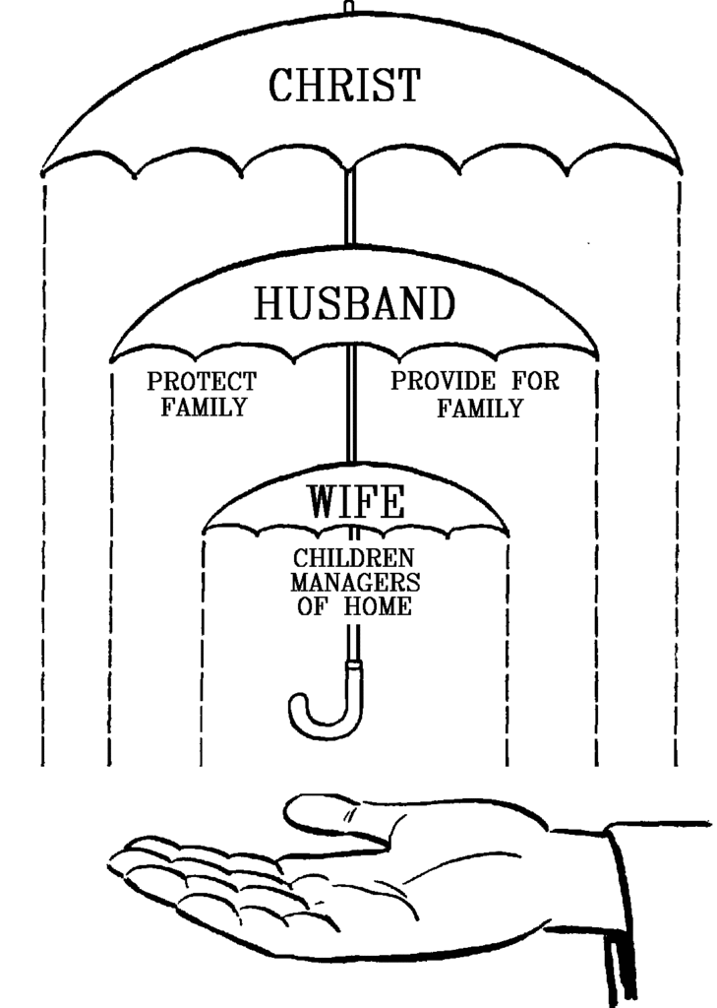
Conclusion
Role of servant-leader (headship) never means asking
your wife to disobey God!
Response of submission never means putting
husband before God!
Each role and response is intended to
fulfill Scripture, honor God and bless
your marriage!
Each role and response of spouses in a
marriage mirror the relationship of the
church to Christ!

Slide 16
Conclusion
When the home is in disarray, the church won’t be too
far off from following! (Pattern is mirrored)
Eph. 5:32: When the home is strong and
functioning as God would have it, the
church ought to be seen following suit!
Let us strive to be the husbands and
wives God wants us to be!

Slide 17
“What Must I Do To Be Saved?”
Hear The Gospel (Jn. 5:24; Rom. 10:17)
Believe In Christ (Jn. 3:16-18; Jn. 8:24)
Repent Of Sins (Lk. 13:35; Acts 2:38)
Confess Christ (Mt. 10:32; Rom. 10:10)
Be Baptized (Mk. 16:16; Acts 22:16)
Remain Faithful (Jn. 8:31; Rev. 2:10)
For The Erring Child of God:
Repent (Acts 8:22), Confess (I Jn. 1:9),
Pray (Acts 8:22)

