Slide 1
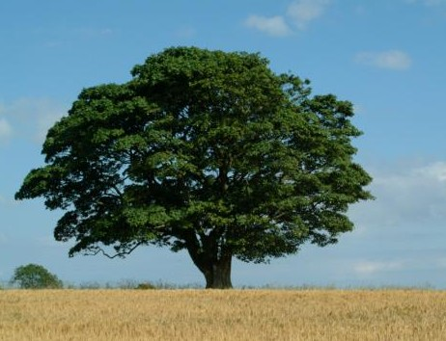
Salvation Came To His House
Text: Luke 19:1-10
Sycamore Tree
Notes:
By Nathan L Morrison
For further study, or if questions, please Call: 804-277-1983 or Visit: www.courthousechurchofchrist.com
All Scripture given is from NASB unless otherwise stated

Slide 2
Intro
Ephesians 3:20-21
20. Now to Him who is able to do far more abundantly beyond all that we ask or think, according to the power that works within us,
21. to Him be the glory in the church and in Christ Jesus to all generations forever and ever. Amen.
“Far more abundantly” is G5228 huper [hooper], and means, “Super Abundant!”
It is “more than, superior to” whatever we ask or think!

Slide 3
Intro
Luke 19:10
10. "For the Son of Man has come to seek and to save that which was lost."
Seek = G2212 zēteō [dzay-teh'-o]: to seek (literally or figuratively); desire!
I Timothy 2:3-4: God “desires all men to be saved and to come to the knowledge of the truth.”

Slide 4
Intro
Heb. 11:6 (NKJ)
6. But without faith it is impossible to please Him, for he who comes to God must believe that He is, and that He is a rewarder of those who diligently seek Him.
NAS: “Seek” (NKJ: “Diligently Seek”) = G1567 ekzēteō [ek-zay-teh'-o]: to search out, that is, (figuratively) investigate, crave, demand, seek after (carefully, diligently).
Faith pleases God, and it is more than an expression of faith, but an action (diligently seek)!
God rewards those who “diligently seek” Him!

Slide 5
Intro
God does more than we ask or think, desires (seeks) man to be saved, but man must “diligently seek” Him to be rewarded! (God wants to reward!)
God rewards those who “diligently seek” Him!
(Not enough to “claim” to believe Him)
“Lost” is perhaps the most frightening word in the
Bible! (Describes one in sin, “perishing” – II Cor. 4:3)
There is cause for celebration and rejoicing when the
“lost” become “found” (Lk. 15)
The angels in Heaven rejoice over one sinner who
repents – Lk. 15:7, 10!

Slide 6
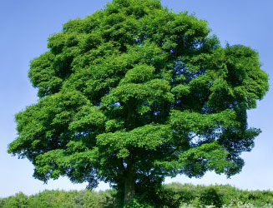
Intro
We see all of this played out in a “lost” man who diligently sought to see Jesus!
(He desired to see Him so badly he climbed a Sycamore Tree to do so!)

Slide 7
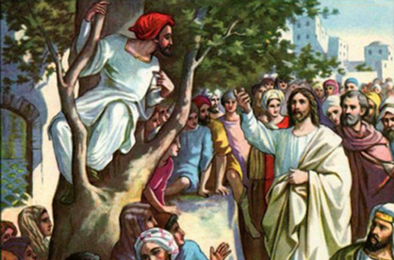
Lk. 19:1-10 (vss. 1-5)
1. He entered Jericho and was passing through.
2. And there was a man called by the name of Zaccheus; he was a chief tax collector and he was rich.
3. Zaccheus was trying to see who Jesus was, and was unable because of the crowd, for he was small in stature.
4. So he ran on ahead and climbed up into a sycamore tree in order to see Him, for He was about to pass through that way.
5. When Jesus came to the place, He looked up and said to him, "Zaccheus, hurry and come down, for today I must stay at your house."

Slide 8
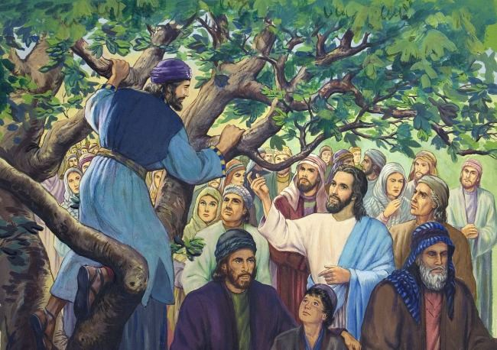
Lk. 19:1-10
6. And he hurried and came down and received Him gladly.
7. When they saw it, they all began to grumble, saying, "He has gone to be the guest of a man who is a sinner."
8. Zaccheus stopped and said to the Lord, "Behold, Lord, half of my possessions I will give to the poor, and if I have defrauded anyone of anything, I will give back four times as much."
9. And Jesus said to him, "Today salvation has come to this house, because he, too, is a son of Abraham.
10. "For the Son of Man has come to seek and to save that which was lost."
Salvation came to the house of the man who climbed a tree to see Jesus!

Slide 9
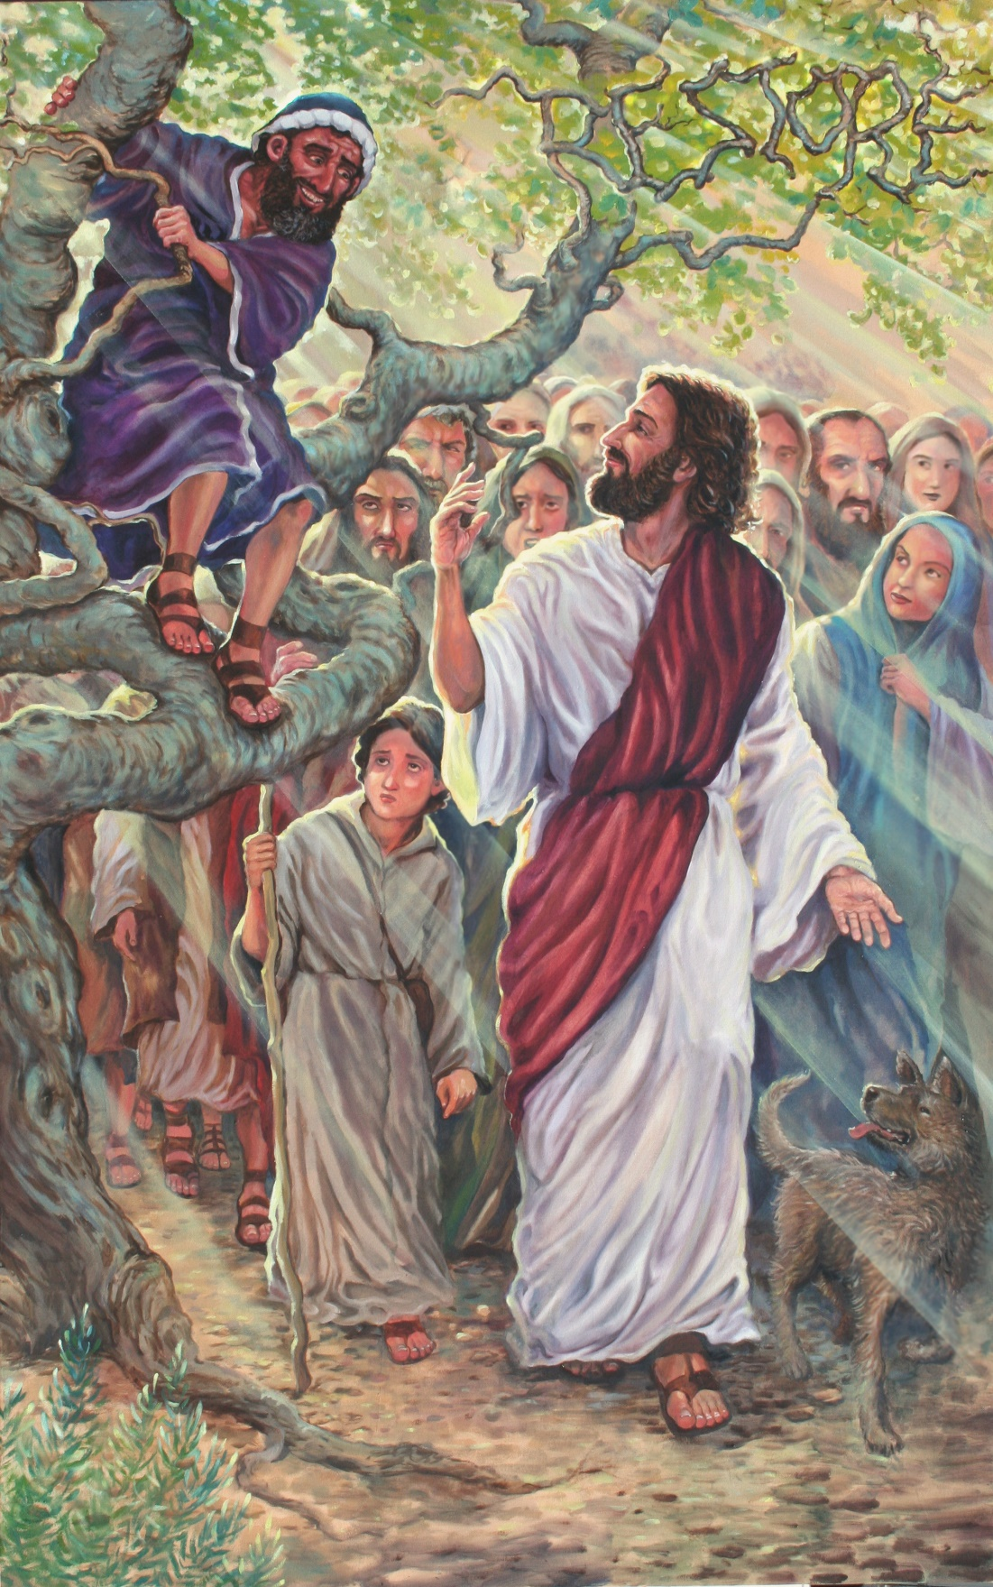
Zaccheus
Good Points – Luke 19:1-10
Wanted to see Jesus – wanted to see who He was (Vs. 3)
Would not be turned from his purpose
He overcame his obstacles – Lk. 19:3: The crowds, his small stature (short)
Ran and climbed a sycamore tree – Lk. 19:4

Slide 10
Zaccheus
Indifferent Points –
Luke 19:1-10
Rich – didn’t make him good or bad (Vs. 2): I Tim. 6:10, 17-19: “Love” of money is evil.
Short – didn’t make him good or bad (Vs. 3)
Looked down on by others (Vs. 7)
He was a Jew (Vs. 9) and a chief tax collector (Vs. 2)
His job didn’t make him good or bad – Matthew was an apostle and a tax collector! (Mt. 9:9)

Slide 11
Zaccheus
Bad Points – Luke 19:1-10
May have become rich at the cost of others (Vs. 8)
May have been uncharitable (Vs. 8)
Was lost (Vs. 10)
Zaccheus was a “lost” man diligently seeking to be found!

Slide 12
Zaccheus: His Great Change
Began with curiosity (wanted to see Who He is) – Lk. 19:3
No interest = No salvation!
Received Jesus gladly – Lk. 19:5-6
Out of everyone in the crowd, Jesus wanted to see Zaccheus (19:5: looked up), and to meet him, and stay with him at his house! (Eph. 3:20-21: Super-Abundant!)
His Repentance – Lk. 19:8
“Stood and said” (NKJV) = A public declaration
Resolved to be charitable (Contrast with Rich Young Ruler – Luke 18:18-23)
Vowed to make restitution fourfold – Ex. 22:1; Eph. 4:28
He was a “lost” man desiring to be saved, and when found he accepted the terms for salvation!

Slide 13
Zaccheus: Salvation Came to His House
Pronounced by the Lord – Lk. 19:9
Wouldn’t we want to hear such a pronouncement?
The terms
Forsake old sin
Resolve to do good – Is. 55:7
Lessons we can learn today from the man who climbed a tree to see Jesus
We need to seek Jesus and let nothing get in our way of being “found” – Js. 4:8 (Heb. 11:6)
Once “found” accept the terms and obey the gospel – Acts 2:38; 8:36-38; 22:16
When we sin we need to repent – I Jn. 1:9 (Lk. 3:8; Acts 26:19-20)
He was a “lost” man who became “found” and “salvation came to his house!”

Slide 14
Conclusion
Anyone can be saved who will pay the price:
Obedience to the gospel! (Heb. 5:9)
It is scary to be lost – Great rejoicing when one who is
lost is found! (Men and angels rejoice)
Zaccheus was lost (Luke 19:10) but didn’t let obstacles or distractions get in the way of his Savior
He just wanted to see Jesus
(Luke 19:3)
He climbed up into a tree to get a
better view and was rewarded
beyond what he thought by Jesus
taking notice and becoming a
guest at his house
(Luke 19:5-6; Eph. 3:20-21).
God rewards “those who diligently
seek Him” (NKJV Heb. 11:6).
Notes:
Emphasis in Scripture mine!

Slide 15
Conclusion
Think of how many “lost” there were in the crowd on that day and how many easily saw Jesus but turned away at His teachings, like the Rich Young Ruler (Luke 18:18-23), and stayed “lost!”

Slide 16
Conclusion
Do you seek after the Lord?
Zaccheus let nothing get in his way! (Heb. 12:1)
Do you want to see Jesus?
Zaccheus overcame obstacles to see Him! – Heb. 12:2-3
Salvation comes to the house of those who
diligently seek God and obey Him!
(Heb. 5:9; 11:6: Rewards eternal life; Eph. 3:20-21: Above and beyond what we think or ask!)

Slide 17
“What Must I Do To Be Saved?”
Hear The Gospel (Jn. 5:24; Rom. 10:17)
Believe In Christ (Jn. 3:16-18; Jn. 8:24)
Repent Of Sins (Lk. 13:35; Acts 2:38)
Confess Christ (Mt. 10:32; Rom. 10:10)
Be Baptized (Mk. 16:16; Acts 22:16)
Remain Faithful (Jn. 8:31; Rev. 2:10)
For The Erring Child:
Repent (Acts 8:22), Confess (I Jn. 1:9),
Pray (Acts 8:22)

