Slide 2


Melody Of The Heart
(Part 1)
Text: Eph. 5:19; Col. 3:16
Notes:
By Nathan L Morrison
All Scripture given is from NASB unless otherwise stated
For further study, or if questions, please Call: 804-277-1983 or Visit: www.courthousechurchofchrist.com
Some points taken from an article by Ron Halbrook and a lesson by Andrew Roberts

Slide 3

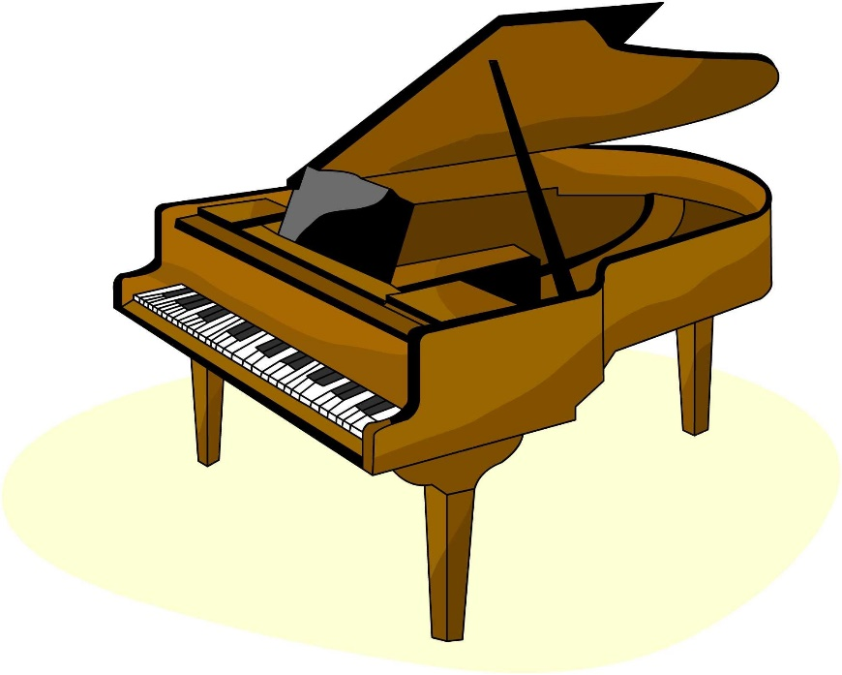
Intro
One of the many things that separates the church of Christ from Catholics, denominations, and the Christian Church is the practice of NOT using mechanical instruments in worship
A popular trend in recent years is churches of Christ adding instrumental music
2006: Richland Hills church of Christ in Texas.
2013: Heritage church of Christ in Texas
Both cases stated their decision was to bring in more people for Christ!
Notes:
Sources:
Richland Hills CoC: The Christian Chronicle, Dec. 12, 2006
Heritage CoC: Website Announcement (May 19, 2013) @ http://heritagechurchofchrist.org/#/myhcc/special-announcement

Slide 4
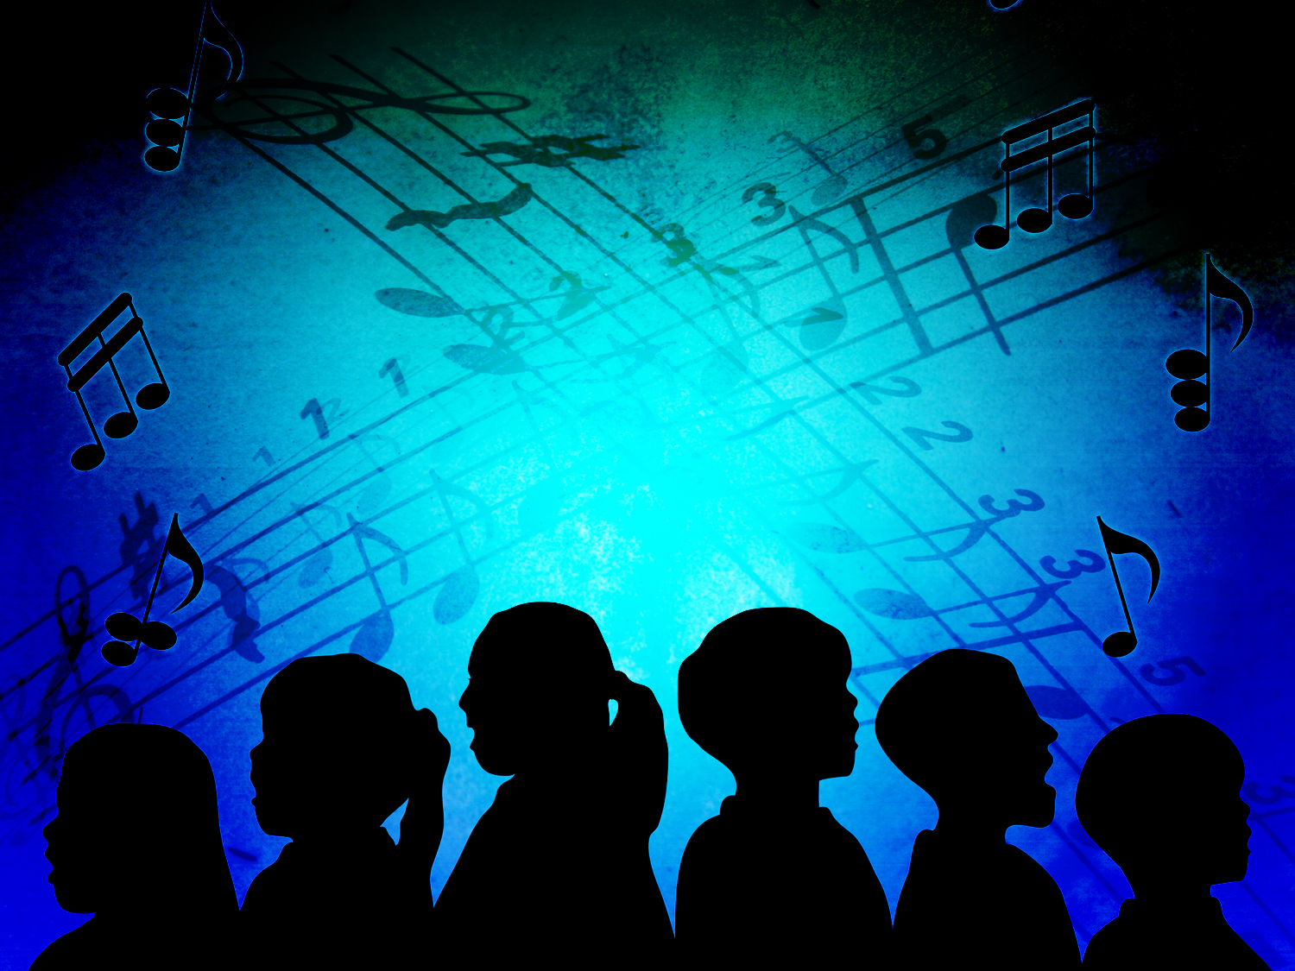
Does the Lord’s church sing a cappella just to be different or is there a pattern to singing in worship and praise found in the new Testament?
Eph. 5:19
19. speaking to one another in psalms and hymns and spiritual songs, singing and making melody with your heart to the Lord;
Col. 3:16
16. Let the word of Christ richly dwell within you, with all wisdom teaching and admonishing one another with psalms and hymns and spiritual songs, singing with thankfulness in your hearts to God.
Saints are commanded to sing, making
melody from the heart with gratitude!

Slide 5

An Appeal to the Scriptures for A Cappella Praise
“Music” is a general term, but “Sing” (Vocal Music) &
“Play” (Instrumental Music) are specific:
If N.T. says, "Make music," this general term authorizes both singing & playing.
The general term “music” is not used in reference to worship in the New Testament.
A Cappella means:
“without instrumental accompaniment” – Webster’s Collegiate Dictionary

Slide 6
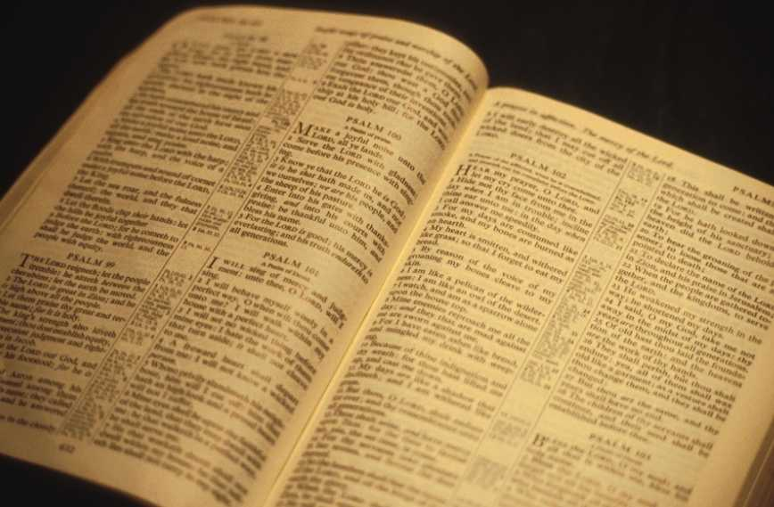
Matthew 26:30; Mark 14:26
After singing a hymn, they went out to the Mount of Olives.

Slide 7
Acts 16:25
But about midnight Paul and Silas were praying and singing hymns of praise to God, and the prisoners were listening to them

Slide 8
Romans 15:6, 9
“…so that with one accord you may with one voice glorify the God and Father of our Lord Jesus Christ…and for the Gentiles to glorify God for His mercy; as it is written:
"THEREFORE I WILL GIVE PRAISE TO YOU AMONG THE GENTILES, AND I WILL SING TO YOUR NAME."

Slide 9
I Corinthians 14:15
What is the outcome then? I will pray with the spirit and I will pray with the mind also; I will sing with the spirit and I will sing with the mind also.

Slide 10
Ephesians 5:18-19
And do not get drunk with wine, for that is dissipation, but be filled with the Spirit,
speaking to one another in psalms and hymns and spiritual songs, singing and making melody with your heart to the Lord;

Slide 11
Colossians 3:16
Let the word of Christ richly dwell within you, with all wisdom teaching and admonishing one another with psalms and hymns and spiritual songs, singing with thankfulness in your hearts to God.

Slide 12
Hebrews 2:12
saying,
"I WILL PROCLAIM YOUR NAME TO MY BRETHREN, IN THE MIDST OF THE CONGREGATION I WILL SING YOUR PRAISE."

Slide 13
Hebrews 13:15
Through Him then, let us continually offer up a sacrifice of praise to God, that is, the fruit of lips that give thanks to His name.

Slide 14
James 5:13
Is anyone among you suffering? Then he must pray. Is anyone cheerful? He is to sing praises.

Slide 15

An Appeal to the Scriptures for A Cappella Praise
Christ gave No Authority for instruments of music
in worship:
Jesus (John 14:26; 16:13; II Tim. 3:16-17) authorized singing by direct command (Col. 3:16), approved example (Paul in I Cor. 14:15), & necessary implication (Heb. 13:15)!
No passage of N.T. Scripture authorizes the practice:
  Jesus, by the Holy Spirit (Jn. 16:13) did not use general or specific terms authorizing it.
  No direct command, no approved example, and no necessary implication can be found.
  Divine silence excludes, prohibits, and forbids the practice (Acts 15:24: “to whom we gave no instruction”).

Slide 16
Old Testament or New Testament Worship?
An Appeal to the Scriptures for A Cappella Praise
O.T.
N.T.
Burn Incense (Ex. 30:7-9)
Light Lampstand (Ex. 40:4)
Keep Sabbath Day (Deut. 5:12-15)
Play Instruments (II Chron. 29:25)
Sing (Ps. 30:4, 12)
Silent
Silent
Silent
Silent
Sing (Col. 3:16)

Slide 17
An Appeal to the Scriptures for A Cappella Praise
Christ authorizes singing (Vocal Music):
Mt. 26:20 – “Sung”
Acts 16:25 – “Singing”
Rom. 15:9 – “Sing”
I Cor. 14:15 – “Sing”
Eph. 5:19 – “Singing”
Col. 3:16 – “Singing”
Heb. 2:12 – “Sing”
Heb. 13:15 – “Fruit of Lips”
Js. 5:13 – “Sing”
Saints are commanded to sing, making the melody from the heart!

Slide 18
An Appeal to History for
A Cappella Praise
A Cappella means:
“without instrumental accompaniment” (Webster’s)
“As far as church history is concerned, the most telling confirmation of textual silence, ironically, is found in the very words, a cappella. Cappella is Latin for chapel or church. Taken in its literal meaning, the Italian a cappella means “in chapel style,” or “in the style of the church.” From the first century onward, vocal music was so distinctive from the instrumental music used in both pagan worship and private entertainment that it was uniquely known as music of the church – that is a cappella! So when we say that we sing a cappella, we are affirming what millions of believers over the centuries have affirmed – that the music of the church is distinctively vocal.”
(F. Lagard Smith, The Cultural Church. p. 201)

Slide 19
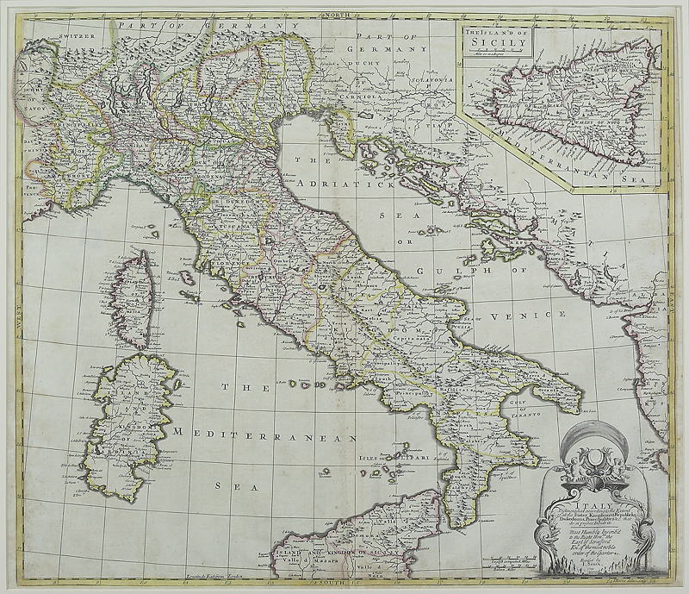
“There is no record in the NT of the use of instruments in the musical worship of the church. In this regard, early believers followed the practice of the Hebrew synagogue music.” (“Music,” Wycliffe Bible Encyclopedia, p.1163)
“The primitive Christian community held the same view, as we know from the apostolic and post-apostolic literature: instrumental music was thought unfit for religious services; the Christian sources are outspoken in their condemnation of instrumental performances. Originally, only song was considered worthy of direct approach to Divinity.” (“The Music of Post-Biblical Judaism,” The New Oxford History of Music, Vol. I, p.135)

Slide 20
Eusebius (265-339)
Eusebius (265-339) wrote, “Throughout the world – in cities, in villages and in the country – in all the churches of God the people of Christ, who have been chosen out of all the nations, send up, not to the native gods nor to demons but to the one God spoken of by the prophets, hymns and psalmody with a loud voice so that the sound of those singing can be heard by those standing outside.” (Eusebius, Commentary on Psalms 65:10-15)

Slide 21
Eusebius (265-339)
Niceta (335-414)
Niceta of Remesiana (335-414) wrote, “It is time that we must also present something from the New Testament in confirmation of the Old, lest one think that the office of psalmody is to be curtailed, inasmuch as many of the Old Law usages are now abolished. For what is carnal has been rejected, for example, circumcision, the Sabbath, sacrifices, discrimination in foods, trumpets, citharas, cymbals and tympana, all of which are understood to reside now in the bodily members of man and there better to sound…The other things which are spiritual – faith, piety, prayer, fasting, patience, chastity, praise – have been increased, not diminished.” (Niceta, bishop of Remesiania, On the Utility of Hymn Singing)

Slide 22
Eusebius (265-339)
Niceta (335-414)
Augustine (354-430)
Augustine (354-430), wrote, “The practice ought without hesitation to be maintained, especially when it can be defended from the Scriptures, as can the singing of hymns and psalms, since we have the example and precepts of the Lord himself and of the Apostles… When, then, is it not the proper time for the brethren gathered in church to sing what is holy…what could be done by Christian congregations that is better, what more beneficial, what more holy?”
(Epistle LV)

Slide 23
Eusebius (265-339)
Niceta (335-414)
Augustine (354-430)
Pope Vitalian (approx. 670). “Pope Vitalian is related to have first introduced organs into some of the churches of Western Europe, about 670; but the earliest trustworthy account is that one sent as a present by the Greek emperor Constantine Copronymus to Pepin, king of the Franks, in 755”
(American Encyclopedia, Vol. 12, p. 688)
Vitalian (670)

Slide 24
Eusebius (265-339)
Early Church Organs. “All ecclesiastical references to organs before the 10th century are to be treated with caution, and even skepticism. All these organs were secular. One of the great unsolved puzzles of music history is how and why the organ came to be almost exclusively a church instrument in western Europe from about 900 to about 1200…The organ was never officially approved or even acknowledged in any known papal or pontifical document despite the traditional legend that Pope Vitalian (657-72) introduced it. Nor, for one reason or another, are any of the references to organs placed or used in church before the 9th century at all reliable.” (Barbara Owen, et al. “Organ.” Grove Music Online. Oxford Music Online. Oxford University Press. Web. 22 May, 2013.)
Niceta (335-414)
Augustine (354-430)
Vitalian (670)

Slide 25
Eusebius (265-339)
Niceta (335-414)
Augustine (354-430)
Greek Orthodox Church (1054). “The execution of Byzantine church music by instruments, or even the accompaniment of sacred chanting by instruments was ruled out by the Eastern Fathers as being incompatible with the pure, solemn, spiritual character of the religion of Christ” (Constantine Cavarnos, Byzantine Sacred Music, p.18)
Vitalian (670)
Greek Orthodox (1054)

Slide 26
Eusebius (265-339)
Niceta (335-414)
Augustine (354-430)
Greek Orthodox Church (1054). “The Fathers of the Church in accordance with the example of the psalmodizing of our Savior and the holy Apostles, established that only vocal music be used in the churches and severely forbade instrumental music as being secular and hedonic, and in general as evoking pleasure without spiritual value.” (G.I. Papadopoulos, A Historical Survey of Byzantine Ecclesiastical Music (in Greek), Athens, 1904. pp. 10-11)
Vitalian (670)
Greek Orthodox (1054)

Slide 27
Eusebius (265-339)
Niceta (335-414)
Augustine (354-430)
Thomas Aquinas (1225-1274) wrote, “But the Church does not make use of musical instruments, such as harps and psaltries, in the divine praises, for fear of seeming to imitate the Jews.” (Summa Theologica, Part 2, Question 91, Article 2)
Vitalian (670)
Greek Orthodox (1054)
Aquinas (1225-1274)

Slide 28
Eusebius (265-339)
Niceta (335-414)
Erasmus (1469-1536) wrote, “We have brought into our churches some kind of laborsome and theatrical music, an uproarious chattering of varied voices, which I doubt was ever heard in the theaters of the Greeks and Romans. The whole thing is a noisy racket of trumpets, crumhorns, shawms and sackbuts, and the human voices are vying with them. Obscene love songs are heard, such as harlots and minstrels dance to. One flocks together in church as if it were a theater, for the gratification of the ears.”
(Annotations on I Corinthians 14)
Augustine (354-430)
Vitalian (670)
Greek Orthodox (1054)
Aquinas (1225-1274)
Erasmus (1469-1536)

Slide 29
Eusebius (265-339)
Niceta (335-414)
John Calvin (1509-1564) wrote, “Musical instruments in celebrating the praises of God would be no more suitable than the burning of incense, the lighting up of lamps, the restoration of the other shadows of the law. The Papists, therefore, have foolishly borrowed this, as well as many other things, from the Jews. Men who are fond of outward pomp may delight in that noise; but the simplicity which God recommends to us by the apostle is far more pleasing to Him.”
(Commentary on Psalm 33:2)
Augustine (354-430)
Vitalian (670)
Greek Orthodox (1054)
Aquinas (1225-1274)
Erasmus (1469-1536)
Calvin (1509-1564)

Slide 30
Eusebius (265-339)
Niceta (335-414)
Augustine (354-430)
Vitalian (670)
John Wesley (1703-1791) wrote, “I have no objection to instruments of music, in our chapels, provided they are neither heard nor seen.” (Adam Clarke, Commentary, vol. IV. Nashville, TN: Abingdon Press, 1977. p. 684)
Greek Orthodox (1054)
Aquinas (1225-1274)
Erasmus (1469-1536)
Calvin (1509-1564)
Wesley (1703-1791)

Slide 31
Eusebius (265-339)
Niceta (335-414)
Adam Clarke (1762-1834) wrote, “I say the same, though I think the expense of purchase had better be spared... I am an old man and an old minister, and I here declare that I never knew them [musical instruments] productive of any good in the worship of God, and have had reason to believe that they were productive of much evil. Music, as a science, I esteem and admire; but instruments of music in the house of God I abominate and abhor. This is the abuse of music, and here I register my protest against all such corruptions in the worship of the Author of Christianity” (Adam Clarke, Commentary, vol. IV. Nashville, TN: Abingdon Press, 1977. p. 686)
Augustine (354-430)
Vitalian (670)
Greek Orthodox (1054)
Aquinas (1225-1274)
Erasmus (1469-1536)
Calvin (1509-1564)
Wesley (1703-1791)
Clarke (1762-1834)

Slide 32
Eusebius (265-339)
Niceta (335-414)
Augustine (354-430)
Charles H. Spurgeon (1834-1892) wrote, “What a degradation to supplant the intelligent song of the whole congregation by the theatrical prettiness of a quartet, the refined niceties of a choir, or the blowing off of wind from inanimate bellows and pipes! We might as well pray by machinery as praise by it.”
(The Treasury of David, Vol. 1. Psalm 42:4)
Vitalian (670)
Greek Orthodox (1054)
Aquinas (1225-1274)
Erasmus (1469-1536)
Calvin (1509-1564)
Wesley (1703-1791)
Clarke (1762-1834)
Spurgeon (1834-1892)

Slide 33
Eusebius (265-339)
Niceta (335-414)
Augustine (354-430)
J.W. McGarvey (1829-1911) wrote, “I again repeat, that every man who bows to the authority of God’s word, must oppose the use of instrumental music in the church” (Glenn McCoy. Return to the Old Paths. Yorba Linda, CA: McCoy Publications, 2004. p. 231)
Vitalian (670)
Greek Orthodox (1054)
Aquinas (1225-1274)
Erasmus (1469-1536)
Calvin (1509-1564)
Wesley (1703-1791)
Clarke (1762-1834)
Spurgeon (1834-1892)
McGarvey (1829-1911)

Slide 34
Melody of the Heart
An Appeal to the Scriptures for
A Cappella Praise
An Appeal to History for
A Cappella Praise
Both the Scriptures and history are witness that the early church did NOT use instrumental music because they recognized it is NOT divinely authorized!

Slide 35
I Peter 4:11 (NKJ)
If anyone speaks, let him speak as the oracles of God. If anyone ministers, let him do it as with the ability which God supplies, that in all things God may be glorified through Jesus Christ, to whom belong the glory and the dominion forever and ever. Amen.

Slide 36
John 4:23-24 (John 17:17)
“But an hour is coming, and now is, when the true worshipers will worship the Father in spirit and truth; for such people the Father seeks to be His worshipers.
God is spirit, and those who worship Him must worship in spirit and truth.”

Slide 37
Colossians 3:17
Whatever you do in word or deed, do all in the name of the Lord Jesus, giving thanks through Him to God the Father.

Slide 38
An Appeal to the Scriptures for A Cappella Praise
Christ authorizes singing (Vocal Music):
Mt. 26:20 – “Sung”
Acts 16:25 – “Singing”
Rom. 15:9 – “Sing”
I Cor. 14:15 – “Sing”
Eph. 5:19 – “Singing”
Col. 3:16 – “Singing”
Heb. 2:12 – “Sing”
Heb. 13:15 – “Fruit of Lips”
Js. 5:13 – “Sing”
Saints today (as in 1st c.) are commanded to sing, making melody from the heart, with thanksgiving!

Slide 39
“What Must I Do To Be Saved?”
Hear The Gospel (Jn. 5:24; Rom. 10:17)
Believe In Christ (Jn. 3:16-18; Jn. 8:24)
Repent Of Sins (Lk. 13:35; Acts 2:38)
Confess Christ (Mt. 10:32; Rom. 10:10)
Be Baptized (Mk. 16:16; Acts 22:16)
Remain Faithful (Jn. 8:31; Rev. 2:10)
For The Erring Child:
Repent (Acts 8:22), Confess (I Jn. 1:9),
Pray (Acts 8:22)

