Slide 1
God Will Take Care Of You! Text: Romans 11:22
Notes:
Prepared By Nathan L Morrison
For further study, or if questions, please Call: 804-277-1983 or Visit: www.courthousechurchofchrist.com
All Scripture given is from NASB unless otherwise stated

Slide 2
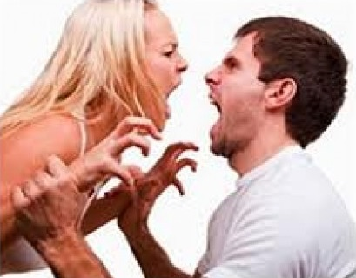
Intro
“I’ll take care of you/him/her/them” can have double meanings!
Positive: “I will take care of you” meaning, “I will see to your needs and care for you!” The person will do what is in the best interest for the other person (person being spoke to/about) – Lk. 10:35: The Samaritan
Negative: “I will take care of you” meaning, “I will eliminate/handle/get rid of/discredit, etc. you!” The person will do what is in the best interest of the one saying it!

Slide 3
Intro
God has promised to “take care” of mankind (II Pet. 2:9)
(positive or negative is up to individuals!)
Mt. 25:34, 41, 46: “These (on His left) will go away into eternal punishment, but the righteous (on His right) into eternal life.”

Slide 4
Intro
Rom. 11:22
22. Behold then the kindness and severity of God; to those who fell, severity, but to you, God's kindness, if you continue in His kindness; otherwise you also will be cut off.
God’s kindness (goodness, NKJV)
God’s severity
The personal choice
God will take care of you!
Your eternity is assured one way or another –
which do you choose?

Slide 5
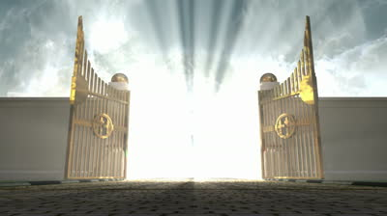
God’s Goodness
Rom. 11:22: “Consider the goodness…of God” (NKJV)
Psalm 8:4: A Psalm of David
4. What is man that You take thought of him, And the son of man that You care for him?
Rom. 2:4: “The riches of His goodness” (NKJV)
4. Or do you think lightly of the riches of His kindness and tolerance and patience, not knowing that the kindness of God leads you to repentance?
God’s goodness leads to repentance (Rom. 2:4)
God’s goodness can be seen in sending His Son (I Jn. 4:10)
God’s goodness can be seen in our salvation (Eph. 2:1-9)
God’s goodness can be seen in our adoption as sons & daughters (Rom. 8:14-17; II Cor. 6:18)
God’s goodness can be seen in our reservation in Heaven (I Pet. 1:3-4)

Slide 6
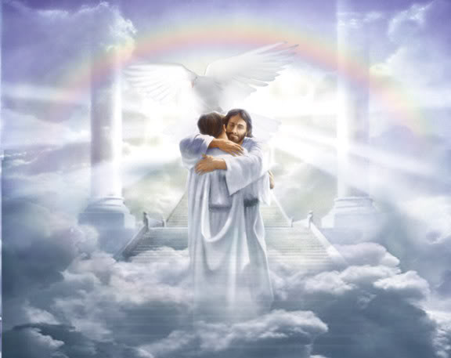
God’s Goodness
Rom. 11:22: “Consider the goodness…of God” (NKJV)
The goodness of God is extended to those who “continue
in His goodness” (Rom. 11:22)
Heb. 5:9: God saves those who obey Him! (Jn. 14:15; I Jn. 5:2-3)
God will take care of us in eternity with eternal life “if”
we continue in His goodness!

Slide 7
God’s Severity
Rom. 11:22: “Consider the…severity of God” (NKJV)
Mt. 25:41
41. "Then He will also say to those on His left, 'Depart from Me, accursed ones, into the eternal fire which has been prepared for the devil and his angels;
Rom. 11:17-21: Israel rejected as God’s holy nation and
Gentiles grafted in (Mt. 21:43)
17. But if some of the branches were broken off, and you, being a wild olive, were grafted in among them and became partaker with them of the rich root of the olive tree,
18. do not be arrogant toward the branches; but if you are arrogant, remember that it is not you who supports the root, but the root supports you.
19. You will say then, "Branches were broken off so that I might be grafted in."
20. Quite right, they were broken off for their unbelief, but you stand by your faith. Do not be conceited, but fear;
21. for if God did not spare the natural branches, He will not spare you, either.

Slide 8
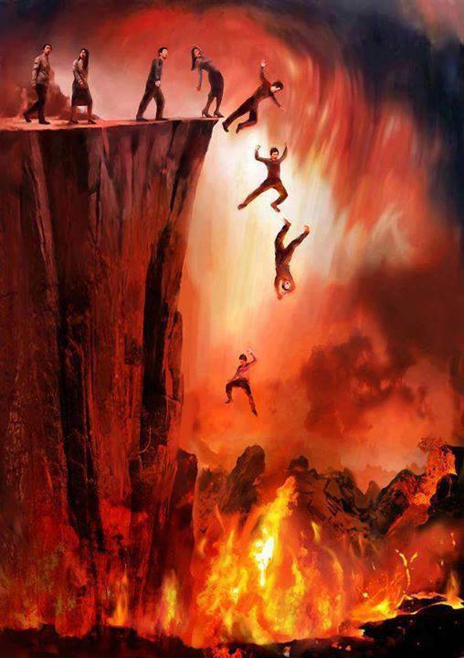
God’s Severity
Rom. 11:22: “Consider the…severity of God” (NKJV)
II Pet. 2:1-9: God’s severity seen in judgment of wicked!
Sinful angels – II Pet. 2:4 (Jude 6)
World of Noah’s day – II Pet. 2:5 (Gen. 6:12-13)
Sodom & Gomorrah – II Pet. 2:6 (Gen. 19:24)
The wicked will be punished in Hell – II Pet. 2:9-11 (Mt. 25:41-46)
Heb. 10:26-31: God’s severity seen on the unfaithful
Trampling under foot the Son of God
Regarding His blood as unclean
Insulting the Spirit of grace
Judgment is all that’s left to such an individual!
God will take care of us in eternity with eternal punishment “if” we continue in His severity!

Slide 9
Personal Choice
Rom. 11:22: “If you continue in His kindness; otherwise you also will be cut off”
Which will you choose – God’s severity or His goodness?
Will you choose to fear God or to fail God?
Will you choose to obey or reject God?
God’s goodness is reserved for those who are obedient & faithful!
God’s grace is given to the one who is obedient (Rom. 6:14-18)
God’s mercy is given to the one justified by conforming to the image of His Son (Rom. 8:29-30)
God’s love is given to the one who “walks with him” in keeping His commandments through obedience (I Jn. 2:3-6)
God’s home in Heaven is given to those who are “faithful until death” and “overcomes” (Rev. 2:10; 21:7)

Slide 10
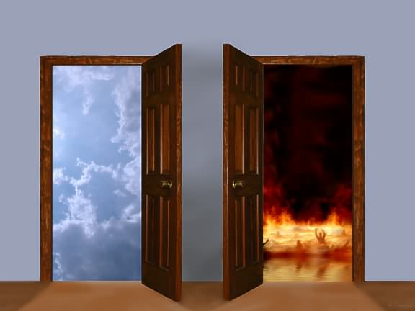
Personal Choice
Rom. 11:22: “If you continue in His kindness; otherwise you also will be cut off”
God’s severity is reserved for those who are disobedient & wicked!
II Thess. 1:7-9: Those who do not know God and who have not obeyed the gospel will be eternally separated from Him!
Rev. 20:14-15: The 2nd death is for those not written in the Book of Life!
We choose if we want God to take care of us with His goodness or with His severity!

Slide 11
Conclusion
Rom. 11:22: Behold then the kindness and severity of God; to those who fell, severity, but to you, God's kindness, if you continue in His kindness; otherwise you also will be cut off.
Heb. 12:28-29
28. Therefore, since we receive a kingdom which cannot be shaken, let us show gratitude, by which we may offer to God an acceptable service with reverence and awe;
29. for our God is a consuming fire.
When we remember God’s rejection of Israel as His
nation, we should pay attention:
To continue (obey/abide) in His goodness that we not be “cut off” – Rom. 11:22
There is a day of wrath that is coming – Rom. 2:5-8
Blessing of eternal life to those who do good
Wrath and indignation to those who disobey. (II Thess. 1:7-9)
God’s goodness blesses our lives now and will bless us eternally – Rom. 2:7

Slide 12
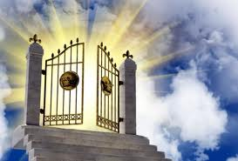
Conclusion
God will take care of you! (Blessing or curse!)
“Consider the goodness and severity of God” and choose to “continue in His goodness!”

Slide 13
“What Must I Do To Be Saved?”
Hear The Gospel (Jn. 5:24; Rom. 10:17)
Believe In Christ (Jn. 3:16-18; Jn. 8:24)
Repent Of Sins (Lk. 13:35; Acts 2:38)
Confess Christ (Mt. 10:32; Rom. 10:10)
Be Baptized (Mk. 16:16; Acts 22:16)
Remain Faithful (Jn. 8:31; Rev. 2:10)
For The Erring Child:
Repent (Acts 8:22), Confess (I Jn. 1:9),
Pray (Acts 8:22)

