Slide 1
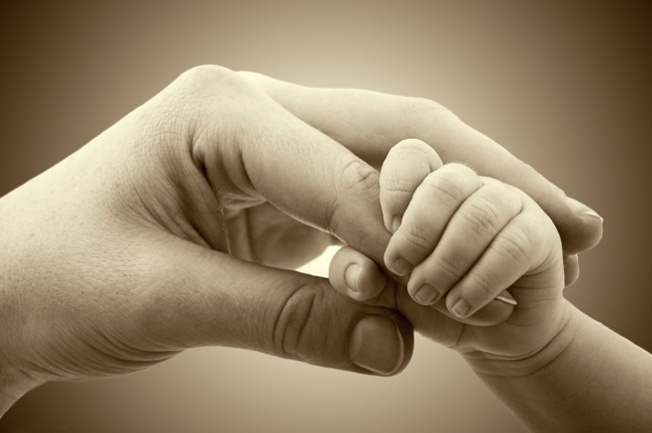
A Tale Of Two Mothers
Text:
Mark 6:17-28; II Tim. 1:5
Notes:
By Nathan L Morrison for Sunday 05/13/2018
All Scripture given is from NASB unless otherwise stated
For further study, or if questions, please Call: 804-277-1983 or Visit: www.courthousechurchofchrist.com
Based on lessons by Richard Thetford
PowerPoint Background from Rod MacArthur

Slide 2
Intro
This Mother’s Day…
Let us look at mothers in light of how they responded to God’s word and their influence on their families
There are examples both good and bad in the Scriptures – Mothers are no different!
A tale of two NT mothers…

Slide 3
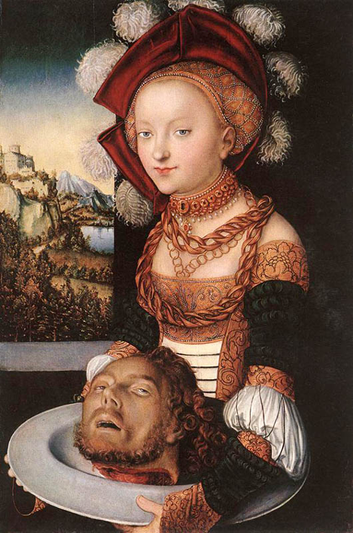
Wicked Herodias
Herodias had a daughter by the name of Salome
Consider what Herodias taught her
Mk. 6:17-28

Slide 4
Mark 6:17-28
Mk. 6:17-19
17. For Herod himself had sent and had John arrested and bound in prison on account of Herodias, the wife of his brother Philip, because he had married her.
18. For John had been saying to Herod, "It is not lawful for you to have your brother's wife."
19. Herodias had a grudge against him and wanted to put him to death and could not do so;

Slide 5
Mark 6:17-28
Mk. 6:20-22
20. for Herod was afraid of John, knowing that he was a righteous and holy man, and he kept him safe. And when he heard him, he was very perplexed; but he used to enjoy listening to him.
21. A strategic day came when Herod on his birthday gave a banquet for his lords and military commanders and the leading men of Galilee;
22. and when the daughter of Herodias herself came in and danced, she pleased Herod and his dinner guests; and the king said to the girl, "Ask me for whatever you want and I will give it to you."

Slide 6
Mark 6:17-28
Mk. 6:23-25
23. And he swore to her, "Whatever you ask of me, I will give it to you; up to half of my kingdom."
24. And she went out and said to her mother, "What shall I ask for?" And she said, "The head of John the Baptist."
25. Immediately she came in a hurry to the king and asked, saying, "I want you to give me at once the head of John the Baptist on a platter."

Slide 7
Mark 6:17-28
Mk. 6:26-28
26. And although the king was very sorry, yet because of his oaths and because of his dinner guests, he was unwilling to refuse her.
27. Immediately the king sent an executioner and commanded him to bring back his head. And he went and had him beheaded in the prison,
28. and brought his head on a platter, and gave it to the girl; and the girl gave it to her mother.

Slide 8
Wicked Herodias
Consider what Herodias taught Salome – Mk. 6:17-28
Marital fidelity is not important
(v. 17-18)
Heb. 13:4
Evil conspiracies & murder are OK (v. 19, 21, 27-28)
Mark 7:21-23

Slide 9
Wicked Herodias
Consider what Herodias taught Salome – Mk. 6:17-28
Perversion (v. 22)
Prov. 6:24-26; 7:7-10; Titus 2:3-5
Immodesty and sensuality are acceptable (v. 22-24)
Gal. 5:19; Prov. 7:10

Slide 10
Wicked Herodias
Consider what Herodias taught Salome – Mk. 6:17-28
Manipulation gets you what you want (v. 24-28)
Prov. 6:18
Herodias taught her daughter it is OK to use her body to get what
she wants, including murder!

Slide 11
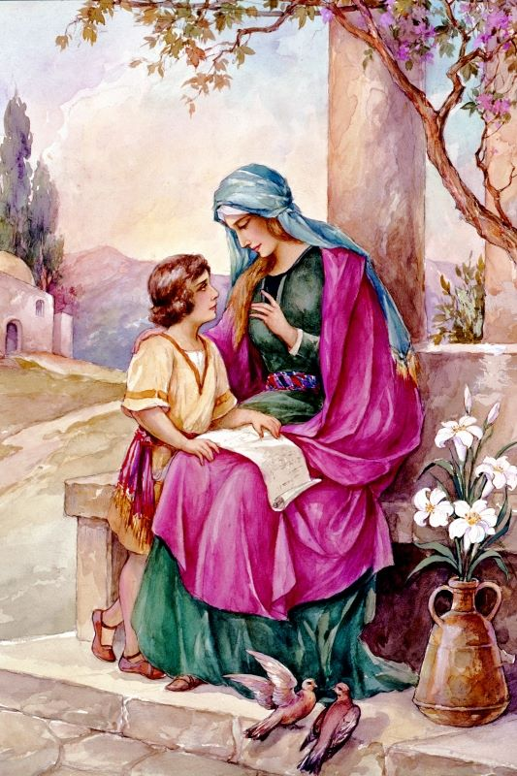
Godly Eunice
Eunice had a son named Timothy
Consider what she taught him
II Tim. 1:5
5. For I am mindful of the sincere faith within you, which first dwelt in your grandmother Lois and your mother Eunice, and I am sure that it is in you as well.

Slide 12
Godly Eunice
Consider what she taught Timothy –
II Tim. 1:5
A “Sincere Faith”
Acts 16:1-3
We can see in Eunice a desire for her husband over social norms and scare tactics of her people
Acts 16:1 (Mt. 19:4-6; Acts 11:1-3; Eph. 2:11-16)

Slide 13
Godly Eunice
Consider what she taught Timothy –
II Tim. 1:5
A teacher of “good things”
Titus 2:3-5 (Prov. 22:6; Eph. 6:4)
The scriptures are important, even in childhood
II Timothy 3:14-17
I Tim. 4:6; Prov. 1:7-9

Slide 14
Godly Eunice
Consider what she taught Timothy –
II Tim. 1:5
Godly children bring delight to the soul
Acts 16:1-2 (Prov. 29:17; Acts 16:1, 3)
Eunice taught her son from his youth up the “fear of the Lord”
and a “sincere faith!”

Slide 15
Godly Mothers Are Special
Prov. 31 describes the ideal wife and mother
Prov. 31:10-31:
These 22 verses are written as an acrostic; that means each beginning letter of each verse is a letter of the Hebrew alphabet (loses that when translated)
“An excellent wife
(NKJ: “virtuous”), who can find?” (31:10)

Slide 16
Godly Mothers Are Special
God describes the “excellent” (“virtuous”) wife & mother
She never leaves her first love – Prov. 31:11
Wedding vows actually do mean something – Prov. 31:12, 23, 25
She is a help meet for her husband – Prov. 31:12-18
She submits to her husband – Prov. 31:23, 28-29
Her husband trusts in her; she is a great example to the children – Prov. 31:11, 28

Slide 17
Godly Mothers Are Special
God describes the “excellent” (“virtuous”) wife & mother
She cherishes all there is to being a mom – Prov. 31:15, 18-19, 21-22, 27
She trains her children in the laws of God – Prov. 31:26; Prov. 1:8
As a result her children honor her – Prov. 31:28
The virtuous wife and mother of Proverbs 31 is the ideal that
godly women ought to strive for, and what godly men ought to search for!

Slide 18
Conclusion
In Herodias and Eunice we have two different mothers with two different influences!

Slide 19
Conclusion
Contrast: “excellent wife” to “contentious wife”
A godly mother is a great example!
Prov. 19:13: “…the contentions of a wife are a constant dripping.” (Annoying!)
Prov. 25:24: “It is better to live in a corner of the roof than in a house shared with a contentious woman.”
Prov. 31:28-29:
Her children rise up and bless her; Her husband also, and he praises her, saying: “Many daughters have done nobly, But you excel them all.”

Slide 20
Conclusion
The example of the “Excellent Wife/Mother”
Wives/Mothers, are you living out virtuous attributes of godliness?
Husbands, are you honoring God by honoring and praising your wife?
Children, do you honor, obey, love, and praise your mothers?
Women, do you strive to be godly and practice the attributes that make for an “excellent wife?”
Prov. 31:30:
“Charm is deceitful and beauty is vain, But a woman who fears the LORD, she shall be praised”

Slide 21
Conclusion
To all of you virtuous Mothers out there, thank you for your love, devotion, loyalty, and service to God, to your husband, and your children!
May we all learn and become better Christians by your wonderful example!

Slide 22
“What Must I Do To Be Saved?”
Hear The Gospel (Jn. 5:24; Rom. 10:17)
Believe In Christ (Jn. 3:16-18; Jn. 8:24)
Repent Of Sins (Lk. 13:35; Acts 2:38)
Confess Christ (Mt. 10:32; Rom. 10:10)
Be Baptized (Mk. 16:16; Acts 22:16)
Remain Faithful (Jn. 8:31; Rev. 2:10)
For The Erring Child of God:
Repent (Acts 8:22), Confess (I Jn. 1:9),
Pray (Acts 8:22)

