Slide 1
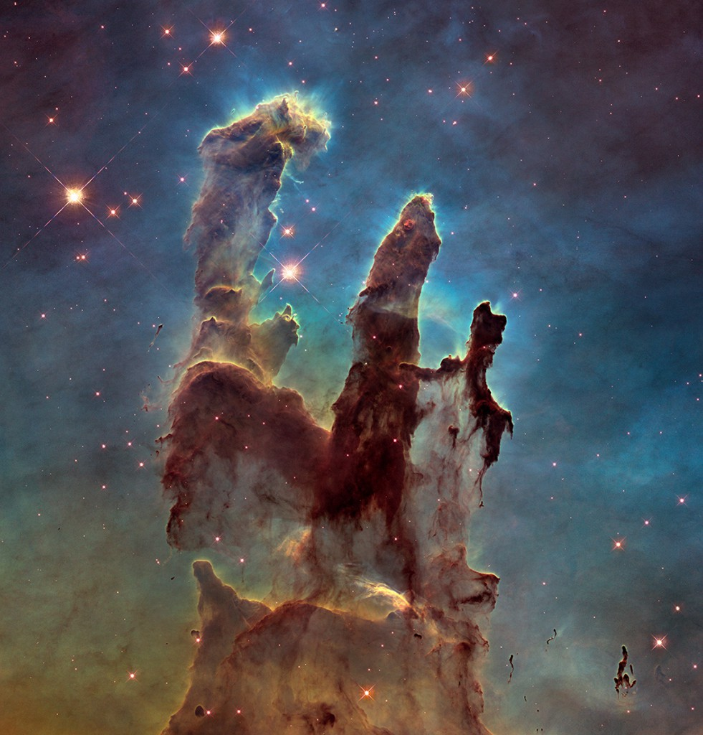
Harmony Of Scriptures & Science Parts 1-2
Text: Ps. 19:1; Is 40:8; Rom. 1:20
Notes:
Prepared by Nathan L Morrison
All Scripture given is from NASB unless otherwise stated!
For further study, or if questions, please Call: 804-277-1983 or Visit: www.courthousechurchofcrist.com
Image: “Pillars of Creation” in the Eagle Nebula taken by the Hubble Telescope in 2014

Slide 2
PART 1
Harmony Of Scriptures & Science
Notes:
Image Top-Right: Painting, “Hands of Creation,” by Evelyn Patrick

Slide 3
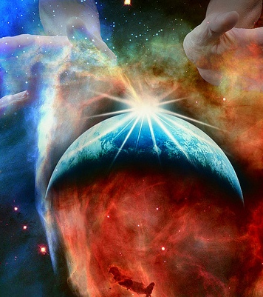
Intro (Part 1)
Psalm 19:1 For the choir director. A Psalm of David.
1. The heavens are telling of the glory of God; And their expanse is declaring the work of His hands.

Slide 4
Intro
Is. 40:8
8. The grass withers, the flower fades, but the word of our God will stand forever.

Slide 5
Intro
Rom. 1:20
20. For since the creation of the world His invisible attributes, His eternal power and divine nature, have been clearly seen, being understood through what has been made, so that they are without excuse.

Slide 6
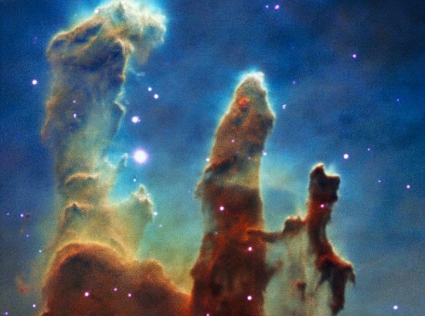
Intro
Wall Street Journal article 12/25/14, Science Increasingly Makes the Case for God by Eric Mataxas
In 1966 Astronomer Carl Sagan announced that there were two important criteria for a planet to support life: The right kind of star, and a planet the right distance from that star.
The government funded a research group called “Search for Extraterrestrial Intelligence” (SETI) in the 1960’s to find life.
Notes:
Science Increasingly Makes the Case for God, Wall Street Journal Article by Eric Mataxas, 12/25/14: http://www.wsj.com/articles/eric-metaxas-science-increasingly-makes-the-case-for-god-1419544568
Image Top-Right: “Pillars of Creation” in the Eagle Nebula taken by the Hubbble Telescope in 1995

Slide 7
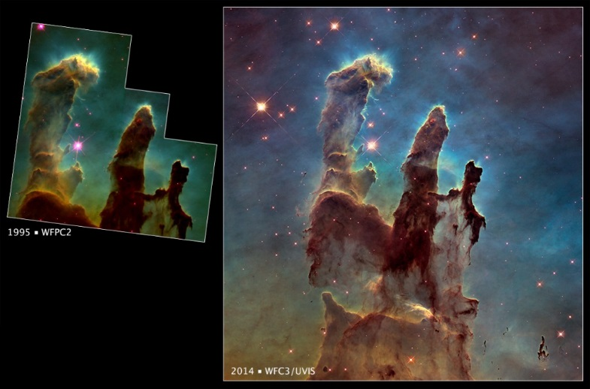
Intro
2014
1995
Wall Street Journal article 12/25/14, Science Increasingly Makes the Case for God by Eric Mataxas
Over the years our knowledge of the universe increased – It became clear that there were far more factors necessary for life than Sagan supposed!
Congress defunded SETI in 1993, but the search continues with private funds!
Notes:
Science Increasingly Makes the Case for God, Wall Street Journal Article by Eric Mataxas, 12/25/14: http://www.wsj.com/articles/eric-metaxas-science-increasingly-makes-the-case-for-god-1419544568
Image Top-Right: “Pillars of Creation” in the Eagle Nebula taken by the Hubbble Telescope in 1995 compared to the photo from 2014

Slide 8
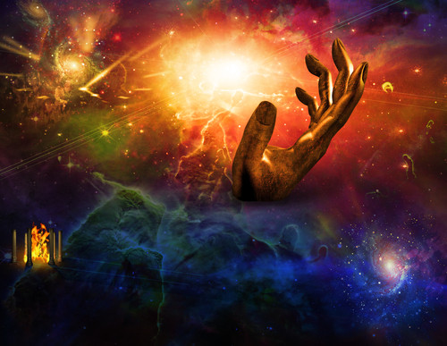
Intro
Wall Street Journal article 12/25/14, Science Increasingly Makes the Case for God by Eric Mataxas
Sagan’s two parameters grew to 10 and then 20 and then 50. The number dropped to a few thousand planets and kept on plummeting
As factors continued to be discovered, the number of possible planets hit zero, and kept going. Probability said that even we shouldn’t be here!
Notes:
Science Increasingly Makes the Case for God, Wall Street Journal Article by Eric Mataxas, 12/25/14: http://www.wsj.com/articles/eric-metaxas-science-increasingly-makes-the-case-for-god-1419544568
Image Top-Right: Depiction of the “Pillars of Creation” as the “Hand of God”

Slide 9
Intro
Wall Street Journal article 12/25/14, Science Increasingly Makes the Case for God by Eric Mataxas
Today there are more than 200 known parameters necessary for a planet to support life—every single one of which must be perfectly met, or the whole thing falls apart!
Notes:
Science Increasingly Makes the Case for God, Wall Street Journal Article by Eric Mataxas, 12/25/14: http://www.wsj.com/articles/eric-metaxas-science-increasingly-makes-the-case-for-god-1419544568
Image Top-Right: Depiction of the “Pillars of Creation” as the “Hand of God”

Slide 10
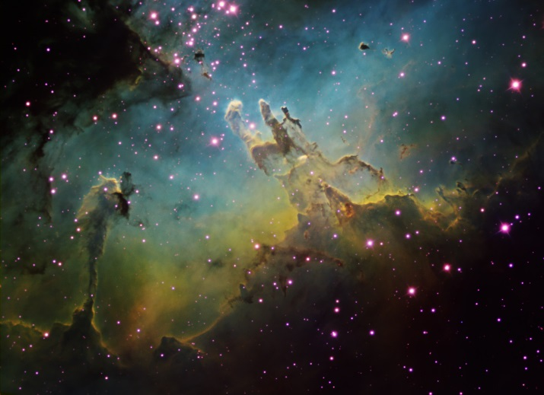
Intro
Wall Street Journal article 12/25/14, Science Increasingly Makes the Case for God by Eric Mataxas
“A common-sense interpretation of the facts suggests that a super-intellect has monkeyed with the physics, as well as with chemistry and biology . . . . The numbers one calculates from the facts seem to me so overwhelming as to put this conclusion almost beyond question” – Fred Hoyle (Astronomer who coined the term “big bang,” also said his atheism was “greatly shaken” at these developments)
Notes:
Science Increasingly Makes the Case for God, Wall Street Journal Article by Eric Mataxas, 12/25/14: http://www.wsj.com/articles/eric-metaxas-science-increasingly-makes-the-case-for-god-1419544568
Image Top-Right: “Pillars of Creation” in the Eagle Nebula taken by the Hubbble Telescope, 1995: Whole Nebula

Slide 11
Intro
Wall Street Journal article 12/25/14, Science Increasingly Makes the Case for God by Eric Mataxas
“The appearance of design is overwhelming” – Paul Davies (Theoretical physicist)
“The more we get to know about our universe, the more the hypothesis that there is a Creator . . . gains in credibility as the best explanation of why we are here” – Dr. John Lennox (Oxford professor)
Notes:
Science Increasingly Makes the Case for God, Wall Street Journal Article by Eric Mataxas, 12/25/14: http://www.wsj.com/articles/eric-metaxas-science-increasingly-makes-the-case-for-god-1419544568
Image Top-Right: Painting, “Hands of Creation,” by Evelyn Patrick

Slide 12
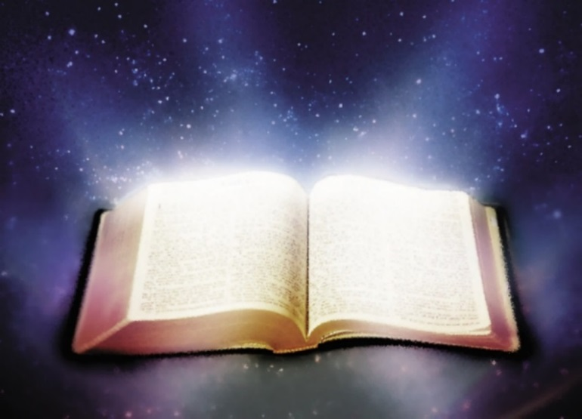
Intro
Doesn’t have to be a choice between God or science!
If the Bible is a revelation from God, we should expect it to be accurate where it touches upon scientific matters:
Scriptures may come into conflict with scientific theories, but they are in harmony with every known fact of science.
Throughout time, Science had to “catch up” with God’s word!

Slide 13
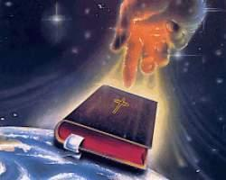
Intro
We can choose God and enjoy science knowing God is in
science and has told man these truths in His word
from the beginning!
We can see God in science as He has provided the Creator’s Handbook to Science in His word!

Slide 14
5 Terms of the Universe
Gen. 1:1-2
1. In the beginning God created the heavens and the earth.
2. The earth was formless and void, and darkness was over the surface of the deep, and the Spirit of God was moving over the surface of the waters.
Notes:
5 Terms of the Universe: http://www.spaceandmotion.com/cosmos-space-time-matter-motion.htm

Slide 15
5 Terms of the Universe
Science expresses the universe in five terms: time, space, matter, power, and motion.
“In the beginning [time] God created [power] the heavens [space] and the earth [matter] . . . And the Spirit of God was moving [motion] over the surface of the waters.”
The first thing God tells man is that He controls all aspects of the universe!
Notes:
5 Terms of the Universe: http://www.spaceandmotion.com/cosmos-space-time-matter-motion.htm

Slide 16
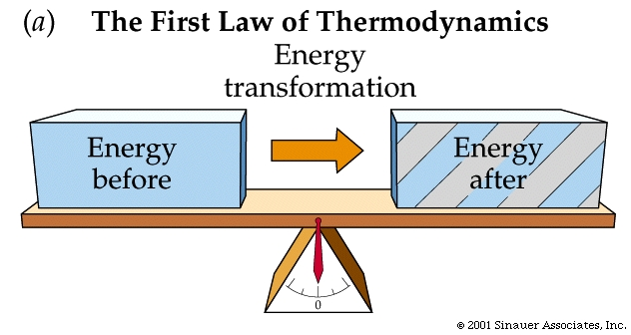
1st Law of Thermodynamics
Gen. 2:1
1. Thus the heavens and the earth were completed, and all their hosts.
Notes:
1st Law of Thermodynamics: http://en.wikipedia.org/wiki/1st_law_of_thermodynamics
http://www.evidencebible.com/witnessingtool/scientificfactsintheBible.shtml

Slide 17
1st Law of Thermodynamics
H3615 kâlâh: past definite tense for the verb “completed” (NKJ: “finished”), indicating an action completed in the past, never again to occur.
1st Law of Thermodynamics (1800’s): “That neither matter nor energy can be either created or destroyed.” There is no “creation” ongoing today.
Notes:
1st Law of Thermodynamics: http://en.wikipedia.org/wiki/1st_law_of_thermodynamics
http://www.evidencebible.com/witnessingtool/scientificfactsintheBible.shtml

Slide 18
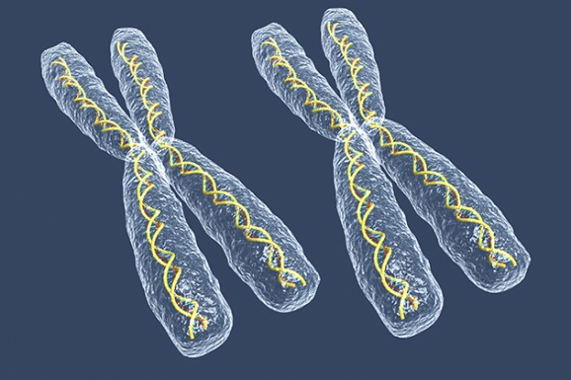
Female “Seed of Life”
Gen. 3:15
15. And I will put enmity Between you and the woman, And between your seed and her seed; He shall bruise you on the head, And you shall bruise him on the heel."
Notes:
Female “Seed of Life”: http://www.custance.org/Library/SOTW/Part_II/chapter15.html; http://en.wikipedia.org/wiki/Hermann_Henking

Slide 19
Female “Seed of Life”
This was not common knowledge until late 1800’s. It was widely believed that only the male possessed the “seed of life” and that the woman was nothing more than a glorified incubator!
The X chromosome (gender distinction) was discovered to be special in 1890 by Hermann Henking, and that women possess two X chromosomes in the ovum later in the 1900’s!
Notes:
Female “Seed of Life”: http://www.custance.org/Library/SOTW/Part_II/chapter15.html; http://en.wikipedia.org/wiki/Hermann_Henking

Slide 20
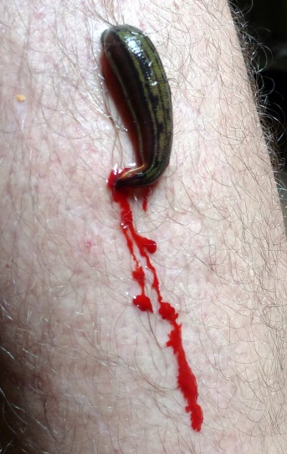
Life in the Blood
Gen. 9:4
4. "Only you shall not eat flesh with its life, that is, its blood.
Notes:
Life is in the Blood/Bloodletting: http://en.wikipedia.org/wiki/Pierre_Charles_Alexandre_Louis; http://www.pbs.org/wnet/redgold/basics/bloodlettinghistory.html; Childbed Fever: A scientific biography of Ignaz Semmelweis, by Codell K. & Barbara R. Carter, 2005

Slide 21
Life in the Blood
“Bloodletting” was standard practice for over 3,000 years and many died because of the practice!
1830’s: Pierre-Charles-Alexandre Louis (1787–1872) began raising concerns about bloodletting; by the end of the 1800’s, the practice ended – Scientists now know: “Life is in the blood!”
Notes:
Life is in the Blood/Bloodletting: http://en.wikipedia.org/wiki/Pierre_Charles_Alexandre_Louis; http://www.pbs.org/wnet/redgold/basics/bloodlettinghistory.html; Childbed Fever: A scientific biography of Ignaz Semmelweis, by Codell K. & Barbara R. Carter, 2005

Slide 22
Circumcision on 8th Day
Gen. 17:12
12. "And every male among you who is eight days old shall be circumcised throughout your generations, a servant who is born in the house or who is bought with money from any foreigner, who is not of your descendants.
Notes:
Circumcision on 8th Day: http://en.wikipedia.org/wiki/Vitamin_K#History_of_discovery; http://en.wikipedia.org/wiki/Carl_Peter_Henrik_Dam; None of These Diseases by S.I. McMillen, M.D., p. 93, 1984

Slide 23
Circumcision on 8th Day
Medical science has discovered that this is when the human body’s immune system is at its peak (Henrik Dam, 1939, who named it “Vitamin K”).
On the 8th day, the amount of prothrombin present actually is elevated above one-hundred percent of normal—and is the only day in the male’s life in which this will be the case under normal conditions!
Notes:
Circumcision on 8th Day: http://en.wikipedia.org/wiki/Vitamin_K#History_of_discovery; http://en.wikipedia.org/wiki/Carl_Peter_Henrik_Dam; None of These Diseases by S.I. McMillen, M.D., p. 93, 1984

Slide 24
Hand-washing in Running Water
Lev. 15:13
13. 'Now when the man with the discharge becomes cleansed from his discharge, then he shall count off for himself seven days for his cleansing; he shall then wash his clothes and bathe his body in running water and will become clean.
Notes:
Hand-washing in Running Water: http://en.wikipedia.org/wiki/Ignaz_Semmelweis; http://en.wikipedia.org/wiki/Louis_Pasteur

Slide 25
Hand-washing in Running Water
The presence of microscopic diseases was unknown (till 1860’s) so doctors washed their hands in a basin of still water, spreading diseases!
1845: The work of Dr. Ignaz Semmelweis (1818-1865), and later Louis Pasteur (1822–1895) ended such practices!
Notes:
Hand-washing in Running Water: http://en.wikipedia.org/wiki/Ignaz_Semmelweis; http://en.wikipedia.org/wiki/Louis_Pasteur

Slide 26
Suspension of the Earth in Space
Job 26:7
7. He stretches out the north over the void and hangs the earth on nothing.
Notes:
Suspension of the Earth: http://en.wikipedia.org/wiki/Ptolemaic_System#Ptolemaic_system; http://en.wikipedia.org/wiki/Copernican_system

Slide 27
Suspension of the Earth in Space
90-168 AD: Ptolemaic System: Planets & Sun revolve around Earth
1473-1543 AD: Copernican System: Planets revolve around Sun
1610 AD: Proven through telescope by Galileo (1564-1642)
Notes:
Suspension of the Earth: http://en.wikipedia.org/wiki/Ptolemaic_System#Ptolemaic_system; http://en.wikipedia.org/wiki/Copernican_system

Slide 28
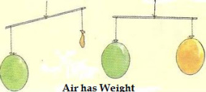
Air Has Weight
Job 28:25
25. "When He imparted weight to the wind And meted out the waters by measure,
Notes:
Air Has Weight: http://superbeefy.com/who-discovered-air-pressure-and-that-the-atmosphere-has-weight-and-presses-down-on-us/; https://en.wikipedia.org/wiki/Evangelista_Torricelli
http://www.kids-fun-science.com/air-pressure-experiments.html

Slide 29
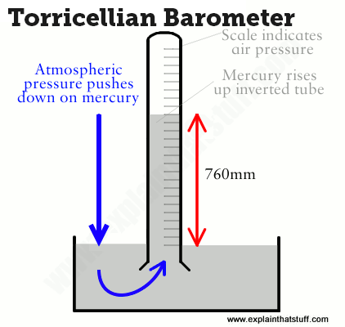
Air Has Weight
In 1643 Italian physicist Evangelista Torricelli (1608–1647) discovered atmospheric pressure and created the barometer!
Atmospheric Pressure weighs 14.7 lb/sq. in.
God not only said through Job that air had weight but that God (the Creator) set the weight!
Notes:
Air Has Weight: http://superbeefy.com/who-discovered-air-pressure-and-that-the-atmosphere-has-weight-and-presses-down-on-us/; https://en.wikipedia.org/wiki/Evangelista_Torricelli
http://www.kids-fun-science.com/air-pressure-experiments.html

Slide 30
Harmony of Scripture & Science
Harmony of Scriptures & Science
Scientific Fact | Scriptures | Fact Discovered
5 Terms of the Universe | Gen. 1:1-2 | Over Time – Taught Now
1st Law of Thermodynamics | Gen. 2:1 | 1800's AD (Stated in 1850)
Female “Seed of Life” | Gen. 3:15 | 1890 AD by Hermann Henking
Life is in the Blood | Gen. 9:4 | 1830's AD by Pierre Louis
Circumcision on 8th Day | Gen. 17:12 | 1939 AD by Henrik Dam
Hand-washing in Running Water | Lev. 15:13 | 1845 AD by Ignaz Semmelweis
Suspension of the Earth | Job 26:7 | 1610 AD by Galileo
Air Has Weight | Job 28:25 | 1643 AD by Evangelista Torricelli
Notes:
Resources:
Science Increasingly Makes the Case for God, Wall Street Journal Article by Eric Mataxas, 12/25/14: http://www.wsj.com/articles/eric-metaxas-science-increasingly-makes-the-case-for-god-1419544568
http://www.evidencebible.com/witnessingtool/scientificfactsintheBible.shtml
• 5 Terms of the Universe: http://www.spaceandmotion.com/cosmos-space-time-matter-motion.htm
• 1st Law of Thermodynamics: http://en.wikipedia.org/wiki/1st_law_of_thermodynamics
• Female “Seed of Life”: http://www.custance.org/Library/SOTW/Part_II/chapter15.html; http://en.wikipedia.org/wiki/Hermann_Henking
• Life is in the Blood/Bloodletting: http://en.wikipedia.org/wiki/Pierre_Charles_Alexandre_Louis; http://www.pbs.org/wnet/redgold/basics/bloodlettinghistory.html; Childbed Fever: A scientific biography of Ignaz Semmelweis, by Codell K. & Barbara R. Carter, 2005
• Circumcision on 8th Day: http://en.wikipedia.org/wiki/Vitamin_K#History_of_discovery; http://en.wikipedia.org/wiki/Carl_Peter_Henrik_Dam; None of These Diseases by S.I. McMillen, M.D., p. 93, 1984
• Hand-washing in Running Water: http://en.wikipedia.org/wiki/Ignaz_Semmelweis; http://en.wikipedia.org/wiki/Louis_Pasteur
• Suspension of the Earth: http://en.wikipedia.org/wiki/Ptolemaic_System#Ptolemaic_system; http://en.wikipedia.org/wiki/Copernican_system
• Air Has Weight: http://superbeefy.com/who-discovered-air-pressure-and-that-the-atmosphere-has-weight-and-presses-down-on-us/; https://en.wikipedia.org/wiki/Evangelista_Torricelli; http://www.kids-fun-science.com/air-pressure-experiments.html
• Water Cycle: http://en.wikipedia.org/wiki/Raoult%27s_law; http://en.wikipedia.org/wiki/Fran%C3%A7ois-Marie_Raoult ; http://ga.water.usgs.gov/edu/watercycle.html
• Earth’s Axis: http://en.wikipedia.org/wiki/Foucault_Pendulum; http://en.wikipedia.org/wiki/L%C3%A9on_Foucault
• Paths of the Seas: http://en.wikipedia.org/wiki/Matthew_Fontaine_Maury
• Sun’s Ecliptic Path: http://en.wikipedia.org/wiki/Ecliptic; http://en.wikipedia.org/wiki/Ecliptic_coordinate_system; http://earthsky.org/space/what-is-the-ecliptic
• Earth is a Circle: http://en.wikipedia.org/wiki/Ferdinand_Magellan ; https://en.wikipedia.org/wiki/Juan_Sebasti%C3%A1n_Elcano
• Universe Expansion: http://www.bbc.com/news/science-environment-15165371; Nobel physics prize honors accelerating Universe find; BBC News; October 4, 2011; http://en.wikipedia.org/wiki/Accelerating_universe; Image at: http://www.universetoday.com/89449/accelerating-expansion-of-universe-discovery-wins-2011-noble-prize-in-physics/
• Underwater Mountains: http://en.wikipedia.org/wiki/Underwater_mountain_range; http://www.marianatrench.com/; http://en.wikipedia.org/wiki/Mariana_Trench
• 2nd Law of Thermodynamics: http://en.wikipedia.org/wiki/Second_law_of_thermodynamics; http://en.wikipedia.org/wiki/Nicolas_L%C3%A9onard_Sadi_Carnot

Slide 31
Harmony of Scripture & Science
The Scriptures were proven right, often hundreds or more years after it was written, and have been used to
discover or prove certain facts throughout time!

Slide 32
Conclusion (Pt. 1)
God’s word does not conflict or contradict science, but coincides in harmony with it (Defines it!)

Slide 33
Conclusion
Let us strengthen our faith and be the examples of the truth to the dark world around us!

Slide 34
“What Must I Do To Be Saved?”
Hear The Gospel (Jn. 5:24; Rom. 10:17)
Believe In Christ (Jn. 3:16-18; Jn. 8:24)
Repent Of Sins (Lk. 13:35; Acts 2:38)
Confess Christ (Mt. 10:32; Rom. 10:10)
Be Baptized (Mk. 16:16; Acts 22:16)
Remain Faithful (Jn. 8:31; Rev. 2:10)
For The Erring Child:
Repent (Acts 8:22), Confess (I Jn. 1:9), Pray (Acts 8:22)

Slide 35
PART 2
Harmony Of Scriptures & Science
Notes:
Image Top-Right: Painting, “Hands of Creation,” by Evelyn Patrick

Slide 36
Intro (Part 2)
Creation alone declares God’s majesty and glory – Psalm 19:1
If the Scriptures are the word of God, one would expect it to be accurate – Is. 40:8
Creation alone leaves man without excuse – Rom. 1:20
Notes:
Image Top-Right: Painting, “Hands of Creation,” by Evelyn Patrick

Slide 37
Intro
Wall Street Journal article 12/25/14, Science Increasingly Makes the Case for God by Eric Mataxas, declares that scientists are increasingly having to change their previous thoughts!
Over time science has become a god to itself, where the choice seems to be God or science
Notes:
Science Increasingly Makes the Case for God, Wall Street Journal Article by Eric Mataxas, 12/25/14: http://www.wsj.com/articles/eric-metaxas-science-increasingly-makes-the-case-for-god-1419544568
Image Top-Right: “Pillars of Creation” in the Eagle Nebula taken by the Hubbble Telescope in 1995

Slide 38
Intro
Throughout time, Science had to “catch up” with God’s word!
We can see God in science as He has provided the Creator’s Handbook to Science in His word!

Slide 39
The Water Cycle
Job 36:27-28
27. For he draws up the drops of water; they distill his mist in rain,
28. which the skies pour down and drop on mankind abundantly.
Notes:
Water Cycle: http://en.wikipedia.org/wiki/Raoult%27s_law; http://en.wikipedia.org/wiki/Fran%C3%A7ois-Marie_Raoult

Slide 40
The Water Cycle
Eccl. 1:7 (Written around 950 BC); Eccl. 11:3; Ps. 135:7; Amos 9:6
1882 AD: Raoult’s (1830-1901) Law of Evaporation (Thermodynamics)
Notes:
Water Cycle: http://en.wikipedia.org/wiki/Raoult%27s_law; http://en.wikipedia.org/wiki/Fran%C3%A7ois-Marie_Raoult
http://ga.water.usgs.gov/edu/watercycle.html

Slide 41
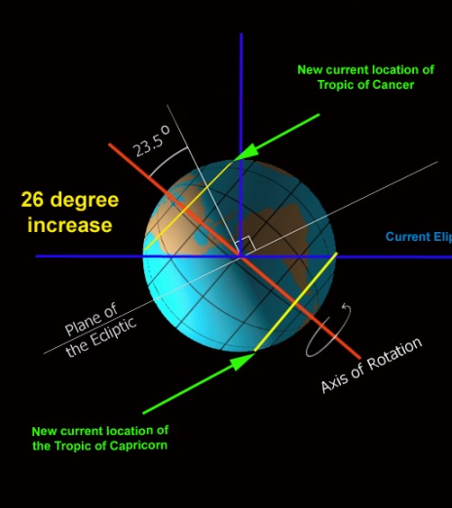
Earth’s Axis
Job 38:12, 14
12. Have you ever in your life commanded the morning, And caused the dawn to know its place,
14. "It [the earth – Vs. 13] is changed like clay under the seal; And they stand forth like a garment.
Notes:
Earth’s Axis: http://en.wikipedia.org/wiki/Foucault_Pendulum; http://en.wikipedia.org/wiki/L%C3%A9on_Foucault

Slide 42
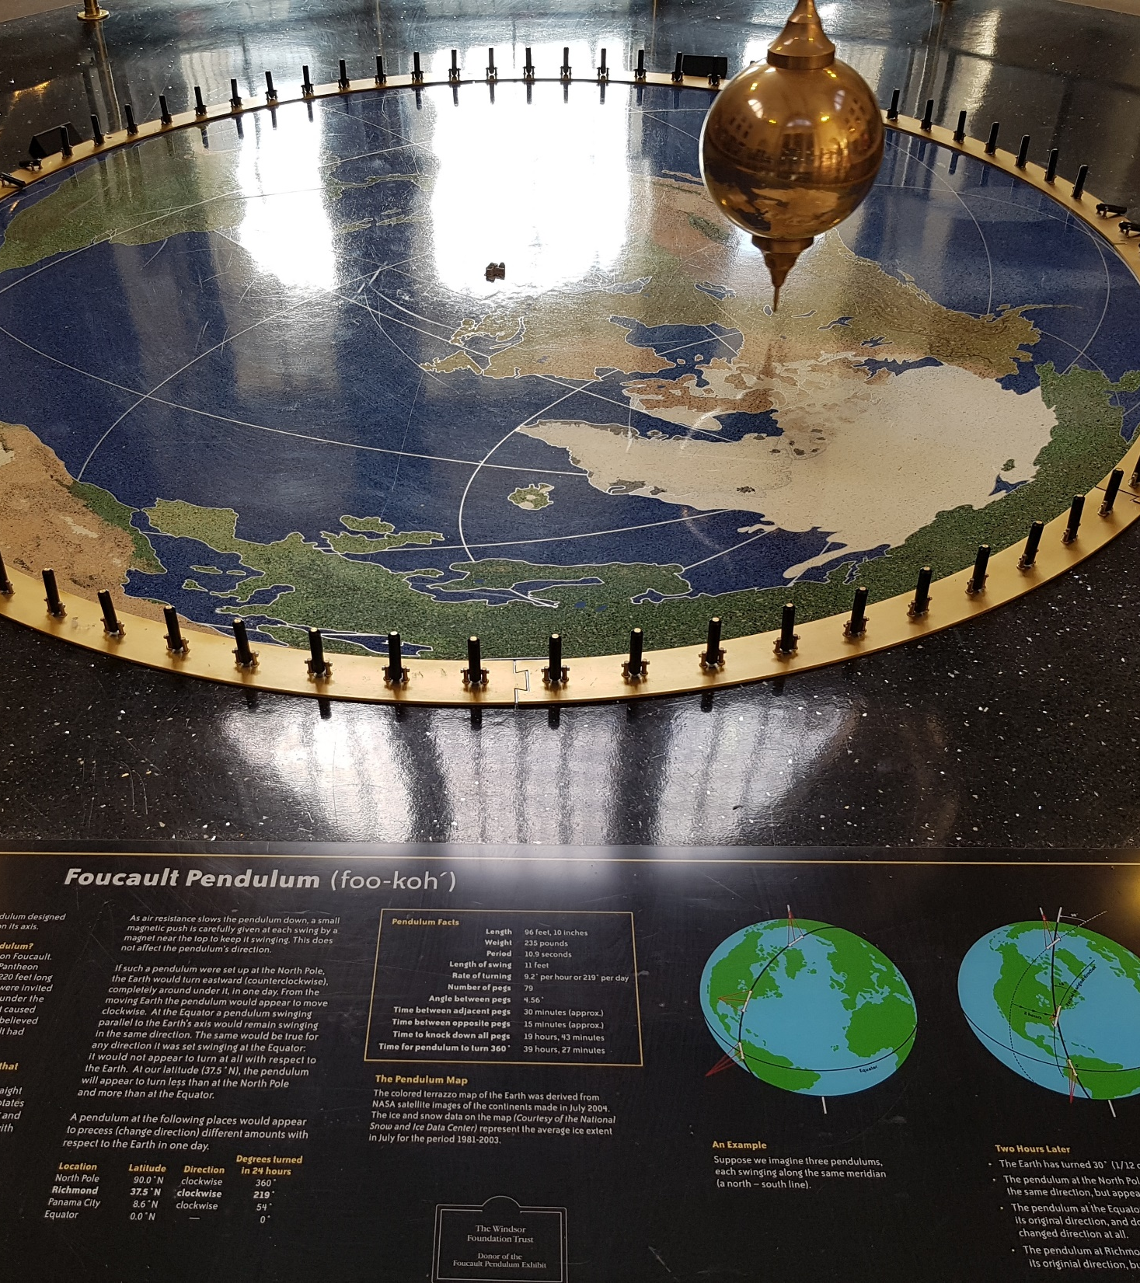
Earth’s Axis
Modern science has come to understand that the earth’s rotation on its axis is responsible for the sun’s “rising and setting.”
Kepler, Galileo and Newton gathered support for the theory of the rotation of the Earth.
1851: Foucault Pendulum by physicist Léon Foucault
Notes:
Earth’s Axis: http://en.wikipedia.org/wiki/Foucault_Pendulum; http://en.wikipedia.org/wiki/L%C3%A9on_Foucault
Image: Author’s photo in the entrance at the Science Museum of Virginia

Slide 43
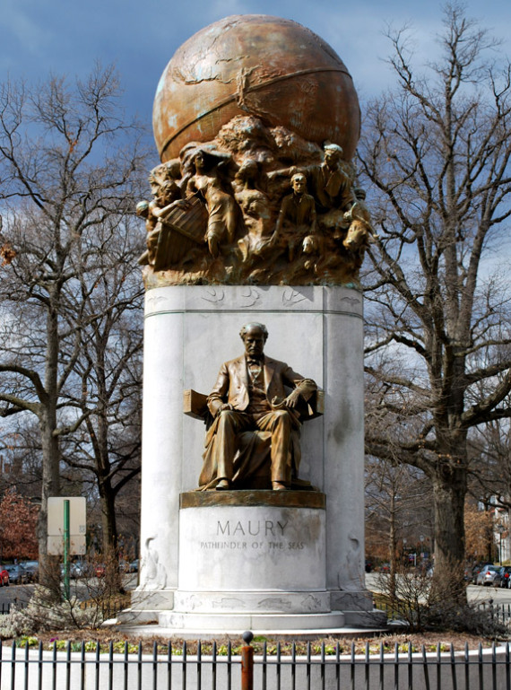
Paths of the Seas
Ps. 8:6-8 (NKJ)
6. You have made him to have dominion over the works of Your hands; You have put all things under his feet,
7. All sheep and oxen— Even the beasts of the field,
8. The birds of the air, And the fish of the sea That pass through the paths of the seas.
Notes:
Paths of the Seas: http://en.wikipedia.org/wiki/Matthew_Fontaine_Maury
Image: Matthew Fontaine Maury "Pathfinder of the Seas" monument on Monument Ave, Richmond, VA. Dedicated November 11, 1929 (Holds in in his right hand Sea-Charts, left hand Maps, and by his left foot a Bible)
Further Memorials: Maury Hall, the home of the Naval Science Department at the University of Virginia and headquarters of the University's Navy ROTC battalion, was named in his honor. The original building of the College of William & Mary Virginia Institute of Marine Science is named Maury Hall as well. Another Maury Hall, named after him, houses the Electrical and Computer Engineering Department and the Systems Engineering Department at the United States Naval Academy in Annapolis, Maryland.
Statue and Monument to him stands on Monument Ave in the intersection with Belmont Avenue in Richmond, VA. He is buried in the President’s Circle at Hollywood Cemetery, Richmond, VA

Slide 44
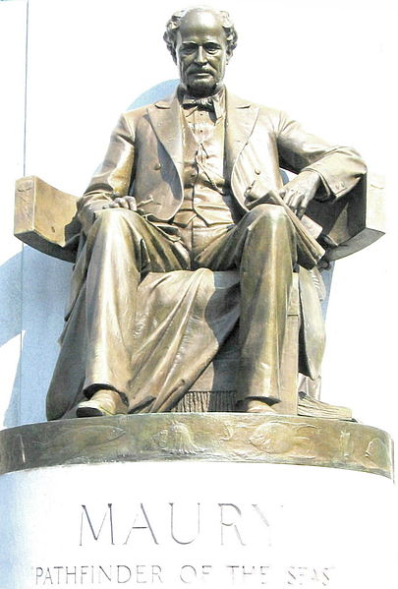
Paths of the Seas
1840-1860 AD: Discovered by Cmdr. (USN, CSN) Matthew F Maury (1806-1873)
Ps. 8: Knew they were there, just needed to find them!
“Pathfinder of the Seas”
Notes:
Paths of the Seas: http://en.wikipedia.org/wiki/Matthew_Fontaine_Maury
Image: Matthew Fontaine Maury "Pathfinder of the Seas" monument on Monument Ave, Richmond, VA. Dedicated November 11, 1929 (Holds in in his right hand Sea-Charts, left hand Maps, and by his left foot a Bible)
Further Memorials: Maury Hall, the home of the Naval Science Department at the University of Virginia and headquarters of the University's Navy ROTC battalion, was named in his honor. The original building of the College of William & Mary Virginia Institute of Marine Science is named Maury Hall as well. Another Maury Hall, named after him, houses the Electrical and Computer Engineering Department and the Systems Engineering Department at the United States Naval Academy in Annapolis, Maryland.
Statue and Monument to him stands on Monument Ave in the intersection with Belmont Avenue in Richmond, VA. He is buried in the President’s Circle at Hollywood Cemetery, Richmond, VA

Slide 45
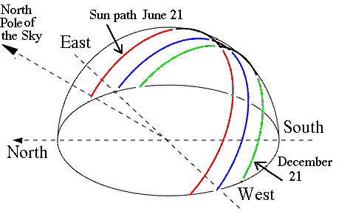
Sun’s Ecliptic Path
Ps. 19:4-6
4. …In them He has placed a tent for the sun,
5. Which is as a bridegroom coming out of his chamber…
6. Its rising is from one end of the heavens, And its circuit to the other end of them; And there is nothing hidden from its heat.
Notes:
Sun’s Ecliptic Path: http://en.wikipedia.org/wiki/Ecliptic; http://en.wikipedia.org/wiki/Ecliptic_coordinate_system; http://earthsky.org/space/what-is-the-ecliptic

Slide 46
Sun’s Ecliptic Path
Scientists once thought the sun was stationary.
The Sun moves through space at approx. 600,000 miles per hour and could take 200 million years to complete one orbit
The ecliptic is the apparent path of the Sun on the celestial sphere, and is the basis for the Ecliptic Coordinate System (not recognized till the 1800’s).
Notes:
Sun’s Ecliptic Path: http://en.wikipedia.org/wiki/Ecliptic; http://en.wikipedia.org/wiki/Ecliptic_coordinate_system; http://earthsky.org/space/what-is-the-ecliptic

Slide 47
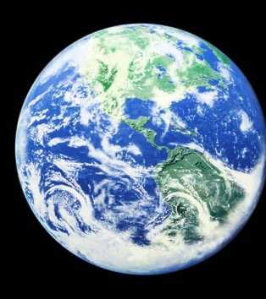
Earth is a Circle
Is. 40:22
22. It is He who sits above the circle of the earth, and its inhabitants are like grasshoppers; Who stretches out the heavens like a curtain, And spreads them like a tent to dwell in.
Notes:
Earth is a Circle: http://en.wikipedia.org/wiki/Ferdinand_Magellan

Slide 48
Earth is a Circle
Is. 40:22 (Written around 700 BC)
1519-1522 AD: Magellan (1480-1521) sailed around the world! (His crew finished the voyage after his death in April 1521)
Notes:
Earth is a Circle: http://en.wikipedia.org/wiki/Ferdinand_Magellan
https://en.wikipedia.org/wiki/Juan_Sebasti%C3%A1n_Elcano

Slide 49
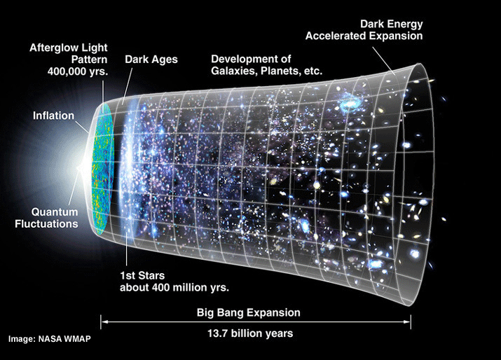
Universe Expansion
Is. 40:22
22. It is He who sits above the circle of the earth, and its inhabitants are like grasshoppers; Who stretches out the heavens like a curtain, And spreads them like a tent to dwell in.
Notes:
Universe Expansion: http://www.bbc.com/news/science-environment-15165371; Nobel physics prize honors accelerating Universe find; BBC News; October 4, 2011; http://en.wikipedia.org/wiki/Accelerating_universe; Image at: http://www.universetoday.com/89449/accelerating-expansion-of-universe-discovery-wins-2011-noble-prize-in-physics/

Slide 50
Universe Expansion
Scientists now know the universe is expanding, or stretching out.
2006 Shaw Prize in Astronomy and the 2011 Nobel Prize in Physics were both awarded to Saul Perlmutter, Brian P. Schmidt, and Adam G. Riess, who in 1998 discovered the accelerating expansion of the Universe.
At least 9 times in Scripture it says God stretches out the heavens!
(Job 26:7; Is. 40:22; 42:5; 44:24; 48:13; 51:13; Jer. 10:12; 51:15; Zech. 12:1)
Notes:
Universe Expansion: http://www.bbc.com/news/science-environment-15165371; Nobel physics prize honors accelerating Universe find; BBC News; October 4, 2011; http://en.wikipedia.org/wiki/Accelerating_universe; Image at: http://www.universetoday.com/89449/accelerating-expansion-of-universe-discovery-wins-2011-noble-prize-in-physics/

Slide 51
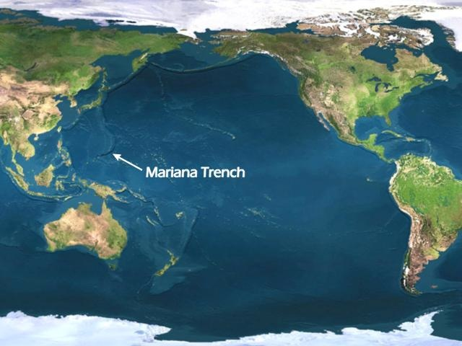
Underwater Mountains
Jonah 2:6
6. "I descended to the roots of the mountains. The earth with its bars was around me forever, But You have brought up my life from the pit, O LORD my God.
Notes:
Underwater Mountains: http://en.wikipedia.org/wiki/Underwater_mountain_range; http://www.marianatrench.com/; http://en.wikipedia.org/wiki/Mariana_Trench

Slide 52
Underwater Mountains
Only in recent years (1950’s) has man discovered that there are mountains on the ocean floor.
The greatest ocean depth has been measured in the Mariana Trench, at around 36,000 feet below sea level. By contrast, Mount Everest is only about 29,000 feet high!
Notes:
Underwater Mountains: http://en.wikipedia.org/wiki/Underwater_mountain_range; http://www.marianatrench.com/; http://en.wikipedia.org/wiki/Mariana_Trench

Slide 53
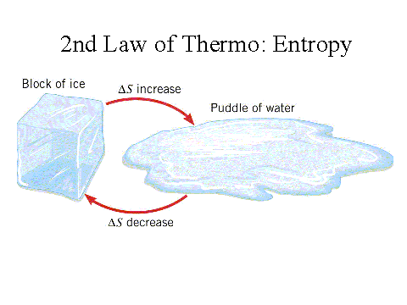
2nd Law of Thermodynamics
Heb. 1:10-11 (NKJ)
10. “You, Lord, in the beginning laid the foundation of the earth, and the heavens are the work of Your hands.
11. They will perish, but You remain; and they will all grow old like a garment
Notes:
2nd Law of Thermodynamics: http://en.wikipedia.org/wiki/Nicolas_L%C3%A9onard_Sadi_Carnot; http://en.wikipedia.org/wiki/Second_law_of_thermodynamics

Slide 54
2nd Law of Thermodynamics
God says the earth is wearing out. (Ps. 102:25-27; Is. 34:4; 51:6)
2nd Law of Thermodynamics (1800’s): “That in all physical processes, every ordered system over time tends to become more disordered.”
Notes:
2nd Law of Thermodynamics: http://en.wikipedia.org/wiki/Nicolas_L%C3%A9onard_Sadi_Carnot; http://en.wikipedia.org/wiki/Second_law_of_thermodynamics

Slide 55
Harmony of Scripture & Science
Harmony of Scriptures & Science
Scientific Fact | Scriptures | Fact Discovered
Water Cycle | Job 36:27-28 | 1882 AD by François-Marie Raoult
Earth’s Axis | Job 38:12,14 | 1851 AD by Leon Foucault
Paths of the Seas | Ps. 8:6-8 | 1840-1860 AD by Matthew F. Maury
Sun’s Ecliptic | Ps. 19:4-6 | 1800's AD
Earth is a Circle | Is. 40:22 | 1519-1522 AD by Magellan and crew
Universe Expansion | Is. 40:22 | 1998 AD by Perlmutter, Schmidt, & Reiss
Underwater Mountains | Jonah 2:6 | 1950's AD
2nd Law of Thermodynamics | Heb. 1:10-11 | 1800's AD (Stated in 1824)
Extra Fun Fact
Radio Waves | Job 38:35 | 1864 AD by James Clerk Maxwell
Notes:
Resources:
Science Increasingly Makes the Case for God, Wall Street Journal Article by Eric Mataxas, 12/25/14: http://www.wsj.com/articles/eric-metaxas-science-increasingly-makes-the-case-for-god-1419544568
http://www.evidencebible.com/witnessingtool/scientificfactsintheBible.shtml
• 5 Terms of the Universe: http://www.spaceandmotion.com/cosmos-space-time-matter-motion.htm
• 1st Law of Thermodynamics: http://en.wikipedia.org/wiki/1st_law_of_thermodynamics
• Female “Seed of Life”: http://www.custance.org/Library/SOTW/Part_II/chapter15.html; http://en.wikipedia.org/wiki/Hermann_Henking
• Life is in the Blood/Bloodletting: http://en.wikipedia.org/wiki/Pierre_Charles_Alexandre_Louis; http://www.pbs.org/wnet/redgold/basics/bloodlettinghistory.html; Childbed Fever: A scientific biography of Ignaz Semmelweis, by Codell K. & Barbara R. Carter, 2005
• Circumcision on 8th Day: http://en.wikipedia.org/wiki/Vitamin_K#History_of_discovery; http://en.wikipedia.org/wiki/Carl_Peter_Henrik_Dam; None of These Diseases by S.I. McMillen, M.D., p. 93, 1984
• Hand-washing in Running Water: http://en.wikipedia.org/wiki/Ignaz_Semmelweis; http://en.wikipedia.org/wiki/Louis_Pasteur
• Suspension of the Earth: http://en.wikipedia.org/wiki/Ptolemaic_System#Ptolemaic_system; http://en.wikipedia.org/wiki/Copernican_system
• Air Has Weight: http://superbeefy.com/who-discovered-air-pressure-and-that-the-atmosphere-has-weight-and-presses-down-on-us/; https://en.wikipedia.org/wiki/Evangelista_Torricelli; http://www.kids-fun-science.com/air-pressure-experiments.html
• Water Cycle: http://en.wikipedia.org/wiki/Raoult%27s_law; http://en.wikipedia.org/wiki/Fran%C3%A7ois-Marie_Raoult ; http://ga.water.usgs.gov/edu/watercycle.html
• Earth’s Axis: http://en.wikipedia.org/wiki/Foucault_Pendulum; http://en.wikipedia.org/wiki/L%C3%A9on_Foucault
• Paths of the Seas: http://en.wikipedia.org/wiki/Matthew_Fontaine_Maury
• Sun’s Ecliptic Path: http://en.wikipedia.org/wiki/Ecliptic; http://en.wikipedia.org/wiki/Ecliptic_coordinate_system; http://earthsky.org/space/what-is-the-ecliptic
• Earth is a Circle: http://en.wikipedia.org/wiki/Ferdinand_Magellan ; https://en.wikipedia.org/wiki/Juan_Sebasti%C3%A1n_Elcano
• Universe Expansion: http://www.bbc.com/news/science-environment-15165371; Nobel physics prize honors accelerating Universe find; BBC News; October 4, 2011; http://en.wikipedia.org/wiki/Accelerating_universe; Image at: http://www.universetoday.com/89449/accelerating-expansion-of-universe-discovery-wins-2011-noble-prize-in-physics/
• Underwater Mountains: http://en.wikipedia.org/wiki/Underwater_mountain_range; http://www.marianatrench.com/; http://en.wikipedia.org/wiki/Mariana_Trench
• 2nd Law of Thermodynamics: http://en.wikipedia.org/wiki/Second_law_of_thermodynamics; http://en.wikipedia.org/wiki/Nicolas_L%C3%A9onard_Sadi_Carnot

Slide 56
Harmony of Scripture & Science
The Scriptures were proven right, often hundreds or more years after it was written, and have been used to
discover or prove certain facts throughout time!

Slide 57
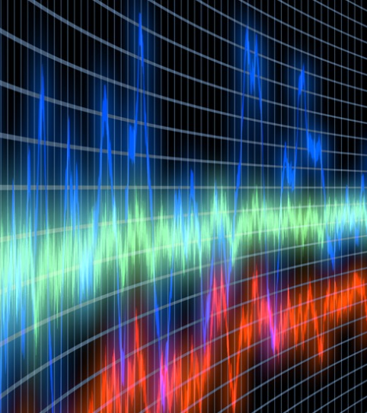
EXTRA FUN FACT: Radio Waves
Job 38:35
35. "Can you send forth lightnings that they may go And say to you, 'Here we are'?
Notes:
Radio Waves: http://en.wikipedia.org/wiki/James_Clerk_Maxwell; Modern Century Illustrated Encyclopedia, Vol. 12

Slide 58
EXTRA FUN FACT: Radio Waves
Not “discovered” until 1864 when Scottish (“British citizenship”) scientist James Clerk Maxwell suggested that electricity and light waves were two forms of the same thing
It was discovered that stars emit radio waves, which are received on earth as a high pitch. Job 38:7: “When the morning stars sang together...”
Notes:
Radio Waves: http://en.wikipedia.org/wiki/James_Clerk_Maxwell; Modern Century Illustrated Encyclopedia, Vol. 12

Slide 59
Conclusion (Part 2)
God’s word does not conflict or contradict science, but coincides in harmony with it (Defines it!)
There is no other book in any of the world’s religions that contain perfectly accurate prophetic and scientific truth
– In fact, they contain statements that are clearly
erroneous and unscientific!

Slide 60
Conclusion
Js. 1:22-25
22. But prove yourselves doers of the word, and not merely hearers who delude themselves.
23. For if anyone is a hearer of the word and not a doer, he is like a man who looks at his natural face in a mirror;
24. for once he has looked at himself and gone away, he has immediately forgotten what kind of person he was.
25. But one who looks intently at the perfect law, the law of liberty, and abides by it, not having become a forgetful hearer but an effectual doer, this man will be blessed in what he does.

Slide 61
Conclusion
The truth is before us, let us not be blinded to it but proclaim it!

Slide 62
Conclusion
Let us strengthen our faith and be the examples of the truth to the dark world around us!

Slide 63
“What Must I Do To Be Saved?”
Hear The Gospel (Jn. 5:24; Rom. 10:17)
Believe In Christ (Jn. 3:16-18; Jn. 8:24)
Repent Of Sins (Lk. 13:35; Acts 2:38)
Confess Christ (Mt. 10:32; Rom. 10:10)
Be Baptized (Mk. 16:16; Acts 22:16)
Remain Faithful (Jn. 8:31; Rev. 2:10)
For The Erring Child:
Repent (Acts 8:22), Confess (I Jn. 1:9), Pray (Acts 8:22)

Slide 64
EXTRA RESOURCE SLIDES

Slide 65
Harmony of Scripture & Science Editable Table 1
Harmony of Scriptures & Science
Scientific Fact | Scriptures | Fact Discovered
5 Terms of the Universe | Gen. 1:1-2 | Over Time – Taught Now
1st Law of Thermodynamics | Gen. 2:1 | 1800's AD (Stated in 1850)
Female “Seed of Life” | Gen. 3:15 | 1890 AD by Hermann Henking
Life is in the Blood | Gen. 9:4 | 1830's AD by Pierre Louis
Circumcision on 8th Day | Gen. 17:12 | 1939 AD by Henrik Dam
Hand-washing in Running Water | Lev. 15:13 | 1845 AD by Ignaz Semmelweis
Suspension of the Earth | Job 26:7 | 1610 AD by Galileo
Air Has Weight | Job 28:25 | 1643 AD by Evangelista Torricelli
Notes:
Resources:
Science Increasingly Makes the Case for God, Wall Street Journal Article by Eric Mataxas, 12/25/14: http://www.wsj.com/articles/eric-metaxas-science-increasingly-makes-the-case-for-god-1419544568
http://www.evidencebible.com/witnessingtool/scientificfactsintheBible.shtml
• 5 Terms of the Universe: http://www.spaceandmotion.com/cosmos-space-time-matter-motion.htm
• 1st Law of Thermodynamics: http://en.wikipedia.org/wiki/1st_law_of_thermodynamics
• Female “Seed of Life”: http://www.custance.org/Library/SOTW/Part_II/chapter15.html; http://en.wikipedia.org/wiki/Hermann_Henking
• Life is in the Blood/Bloodletting: http://en.wikipedia.org/wiki/Pierre_Charles_Alexandre_Louis; http://www.pbs.org/wnet/redgold/basics/bloodlettinghistory.html; Childbed Fever: A scientific biography of Ignaz Semmelweis, by Codell K. & Barbara R. Carter, 2005
• Circumcision on 8th Day: http://en.wikipedia.org/wiki/Vitamin_K#History_of_discovery; http://en.wikipedia.org/wiki/Carl_Peter_Henrik_Dam; None of These Diseases by S.I. McMillen, M.D., p. 93, 1984
• Hand-washing in Running Water: http://en.wikipedia.org/wiki/Ignaz_Semmelweis; http://en.wikipedia.org/wiki/Louis_Pasteur
• Suspension of the Earth: http://en.wikipedia.org/wiki/Ptolemaic_System#Ptolemaic_system; http://en.wikipedia.org/wiki/Copernican_system
• Air Has Weight: http://superbeefy.com/who-discovered-air-pressure-and-that-the-atmosphere-has-weight-and-presses-down-on-us/; https://en.wikipedia.org/wiki/Evangelista_Torricelli; http://www.kids-fun-science.com/air-pressure-experiments.html
• Water Cycle: http://en.wikipedia.org/wiki/Raoult%27s_law; http://en.wikipedia.org/wiki/Fran%C3%A7ois-Marie_Raoult ; http://ga.water.usgs.gov/edu/watercycle.html
• Earth’s Axis: http://en.wikipedia.org/wiki/Foucault_Pendulum; http://en.wikipedia.org/wiki/L%C3%A9on_Foucault
• Paths of the Seas: http://en.wikipedia.org/wiki/Matthew_Fontaine_Maury
• Sun’s Ecliptic Path: http://en.wikipedia.org/wiki/Ecliptic; http://en.wikipedia.org/wiki/Ecliptic_coordinate_system; http://earthsky.org/space/what-is-the-ecliptic
• Earth is a Circle: http://en.wikipedia.org/wiki/Ferdinand_Magellan ; https://en.wikipedia.org/wiki/Juan_Sebasti%C3%A1n_Elcano
• Universe Expansion: http://www.bbc.com/news/science-environment-15165371; Nobel physics prize honors accelerating Universe find; BBC News; October 4, 2011; http://en.wikipedia.org/wiki/Accelerating_universe; Image at: http://www.universetoday.com/89449/accelerating-expansion-of-universe-discovery-wins-2011-noble-prize-in-physics/
• Underwater Mountains: http://en.wikipedia.org/wiki/Underwater_mountain_range; http://www.marianatrench.com/; http://en.wikipedia.org/wiki/Mariana_Trench
• 2nd Law of Thermodynamics: http://en.wikipedia.org/wiki/Second_law_of_thermodynamics; http://en.wikipedia.org/wiki/Nicolas_L%C3%A9onard_Sadi_Carnot

Slide 66
Harmony of Scripture & Science Editable Table 2
Harmony of Scriptures & Science
Scientific Fact | Scriptures | Fact Discovered
Water Cycle | Job 36:27-28 | 1882 AD by François-Marie Raoult
Earth’s Axis | Job 38:12,14 | 1851 AD by Leon Foucault
Paths of the Seas | Ps. 8:6-8 | 1840-1860 AD by Matthew F. Maury
Sun’s Ecliptic | Ps. 19:4-6 | 1800's AD
Earth is a Circle | Is. 40:22 | 1519-1522 AD by Magellan and crew
Universe Expansion | Is. 40:22 | 1998 AD by Perlmutter, Schmidt, & Reiss
Underwater Mountains | Jonah 2:6 | 1950's AD
2nd Law of Thermodynamics | Heb. 1:10-11 | 1800's AD (Stated in 1824)
Extra Fun Fact
Radio Waves | Job 38:35 | 1864 AD by James Clerk Maxwell
Notes:
Resources:
Science Increasingly Makes the Case for God, Wall Street Journal Article by Eric Mataxas, 12/25/14: http://www.wsj.com/articles/eric-metaxas-science-increasingly-makes-the-case-for-god-1419544568
http://www.evidencebible.com/witnessingtool/scientificfactsintheBible.shtml
• 5 Terms of the Universe: http://www.spaceandmotion.com/cosmos-space-time-matter-motion.htm
• 1st Law of Thermodynamics: http://en.wikipedia.org/wiki/1st_law_of_thermodynamics
• Female “Seed of Life”: http://www.custance.org/Library/SOTW/Part_II/chapter15.html; http://en.wikipedia.org/wiki/Hermann_Henking
• Life is in the Blood/Bloodletting: http://en.wikipedia.org/wiki/Pierre_Charles_Alexandre_Louis; http://www.pbs.org/wnet/redgold/basics/bloodlettinghistory.html; Childbed Fever: A scientific biography of Ignaz Semmelweis, by Codell K. & Barbara R. Carter, 2005
• Circumcision on 8th Day: http://en.wikipedia.org/wiki/Vitamin_K#History_of_discovery; http://en.wikipedia.org/wiki/Carl_Peter_Henrik_Dam; None of These Diseases by S.I. McMillen, M.D., p. 93, 1984
• Hand-washing in Running Water: http://en.wikipedia.org/wiki/Ignaz_Semmelweis; http://en.wikipedia.org/wiki/Louis_Pasteur
• Suspension of the Earth: http://en.wikipedia.org/wiki/Ptolemaic_System#Ptolemaic_system; http://en.wikipedia.org/wiki/Copernican_system
• Air Has Weight: http://superbeefy.com/who-discovered-air-pressure-and-that-the-atmosphere-has-weight-and-presses-down-on-us/; https://en.wikipedia.org/wiki/Evangelista_Torricelli; http://www.kids-fun-science.com/air-pressure-experiments.html
• Water Cycle: http://en.wikipedia.org/wiki/Raoult%27s_law; http://en.wikipedia.org/wiki/Fran%C3%A7ois-Marie_Raoult ; http://ga.water.usgs.gov/edu/watercycle.html
• Earth’s Axis: http://en.wikipedia.org/wiki/Foucault_Pendulum; http://en.wikipedia.org/wiki/L%C3%A9on_Foucault
• Paths of the Seas: http://en.wikipedia.org/wiki/Matthew_Fontaine_Maury
• Sun’s Ecliptic Path: http://en.wikipedia.org/wiki/Ecliptic; http://en.wikipedia.org/wiki/Ecliptic_coordinate_system; http://earthsky.org/space/what-is-the-ecliptic
• Earth is a Circle: http://en.wikipedia.org/wiki/Ferdinand_Magellan ; https://en.wikipedia.org/wiki/Juan_Sebasti%C3%A1n_Elcano
• Universe Expansion: http://www.bbc.com/news/science-environment-15165371; Nobel physics prize honors accelerating Universe find; BBC News; October 4, 2011; http://en.wikipedia.org/wiki/Accelerating_universe; Image at: http://www.universetoday.com/89449/accelerating-expansion-of-universe-discovery-wins-2011-noble-prize-in-physics/
• Underwater Mountains: http://en.wikipedia.org/wiki/Underwater_mountain_range; http://www.marianatrench.com/; http://en.wikipedia.org/wiki/Mariana_Trench
• 2nd Law of Thermodynamics: http://en.wikipedia.org/wiki/Second_law_of_thermodynamics; http://en.wikipedia.org/wiki/Nicolas_L%C3%A9onard_Sadi_Carnot

Slide 67
Harmony of Scriptures & Science Editable Table
5 Terms of the Universe – Gen. 1:1-2 | Water Cycle – Job 36:27-28
1st Law of Thermodynamics – Gen. 2:1 | Earth’s Axis – Job 38:12, 14
Female “Seed of Life” – Gen. 3:15 | Paths of the Seas – Ps. 8:6-8
Life is in the Blood – Gen. 9:4 | Sun’s Ecliptic – Ps. 19:4-6
Circumcision on 8th Day – Gen. 17:12 | Earth is a Circle – Is. 40:22
Hand-washing in Running Water – Lev. 15:13 | Universe Expansion – Is. 40:22
Suspension of the Earth – Job 26:7 | Underwater Mountains – Jonah 2:6
Air Has Weight – Job 28:25 | 2nd Law of Thermodynamics – Heb. 1:10-11
Notes:
Resources:
Science Increasingly Makes the Case for God, Wall Street Journal Article by Eric Mataxas, 12/25/14: http://www.wsj.com/articles/eric-metaxas-science-increasingly-makes-the-case-for-god-1419544568
http://www.evidencebible.com/witnessingtool/scientificfactsintheBible.shtml
• 5 Terms of the Universe: http://www.spaceandmotion.com/cosmos-space-time-matter-motion.htm
• 1st Law of Thermodynamics: http://en.wikipedia.org/wiki/1st_law_of_thermodynamics
• Female “Seed of Life”: http://www.custance.org/Library/SOTW/Part_II/chapter15.html; http://en.wikipedia.org/wiki/Hermann_Henking
• Life is in the Blood/Bloodletting: http://en.wikipedia.org/wiki/Pierre_Charles_Alexandre_Louis; http://www.pbs.org/wnet/redgold/basics/bloodlettinghistory.html; Childbed Fever: A scientific biography of Ignaz Semmelweis, by Codell K. & Barbara R. Carter, 2005
• Circumcision on 8th Day: http://en.wikipedia.org/wiki/Vitamin_K#History_of_discovery; http://en.wikipedia.org/wiki/Carl_Peter_Henrik_Dam; None of These Diseases by S.I. McMillen, M.D., p. 93, 1984
• Hand-washing in Running Water: http://en.wikipedia.org/wiki/Ignaz_Semmelweis; http://en.wikipedia.org/wiki/Louis_Pasteur
• Suspension of the Earth: http://en.wikipedia.org/wiki/Ptolemaic_System#Ptolemaic_system; http://en.wikipedia.org/wiki/Copernican_system
• Air Has Weight: http://superbeefy.com/who-discovered-air-pressure-and-that-the-atmosphere-has-weight-and-presses-down-on-us/; https://en.wikipedia.org/wiki/Evangelista_Torricelli; http://www.kids-fun-science.com/air-pressure-experiments.html
• Water Cycle: http://en.wikipedia.org/wiki/Raoult%27s_law; http://en.wikipedia.org/wiki/Fran%C3%A7ois-Marie_Raoult ; http://ga.water.usgs.gov/edu/watercycle.html
• Earth’s Axis: http://en.wikipedia.org/wiki/Foucault_Pendulum; http://en.wikipedia.org/wiki/L%C3%A9on_Foucault
• Paths of the Seas: http://en.wikipedia.org/wiki/Matthew_Fontaine_Maury
• Sun’s Ecliptic Path: http://en.wikipedia.org/wiki/Ecliptic; http://en.wikipedia.org/wiki/Ecliptic_coordinate_system; http://earthsky.org/space/what-is-the-ecliptic
• Earth is a Circle: http://en.wikipedia.org/wiki/Ferdinand_Magellan ; https://en.wikipedia.org/wiki/Juan_Sebasti%C3%A1n_Elcano
• Universe Expansion: http://www.bbc.com/news/science-environment-15165371; Nobel physics prize honors accelerating Universe find; BBC News; October 4, 2011; http://en.wikipedia.org/wiki/Accelerating_universe; Image at: http://www.universetoday.com/89449/accelerating-expansion-of-universe-discovery-wins-2011-noble-prize-in-physics/
• Underwater Mountains: http://en.wikipedia.org/wiki/Underwater_mountain_range; http://www.marianatrench.com/; http://en.wikipedia.org/wiki/Mariana_Trench
• 2nd Law of Thermodynamics: http://en.wikipedia.org/wiki/Second_law_of_thermodynamics; http://en.wikipedia.org/wiki/Nicolas_L%C3%A9onard_Sadi_Carnot

Slide 68
Harmony of Scripture & Science Pic
Notes:
Resources:
Science Increasingly Makes the Case for God, Wall Street Journal Article by Eric Mataxas, 12/25/14: http://www.wsj.com/articles/eric-metaxas-science-increasingly-makes-the-case-for-god-1419544568
http://www.evidencebible.com/witnessingtool/scientificfactsintheBible.shtml
• 5 Terms of the Universe: http://www.spaceandmotion.com/cosmos-space-time-matter-motion.htm
• 1st Law of Thermodynamics: http://en.wikipedia.org/wiki/1st_law_of_thermodynamics
• Female “Seed of Life”: http://www.custance.org/Library/SOTW/Part_II/chapter15.html; http://en.wikipedia.org/wiki/Hermann_Henking
• Life is in the Blood/Bloodletting: http://en.wikipedia.org/wiki/Pierre_Charles_Alexandre_Louis; http://www.pbs.org/wnet/redgold/basics/bloodlettinghistory.html; Childbed Fever: A scientific biography of Ignaz Semmelweis, by Codell K. & Barbara R. Carter, 2005
• Circumcision on 8th Day: http://en.wikipedia.org/wiki/Vitamin_K#History_of_discovery; http://en.wikipedia.org/wiki/Carl_Peter_Henrik_Dam; None of These Diseases by S.I. McMillen, M.D., p. 93, 1984
• Hand-washing in Running Water: http://en.wikipedia.org/wiki/Ignaz_Semmelweis; http://en.wikipedia.org/wiki/Louis_Pasteur
• Suspension of the Earth: http://en.wikipedia.org/wiki/Ptolemaic_System#Ptolemaic_system; http://en.wikipedia.org/wiki/Copernican_system
• Air Has Weight: http://superbeefy.com/who-discovered-air-pressure-and-that-the-atmosphere-has-weight-and-presses-down-on-us/; https://en.wikipedia.org/wiki/Evangelista_Torricelli; http://www.kids-fun-science.com/air-pressure-experiments.html
• Water Cycle: http://en.wikipedia.org/wiki/Raoult%27s_law; http://en.wikipedia.org/wiki/Fran%C3%A7ois-Marie_Raoult ; http://ga.water.usgs.gov/edu/watercycle.html
• Earth’s Axis: http://en.wikipedia.org/wiki/Foucault_Pendulum; http://en.wikipedia.org/wiki/L%C3%A9on_Foucault
• Paths of the Seas: http://en.wikipedia.org/wiki/Matthew_Fontaine_Maury
• Sun’s Ecliptic Path: http://en.wikipedia.org/wiki/Ecliptic; http://en.wikipedia.org/wiki/Ecliptic_coordinate_system; http://earthsky.org/space/what-is-the-ecliptic
• Earth is a Circle: http://en.wikipedia.org/wiki/Ferdinand_Magellan ; https://en.wikipedia.org/wiki/Juan_Sebasti%C3%A1n_Elcano
• Universe Expansion: http://www.bbc.com/news/science-environment-15165371; Nobel physics prize honors accelerating Universe find; BBC News; October 4, 2011; http://en.wikipedia.org/wiki/Accelerating_universe; Image at: http://www.universetoday.com/89449/accelerating-expansion-of-universe-discovery-wins-2011-noble-prize-in-physics/
• Underwater Mountains: http://en.wikipedia.org/wiki/Underwater_mountain_range; http://www.marianatrench.com/; http://en.wikipedia.org/wiki/Mariana_Trench
• 2nd Law of Thermodynamics: http://en.wikipedia.org/wiki/Second_law_of_thermodynamics; http://en.wikipedia.org/wiki/Nicolas_L%C3%A9onard_Sadi_Carnot

