Slide 1
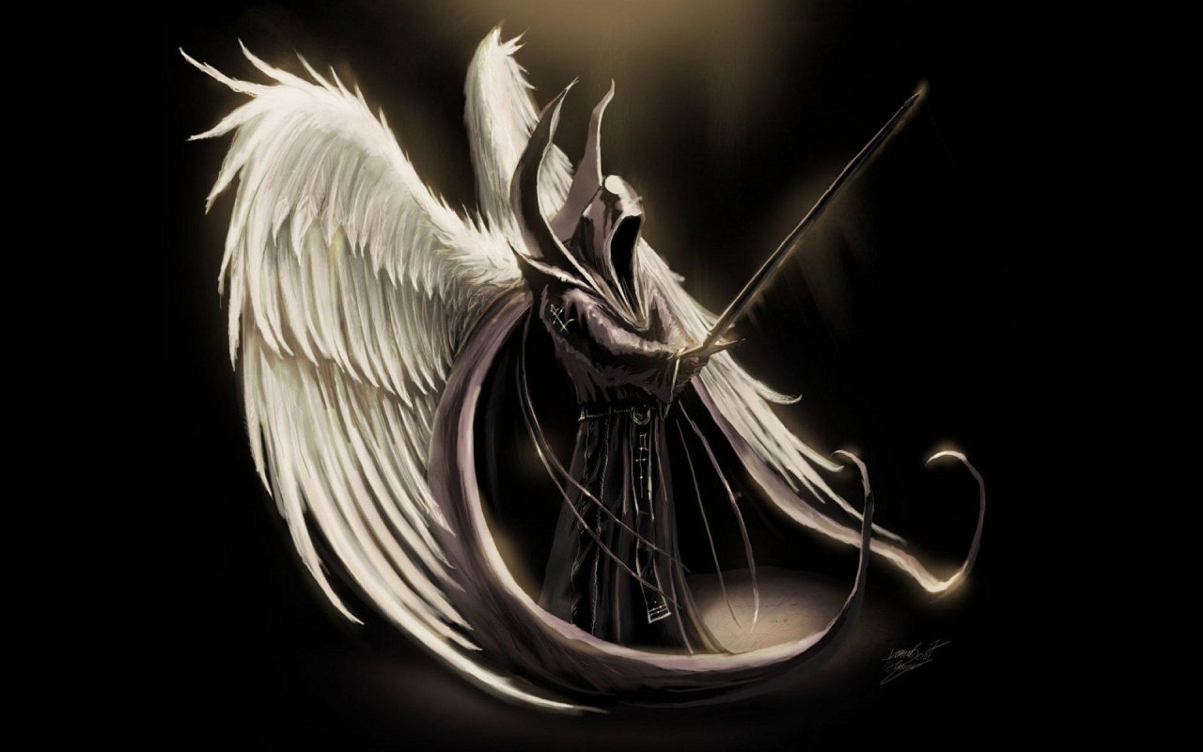
Angels: Definitions & Characteristics (Parts 1-2)
Text: Hebrews 1:13-14
Notes:
By Nathan L Morrison
All Scripture given is from NASB unless otherwise stated
For further study, or if questions, please Call: 804-277-1983 or Visit: www.courthousechurchofchrist.com
Based on a lesson by Baxter Exum

Slide 2
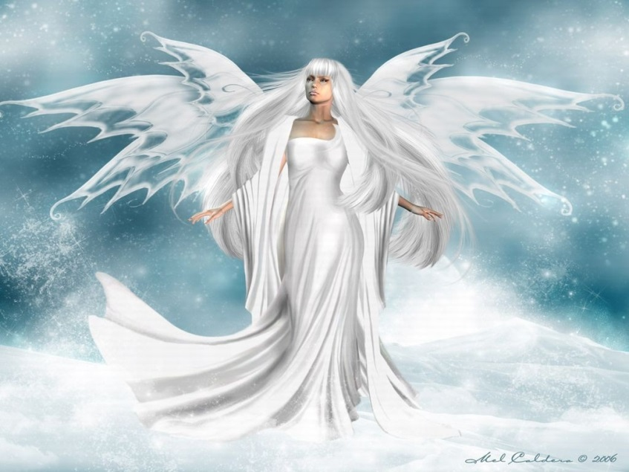
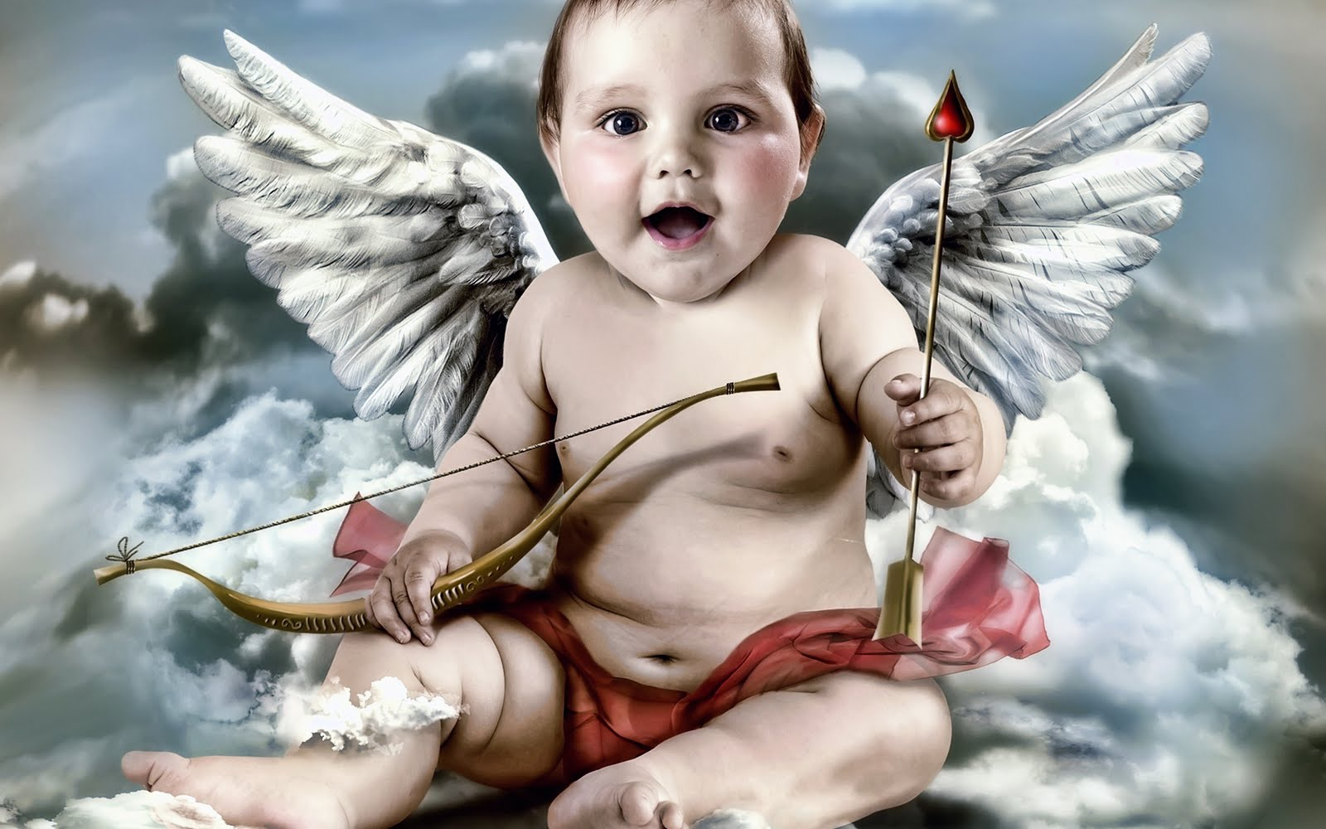
Intro (Part 1)
The world has been fascinated with angels for
Centuries and there are vast differences in the way they are depicted
What do you normally picture in your mind when you think of an angel?

Slide 3
Intro (Part 1)
The Scriptures reveal that angels are never
pictured as being women!
(In human form: masculine names, tenses)
In God’s word it is rare to read of any
angels with wings
The Scriptures reveal that angels are never pictured as being chubby little babies!
Let’s discuss angels, their definition and
their characteristics as defined by the
Scriptures, not by man’s ideas!
Notes:
Angel Museum: http://www.angelmuseum.org/

Slide 4
Angels: Definition
Angels are mentioned 108 times in O.T. &
186 in N.T.
Despite appearing hundreds of times in the
Scriptures, Angels are never the main point!
What does “Angel” mean?
H4397 mal'âk [mal-awk’]: Deputy; a messenger; specifically of God, that is, an angel (also a prophet, priest or teacher): - ambassador, angel, king, messenger.
G32 aggelos [ang'-el-os]: A messenger; especially an “angel”; by implication a preacher: - angel, messenger.

Slide 5
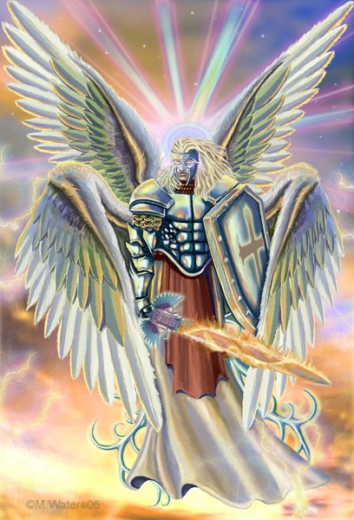
Angels: Definition
Three ways this term is normally used:
Authority to speak for God – “The angel of the Lord”
Gen. 16:7-13
Gen. 18
Exodus 3
Judges 6
Heb. 2:2

Slide 6
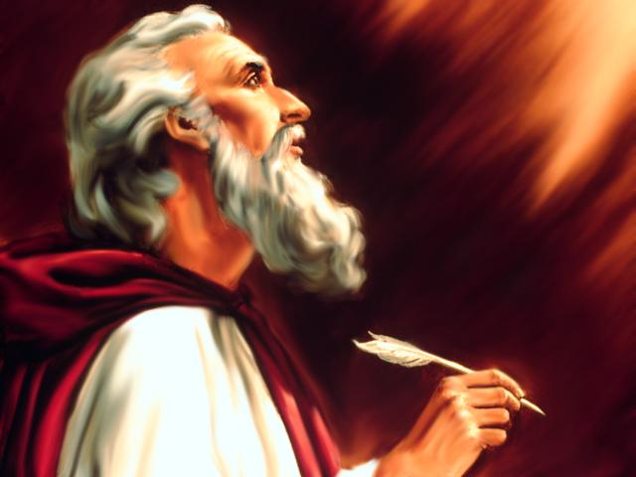
Angels: Definition
Three ways this term is normally used:
Authority to speak for God (Gen. 16; 18; Ex. 3; Jud. 6)
The term also refers to various human messengers
Is. 42:19
Haggai 1:13
Mal. 2:7
Rev. 2-3?

Slide 7
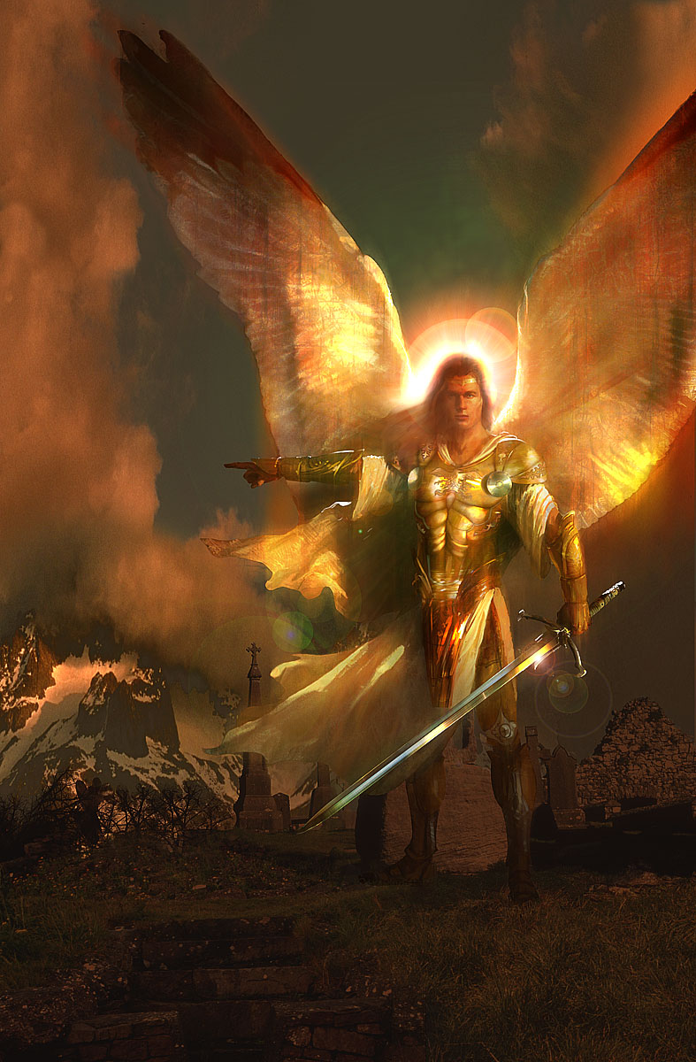
Angels: Definition
Three ways this term is normally used:
Authority to speak for God (Gen. 16; 18; Ex. 3; Jud. 6)
Also used to refer to various human messengers (Mal. 2:7; Is. 42:19; Haggai 1:13)
References to “spiritual beings”
Heb. 1:13-14
Gen. 19; 22
Acts 27
Gabriel
(Dan. 8:16; 9:21; Luke 1:19, 26)
Michael the archangel
(Dan. 10:13, 21; 12:1; Jude 9;
Rev. 12:7)

Slide 8
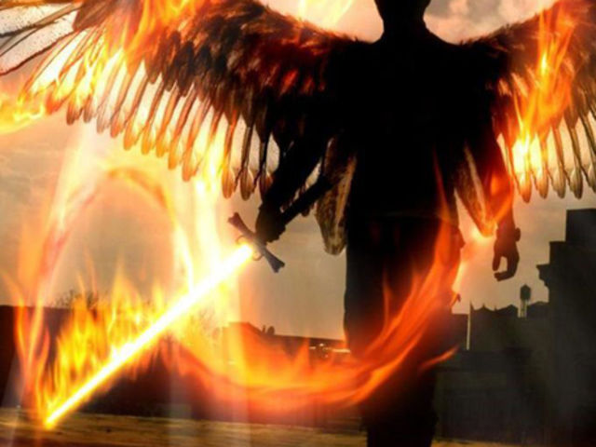
Angels: Definition
There are hundreds of other
examples, but the main point:
The word “angel” refers to a “messenger of God”
Angels, whether sent from God to deliver a message, whether human or supernatural, they serve a purpose of revealing God’s will to mankind!

Slide 9
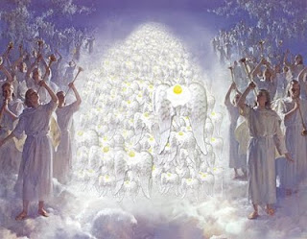
Conclusion (Part 1)
There is something else we know about angels:
Jesus said, “…there is joy in the presence of the angels of God over one sinner who repents” (Lk. 15:7, 10).
God tells us through His word that we must
repent and be baptized for the forgiveness of our sins! (Mk. 16:16; Acts 2:38; 22:16)
You can cause
the angels to rejoice
by obeying the gospel,
or repenting of your
sins today!

Slide 10
“What Must I Do To Be Saved?”
Hear The Gospel (Jn. 5:24; Rom. 10:17)
Believe In Christ (Jn. 3:16-18; Jn. 8:24)
Repent Of Sins (Lk. 13:35; Acts 2:38)
Confess Christ (Mt. 10:32; Rom. 10:10)
Be Baptized (Mk. 16:16; Acts 22:16)
Remain Faithful (Jn. 8:31; Rev. 2:10)
For The Erring Child:
Repent (Acts 8:22), Confess (I Jn. 1:9),
Pray (Acts 8:22)

Slide 12
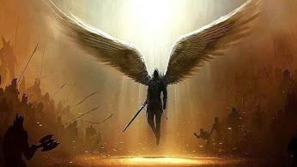
Angels: Definitions & Characteristics (Parts 1-2)
Text: Hebrews 1:13-14
Notes:
By Nathan L Morrison
All Scripture given is from NASB unless otherwise stated
For further study, or if questions, please Call: 804-277-1983 or Visit: www.courthousechurchofcrist.com
Based on a lesson by Baxter Exum

Slide 13
Intro (Part 2)
The world has been fascinated with angels for centuries and there are vast differences in the way they are depicted (World sees beautiful women, winged beings, and chubby babies for most part, while Scriptures depict them as usually appearing as men, and rarely with wings)

Slide 14
Intro (Part 2)
What an angel is: A Messenger!
H4397 mal'âk [mal-awk’]: Deputy; a messenger; specifically of God, that is, an angel (also a prophet, priest or teacher): - ambassador, angel, king, messenger.
G32 aggelos [ang'-el-os]: A messenger; especially an “angel”; by implication a preacher: - angel, messenger.
We looked at their definition so now let’s
look at their characteristics as defined by
the Scriptures!

Slide 15
Angels: Characteristics
What do we know about
them?
1st: Angels are CREATED BEINGS
Gen. 3:24
Job 38:4-7
Col. 1:16 (Jn. 1:1-3)
Rev. 4:11
Ps. 148:1-2, 5 (Is. 6:2-3; Rev. 5:11-14)
1. Praise the LORD! Praise the LORD from the heavens; Praise Him in the heights!
2. Praise Him, all His angels; Praise Him, all His hosts!
5. Let them praise the name of the LORD, For He commanded and they were created.
We learn that the angels are created beings and praise God!

Slide 16
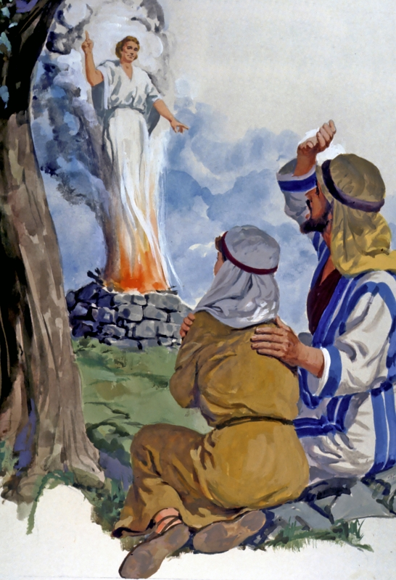
Angels: Characteristics
What do we know about them?
2nd: Angels are SPIRITUAL BEINGS
Heb. 1:13-14
Gen. 18 & 19 (Heb. 13:2)
Mk. 16:5; Lk. 24:4-5; Jn. 20:12
Mt. 28:2-4
Jud. 13:3, 6, 8-9, 16-21
Heb. 1:14 (Context of angels goes back to v.4)
14. Are they not all ministering spirits, sent out to render service for the sake of those who will inherit salvation?
Angels are not of the physical realm,
but are spiritual beings!

Slide 17
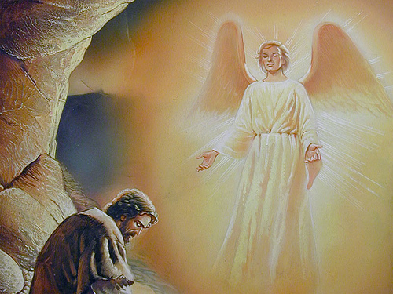
Angels: Characteristics
What do we know about them?
3rd: Angels have some kind of HIERARCHY
Rev. 12:7; Jude 9; Dan. 12:1
Lk. 1:19, 26; Dan. 8:16; 9:21
Ps. 80:1; Ezek. 1:5-11; 10:19
Is. 6:2-3, 6-7
Jude 9
9. But Michael the archangel, when he disputed with the devil and argued about the body of Moses, did not dare pronounce against him a railing judgment, but said, "The Lord rebuke you!"
There are different kinds of angels or ranks of angels!

Slide 18
Angels: Characteristics
What do we know about them?
4th: Angels are NOT DEAD PEOPLE
Lk. 16:19-31
We do not become angels when we die!
(I Jn. 3:2)
I John 3:2
2. Beloved, now we are children of God, and it has not appeared as yet what we will be. We know that when He appears, we will be like Him, because we will see Him just as He is.

Slide 19
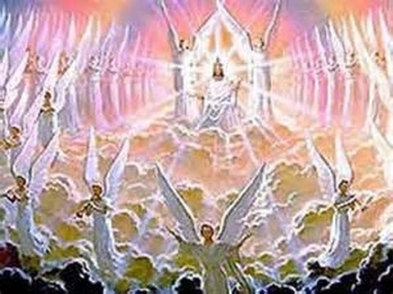
Angels: Characteristics
What do we know about them?
5th: Angels’ numbers – THERE ARE MANY OF THEM
Heb. 12:22
Deut. 33:2
Ps. 68:17
Dan. 7:10
Rev. 5:11
Heb. 12:22
22. But you have come to Mount Zion and to the city of the living God, the heavenly Jerusalem, and to myriads of angels,
Like the stars of heaven, they cannot be numbered!

Slide 20
Angels: Characteristics
What do we know about them?
6th: Angels can SIN & WILL BE JUDGED
II Pet. 2:4; Jude 6
Mt. 25:41
Jude 6
6. And angels who did not keep their own domain, but abandoned their proper abode, He has kept in eternal bonds under darkness for the judgment of the great day,
Angels that rebelled and sinned will be judged and punished!

Slide 21
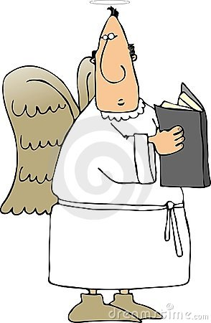
Angels: Characteristics
What do we know about them?
7th: Angels are LIMITED IN THEIR KNOWLEDGE
Mt. 24:36-39
I Peter 1:10-12
I Peter 1:12
12. It was revealed to them that they were not serving themselves, but you, in these things which now have been announced to you through those who preached the gospel to you by the Holy Spirit sent from heaven--things into which angels long to look.
Angels are limited in their knowledge!

Slide 22
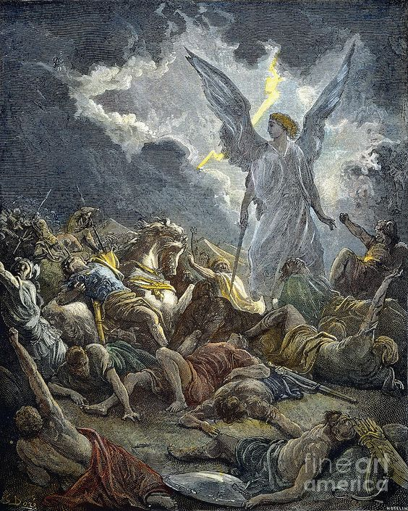
Angels: Characteristics
What do we know about them?
8th: Angels are incredibly POWERFUL
Gen. 19:11
I Chr. 21:15-16
II Kings 19:35 (Mt. 26:53)
Acts 12:6-10
Acts 12:23
II Kings 19:35
35. Then it happened that night that the angel of the LORD went out and struck 185,000 in the camp of the Assyrians; and when men rose early in the morning, behold, all of them were dead.
Angels have some amazing power and abilities!

Slide 23
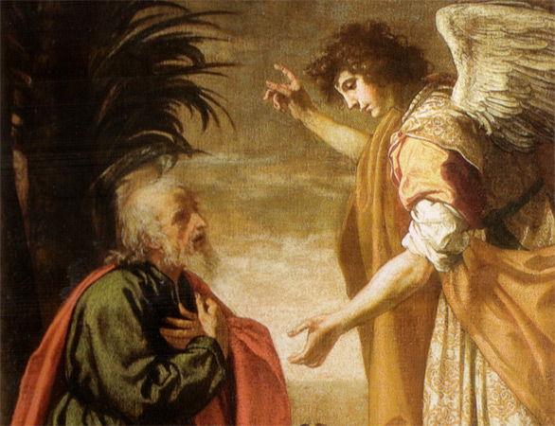
Angels: Characteristics
What do we know about them?
9th: Angels are NOT TO BE WORSHIPED
Col. 2:18 (Josh. 5: Not an angel!)
Rev. 19:10; 22:8-9
Col. 2:18
18. Let no one keep defrauding you of your prize by delighting in self-abasement and the worship of the angels, taking his stand on visions he has seen, inflated without cause by his fleshly mind,
Angels, as mighty and amazing as they are, are not to be worshiped!

Slide 24
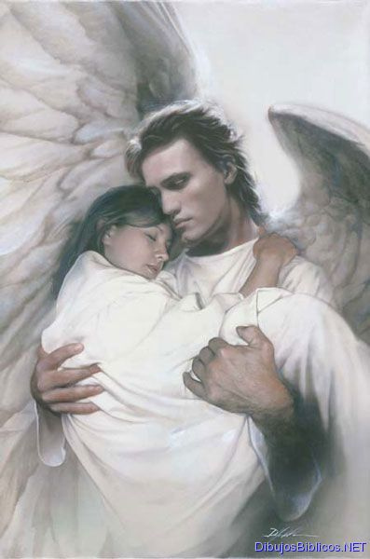
Angels: Characteristics
What do we know about them?
10th: Angels will CARRY AWAY THE FAITHFUL TO HADES
Luke 16:22
Luke 16:22
22. "Now the poor man died and was carried away by the angels to Abraham's bosom; and the rich man also died and was buried.
Angels, according to Jesus, carry away the souls of the righteous!

Slide 25
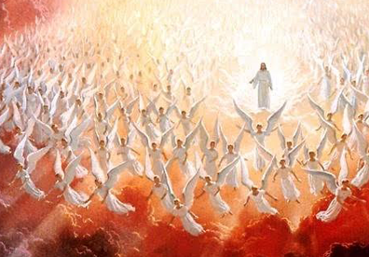
Angels: Characteristics
What do we know about them?
11th: Angels will be AGENTS OF JUDGMENT WITH CHRIST
Gen. 19:11-13, 21-25 (Ps. 78:43-51)
I Chr. 21:11-16
II Thess. 1:7-9
Mt. 13:36-43
Mt. 13:47-51
II Thess. 1:7-8
7. and to give relief to you who are afflicted and to us as well when the Lord Jesus will be revealed from heaven with His mighty angels in flaming fire,
8. dealing out retribution...
Angels carry out God’s will, whether by message or by judgment!

Slide 26
Angels: Characteristics
What do we know about them?
1st: CREATED
2ND: SPIRITUAL
3RD: HIERARCHY
4TH: NOT DEAD PEOPLE
5TH: MANY OF THEM
6TH: CAN SIN & BE JUDGED
7TH: LIMITED KNOWLEDGE
8TH: POWERFUL
9th: NOT TO BE WORSHIPED
10TH: CARRY AWAY FAITHFUL
11TH: AGENTS OF JUDGMENT WITH CHRIST
Angels are “messengers” of God and are amazing in how they carry out God’s commands, and yet, with all their powers, they are not to be worshiped!

Slide 27
Conclusion (Part 2)
Angels long to look into the affairs of men
concerning prophecy (I Pet.1:10-12) but also
rejoice over the sinner who repents (Lk. 15:7, 10)
God, in His word, tells us how to cause such rejoicing in Heaven: one must repent and be baptized for the forgiveness of sins!
(Mk. 16:16; Acts 2:38; 22:16)
Today you can cause
the angels to rejoice in Heaven by obeying the gospel, or by repenting of your sins!

Slide 28
“What Must I Do To Be Saved?”
Hear The Gospel (Jn. 5:24; Rom. 10:17)
Believe In Christ (Jn. 3:16-18; Jn. 8:24)
Repent Of Sins (Lk. 13:35; Acts 2:38)
Confess Christ (Mt. 10:32; Rom. 10:10)
Be Baptized (Mk. 16:16; Acts 22:16)
Remain Faithful (Jn. 8:31; Rev. 2:10)
For The Erring Child:
Repent (Acts 8:22), Confess (I Jn. 1:9),
Pray (Acts 8:22)

