Slide 2
Guardians of the Truth
Romans 2:13
Richie Thetford www.thetfordcountry.com

Slide 3
Introduction
Guardians of the Truth
People of Ephesus
Acts 19:35
Jews
Romans 3:1-2
Deuteronomy 4:5-8
Romans 9:4-5
Romans 2:17-24
“The essence of knowledge is, having it, to use it”
--- Confucius
Richie Thetford www.thetfordcountry.com

Slide 4
Guardians of God’s Truth is What We Are
Guardians of the Truth
“Entrusted” with God’s Word
2 Timothy 2:2
Handle accurately the saving truth
1 Timothy 3:15
Titus 2:10
2 Timothy 2:15
Maintain a genuine respect for the truth
Richie Thetford www.thetfordcountry.com

Slide 5
We Are Not Guardians of the Truth Only
Guardians of the Truth
Don’t be filled with pride
Romans 2:17-20
We must DO the truth
Matthew 23:1-4; James 1:22-27
James 2:14-26; James 4:17
Matthew 7:21-23; Matthew 21:28-32
Must USE the Truth
Ephesians 6:17
Richie Thetford www.thetfordcountry.com

Slide 6
We Are Not Guardians of the Truth Only
Guardians of the Truth
Don’t keep the truth to ourselves
Psalms 40:9-10
1 Thessalonians 1:8
Take the truth to others
Luke 15:4-7
Luke 19:10
Richie Thetford www.thetfordcountry.com

Slide 7
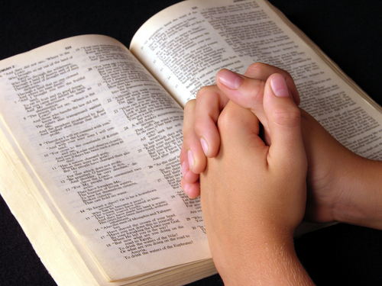
Accept the Responsibilities in What We Know
Guardians of the Truth
The more we know, the more responsibility we have as a result of it
Luke 12:47-48
Richie Thetford www.thetfordcountry.com

Slide 8
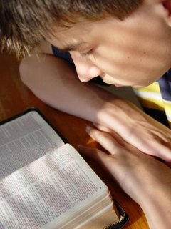
Accept the Responsibilities in What We Know
Guardians of the Truth
Putting it to the test:
Benevolent work
Galatians 6:10
Matthew 25:31-46
Morality
1 Thessalonians 5:14
Richie Thetford www.thetfordcountry.com

Slide 9
Accept the Responsibilities in What We Know
Guardians of the Truth
Putting it to the test:
Worship
1 Samuel 15:22-23
Salvation
Acts 20:20
Acts 20:26-27
Must do what we should as a result of possessing the TRUTH
Romans 2:13, 25-29
Richie Thetford www.thetfordcountry.com

Slide 10
Conclusion
Guardians of the Truth
A blessedness in doing the Lord’s will
James 1:25
Wise if we “DO”
Luke 6:46-49
God revealed everything to us
Deuteronomy 29:29
Richie Thetford www.thetfordcountry.com

Slide 11
Guardians of the Truth
“For Ezra had prepared his heart to seek the Law of the LORD, and to do it, and to teach statutes and ordinances in Israel” Ezra 7:10
Strive to be TRUE
Your talk talks, and your walk talks, but your walk talks more than your talk talks
Richie Thetford www.thetfordcountry.com

