Slide 2
To Live Is Christ To Die Is GAIN!
Are You Afraid to Die?
Richie Thetford www.thetfordcountry.com

Slide 3
What Did the Apostle Paul See?
His Account
2 Corinthians 12:1-6
Event occurred 14 years earlier (42-43 A.D.)
Richie Thetford www.thetfordcountry.com

Slide 4
Paul’s Passionate Words
His love for Christ
Philippians 1:19-26
This should be our attitude
Knowing that paradise and being with Jesus awaits us!
Richie Thetford www.thetfordcountry.com

Slide 5
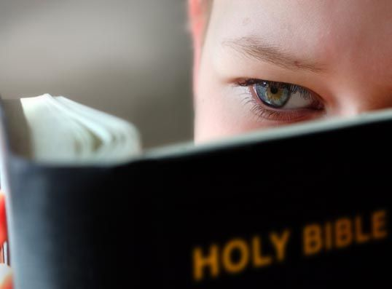
Paul’s Passionate Words
For me to live is Christ, to die is gain (v.21)
Galatians 6:14
Colossians 3:4
Romans 8:35-39
2 Corinthians 5:1, 6-8
Revelation 14:13
Richie Thetford www.thetfordcountry.com

Slide 6
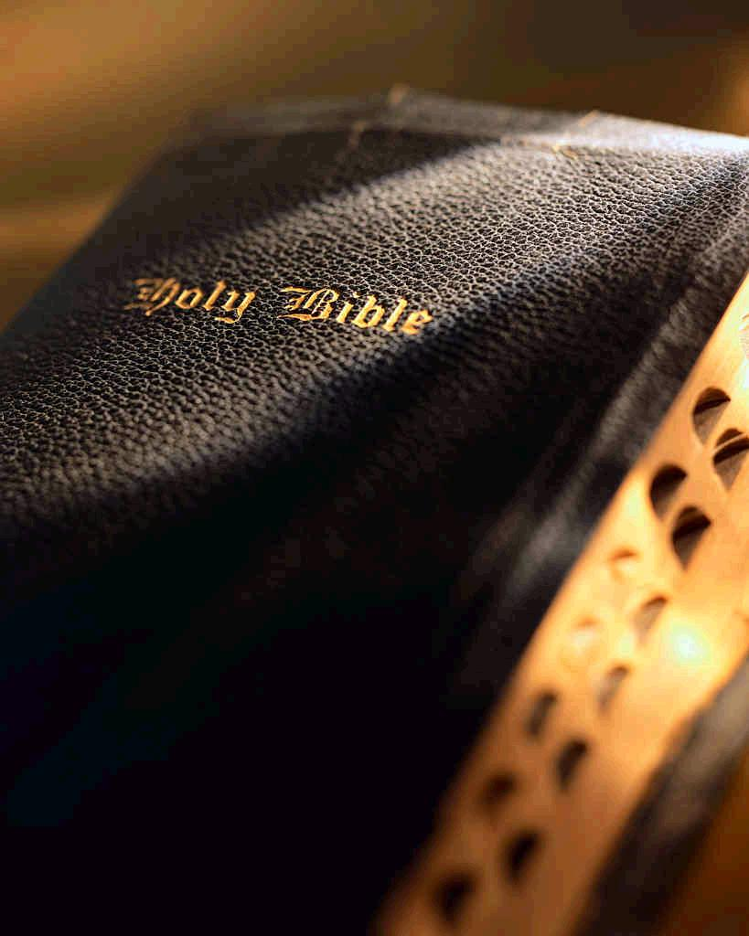
Paul’s Passionate Words
But if I live on in the flesh (v.22)
I am hard-pressed between the two (v.23)
Having a desire to depart and be with Christ – which is FAR BETTER
Luke 2:29-30
John 17:24
Richie Thetford www.thetfordcountry.com

Slide 7
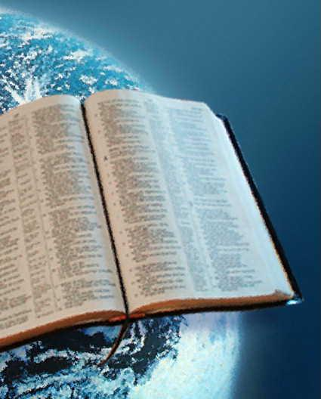
Paul’s Passionate Words
Nevertheless to remain in the flesh is more needful for you (v.24)
Acts 20:29-31
And being confident of this, I know that I shall remain (v.25)
Acts 11:23; 14:22
2 Corinthians 1:24
Richie Thetford www.thetfordcountry.com

Slide 8
Paul’s Passionate Words
That your rejoicing for me may be more abundant (v.26)
Romans 5:1-2
1 Peter 1:8
Richie Thetford www.thetfordcountry.com

Slide 9
Jesus’ Promise
“Let not your heart be troubled; you believe in God, believe also in Me. In My Father’s house are many mansions; if it were not so, I would have told you. I go to prepare a place for you. And if I go and prepare a place for you, I will come again and receive you to Myself; that where I am, there you may be also. And where I go you know, and the way you know.” Thomas said to Him, “Lord, we do not know where You are going, and how can we know the way?” Jesus said to him, “I am the way, the truth, and the life. No one comes to the Father except through Me.” John 14:1-6
Richie Thetford www.thetfordcountry.com

Slide 10
Living Our Lives with Paul’s Confidence!
“For I am already being poured out as a drink offering, and the time of my departure is at hand. I have fought the good fight, I have finished the race, I have kept the faith. Finally, there is laid up for me the crown of righteousness, which the Lord, the righteous Judge, will give to me on that Day, and not to me only but also to all who have loved His appearing.
2 Timothy 4:6-8
Richie Thetford www.thetfordcountry.com

Slide 11
To Live Is Christ To Die Is GAIN!
Richie Thetford www.thetfordcountry.com

