Slide 2
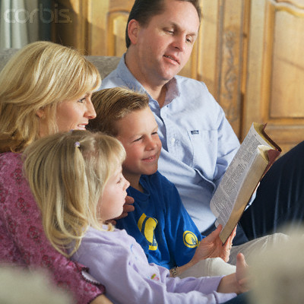
Spirituality Exemplified in Christian Life
“you also, as living stones, are being built up a spiritual house, a holy priesthood, to offer up spiritual sacrifices acceptable to God through Jesus Christ.” 1 Peter 2:5
Richie Thetford www.thetfordcountry.com

Slide 3
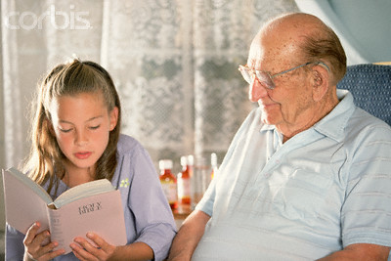
What is Spirituality?
Defined:
“sensitivity or commitment to religious values and sacred matters” (Nelson’s Bible Dictionary)
“the state of a soul vitalized by the Divine Spirit and made alive unto God. It covers the entire range of man’s faculties: intellect, feeling, will – all the attributes of personality” (International Standard Bible Encyclopedia)
Richie Thetford www.thetfordcountry.com

Slide 4
What is Spirituality?
A person that is marked by stability and maturity in living by God’s Spirit
Spiritually minded (Galatians 6:1)
Carnal minded (1 Corinthians 3:1-4)
Richie Thetford www.thetfordcountry.com

Slide 5
Vines Expository Dictionary of New Testament Words:
“The spiritual state is reached by diligence in the Word of God and in prayer; it is maintained by obedience and self-judgment. Such as are led by the Spirit are spiritual, but, of course, spirituality is not a fixed or absolute condition, it admits of growth; indeed growth in ‘the grace and knowledge of our Lord and Savior Jesus Christ,’ (2 Peter 3:18), is evidence of true spirituality.”
Richie Thetford www.thetfordcountry.com

Slide 6
What is Spirituality?
Growing Process
Begins with one’s “new birth” John 3:6; 4:24
Driving Force of Maturing Christians
Romans 8:2-11
Maturing as a Christian means becoming more spiritual – more directed by God’s Spirit and more focused on the spiritual things of life instead of the physical things.
Richie Thetford www.thetfordcountry.com

Slide 7
Ramifications of Spirituality
3
Takes Time to Achieve
1 Timothy 4:15
Must Yield Our Wills to the Holy Spirit
Hebrews 5:12-14
Various Stages of spirituality
We must continue to grow
Richie Thetford www.thetfordcountry.com

Slide 8
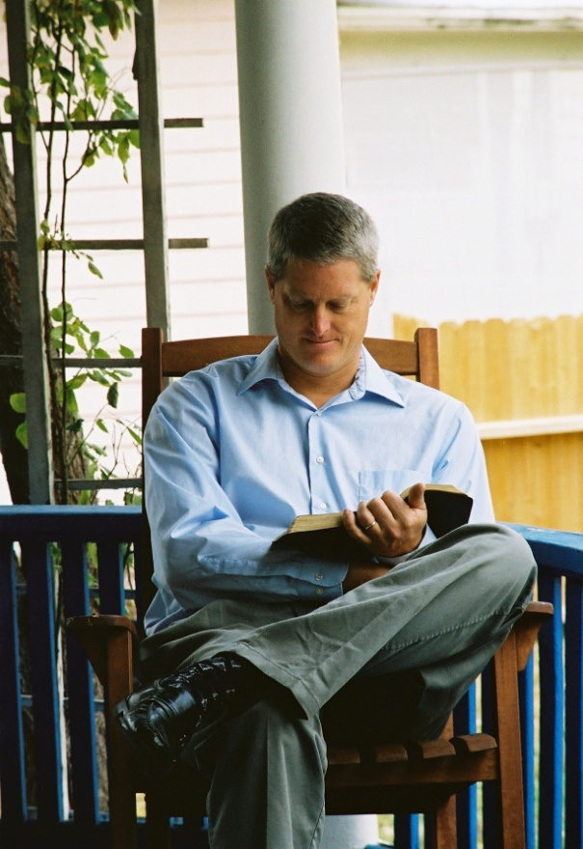
Characteristics of the Spiritual Man
Recognize they’re truly “reborn”
1 Corinthians 2:14-15
Directed by the Spirit of God
Ephesians 5:18
Richie Thetford www.thetfordcountry.com

Slide 9
Characteristics of the Spiritual Man
Continues to Mature
2 Timothy 2:15
Manifests Christ in their Character
Galatians 5:22-23; 2:20; 1 Peter 2:21
Spirituality reflected in attitude
Ephesians 5:18-21; 1 Corinthians 15:58
Richie Thetford www.thetfordcountry.com

Slide 10
Commit to becoming a Spiritual Person!
“you also, as living stones, are being built up a spiritual house, a holy priesthood, to offer up spiritual sacrifices acceptable to God through Jesus Christ.” 1 Peter 2:5
Richie Thetford www.thetfordcountry.com

