Slide 1
“I Will Awaken The Dawn!”
Text: Ps. 57; 142
Notes:
By Nathan L Morrison
All Scripture given is from the NASB, unless otherwise stated
For further study or if questions, Call: 804-277-1983 or Visit: www.courthousechurchofcrist.com

Slide 2
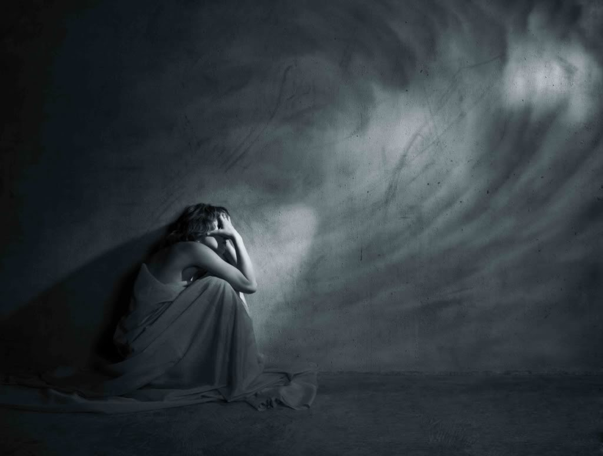
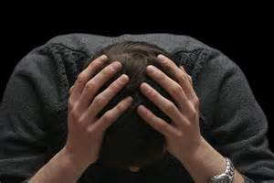
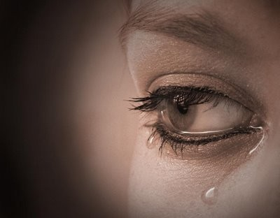
Intro
Have you ever felt depressed, distressed or alone?
Sometimes in our depression, grief, and sorrow it easy to feel all alone!
When in that “dark place” what did you do to get out?
What can be done when we are depressed or sorrowful?

Slide 3
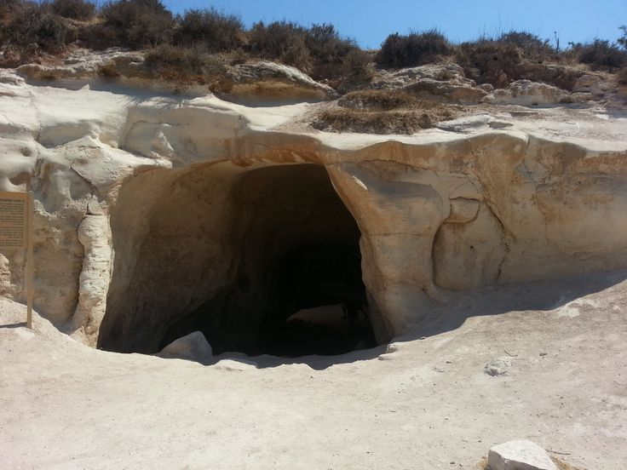
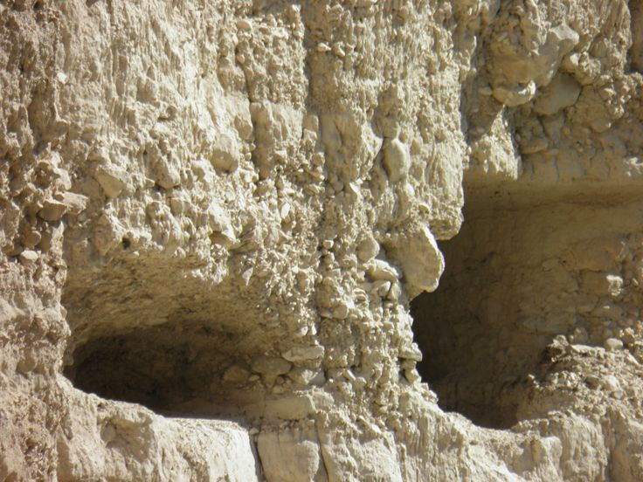
Intro
David was distressed to the point of hiding in caves!
I Sam. 22:1-2: David “escapes” to the cave of Adullam. Here the once mighty captain of Israel’s host becomes a captain of outlaws and refugees!
I Sam. 24:1-7: David and his men hid in the cave at En Gedi where David encountered Saul, and spared his life, against the wishes of his men.
Notes:
Image 1: Cave at Adullum
Image 2: Cave at En Gedi

Slide 4
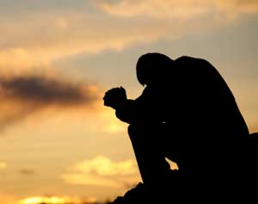
Intro
While in the caves (physical dark place), David was in an emotional “dark place”
Ps. 57 & 142 were written while in a cave hiding from Saul, either at Adullam or En Gedi
Ps. 57:6: “My soul is bowed down.” David was sorrowful
(Ps. 142:6)

Slide 5
Intro
Though David was distressed, he knew it would pass, that God would see him through
Ps. 57:4, 8: He says the night is full of danger but he will awaken to the dawn!
Ps. 30:5b: “Weeping may endure for a night, But joy comes in the morning.”
Sometimes we have to weep through
the night, but when we awaken to the
dawn there is joy!

Slide 6
Attitude
I Sam. 22:1-2 & I Sam. 24:1-7: David was hiding in caves!
He was God’s anointed to be king!
He was a mighty man of valor.
He was a man of faith in God.
He was a captain of the army of Israel.
He was the King Saul’s son-in-law.
He was a fugitive hiding in a cave!

Slide 7
Attitude
Ps. 142 Maskil of David, when he was in the cave. A Prayer.
1. I cry aloud with my voice to the LORD; I make supplication with my voice to the LORD.
2. I pour out my complaint before Him; I declare my trouble before Him.
3. When my spirit was overwhelmed within me, You knew my path. In the way where I walk They have hidden a trap for me.

Slide 8
Attitude
Ps. 142 Maskil of David, when he was in the cave. A Prayer.
4. Look to the right and see; For there is no one who regards me; There is no escape for me; No one cares for my soul.
5. I cried out to You, O LORD; I said, "You are my refuge, My portion in the land of the living.
6. "Give heed to my cry, For I am brought very low; Deliver me from my persecutors, For they are too strong for me.
7. "Bring my soul out of prison, So that I may give thanks to Your name; The righteous will surround me, For You will deal bountifully with me."

Slide 9
Attitude
His attitude was one that despite his sorrow and grief, he would lean on God!
He saw it as suffering through the night but awakening to the joy of the dawn! (Ps. 30:5; 57:4, 8)
Sometimes when we are “brought very low” in our cave of sorrow, it is hard to see the end, but we must have the attitude of David to see the joy of the dawn!

Slide 10
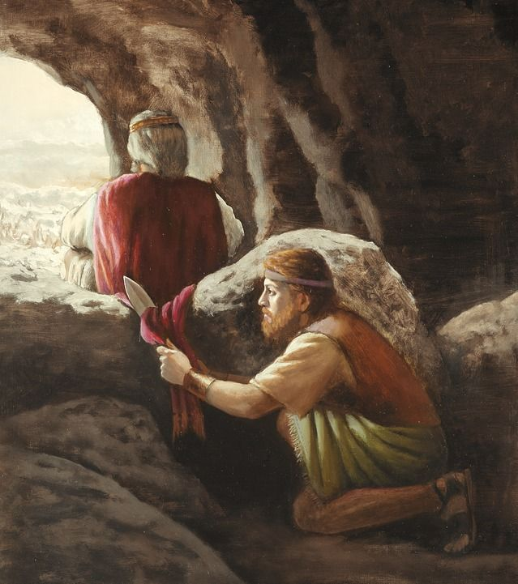
Action
David wasn’t idle in the cave, just feeling sorry for himself; he was praising God!
Ps. 57 & 142 show that even though he was sorrowful, he was praising God and communing with Him
David was in control of his actions and stopped his men from harming Saul!
I Sam. 24:4-7

Slide 11
Action
He showed complete faith in God to
deliver him from Saul in His way in His
timing! (I Sam. 31; II Sam. 2)
When in our “cave of sorrow” let us like David draw near to God and act honorably!

Slide 12
Look Ahead
Ps. 57 A Mikhtam of David, when he fled from Saul in the cave.
1. Be gracious to me, O God, be gracious to me, For my soul takes refuge in You; And in the shadow of Your wings I will take refuge Until destruction passes by.
2. I will cry to God Most High, To God who accomplishes all things for me.
3. He will send from heaven and save me; He reproaches him who tramples upon me. Selah. God will send forth His lovingkindness and His truth.
4. My soul is among lions; I must lie among those who breathe forth fire, Even the sons of men, whose teeth are spears and arrows And their tongue a sharp sword.

Slide 13
Look Ahead
Ps. 57 A Mikhtam of David, when he fled from Saul in the cave.
5. Be exalted above the heavens, O God; Let Your glory be above all the earth.
6. They have prepared a net for my steps; My soul is bowed down; They dug a pit before me; They themselves have fallen into the midst of it. Selah.
7. My heart is steadfast, O God, my heart is steadfast; I will sing, yes, I will sing praises!
8. Awake, my glory! Awake, harp and lyre! I will awaken the dawn.

Slide 14
Look Ahead
Ps. 57 A Mikhtam of David, when he fled from Saul in the cave.
9. I will give thanks to You, O Lord, among the peoples; I will sing praises to You among the nations.
10. For Your lovingkindness is great to the heavens And Your truth to the clouds.
11. Be exalted above the heavens, O God; Let Your glory be above all the earth.

Slide 15
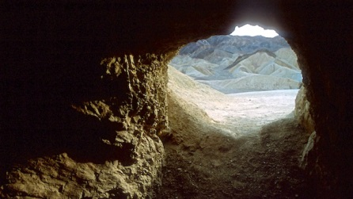
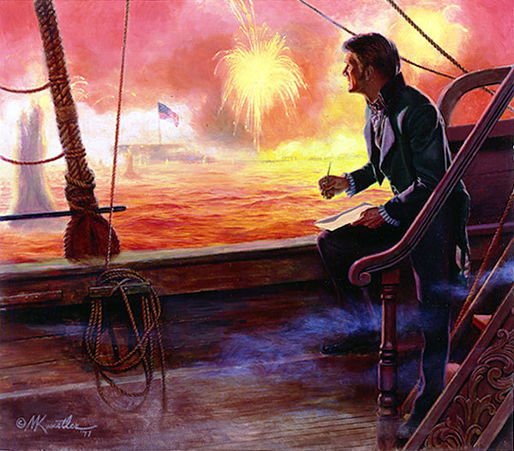
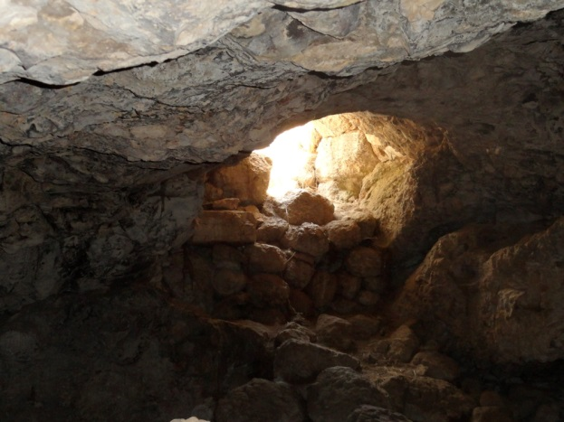
Look Ahead
No matter how bad things are look ahead past our present to see the “dawn” of the Lord!
Rom. 8:18: Nothing we suffer in this life can compare to the joy we will have when Christ comes again
I Thess. 4:16-18: Saints are to comfort one another with this thought – Christ is coming again!
IE: Battle of Baltimore at Fort McHenry, Sept. 13-14, 1814
Notes:
Image 1: Cave at Adullum – looking out
Image 2: Cave at En Gedi – looking out
Image 3: “Star Bangled Banner, 1814” by Mort Kuntsler

Slide 16
Look Ahead
When in our “cave of sorrow” let us like David look ahead
to God’s deliverance, and trust we will
“awaken the dawn!”
Notes:
Image 1: Cave at En Gedi – looking out

Slide 17
Conclusion
David went from the caves and from being a captain of outlaws to the king of Israel
He trusted and waited on God and was exalted and blessed in his rule!
God delivered him from Saul and from his enemies because as David recognized, God is stronger than any enemy!
I Sam. 22 (Ps. 18) records David’s psalm of joy over God’s deliverance from his enemies and from the hand of Saul.

Slide 18
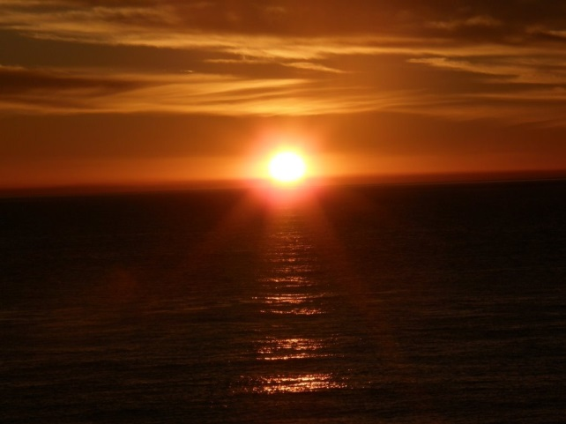
Conclusion
When we are depressed, or in sorrow and distress, let us:
Have the attitude of trust in God for deliverance!
Act honorably despite the way we feel or our circumstances being poor.
Look ahead past the “weeping of night” to the “joy of the dawn!” (Ps. 30:5b)
When we trust in Him, God can
take us from our “cave of sorrow”
and exalt us! (Js. 4:10)

Slide 19
“What Must I Do To Be Saved?”
Hear The Gospel (Jn. 5:24; Rom. 10:17)
Believe In Christ (Jn. 3:16-18; Jn. 8:24)
Repent Of Sins (Lk. 13:35; Acts 2:38)
Confess Christ (Mt. 10:32; Rom. 10:10)
Be Baptized (Mk. 16:16; Acts 22:16)
Remain Faithful (Jn. 8:31; Rev. 2:10)
For The Erring Child:
Repent (Acts 8:22), Confess (I Jn. 1:9), Pray (Acts 8:22)

