Slide 1
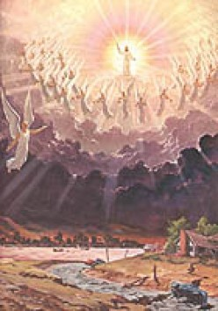
Christ's 2nd Coming Unveiled!
Text: I Thess. 4:13-18
Notes:
Prepared By Nathan L Morrison
All Scripture given is from NASB unless otherwise stated
For further study or if questions, Call: 804-277-1983 or Visit: www.courthousechurchofcrist.com
Based on a lesson by Joe Price

Slide 2
Intro
The Book of Revelation is the “Unveiling” of Jesus Christ (Rev. 1:1):
Revelation = “Unveiling” (G602 apokalupsis [ap-ok-al'-oop-sis], where word apocalypse comes from): disclosure, unveiling, to reveal
Jesus revealed to John (Rev. 1:1-2) His true nature and what would happen when He returns!
Christ’s return promised by:
Jesus (Jn. 14:1-6), Angels (Acts 1:9-11), & Apostles (I Thess. 4:16; II Pet. 3:10; Rev. 1:7).

Slide 3
Intro
“Where is the promise of His coming?”
(II Pet. 3:3-4, 9)
“What is the promise of His coming?”
(Wrath or Glory? I Thess. 5:1-3, 9)
Jesus Christ’s 2nd Coming is for judgment & reward!
(Heb. 9:27-28; Rev. 11:18; 22:12)

Slide 4
Events of Christ’s Return
I Thess. 4:16
16. For the Lord Himself will descend from heaven with a shout, with the voice of the archangel and with the trumpet of God, and the dead in Christ will rise first.
The end of all things sounded!
I Thess. 4:16
Resurrection of all the Dead:
Dead in Christ 1st (I Thess. 4:16)
Righteous and wicked same hour (Jn. 5:28-29)
Last day (Jn. 6:39-40, 54; 11:24)
Death subdued, Kingdom handed over (I Cor. 15:22-26, 35-49).

Slide 5
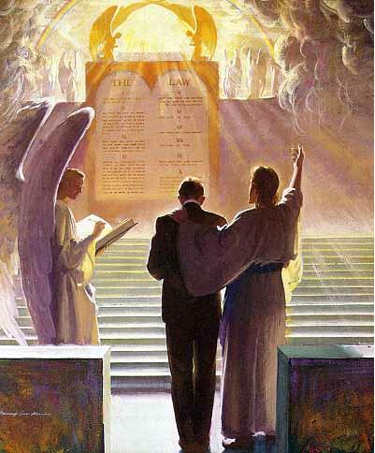
Events of Christ’s Return
All people bow, praise God, and confess Christ:
Rom. 14:11-12; Phil. 2:9-11
Judgment of All People
(Books opened – Rev. 20:12):
Household of God 1st (I Pet. 4:17; Mt. 25:31-34)
All will give account (Mt. 25:31-46; Acts 17:30-31; Rom. 2:5-10; 14:11-12; II Cor. 5:10; Rev. 20:11-13)

Slide 6
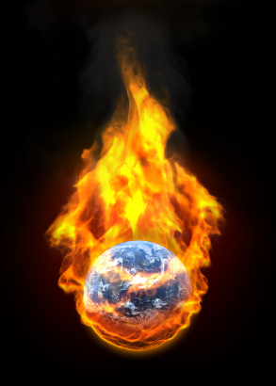
Events of Christ’s Return
Matthew 25:46
46. "These will go away into eternal punishment, but the righteous into eternal life."
The Sentence will be Carried Out:
Reward (Mt. 25:34,46; Rom. 2:7)
Punishment (Mt. 25:41,46; II Thess. 1:8-9)
Material World Burned Up:
II Pet. 3:10-12
Knowing how it all ends
we are to be ready!

Slide 7
Will Christ Come to Earth or Take Us To Heaven (or Both)?
Jesus promised to take His disciples to Heaven! (Jn. 14:1-6)
Jn. 14:1-3
1. "Do not let your heart be troubled; believe in God, believe also in Me.
2. "In My Father's house are many dwelling places; if it were not so, I would have told you; for I go to prepare a place for you.
3. "If I go and prepare a place for you, I will come again and receive you to Myself, that where I am, there you may be also.

Slide 8
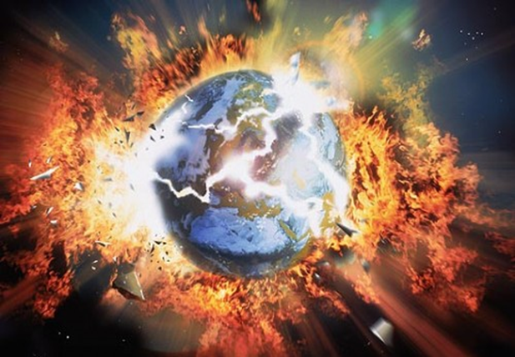
Will Christ Come to Earth or Take Us To Heaven (or Both)?
When He comes again it is for judgment &
to destroy the world!
(Heb. 9:27-28; II Pet. 3:11-13)
Saints will be with Jesus in Heaven, not on Earth! (Jn. 14:2-3; I Thess. 4:17)

Slide 9
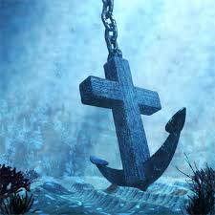
Comfort of His Promise
Our Hope is Secure
(I Thess. 4:13-15; Heb. 6:19)
Heb. 6:19
19. This hope we have as an anchor of the soul, a hope both sure and steadfast and one which enters within the veil,

Slide 10
Comfort of His Promise
When He comes again it is to take His saints home with Him
(I Thess. 4:16-18; Jn. 14:3)
I Thess. 4:16-18
16. For the Lord Himself will descend from heaven with a shout, with the voice of the archangel and with the trumpet of God, and the dead in Christ will rise first.
17. Then we who are alive and remain will be caught up together with them in the clouds to meet the Lord in the air, and so we shall always be with the Lord.
18. Therefore comfort one another with these words.

Slide 11
Comfort of His Promise
Christ’s 2nd Coming is fulfillment of hope with which we are to
“comfort one another!”

Slide 12
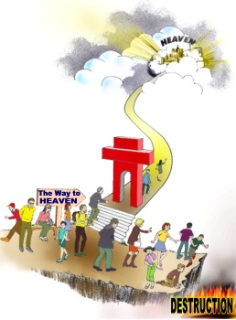
Conclusion
Though death comes to us here, an eternal life awaits those who “have loved His appearing” (II Tim. 4:8), and
death will be the last enemy abolished
(I Cor. 15:26)!
To be with Him in eternity:
Love His (future, promised)
Appearing like Paul did
(II Tim. 4:7)!

Slide 13
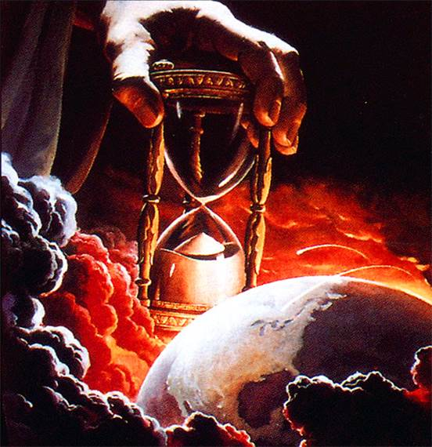
Conclusion
Live in “holy conduct & godliness” and look forward to Christ’s 2nd Coming (II Pet. 3:11-12), being ready for that hour only the Father knows (Mt. 24:36)!

Slide 14
“What Must I Do To Be Saved?”
Hear The Gospel (Jn. 5:24; Rom. 10:17)
Believe In Christ (Jn. 3:16-18; Jn. 8:24)
Repent Of Sins (Lk. 13:35; Acts 2:38)
Confess Christ (Mt. 10:32; Rom. 10:10)
Be Baptized (Mk. 16:16; Acts 22:16)
Remain Faithful (Jn. 8:31; Rev. 2:10)
For The Erring Child:
Repent (Acts 8:22), Confess (I Jn. 1:9),
Pray (Acts 8:22)

