Slide 1
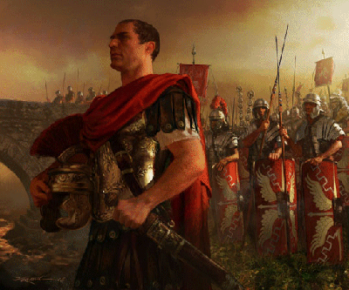
Centurion That Impressed Jesus Text: Lk. 7:1-10
Notes:
By Nathan L Morrison
All Scripture given is from NASB unless otherwise stated
For further study or if questions, Call: 804-277-1983 or Visit: www.courthousechurchofcrist.com

Slide 2
Intro
Six Centurions mentioned in the NT:
Lk. 7:1-10: The Centurion who asked Jesus to heal his servant (Mt. 8:5-13)
Mt 27:54: The one who professed Jesus as the Son of God (Mk. 15:39, 44-45; Lk. 23:47)
Acts 10-11: Cornelius of the Italian Cohort, the first Gentile convert.
Acts 22:25-26: The centurion who reported that Paul was a Roman.
Acts 24:23: Felix put Paul in the custody of a centurion, and was given freedom.
Acts 27: Julius of the Augustan Cohort, who took Paul to Rome (Acts 27:1).
All of them seem to be men of noble quality!

Slide 3
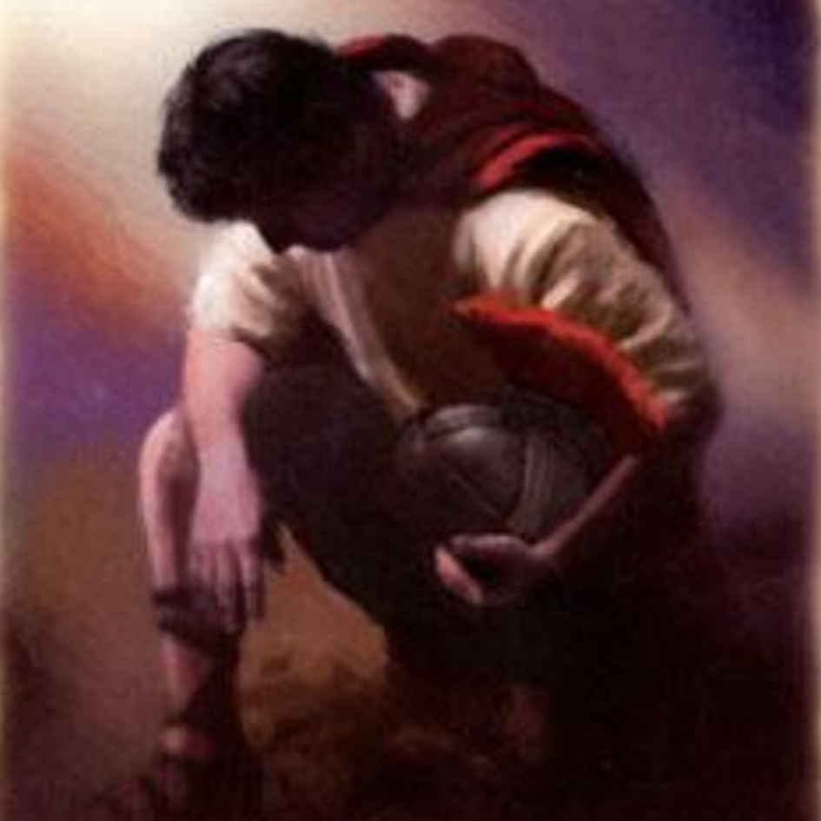
Intro
Lk. 7:1-10: One of the nameless centurions stands out:
The Centurion sent emissaries to Jesus asking on his behalf to come and heal his servant.
He asks for the healing of a servant he held in high regard, whom was at death’s door.
Mt. 8:6: We see his servant was “paralyzed and fearfully tormented.”

Slide 4
Intro
In the case of this centurion we see him
through the eyes of the Jews, himself, and the Lord!

Slide 5
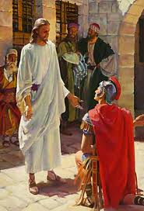
Centurion That Impressed Jesus
What The Jews Thought of Him (Lk. 7:3-5)

Slide 6
Centurion That Impressed Jesus
Lk. 7:3-5
3. When he heard about Jesus, he sent some Jewish elders asking Him to come and save the life of his slave.
4. When they came to Jesus, they earnestly implored Him, saying, "He is worthy for You to grant this to him;
5. for he loves our nation and it was he who built us our synagogue."

Slide 7
What The Jews Thought of Him (Lk. 7:3-5)
“He is worthy” (Lk. 7:4-5)
“Loves our nation” (LK. 7:5)
“Has built us a synagogue” (Lk. 7:5)
(I Jn. 3:18; Lk. 10:29-37)

Slide 8
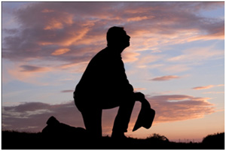
What The Jews Thought of Him (Lk. 7:3-5)
What would our neighbors (or enemies) say about us?
Phil. 2:15: We are to be lights in the world (Mt. 7:12).
We are to be a good neighbor (Lk. 10:30-37: Show mercy & be a neighbor)
Would those around us consider us “worthy?”

Slide 9
Centurion That Impressed Jesus
What The Jews Thought of Him (Lk. 7:3-5)
What He Thought of Himself (Lk. 7:1-3, 6-8)

Slide 10
Centurion That Impressed Jesus
Lk. 7:6-8
6. Now Jesus started on His way with them; and when He was not far from the house, the centurion sent friends, saying to Him, "Lord, do not trouble Yourself further, for I am not worthy for You to come under my roof;
7. for this reason I did not even consider myself worthy to come to You, but just say the word, and my servant will be healed.
8. "For I also am a man placed under authority, with soldiers under me; and I say to this one, 'Go!' and he goes, and to another, 'Come!' and he comes, and to my slave, 'Do this!' and he does it."

Slide 11
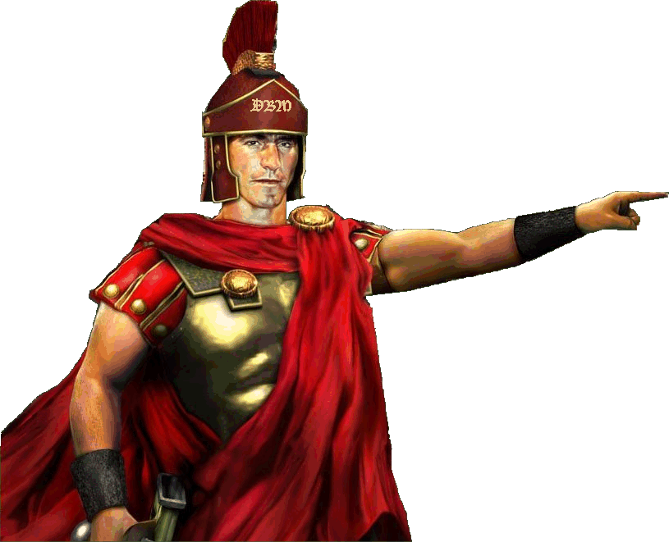
What He Thought of Himself (Lk. 7:6-8)
“I am not worthy” (Lk. 7:6) – Humble! Submitted to Jesus as “Lord” (Kurios)
He understood authority (Lk. 7:7-8) – Jesus just had to say the word & his slave would be healed!

Slide 12
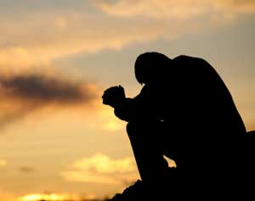
What He Thought of Himself (Lk. 7:6-8)
A thorough self-examination is profitable to us all!
II Cor. 13:5: “Examine yourselves.”
I Cor. 11:28: “Let a man examine himself.”
I Jn. 3:19-20: “If our hearts condemn us.”
Are we humble and
submit to the authority of Jesus Christ?

Slide 13
Centurion That Impressed Jesus
What The Jews Thought of Him (Lk. 7:3-5)
What He Thought of Himself (Lk. 7:1-3, 6-8)
What Jesus Knew About Him (Lk. 7:9)

Slide 14
Centurion That Impressed Jesus
Lk. 7:9
9. Now when Jesus heard this, He marveled at him, and turned and said to the crowd that was following Him, "I say to you, not even in Israel have I found such great faith."

Slide 15
What Jesus Knew About Him (Lk. 7:9)
The Lord Marveled! (Lk. 7:9; Mk. 6:5-6)
This man’s “great faith” is an indictment against the Jews and even Jesus’ own disciples! (Mt. 8:26; Js. 2:17, 26)
Jesus did as he asked (Lk. 7:10; Mt. 8:13)

Slide 16
What Jesus Knew About Him (Lk. 7:9)
What about your faith?
Would the Lord marvel at it?
Or would He marvel at the lack of it?
The Centurion was a man with so “great a
faith” that it
Impressed Jesus!

Slide 17
Conclusion
Do we have the Lord’s approval?
Jesus told the Roman centurion He had yet to find greater faith in all Israel
(His people)
If Jesus were to walk in on us today
(I Pet. 2:9-10: His people), would He find us lacking or people of “so great a faith”?

Slide 18
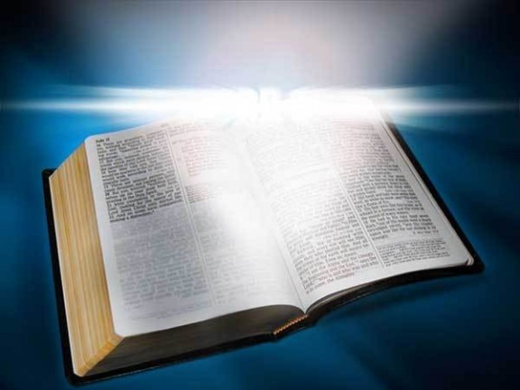
Conclusion
Be the kind of child of God with
“so great a faith” to cause Jesus to marvel!

Slide 19
“What Must I Do To Be Saved?”
Hear The Gospel (Jn. 5:24; Rom. 10:17)
Believe In Christ (Jn. 3:16-18; Jn. 8:24)
Repent Of Sins (Lk. 13:35; Acts 2:38)
Confess Christ (Mt. 10:32; Rom. 10:10)
Be Baptized (Mk. 16:16; Acts 22:16)
Remain Faithful (Jn. 8:31; Rev. 2:10)
For The Erring Child of God:
Repent (Acts 8:22), Confess (I Jn. 1:9),
Pray (Acts 8:22)

