Slide 1
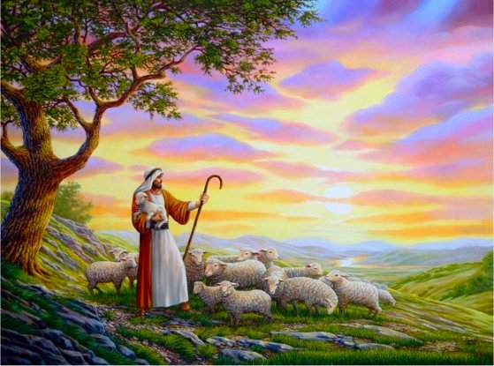
Messianic Psalms Parts 1-2 Text: Psalms 22; 110; 16
Notes:
By Nathan L Morrison
All Scripture given is from NASB unless otherwise stated
For further study or if questions, Call: 804-277-1983, or Visit: www.courthousechurchofchrist.com
Resources:
• Psalms in Bible Text Books (BTB) by Randy Blackaby, Lessons 8-9, www.onestone.com/btb-psalms.html / www.ceibooks.com/bible-class-materials/btb-psalms/
• Medical Aspects of the Crucifixion of Jesus Christ, Compiled by David Terasaka, M.D. ©1996 @ https://www.blueletterbible.org/comm/terasaka_david/misc/crucify.cfm
• The Crucifixion in Excruciating Detail, 2012, @ http://mudpreacher.org/2012/04/03/the-crucifixion-of-jesus-in-excruciating-detail/
o Dr. C Truman David, “The Crucifixion”, New Wine Magazine, April 1982. Originally published in Arizona Medicine, March 1965, Arizona Medical Association.
o The Agony of Love by Dr. Mark Eastman
o http://www.frugalsites.net/jesus/crucifixion.html

Slide 2
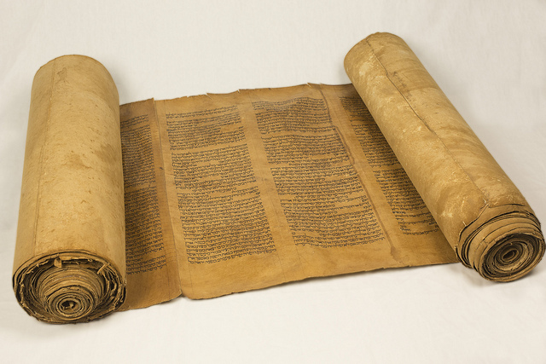
Messianic Psalms Part 1

Slide 3
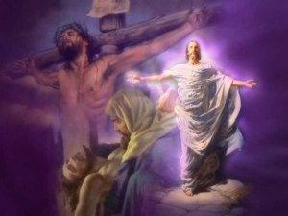
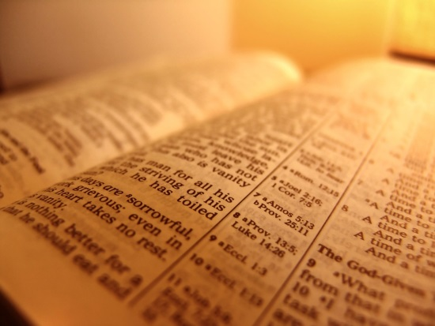
Intro
“Messianic” Psalms refer to psalms that, in one way
or another, pertain to the Messiah
(H4899: Anointed One) or Christ (Jn. 1:41: Greek equivalent to Hebrew; G5547: Anointed One)

Slide 4
Intro
The psalms are certainly full of prophecy!
The Messianic Psalms speak of Jesus from His birth to His betrayal, from His torture to His death, from His resurrection to his ascension to Heaven, and from His world-wide reign to His 2nd Coming.
They speak of the Messiah as King, Priest, and Prophet.
Jesus said all that was contained in the Law, the Prophets, and the Psalms concerning Him had to be fulfilled – Lk. 24:44

Slide 5
Intro
The term “Messiah” or “Anointed One” can be in
reference to a king or even David specifically, but
often goes beyond the short term and references Jesus in the long term!
Example – Psalm 41: May appear to only be in reference to an event at the time of David (Ps. 41:1)
Fits the time of David (II Sam. 15-18).
Also refers to Jesus’ betrayal by Judas – Jn. 13:18 (Mt. 26:20-25; Lk. 22:47-48)

Slide 6
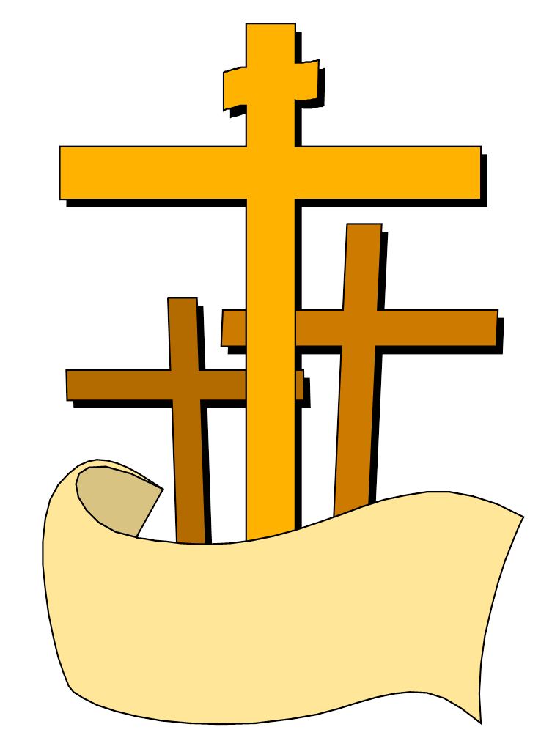
Intro
We will study three Messianic Psalms (22, 110, 16) and see how they relate to Jesus!
In Him we have redemption through His blood, the forgiveness of our trespasses, according to the riches of His grace
Eph. 1:7

Slide 7
Psalm 22: The Psalm of the Cross
Ps. 22:1
1. For the choir director; upon Aijeleth Hashshahar. A Psalm of David. My God, my God, why have You forsaken me? Far from my deliverance are the words of my groaning.

Slide 8
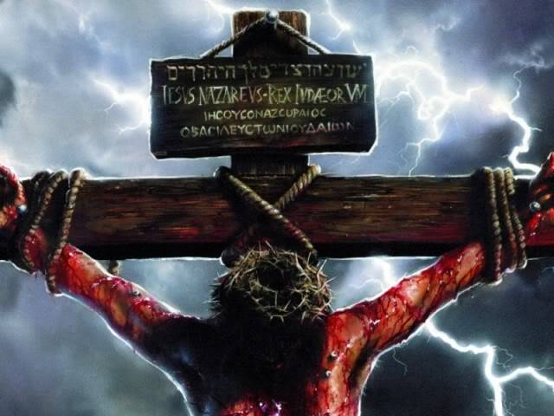
Psalm 22: The Psalm of the Cross
While He hung on the cross dying, shortly before He died,
Jesus cried out, “My God, My God, why have you forsaken
Me?” (Mt. 27:46; Mk. 15:34)

Slide 9
Psalm 22: The Psalm of the Cross
Jesus quoted Ps. 22:1 as one of His final sayings on
the cross (foretold hundreds of years earlier)!
It is possible that Jesus’ quoting the first passage of Psalm 22 was to draw the people’s minds to the whole psalm, which foretold His agony on the cross!
This is also the only recorded time where Jesus addressed
God and didn’t call Him “Father!”

Slide 10
Psalm 22: The Psalm of the Cross
Ps. 22:14
14. I am poured out like water, And all my bones are out of joint; My heart is like wax; It is melted within me.
EXCRUCIATE: to cause great agony, torment. Latin for, “from (or out of) the cross” (Webster’s).
Notes:
Latin ex = from, out of
Latin cruciate = cross

Slide 11
Psalm 22: The Psalm of the Cross
On Ps. 22:14:
“When the cross was erected upright, there was tremendous strain put on the wrists, arms and shoulders, resulting in a dislocation of the shoulder and elbow joints.”
(Excerpt from: Medical Aspects of the Crucifixion of Jesus Christ by Dr. David Teraska)

Slide 12
Psalm 22: The Psalm of the Cross
On Ps. 22:14:
“Within a few minutes of being placed on the cross, the shoulders will become dislocated. Minutes later the elbows and wrists become dislocated. The result of these dislocations is that the arms are as much as 6-9 inches longer than normal. With the arms dislocated, considerable body weight is transferred to the chest, causing the rib cage to be elevated in a state of perpetual inhalation...
(Excerpt from: The Crucifixion in Excruciating Detail, 2012)

Slide 13
Psalm 22: The Psalm of the Cross
On Ps. 22:14:
“…Consequently, in order to exhale the victim must push down on his feet to allow the rib muscles to relax. The problem is that the victim cannot push very long because the legs are extremely fatigued. As time goes on, the victim is less and less able to bear weight on the legs, causing further dislocation of the arms and further rising of the chest wall, making breathing more and more difficult.”
(Excerpt from: The Crucifixion in Excruciating Detail, 2012)

Slide 14
Psalm 22: The Psalm of the Cross
On Ps. 22:14:
“Due to the shallow breathing, the victim's lungs begin to collapse in small areas, causing hypoxia and hypercarbia. A respiratory acidosis, with lack of compensation by the kidneys due to the loss of blood from the numerous beatings, resulted in an increased strain on the heart, which beats faster to compensate. Fluid builds up in the lungs. Under the stress of hypoxia and acidosis the heart eventually fails.”
(Excerpt from: Medical Aspects of the Crucifixion of Jesus Christ by Dr. David Teraska)

Slide 15
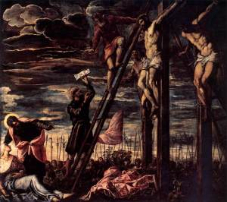
Psalm 22: The Psalm of the Cross
Death by Crucifixion: Slow Asphyxiation (Suffocation):
Shallowness of breathing causes small areas of lung collapse.
Decreased oxygen and increased carbon dioxide causes acidic conditions in the tissues.
Fluid builds up in the lungs.
Heart is stressed and eventually fails.

Slide 16
Psalm 22: The Psalm of the Cross
Every time Jesus spoke He had to push Himself up on his nail-pierced feet – 7 Utterances recorded:
“Father, forgive them, for they do not know what they do” (Luke 23:34).
“Assuredly, I say to you, today you will be with Me in Paradise” (Luke 23:43).
“Woman, behold your son! . . . Behold your mother!” (John 19:26-27).
“Eli, Eli, lama sabachthani? . . . My God, My God, why have You forsaken Me?” (Ps. 22:1; Mt. 27:46; Mark 15:34).
“I thirst!” (John 19:28).
“It is finished!” (John 19:30).
“Father, into Your hands I commit My spirit” (Luke 23:46; also see Ps. 31:5; Mt. 27:50; Mark 15:37).

Slide 17
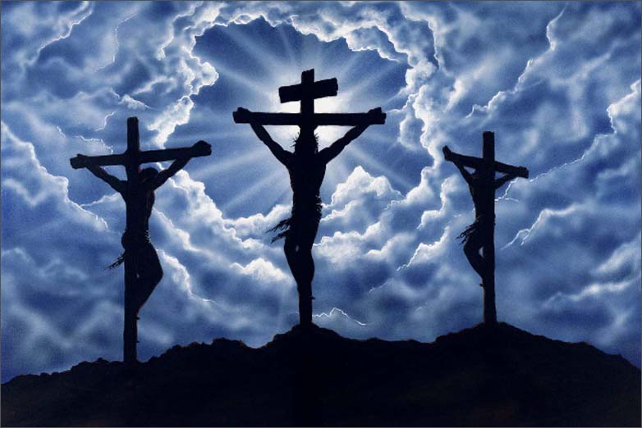
Psalm 22: The Psalm of the Cross
Breaking the legs would hasten the death as they could no longer lift themselves up for a breath of air! (John 19:31-34)
Despite the agony and dislocated bones and joints, no bones were broken, just
as was foretold! (Ex. 12:46;
Ps. 34:20; Jn. 19:32-33, 36;
I Cor. 5:7)

Slide 18
Psalm 22: The Psalm of the Cross
Ps. 22:16
16. For dogs have surrounded me; A band of evildoers has encompassed me; They pierced my hands and my feet.

Slide 19
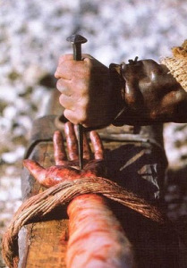
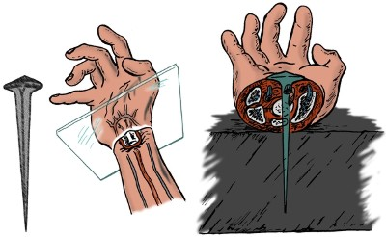
Psalm 22: The Psalm of the Cross
None of the accounts of Jesus' crucifixion specifically say that Jesus was nailed to the cross
(Mt. 27:35; Mk. 15:24; Lk. 23:33; Jn. 19:18)
The Scriptures elsewhere say He was:
Jn. 20:25; Acts 2:23; Col. 2:14: Was foretold in Ps. 22:16 & Zech. 12:10 (Jn. 19:37)!
Artist’s rendition of crucifixion nail. Note the piercing of the median nerve in the midline of the wrist.

Slide 20
Psalm 22: The Psalm of the Cross
Israel’s method of execution at the
time of David was stoning, so not a
reference to this time period, but
pointing to Jesus!

Slide 21
Psalm 22: The Psalm of the Cross
Ps. 22:7-8, 16
All who see me sneer at me; They separate with the lip, they wag the head, saying,
"Commit yourself to the LORD; let Him deliver him; Let Him rescue him, because He delights in him."
16. For dogs have surrounded me; A band of evildoers has encompassed me; They pierced my hands and my feet.
Jesus would be mocked while on the cross!

Slide 22
Psalm 22: The Psalm of the Cross
On Ps. 22:7-8, 16:
“The crucifixion site ‘was purposely chosen to be outside the city walls because the Law forbade such within the city walls...for sanitary reasons... the crucified body was sometimes left to rot on the cross and serve as a disgrace, a convincing warning and deterrent to passers by. Sometimes, the subject was eaten while alive and still on the cross by wild beasts!’”
(Excerpt from: Medical Aspects of the Crucifixion of Jesus Christ by Dr. David Teraska)

Slide 23
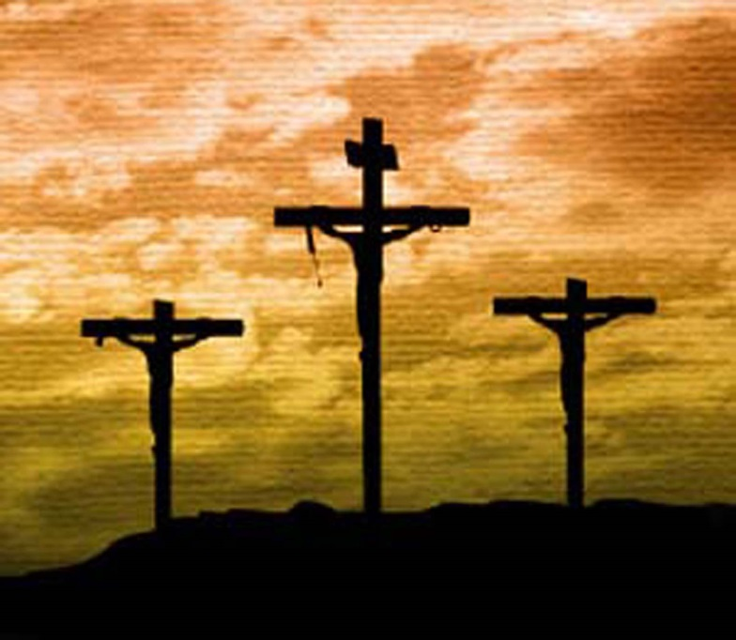
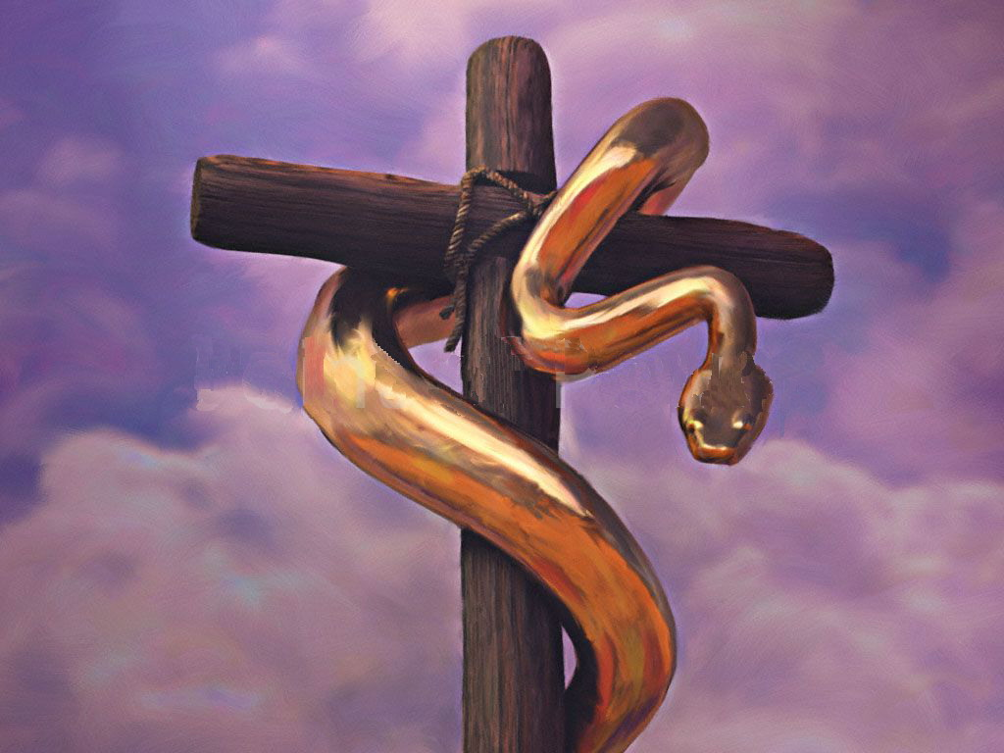
Psalm 22: The Psalm of the Cross
Those who saw Him mocked Him:
Even the thieves on the crosses next to His (one had a change of heart) & soldiers – Mt. 27:39-44; Mk. 15:29-32; Lk. 23:35-43
Jesus said He would “be lifted up” (Jn. 3:14-15)!

Slide 24
Psalm 22: The Psalm of the Cross
Ps. 22:17
17. I can count all my bones. They look, they stare at me;
The death of Jesus was predicted to be, and was,
a spectacle!

Slide 25
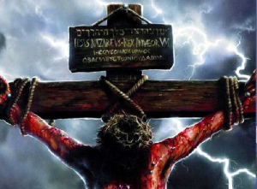
Psalm 22: The Psalm of the Cross
Jesus the Spectacle!
Naked, or nearly so, His body stretched out unnaturally, blood, sweat, flies, groaning, and dogs circling, it was a scene that riveted the eyes of all who were there to see it!

Slide 26
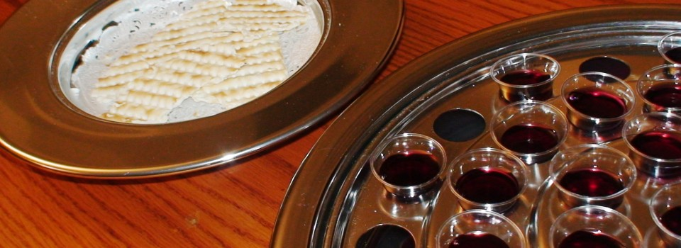
Psalm 22: The Psalm of the Cross
We partake of the Lord’s Supper every first day of the
week, to “proclaim the Lord’s death until He comes”
(I Cor. 11:26) so we remember what our salvation cost!

Slide 27
Psalm 22: The Psalm of the Cross
Ps. 22:18
18. They divide my garments among them, And for my clothing they cast lots.
Jesus’ garments would be divided and lots cast for them!

Slide 28
Psalm 22: The Psalm of the Cross
Jn. 19:23-25
The soldiers gambled for the only thing of value they saw in Jesus, His seamless tunic and outer garments.
Psalm 22 foretells Jesus’ loss of human dignity, ridicule,
the physical effects of fear, terror, and a deteriorating
body, including the impact upon the heart, bones, hands
and feet!
Psalm 22 depicts a totally broken man (Jesus),
physically, and emotionally!

Slide 29
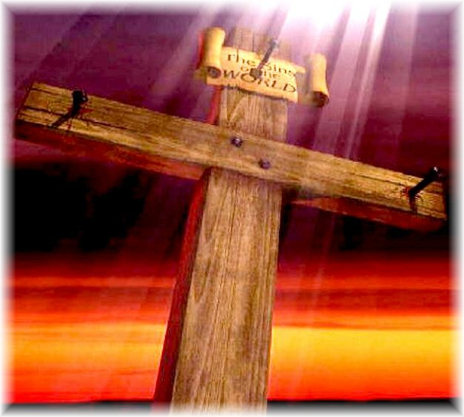
Conclusion (Part 1)
Psalm 22 depicts the cross, not an instrument for execution at the time of its writing but a future mode of execution at a time of God’s choosing (Gal. 4:4), and the Son of God Who would die there for all of mankind
Jesus was the perfect sacrifice for sins for all time
(Heb. 9:28; 10:12)

Slide 30
Conclusion (Part 1)
Just as the story of the Messiah doesn’t end at the cross,
neither do the Psalms end at the cross but they further
prophesy of His being a King and Priest (Ps. 110) and gives the hope of His resurrection (Ps. 16)
Jesus’ death on the cross was to
fulfill the will of God in order to save
mankind from sin!

Slide 31
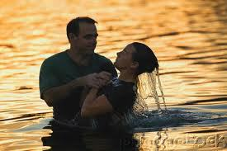
Conclusion (Part 1)
Eph. 1:7: In His blood we have forgiveness and redemption and the hope of Heaven (Col. 1:5)
Have you obeyed the gospel that you might be washed in His blood and freed from your sins?

Slide 32
“What Must I Do To Be Saved?”
Hear The Gospel (Jn. 5:24; Rom. 10:17)
Believe In Christ (Jn. 3:16-18; Jn. 8:24)
Repent Of Sins (Lk. 13:35; Acts 2:38)
Confess Christ (Mt. 10:32; Rom. 10:10)
Be Baptized (Mk. 16:16; Acts 22:16)
Remain Faithful (Jn. 8:31; Rev. 2:10)
For The Erring Child of God:
Repent (Acts 8:22), Confess (I Jn. 1:9), Pray (Acts 8:22)

Slide 33
Messianic Psalms Parts 1-2 Text: Psalms 22; 110; 16
Notes:
By Nathan L Morrison
All Scripture given is from NASB unless otherwise stated
For further study or if questions, Call: 804-277-1983, or Visit: www.courthousechurchofchrist.com
Resources:
• Psalms in Bible Text Books (BTB) by Randy Blackaby, Lessons 8-9, www.onestone.com/btb-psalms.html / www.ceibooks.com/bible-class-materials/btb-psalms/
• Medical Aspects of the Crucifixion of Jesus Christ, Compiled by David Terasaka, M.D. ©1996 @ https://www.blueletterbible.org/comm/terasaka_david/misc/crucify.cfm
• The Crucifixion in Excruciating Detail, 2012, @ http://mudpreacher.org/2012/04/03/the-crucifixion-of-jesus-in-excruciating-detail/
o Dr. C Truman David, “The Crucifixion”, New Wine Magazine, April 1982. Originally published in Arizona Medicine, March 1965, Arizona Medical Association.
o The Agony of Love by Dr. Mark Eastman
o http://www.frugalsites.net/jesus/crucifixion.html

Slide 34
Messianic Psalms Part 2

Slide 35
Intro
“Messianic” Psalms refer to psalms that, in one way
or another, pertain to the Messiah
(H4899: Anointed One) or Christ (Jn. 1:41: Greek equivalent to Hebrew; G5547: Anointed One)
Psalm 22: often referred to as “The Psalm of the Cross”
Psalm 22 depicted the agony, both physically and emotionally, of Jesus on the cross!
By the end of the psalm we have a picture of a broken and dying man.
But the Psalms don’t leave us with the picture of the Messiah dead on a cross!

Slide 36
Intro
We will look at Psalms 110 & 16 and see that they foretell of Jesus’ Lordship and the hope of His resurrection!

Slide 37
Psalm 110: Jesus is Both King and Priest
Ps. 110:1
1. A Psalm of David. The LORD says to my Lord: "Sit at My right hand Until I make Your enemies a footstool for Your feet."
David wrote this psalm (Ps. 110:1; Mt. 22:43; Acts 2:34)

Slide 38
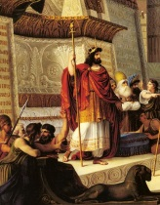
Psalm 110: Jesus is Both King and Priest
David speaks of God (YHWH, H3068), speaking to his
(David’s) Lord (Adonay, H136)
David was king at the time so to whom was YHWH speaking, who was higher in authority than King David of Israel?

Slide 39
Psalm 110: Jesus is Both King and Priest
The NT makes the conclusion obvious:
Lk. 2:10-11: Angel to the shepherds: Jesus would be a “Savior” and “Christ the Lord.”
Mt. 22:41-46: Jesus used this psalm to show the “Son” of David was higher in authority than David because He is Lord (G2962 Kurios = H3068 YHWH).
Acts 2:34-36: Peter used this psalm to show the Jews they crucified Jesus, who was “both Lord (G2962: Kurios) and Christ (G5547: Anointed One, equiv. to Heb. Messiah)!”

Slide 40
Psalm 110: Jesus is Both King and Priest
Ps. 110:2, 4
2. The LORD will stretch forth Your strong scepter from Zion, saying, "Rule in the midst of Your enemies."
4. The LORD has sworn and will not change His mind, "You are a priest forever According to the order of Melchizedek."
Jesus is not only a King but a Priest!

Slide 41
Psalm 110: Jesus is Both King and Priest
This one spoken of in Ps. 110:2 holds a “strong scepter from Zion” and will “Rule in the midst of Your enemies” – He would be Lord and King
David certainly ruled as lord and king and brought peace to his nation – handed over a peaceful Israel to his son Solomon!

Slide 42
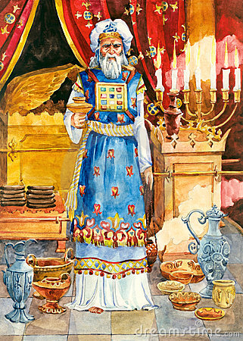
Psalm 110: Jesus is Both King and Priest
This one spoken of in Ps. 110:4 will be “a priest forever according to the order of Melchizedek” – Not only Lord and King, but also a Priest
From an Israelite standpoint, no king over Israel in the line of David could be king and priest, because David was of the tribe of Judah, and priests were from the tribe of Levi (Heb. 7:11)!
This is not speaking about David (II Sam. 7:12-16: House of David established forever as king) as a priest!

Slide 43
Psalm 110: Jesus is Both King and Priest
This one spoken of in Ps. 110:4 will be “a priest forever according to the order of Melchizedek”
This could be no ordinary human king – God was inviting this individual to sit at His own side:
Acts 2:33; 7:56; Heb. 1:3; 12:2: Jesus sat at the right hand of God!
Heb. 6:20-8:6: Jesus is the Priest forever according to the order of Melchizedek & is our Great High Priest (Heb. 4:14).
Hebrews 7: The superiority of the order of Melchizedek over the Levitical priesthood!

Slide 44
Psalm 110: Jesus is Both King and Priest
Ps. 110:5-7
5. The Lord is at Your right hand; He will shatter kings in the day of His wrath.
6. He will judge among the nations, He will fill them with corpses, He will shatter the chief men over a broad country.
7. He will drink from the brook by the wayside; Therefore He will lift up His head.
Work of the Messiah foretold: Judge!

Slide 45
Psalm 110: Jesus is Both King and Priest
I Cor. 15:24-28: After His resurrection from the dead and
ascension to Heaven where He sits at the right hand of
God, He reigns till His enemies are made a footstool
(I Tim. 6:15: Jesus is “the King of kings and Lord of lords”)
Mt. 25:31-46: As King & Priest Jesus will judge the nations
with reward & punishmnet!
Levitical priests could only serve a few years, but Jesus will serve “forever!” (Heb. 7:23-24)

Slide 46
Psalm 16: Hope of the Resurrection
Ps. 16:9-10
9. Therefore my heart is glad and my glory rejoices; My flesh also will dwell securely (NKJ: “rest in hope”).
10. For You will not abandon my soul to Sheol; Nor will You allow Your Holy One to undergo decay.
The hope (NKJ) of the Resurrection of Jesus!

Slide 47
Psalm 16: Hope of the Resurrection
This psalm of David expresses his total trust in God,
not only for the present but also for the future
He wrote, “My flesh also will rest in hope” (NKJ: Ps. 16:9) and “You will not abandon my soul to Sheol; Nor will You allow Your Holy One to undergo decay” (NAS: Ps. 16:10).
What did he mean?

Slide 48
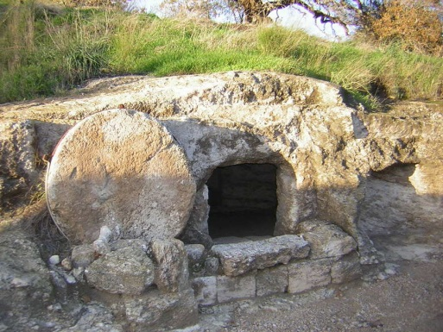
Psalm 16: Hope of the Resurrection
Ps. 16:8-11: Hope of Jesus’ resurrection!
Acts 2:25-32, 36: Peter applied Ps. 16:8-11 to Jesus! He said David spoke of the hope of Jesus’ resurrection from the dead.
Acts 17:30-31: Paul later states that the resurrection of Jesus is proof that He will judge the world! (Ps. 110:5-7; Mt. 25:31-46)

Slide 49
Psalm 16: Hope of the Resurrection
Saints have the hope of Heaven because Jesus was raised
from the dead, defeating the power of death and Satan! (Heb. 2:14)

Slide 50
Conclusion (Part 2)
Jesus was unlike any human or Israelite king, who could
only be King/Prophet, for He was King (I Tim. 6:15),
Prophet (Acts 3:22-26), and Priest (Heb. 6:20)!
The Psalms contain these and many more prophecies
concerning the Messiah, Jesus Christ, and left the Jews
of His day without excuse (Jn. 1:11)

Slide 51
Conclusion (Part 2)
As these things were foretold a thousand years before
Jesus’ birth and left the Jews without excuse for not
knowing Him, how much more now ought we to see these
things and believe? (Lk. 24:44; Acts 4:10-12; Phil. 2:9-11)

Slide 52
Conclusion (Part 2)
The Scriptures of old give us instruction and hope
(Rom. 15:4)
May we study these things and be strengthened in our
faith and hope in Jesus, who is both Lord and Christ!
(Acts 2:36)

Slide 53
“What Must I Do To Be Saved?”
Hear The Gospel (Jn. 5:24; Rom. 10:17)
Believe In Christ (Jn. 3:16-18; Jn. 8:24)
Repent Of Sins (Lk. 13:35; Acts 2:38)
Confess Christ (Mt. 10:32; Rom. 10:10)
Be Baptized (Mk. 16:16; Acts 22:16)
Remain Faithful (Jn. 8:31; Rev. 2:10)
For The Erring Child of God:
Repent (Acts 8:22), Confess (I Jn. 1:9), Pray (Acts 8:22)

