Slide 1
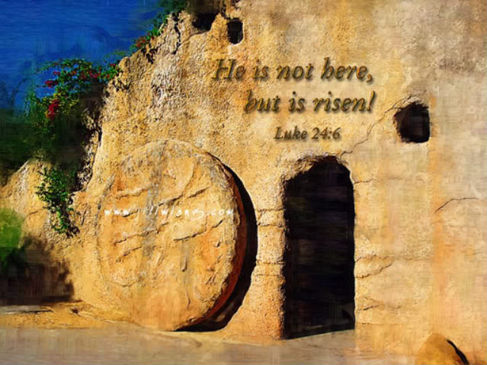
“He Is Not Here, But He Has Risen!”
Text: Lk. 24:1-9
Notes:
By Nathan L Morrison
All Scripture given is from NASB unless otherwise stated
For further study or if questions, Call: 804-277-1983, or Visit: www.courthousechurchofchrist.com

Slide 2
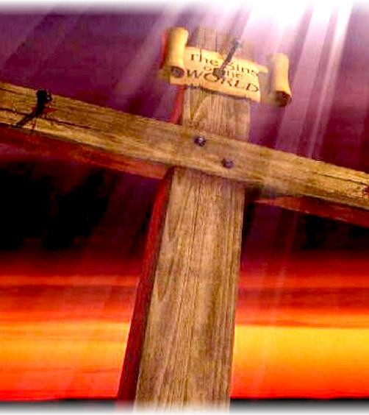
Intro
The death of Jesus is important (“of first importance” – I Cor. 15:3)
His blood washes away sin (I Cor. 1:23-24; 2:2; 15:3; Eph. 1:7; Rev. 1:5)

Slide 3
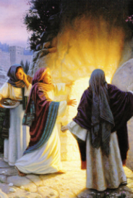
Intro
The resurrection of Jesus is central to Christianity!
Jesus said He would rise the 3rd day (Jn. 2:19; Mt. 12:40; 27:63; Mk. 8:31-32; Lk. 24:7, 21)
If He didn’t, then He was a false prophet!

Slide 4
I Cor. 15:12-15
12. Now if Christ is preached, that He has been raised from the dead, how do some among you say that there is no resurrection of the dead?
13. But if there is no resurrection of the dead, not even Christ has been raised;
14. and if Christ has not been raised, then our preaching is vain, your faith also is vain.
15. Moreover we are even found to be false witnesses of God, because we testified against God that He raised Christ, whom He did not raise, if in fact the dead are not raised.

Slide 5
I Cor. 15:16-20
16. For if the dead are not raised, not even Christ has been raised;
17. and if Christ has not been raised, your faith is worthless; you are still in your sins.
18. Then those also who have fallen asleep in Christ have perished.
19. If we have hoped in Christ in this life only, we are of all men most to be pitied.
20. But now Christ has been raised from the dead, the first fruits of those who are asleep.

Slide 6
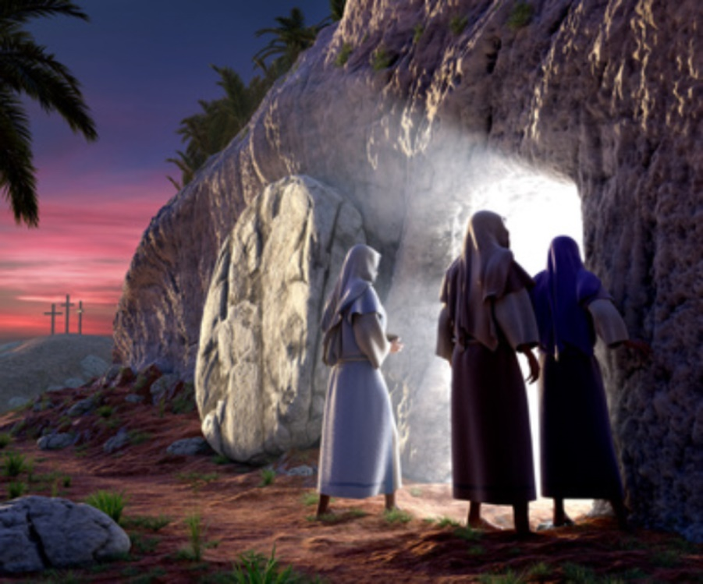
Luke 24:1-5
1. But on the first day of the week, at early dawn, they came to the tomb bringing the spices which they had prepared.
2. And they found the stone rolled away from the tomb,
3. but when they entered, they did not find the body of the Lord Jesus.
4. While they were perplexed about this, behold, two men suddenly stood near them in dazzling clothing;
5. and as the women were terrified and bowed their faces to the ground, the men said to them, "Why do you seek the living One among the dead?

Slide 7
Luke 24:6-9
6. "He is not here, but He has risen. Remember how He spoke to you while He was still in Galilee,
7. saying that the Son of Man must be delivered into the hands of sinful men, and be crucified, and the third day rise again."
8. And they remembered His words,
9. and returned from the tomb and reported all these things to the eleven and to all the rest.

Slide 8
Intro
Numerous theories have been provided to explain
away His resurrection over the years:
The wrong tomb theory: Disciples discovered wrong tomb empty.
The stolen body: The disciples stole away His body.
The swoon theory: He didn’t really die but was comatose, then awoke.
The hallucination theory: His disciples didn’t really see Him alive.
None of these explains why the tomb was empty!
(Joseph of Arimathea knew where it was – Mt. 27:60)

Slide 9
Intro
Josephus the historian records it as fact:
Antiquities 18.3.3
“Now there was about this time Jesus, a wise man, if it be lawful to call him a man; for he was a doer of wonderful works, a teacher of such men as receive the truth with pleasure. He drew over to him both many of the Jews and many of the Gentiles. He was the Christ. And when Pilate, at the
suggestion of the principal men amongst us, had condemned him to the
cross, those that loved him at the first did not forsake him; for he appeared to them alive again the third day; as the divine prophets had foretold these and ten thousand other wonderful things concerning him.
And the tribe of Christians, so named from him, are not extinct at this day.”
He recognized that it was foretold by the prophets!

Slide 10
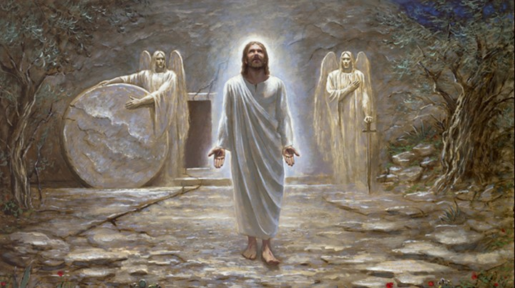
Intro
The empty tomb stands as evidence that
Jesus “is not here, but He has risen” and gives us hope!

Slide 11
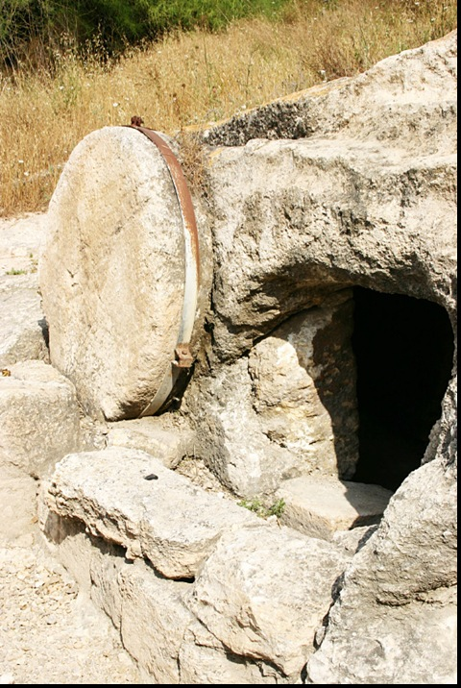
Physical Evidence: Tomb Of Jesus
A solid rock tomb (Mt. 27:60; Mk.
15:46; Lk. 23:53: Cut out of rock)
No entrance from outside (Mt. 27:60; Mk. 16:3-4)
No escape from within (Jn. 19:39-40: Bound; like Lazarus in Jn. 11:44).
A new tomb (Jn. 19:41; Lk. 23:53)
His was the only body laid in the tomb

Slide 12
Physical Evidence: Tomb Of Jesus
Jn. 19:41
41. Now in the place where He was crucified there was a garden, and in the garden a new tomb in which no one had yet been laid.

Slide 13
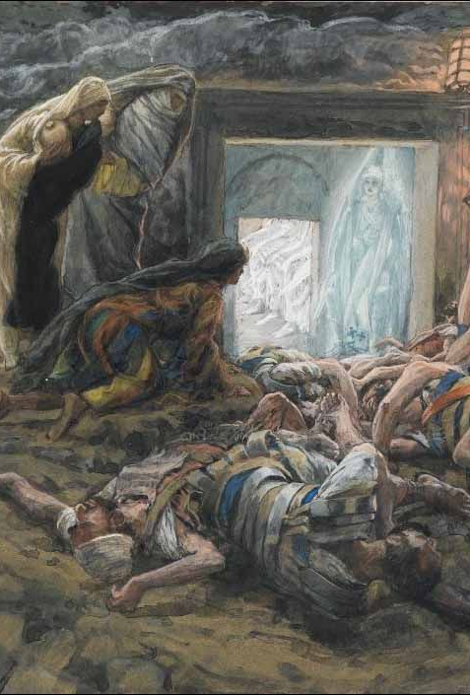
Physical Evidence: Tomb Of Jesus
A borrowed tomb (Is. 53:9; Mt. 27:57-60; Lk. 23:50-53)
The tomb belonged to Joseph of Arimathea – It was his “new tomb.”
A guarded tomb (Mt. 27:65)
Dispels Wrong Tomb & Stolen Body Theory.
Jews, Romans, disciples knew location of tomb.

Slide 14
Physical Evidence: Tomb Of Jesus
Mt. 27:65
65. Pilate said to them, "You have a guard; go, make it as secure as you know how."

Slide 15
Physical Evidence: Tomb Of Jesus
A sealed tomb (Mt. 27:66)
Had a stone rolled in front of it (Mt. 27:60; Mk. 16:3-4) – Dispels Swoon Theory
The Guards sealed the tomb (Mt. 27:66).
An inspected tomb (Mk. 15:47; Lk. 23:55-56)
Location, situation, & condition were well known!
Jews, Romans, and disciples knew its location!

Slide 16
Physical Evidence: Tomb Of Jesus
Lk. 23:55-56
Now the women who had come with Him out of Galilee followed, and saw the tomb and how His body was laid.
Then they returned and prepared spices and perfumes. And on the Sabbath they rested according to the commandment.

Slide 17
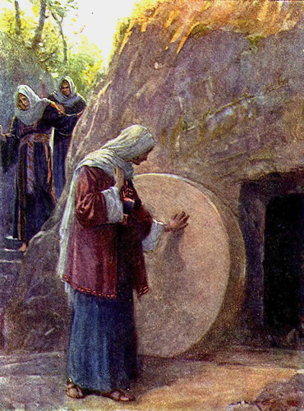
Physical Evidence: Tomb Of Jesus
An empty tomb (Lk. 24:1-3)
All parties to the burial of Jesus agree that He was dead (Mk. 15:42-47; Jn. 19:31-42).
All parties to the burial of Jesus agree that His body was in the tomb (Mt. 27:63-64; 27:66; Mk. 15:45-47).
All parties to the burial of Jesus agree that the tomb was empty on Sunday morning (Mt. 28:9, 11-15; Lk. 24:5-6; Jn. 20:2-8).

Slide 18
Physical Evidence: Tomb Of Jesus
Lk. 24:5-6 (Mt. 28:6, 9)
5. and as the women were terrified and bowed their faces to the ground, the men said to them, "Why do you seek the living One among the dead?
6. "He is not here, but He has risen. Remember how He spoke to you while He was still in Galilee,

Slide 19
Physical Evidence: Tomb Of Jesus
Solid Rock
New
Borrowed
Guarded
Sealed
Inspected
Empty
The well-known tomb was verified as
empty on the third day!

Slide 20
Eyewitness Testimony
Jesus appeared to (individuals):
Mary Magdalene – Mk. 16:9-11; Jn. 20:11-18
Peter – Lk. 24:34; I Cor. 15:5
James, the Lord’s brother – I Cor. 15:7
Saul (Paul) of Tarsus – Acts 9:1-9; I Cor. 15:8

Slide 21
Eyewitness Testimony
Jesus appeared to
(small groups):
The women – Mt. 28:9
2 on the road to Emmaus – Mk. 16:12-13; Lk. 24:33-35
10 apostles (missing Thomas) – Jn. 20:19-23
11 apostles (including Thomas) – Jn. 20:24-29
7 disciples in Galilee – Jn. 21:1-14
11 apostles on Mt. of Olives – Acts 1:4-13; I Cor. 15:7

Slide 22
Eyewitness Testimony
Jesus appeared to
(over five hundred brethren at one time):
I Cor. 15:6: “He appeared to more than five hundred brethren at one time.”
Dispels the hallucination theory.

Slide 23
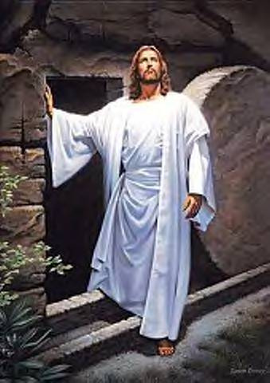
Eyewitness Testimony
Jesus appeared to many individuals
Jesus appeared to several small groups
Jesus appeared to over 500 brethren at one time!
Jesus was seen ALIVE by multitudes after His resurrection!

Slide 24
Are The Witnesses Credible?
What possible motive would they
have to lie? (I Jn. 1:1-4; II Pet.
1:12, 15-16)
Their homes and property were seized – Heb. 10:34
Their families were tortured and put to death.
They often lost their lives.
Consider Paul’s trials – II Cor. 11:21-33; 15:8
Notes:
Early saints lost their lives…(Letter from Gov. Pliny the Younger to Emperor Trajan in 112 A.D. – http://faculty.georgetown.edu/jod/texts/pliny.html)

Slide 25
Are The Witnesses Credible?
It could have been put to rest if
someone produced the body of
Christ!
If the disciples stole the body, why suffer death and torture for a lie?
If Jews stole body, why let Christianity spread?
If Romans stole body, why persecute people believing a lie?

Slide 26
Are The Witnesses Credible?
There wasn’t a body because the tomb was empty!

Slide 27
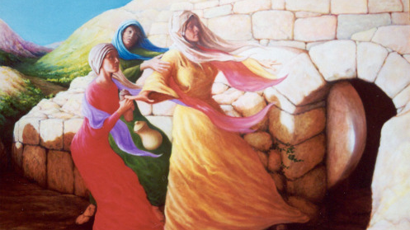
Conclusion
Christians remember Jesus Who died, was buried, and
ROSE the 3rd day, and ascended to Heaven to return again one day!
There is hope in the empty tomb:
Christ is risen and will one day return!

Slide 28
Conclusion
He will bring reward and judgment: must obey the gospel (II Thess. 1:7-9)
Are you ready?
Do you have the hope of
the empty tomb?

Slide 29
“What Must I Do To Be Saved?”
Hear The Gospel (Jn. 5:24; Rom. 10:17)
Believe In Christ (Jn. 3:16-18; Jn. 8:24)
Repent Of Sins (Lk. 13:35; Acts 2:38)
Confess Christ (Mt. 10:32; Rom. 10:10)
Be Baptized (Mk. 16:16; Acts 22:16)
Remain Faithful (Jn. 8:31; Rev. 2:10)
For The Erring Child of God:
Repent (Acts 8:22), Confess (I Jn. 1:9), Pray (Acts 8:22)

