Slide 1
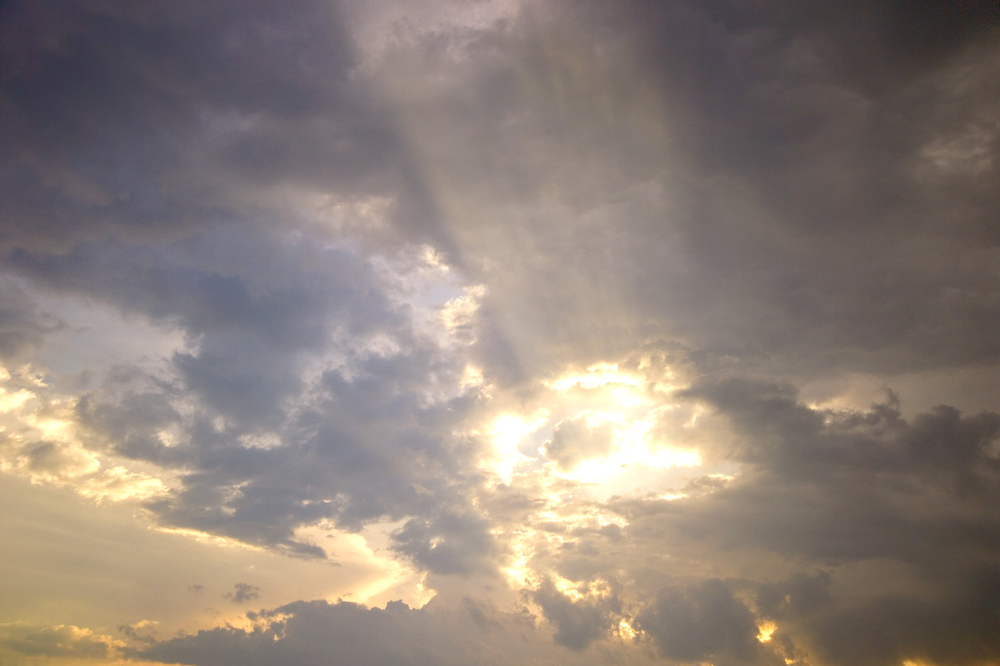
That Which Belongs To God Alone
Text: Jer. 8:2
Notes:
Prepared by Nathan L Morrison
All Scripture given is from NASB unless otherwise stated
For further study, or if questions, please Call: 804-277-1983 or Visit www.courthousechurchofcrist.com

Slide 2
Intro
Jer. 8:1-2
1. "At that time," declares the LORD, "they will bring out the bones of the kings of Judah and the bones of its princes, and the bones of the priests and the bones of the prophets, and the bones of the inhabitants of Jerusalem from their graves.
2. "They will spread them out to the sun, the moon and to all the host of heaven, which they have loved and which they have served, and which they have gone after and which they have sought, and which they have worshiped. They will not be gathered or buried; they will be as dung on the face of the ground.
Devotions that belong to God alone!
Notes:
Emphasis in Scripture mine

Slide 3
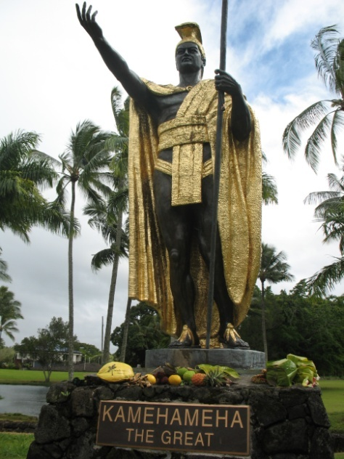
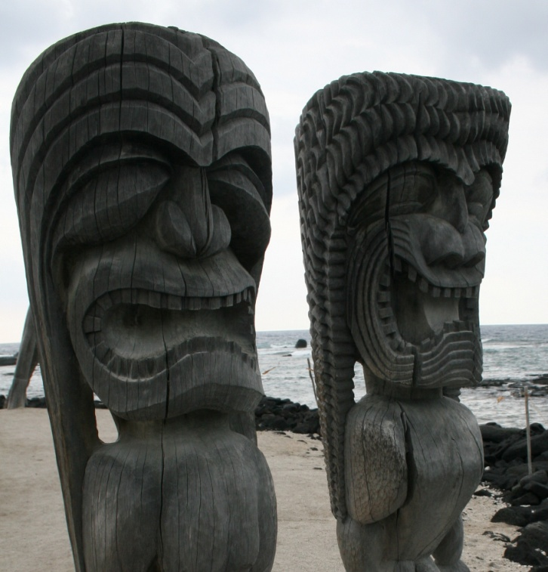
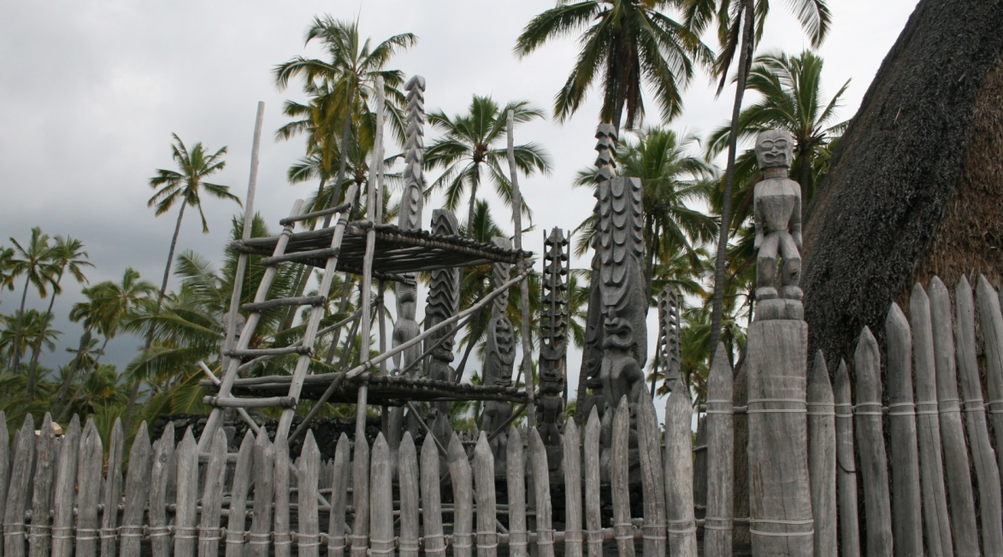
Intro
Hawaii:
An example of idolatry alive and well in modern times
Statue of King
Kamehameha
the Great with offerings
Temple and “tiki”
guardian idols at the
Place of Refuge
Notes:
Pics:
King Kamehameha the Great Statue in Wailoa State Park, Hilo, Hi:
Though not a Hawaiian god, due to his popularity he became “deified” by the people and they offer sacrifices and offerings to his statues, as seen in these pics.
Place of Refuge (Pu’uhonua O Honaunau) National Park on the Big Island, HI:
Has many wood carved idols dotting the landscape, as well as a reconstructed temple grounds, which a State Park Ranger said offerings and sacrifices are offered there regularly, and they are in charge of the “cleanup.” He said certain days and events make them more numerous than other days. The “Tiki Guardian” idols are set up at the water’s edge to “guard” the coast.

Slide 4
Intro
Col. 3:5
5. Therefore consider the members of your earthly body as dead to immorality, impurity, passion, evil desire, and greed, which amounts to idolatry.
“Evil desire, and greed” are acts of selfishness – We sin because we want to! (James 1:14-15)
Let us not devote to other things that which
belongs to God alone!
Notes:
Emphasis in Scripture mine

Slide 5
Love
Jer. 8:2: "They will spread them out to the sun, the moon and to all the host
of heaven, which they have loved …
Mk. 12:29-30
29. Jesus answered him, "The first of all the commandments is: `Hear, O Israel, the Lord our God, the Lord is one.
30. `And you shall love the Lord your God with all your heart, with all your soul, with all your mind, and with all your strength.' This is the first commandment.
We are to give God our love!
I Jn. 5:1-4: We show God our love by “keeping His commandments.”
Notes:
Emphasis in Scripture mine

Slide 6
Love
Jer. 8:2: "They will spread them out to the sun, the moon and to all the host
of heaven, which they have loved …
Our love is demonstrated by obedience! (Rom. 6:16)
We will either demonstrate our love (obedience) to that which is false, resulting in sin, or to God, resulting in righteousness – Rom. 6:16
We will be obedient to something in life, and we need to make sure our love is given to God!
Our love belongs to God alone if we want to live eternally with Him!
Notes:
Emphasis in Scripture mine

Slide 7
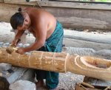
Serve
Jer. 8:2: "They will spread them out to the sun, the moon and to all the host
of heaven, which they have loved and which they have served…
Rom. 1:25
25. For they exchanged the truth of God for a lie, and worshiped and served the creature rather than the Creator, who is blessed forever. Amen.
Charlie Grace, Master Craftsman, carves a
new tiki idol at The Place of Refuge
Isaiah 44:9-20
Notes:
Emphasis in Scripture mine

Slide 8
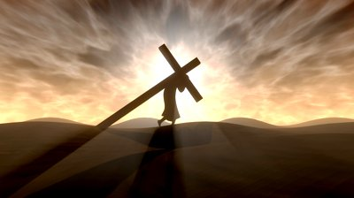
Serve
Jer. 8:2: "They will spread them out to the sun, the moon and to all the host
of heaven, which they have loved and which they have served…
Mt. 4:10
Then Jesus said to him, “Go, Satan! For it is written, `You shall worship the Lord your God, and serve Him only.' ‘‘
Jn. 12:26: To serve God one must Follow Christ.
I Pet. 4:11: One must speak as God speaks, and serve with the strength God supplies (Phil. 4:13).
Col. 3:23-24: When we follow
Christ we serve Christ!
Notes:
Emphasis in Scripture mine

Slide 9
Serve
Jer. 8:2: "They will spread them out to the sun, the moon and to all the host
of heaven, which they have loved and which they have served…
We will serve someone in this life (Mt. 6:24; Rom. 6:16);
we must choose God!
Paul chose God and became His servant – Acts 24:14-15; 27:23; Rom. 1:9-10; II Tim. 1:3: Paul says of himself: “I serve God.”
We will serve whom we love; if we love God our
service belongs to Him alone!
Notes:
Emphasis in Scripture mine

Slide 10
“Go After”
(NKJV) Jer. 8:2: "They shall spread them before the sun and the moon and
all the host of heaven, which they have loved and which they have served and
after which they have walked…
Phil. 3:18-19
18. For many walk, of whom I often told you, and now tell you even weeping, that they are enemies of the cross of Christ,
19. whose end is destruction, whose god is their appetite, and whose glory is in their shame, who set their minds on earthly things.
Notes:
Emphasis in Scripture mine

Slide 11
“Go After”
(NKJV) Jer. 8:2: "They shall spread them before the sun and the moon and
all the host of heaven, which they have loved and which they have served and
after which they have walked…
Eph. 2:10
10. For we are His workmanship, created in Christ Jesus for good works, which God prepared beforehand so that we would walk in them.
To “go after” or “walk after” means to follow that which we love and serve.
We will “walk after” or obey that which we serve! (Manner of life)
Eph. 5:1-4: Saints are to “walk in” love, “as is proper among saints.”
Col. 1:9-12: “Walk in a manner worthy of the Lord.”
I Jn. 2:4-6: We need to “walk in the same manner as He walked.”
We are not to “go after” other things, but are to “walk in a manner worthy of the Lord!”
Notes:
Emphasis in Scripture mine

Slide 12
Seek
Jer. 8:2: "They will spread them out to the sun, the moon and to all the host
of heaven, which they have loved and which they have served, and which they
have gone after and which they have sought…
Mt. 6:33
33. "But seek first His kingdom and His righteousness, and all these things will be added to you.
Col. 3:1-3: “Keep seeking the things above, where Christ is.”
Acts 17:24-28: God created mankind so that “they would seek God.”
Heb. 11:6: God rewards those who seek Him!”
We seek out the things we love and enjoy
Israel had “sought” after false gods
Notes:
Emphasis in Scripture mine

Slide 13
Seek
Jer. 8:2: "They will spread them out to the sun, the moon and to all the host
of heaven, which they have loved and which they have served, and which they
have gone after and which they have sought…
What do you seek after?
We ought to seek after the only One, by which
we can be saved! (Acts 4:12)
Notes:
Emphasis in Scripture mine

Slide 14
Worship
Jer. 8:2: "They will spread them out to the sun, the moon and to all the host
of heaven, which they have loved and which they have served, and which they
have gone after and which they have sought, and which they have
worshiped…
Rom. 1:25
25. For they exchanged the truth of God for a lie, and worshiped and served the creature rather than the Creator, who is blessed forever. Amen.
Acts 17:16, 23
16. Now while Paul was waiting for them at Athens, his spirit was being provoked within him as he was observing the city full of idols.
23. "For while I was passing through and examining the objects of your worship, I also found an altar with this inscription, 'TO AN UNKNOWN GOD.' Therefore what you worship in ignorance, this I proclaim to you.
Notes:
Emphasis in Scripture mine

Slide 15
Worship
Jer. 8:2: "They will spread them out to the sun, the moon and to all the host
of heaven, which they have loved and which they have served, and which they
have gone after and which they have sought, and which they have
worshiped…
Serving and worship go together!
Mt. 4:8-10
8. Again, the devil took Him up on an exceedingly high mountain, and showed Him all the kingdoms of the world and their glory.
9. And he said to Him, "All these things I will give You if You will fall down and worship me.''
10. Then Jesus said to him, "Away with you, Satan! For it is written, `You shall worship the Lord your God, and Him only you shall serve.' ''
Jn. 4:23-24: “True worshipers will worship the Father in spirit and truth.”
Phil. 3:2-3: “True circumcision” refers to the spiritual people of God, and he says we “worship in the Spirit of God and glory in Christ Jesus.”
Rom. 12:1: The way we live our lives is our “spiritual service of worship.”
Notes:
Emphasis in Scripture mine

Slide 16
Worship
Jer. 8:2: "They will spread them out to the sun, the moon and to all the host
of heaven, which they have loved and which they have served, and which they
have gone after and which they have sought, and which they have
worshiped…
God is to be praised and worshiped, and
He alone!
II Kings 19:15-19: King Hezekiah acknowledged God as the only true God, and the Creator of heaven and earth! (False gods are the works of men’s hands!)
Is. 44:9-20: Men cut wood and use half for firewood and the other half they fashion an idol from it and worship it!
Neh. 9:5-6: It is to God alone “the heavenly host bows down.”
Lk. 19:37-40: Jesus said of the multitude praising Him at His triumphal entry into Jerusalem, “If these should hold their peace, the stones would immediately cry out.”
Notes:
Emphasis in Scripture mine

Slide 17
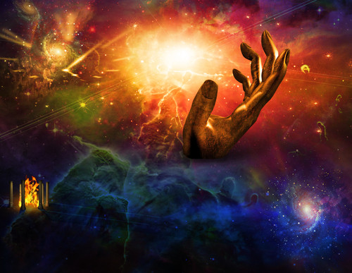
Worship
Jer. 8:2: "They will spread them out to the sun, the moon and to all the host
of heaven, which they have loved and which they have served, and which they
have gone after and which they have sought, and which they have
worshiped…
Our praise, adoration, and worship belong to God,
the Creator, alone!
Notes:
Emphasis in Scripture mine

Slide 18
Conclusion
Jer. 8:2: Israel was guilty of devoting to idols that
which belongs to God alone!
2. "They will spread them out to the sun, the moon and to all the host of heaven, which they have loved and which they have served, and which they have gone after and which they have sought, and which they have worshiped. They will not be gathered or buried; they will be as dung on the face of the ground.
Col. 3:5: People today can be just as guilty of “idolatry”
5. Therefore consider the members of your earthly body as dead to immorality, impurity, passion, evil desire, and greed, which amounts to idolatry.
If not to God, our love, service, manner of life, what we
seek after and worship will be to other things, and we will
stand condemned! (Rom. 6:16; Phil. 3:18-19)
Notes:
Emphasis in Scripture mine

Slide 19
Conclusion
The good news is: Man can change, can repent and serve
the only living God!
I Thess. 1:9
9. For they themselves report about us what kind of a reception we had with you, and how you turned to God from idols to serve a living and true God,
Rom. 6:4
4. Therefore we have been buried with Him through baptism into death, so that as Christ was raised from the dead through the glory of the Father, so we too might walk in newness of life.
Notes:
Emphasis in Scripture mine

Slide 20
Conclusion
Let us devote to God that which belongs to Him alone:
Our love
Service
Manner of life
Our seeking after
Worship

Slide 21
“What Must I Do To Be Saved?”
Hear The Gospel (Jn. 5:24; Rom. 10:17)
Believe In Christ (Jn. 3:16-18; Jn. 8:24)
Repent Of Sins (Lk. 13:35; Acts 2:38)
Confess Christ (Mt. 10:32; Rom. 10:10)
Be Baptized (Mk. 16:16; Acts 22:16)
Remain Faithful (Jn. 8:31; Rev. 2:10)
For The Erring Child:
Repent (Acts 8:22), Confess (I Jn. 1:9),
Pray (Acts 8:22)

