Slide 1
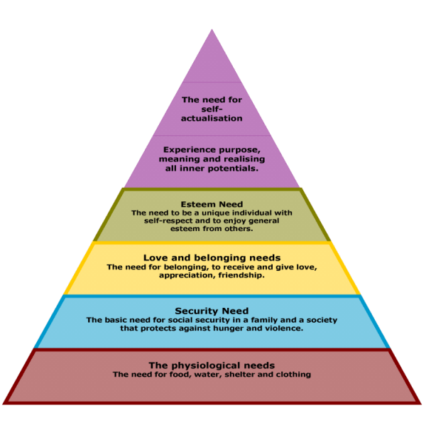
Needful Things
Text: II Peter 1:5-11
Notes:
By Nathan L Morrison
All Scripture given is from NASB unless otherwise stated
For further study or if questions, please Call: 804-277-1983, or Visit: www.courthousechurchofchrist.com
Picture: Maslow’s Hierarchy of Needs Pyramid

Slide 2
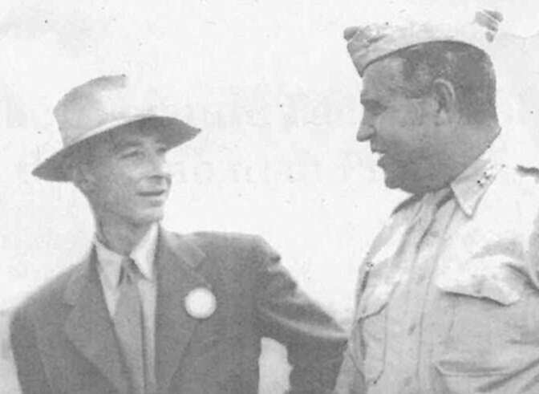
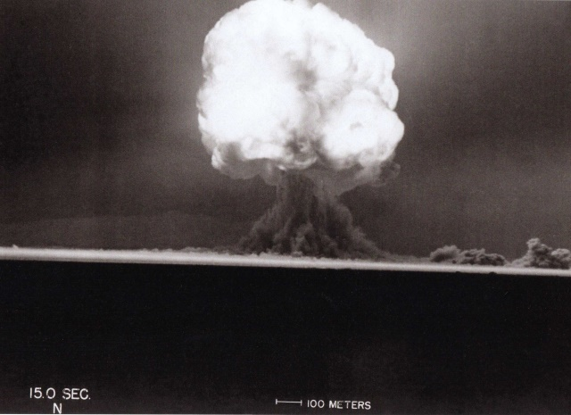
Intro
First atomic bomb explosion at the Trinity Test Site near Los Alamos, NM, at precisely 5:30 AM on Monday, July 16, 1945, entered the world into the Nuclear Age!
“We knew the world would not be the same. A few people laughed, a few people cried, most people were silent. I remembered the line from the Hindu scripture, the Bhagavad-Gita; Vishnu is trying to persuade the Prince that he should do his duty and, to impress him, takes on his multi-armed form and says, ‘Now I am become Death, the destroyer of worlds.’ I suppose we all thought that, one way or another.”
(Dr. J. Robert Oppenheimer)
Notes:
Sources;
https://www.awesomestories.com/asset/view/Oppenheimer-J.-Robert-Now-I-am-Become-Death-
https://www.osti.gov/opennet/manhattan-project-history/Events/1945/trinity.htm
Images:
J. Robert Oppenheimer with General Groves, July 16, 1945 at Los Alamos
The first 15 seconds of the nuclear blast at the Trinity Test Site, July 16, 1945

Slide 3
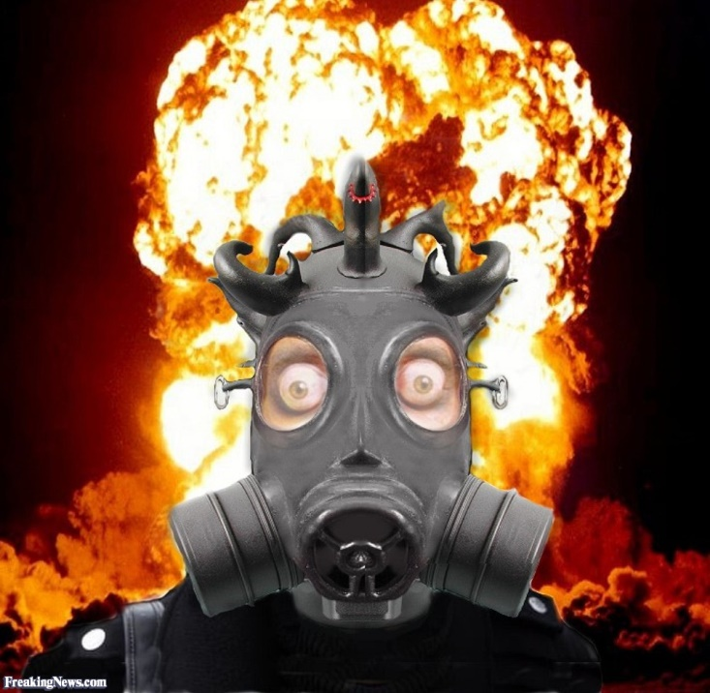
Intro
Is it possible to have a sense of security in a world of atomic bombs?
Security is recognized as one of man’s fundamental needs

Slide 4
Intro
Abraham Maslow’s Hierarchy of Needs Pyramid (1943):
Five things Maslow says man can’t do without:
Food, water, clothing, shelter, & security
The bottom two tiers
of pyramid must be
met before climbing
further:
Physiological Needs
Security Needs
Man’s hierarchy of needs versus what God says man’s hierarchy of needs are…

Slide 5
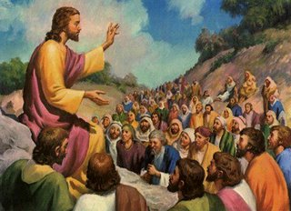
Physical Needs
Jesus said God knows our physical needs and shifted the
focus from the physical to the spiritual
Jesus talks about food & water, clothing, shelter, & safety,
and their importance:
Mt. 6:25-33: Christ says to seek after God first and these will follow.

Slide 6
Physical Needs
Maslow’s Importance of Needs | Jesus’ Response
Food & Water | Mt. 6:25-32: Not to worry about it
Clothing | Mt. 6:25-32: God knows our Needs
Shelter | Mt. 8:18-20: No promise of shelter in this world for following Christ
Safety (Security) | Mt. 10:16-23: Told safety may be in jeopardy as we will be hated by all on account of Christ
Jesus did not place the same importance on our physical
needs as man has! (Psalm 37:25)

Slide 7
Spiritual Needs
In the same way that our physical bodies need food,
water, clothing, shelter, and safety, so does our soul have
basic needs to survive
As Christians, the top of our pyramid (our goal) is heaven.
There is a foundation of needs that need to be met first.
There is a parallel between our physical needs and our spiritual needs…

Slide 8
Spiritual Needs
The Word of God is food for
the soul, and we need to
study to continually grow
in His knowledge!
(I Pet. 2:1-3; II Pet. 3:18)
Mt. 5:6
6. "Blessed are those who hunger and thirst for righteousness, for they shall be satisfied.
Heaven
Food & Water = Study (The Word of God), or Knowledge
Mt. 5:6; II Tim. 2:15; II Pet. 1:2-3; Eph. 4:14-16

Slide 9
Spiritual Needs
As clothing is what is seen
as our outward
appearance, love is to be
what defines us as
Christians!
Col. 3:14
14. Beyond all these things put on love, which is the perfect bond of unity.
Heaven
Clothing = Love
Jn. 13:34-35; Col. 3:12-14
(To put on Love is to put on Jesus – Rom. 13:14; Gal. 3:27)

Slide 10
Spiritual Needs
Our faith provides us with
shelter as it protects us
from the attacks of Satan!
I Jn. 5:4
4. For whatever is born of God overcomes the world; and this is the victory that has overcome the world--our faith.
Heaven
Shelter = Faith
Eph. 6:11, 16; I Cor. 16:13-14; Heb. 11:6; I Jn. 5:4

Slide 11
Spiritual Needs
There is safety in self-
discipline – It is part of
guarding our souls!
(Gal. 5:22-24; II Pet. 1:6)
Lk. 9:23
23. And He was saying to them all, "If anyone wishes to come after Me, he must deny himself, and take up his cross daily and follow Me.
Heaven
Security = Self-control (Discipline)
Lk. 9:23; I Cor. 9:24-27
Spiritual Needs:
Study, Love, Faith

Slide 12
Spiritual Needs
Like the physical pyramid where we can take steps
backward along the way, this is no different:
Heb. 5:12: Those who should be mature sometimes go backwards and need the foundations again
As we need to eat and drink daily, we need daily
nourishment in these things spiritually
II Pet. 1:5-11: These qualities all tie together the fabric of our faith.
Knowledge produces self-control, & out of self-control comes kindness towards love – Practice them to never stumble and enter into Heaven

Slide 13
Spiritual Needs
Practicing these
things will produce
spiritual maturity
on way to Heaven!
Heaven
Spiritual
Growth:
Maturity in God’s Word
Heb. 5:14; II Pet. 3:18
Spiritual Security Need:
Self-Control
Spiritual Needs:
Study, Love, Faith

Slide 14
Conclusion
Sometimes we need to be reminded that the day-to-day needs we often stress over, Jesus fulfills in Himself:
Physical Needs | Jesus Provides
Food & Water | Bread of Life – Jn. 6:35 Eternal Water – Jn. 4:12-14
Clothing | Clothing – Gal. 3:27 (His attributes & character)
Shelter | Heaven – Jn. 14:2-3
Safety (Security) | Never Forsake – Rom. 8:31; Heb. 13:5-6

Slide 15
Intro
Is it possible to have a sense of security in a world of atomic bombs?
In Jesus, Yes!

Slide 16
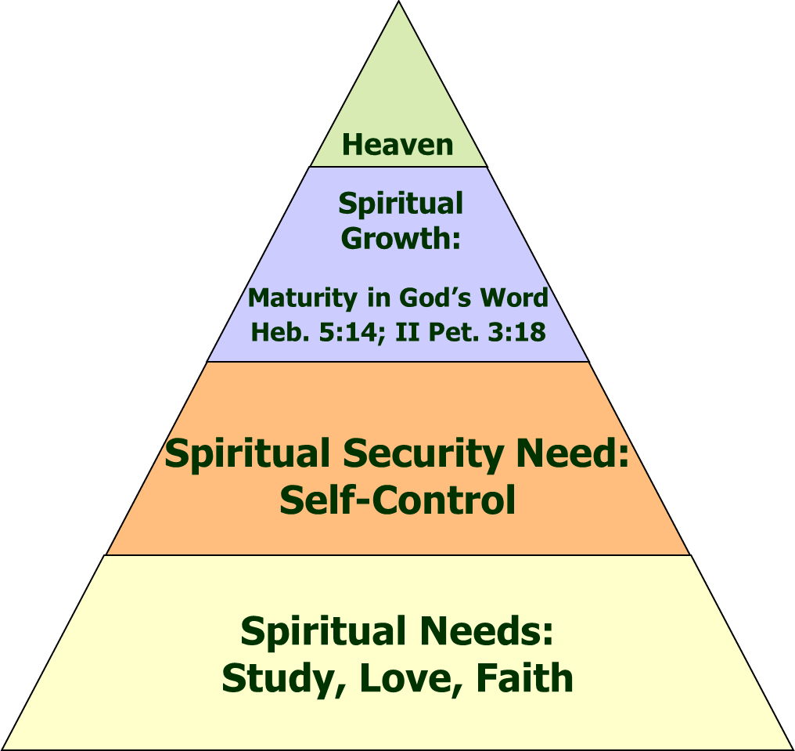
Conclusion
Man’s importance of needs is different than God’s!
Man says can’t achieve
goals in life without
physical needs
God says can’t enter
Heaven without applying these spiritual needs

Slide 17
Conclusion
Maslow said most people don’t reach their self-
actualization goals – God says we have a reservation
in Heaven! (I Pet. 1:3-5)
True sense of security comes from knowing our souls are
secure in Christ! (I Pet. 4:19)
Where are your priorities?
Physical or Spiritual? (Perishable or Imperishable?)

Slide 18
“What Must I Do To Be Saved?”
Hear The Gospel (Jn. 5:24; Rom. 10:17)
Believe In Christ (Jn. 3:16-18; Jn. 8:24)
Repent Of Sins (Lk. 13:35; Acts 2:38)
Confess Christ (Mt. 10:32; Rom. 10:10)
Be Baptized (Mk. 16:16; Acts 22:16)
Remain Faithful (Jn. 8:31; Rev. 2:10)
For The Erring Child of God:
Repent (Acts 8:22), Confess (I Jn. 1:9),
Pray (Acts 8:22)

