Slide 1
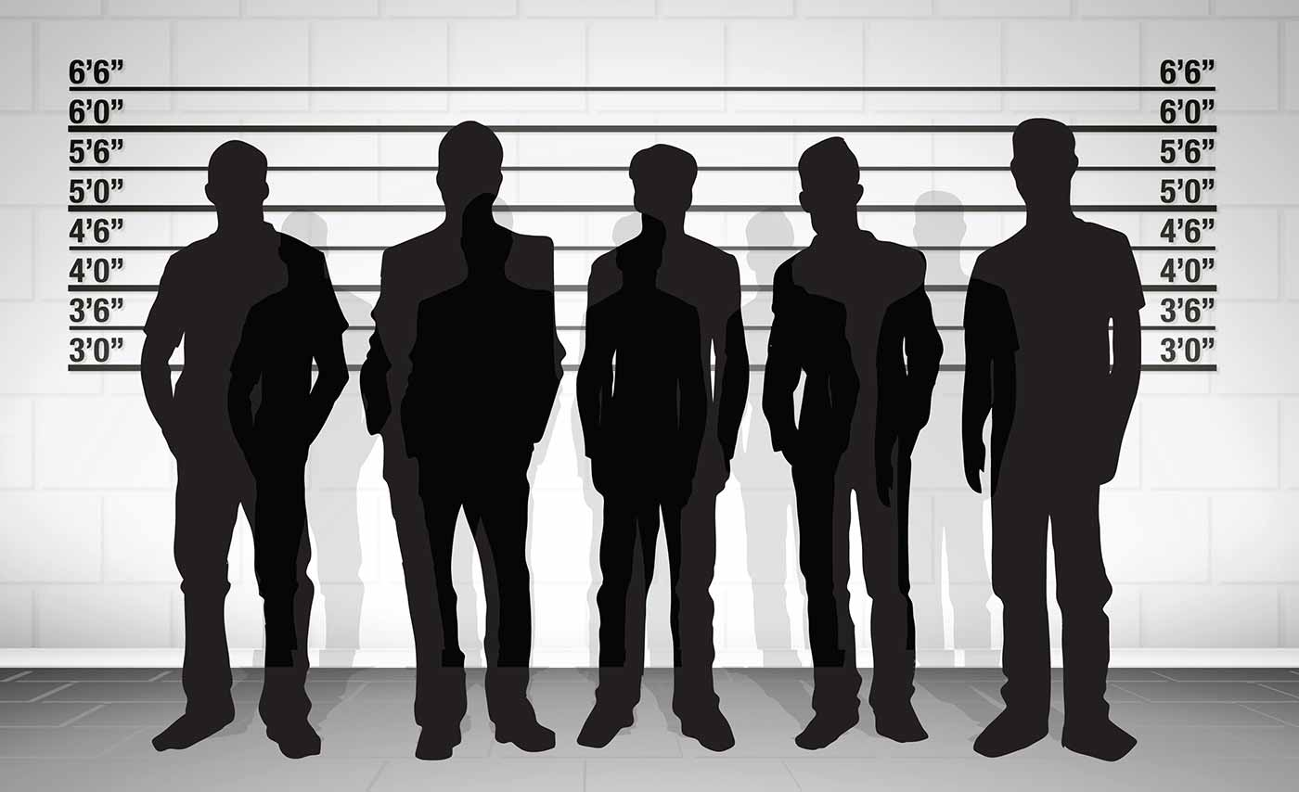
Five Brothers In Danger
Text: Luke 16:27-28, 30
Notes:
By Nathan L Morrison for Sunday 02/25/18
All Scripture given is from NASB unless otherwise stated
For further study or if questions, Call: 804-277-1983, or Visit: www.courthousechurchofchrist.com

Slide 2
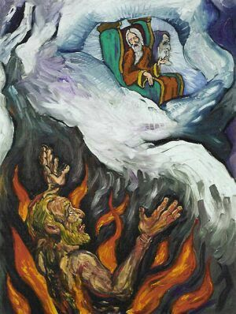
Intro
Luke 16:19-31: The rich man and Lazarus the poor man
Both died and went somewhere together
One in bliss and the other in torment
Both separated by an un-crossable chasm!
Jesus made clear: Both men physically died; Both men (even after death) were still living in some form with their consciousness in tact!
The rich man, in torments, was feeling pain and regret
Lk. 16:23-27: He could see, feel, speak, and hear!
Lk. 16:24-26: He could experience thirst
(asked for Lazarus to bring him water –
told there was an un-crossable chasm (KJV: “gulf”)!
Notes:
Emphasis in Scripture mine!

Slide 3
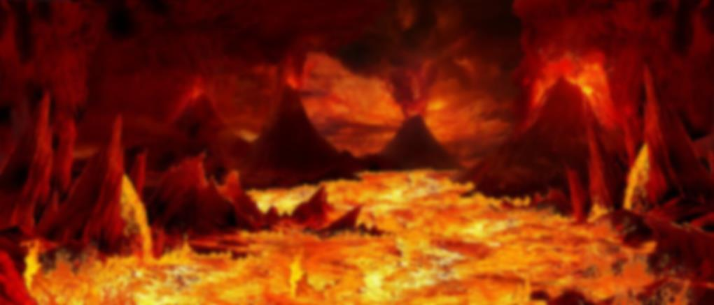
Intro
Luke 16:27-28, 30
27. "And he said, 'Then I beg you, father, that you send him to my father's house--
28. for I have five brothers--in order that he may warn them, so that they will not also come to this place of torment.'
30. "But he said, 'No, father Abraham, but if someone goes to them from the dead, they will repent!'
This man’s five brothers were in danger and he wanted them warned!
Notes:
The rich man thought Lazarus going to his family from the dead would convince them to repent! Lazarus, brother to Mary and Martha, proved otherwise (John 12:9-11); and Jesus raising from the dead proved otherwise (Mt. 28:11-15)

Slide 4
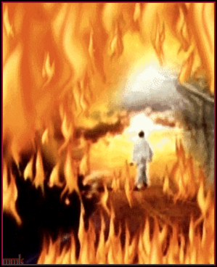
Intro
“Misery loves company”
Except in torments awaiting judgment (Lk. 16:24), and in Hell (Mt. 25:41)!
What these five brothers in danger had mirrors
what the lost of the world has today!
Notes:
Emphasis in Scripture mine!

Slide 5
Five Brothers In Danger – What They Had:
Had A Brother In Torments
Lk. 16:22-24: Their brother was the rich man who died and was in “torments” and in “agony in this flame”
The Scriptures plainly teach there is a separation at death and an eternal one at the Judgment Day (Mt. 25:31-46) – No excuse for not knowing & not being prepared!

Slide 6
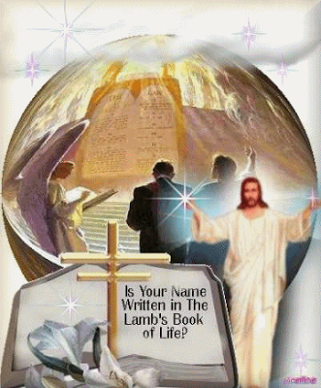
Five Brothers In Danger – What They Had:
Had A Brother In Torments
Had Sins Not Repented Of
Lk. 16:28, 30: Their brother, the rich man in torments, knew they needed to repent, which suggests they may have been living similar to him (16:19, 25)
Lk. 13:3, 5 (Jn. 8:24)
Rev. 2:5
It is a scary thing to face the Lord unrepentant!
(Rev. 20:11-15)

Slide 7
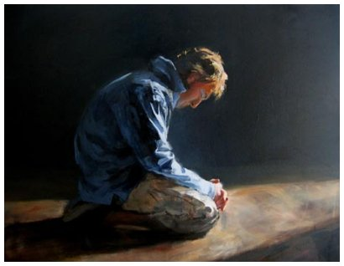
Five Brothers In Danger – What They Had:
Had A Brother In Torments
Had Sins Not Repented Of
Had A Brother In Torments That Could Not Repent For Them
Lk. 16:30: Their brother the rich man wanted them warned badly enough he wanted Lazarus sent from the dead so that they would repent!
Acts 2:38; 17:30; 26:19-20
II Pet. 3:9 (Acts 2:38)
II Cor. 5:10 (Acts 26:20)
Confess sins to God (II Sam. 12:13)--He will forgive you (Acts 8:22; I Jn. 1:9)!

Slide 8
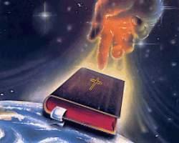
Five Brothers In Danger – What They Had:
Had A Brother In Torments
Had Sins Not Repented Of
Had A Brother In Torments-Could Not Repent For Them
Had Moses And The Prophets
Lk. 16:29: “But Abraham said, 'They have Moses and the Prophets; let them hear them.'”
Mt. 15:7-9
II Tim. 3:16-17
II Pet. 3:1-2: Peter said to “remember the words spoken beforehand by the holy prophets and the commandment of the Lord and Savior spoken by your apostles”

Slide 9
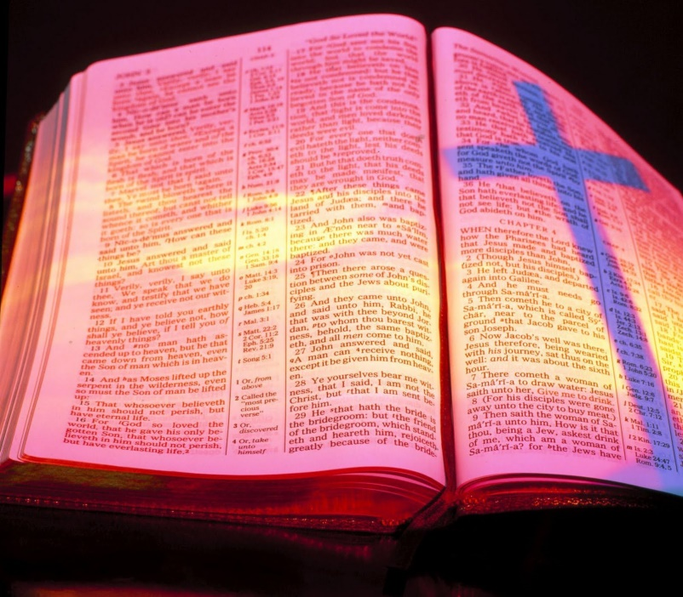
Five Brothers In Danger – What They Had:
Had A Brother In Torments
Had Sins Not Repented Of
Had A Brother In Torments-Could Not Repent For Them
Had Moses And The Prophets
Had Ability To Hear & Obey
Lk. 16:29: “But Abraham said, 'They have Moses and the Prophets; let them hear them'”
James 1:21 (Js. 1:22-25)
Rom. 1:5 (1:1-7); II Cor. 10:5
Rom. 6:16-18
Lk. 16:31: “If they do not listen to Moses and the Prophets, they will not be persuaded even if someone rises from the dead” – True of the lost today! (Acts 2:22-24, 32-36)

Slide 10
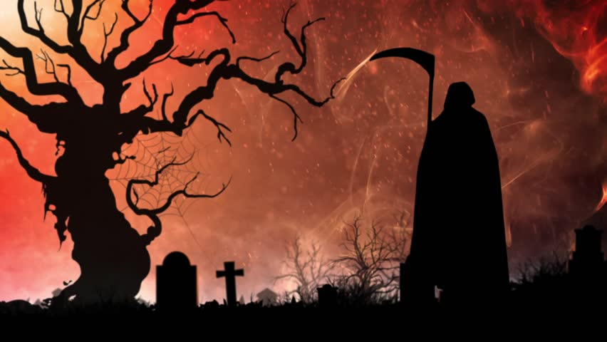
Five Brothers In Danger – What They Had:
Had A Brother In Torments
Had Sins Not Repented Of
Had A Brother In Torments-Could Not Repent For Them
Had Moses And The Prophets
Had Ability To Hear & Obey
Had A Death To Meet
Lk. 16:30: Their brother the rich man was worried they would meet his fate if they did not repent by the time they too died
Heb. 9:27: It is appointed for men to die once then judgment! Death comes to all (the rich and poor – Lk. 16:22)!

Slide 11
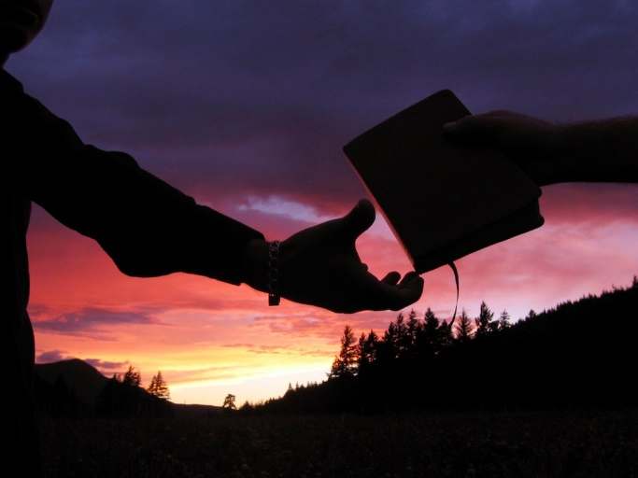
Five Brothers In Danger – What They Had:
Had A Brother In Torments
Had Sins Not Repented Of
Had A Brother In Torments-Could Not Repent For Them
Had Moses And The Prophets
Had Ability To Hear & Obey
Had A Death To Meet
Had A Judgment To Face
Lk. 16:23: Hades, the receptacle of the dead, where even angels await the judgment (II Pet. 2:4 “Tartaros” for “hell”: deep abyss of Hades; Jude 6)
Jn. 5:28-29 (Mt. 25:31-46; Rev. 20:11-15)
Rev. 20:11-15
II Cor. 5:9-11: Knowing there is a
Judgment Day awaiting us all, saints
are to “persuade men”
(teach the gospel) and keep
ourselves holy (II Pet. 3:10-12)!

Slide 12
Five Brothers In Danger – What They Had:
Had A Brother In Torments
Had Sins Not Repented Of
Had A Brother In Torments-Could Not Repent For Them
Had Moses And The Prophets
Had Ability To Hear & Obey
Had A Death To Meet
Had A Judgment To Face
The rich man’s five brothers were in danger and he
wanted them warned – all the lost of the world are in the
same danger and need to be warned while there is still
a chance!

Slide 13
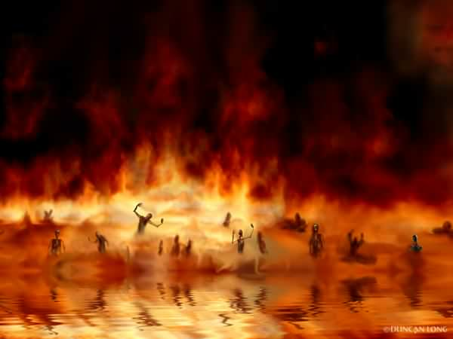
Conclusion
The lost of the world are like the rich man’s 5 brothers –
they have God’s word and need to hear it and obey it to
avoid eternal torments!
Our souls will live on forever – in one of two very
different places! (Mt. 25:34, 41, 46)

Slide 14
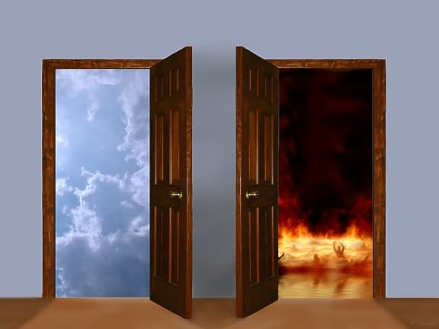
Conclusion
When we die, the time for change is over – either we will
enter Paradise to meet Lazarus and Abraham or into
Tartaros with false teachers and disobedient angels to
await final judgment!
(Luke 16:22-23; II Pet. 2:4, 9; Jude 6; Rev. 20:11-15)

Slide 15
Conclusion
Nothing better than to enter eternal bliss, and nothing
worse than to enter eternal torments!
Where will your soul reside for eternity?
Will the angels bear you away to bliss or will you awake in torments?
Like the rich man’s
five brothers, the
lost need to hear &
obey the word of
God!

Slide 16
“What Must I Do To Be Saved?”
Hear The Gospel (Jn. 5:24; Rom. 10:17)
Believe In Christ (Jn. 3:16-18; Jn. 8:24)
Repent Of Sins (Lk. 13:35; Acts 2:38)
Confess Christ (Mt. 10:32; Rom. 10:10)
Be Baptized (Mk. 16:16; Acts 22:16)
Remain Faithful (Jn. 8:31; Rev. 2:10)
For The Erring Child of God:
Repent (Acts 8:22), Confess (I Jn. 1:9),
Pray (Acts 8:22)

