Slide 1
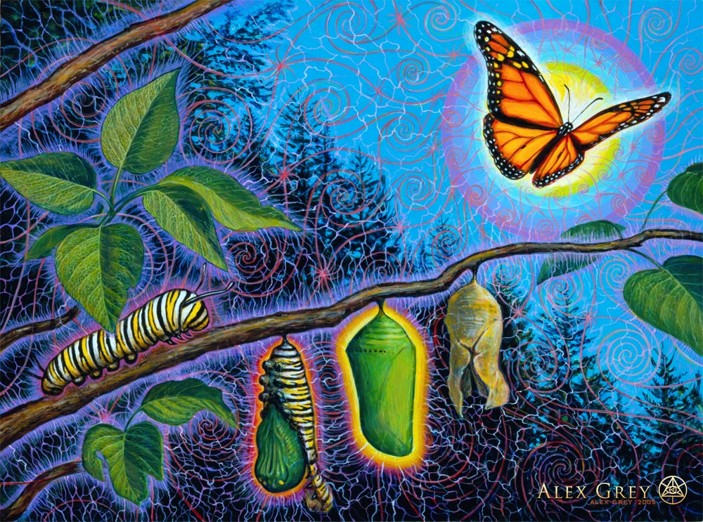
“Be Transformed!”
Text: Mark 12:29-31
Notes:
Prepared by Nathan L Morrison
All Scripture given is from NASB unless otherwise stated
For further study, or if questions, please Call: 804-277-1983 or Visit www.courthousechurchofcrist.com
Based on a lesson by Richard Thetford

Slide 2
Intro
Mark 12:29-31 (12:32-34: The scribe understood!)
29. Jesus answered, "The foremost is, 'HEAR, O ISRAEL! THE LORD OUR GOD IS ONE LORD;
30. AND YOU SHALL LOVE THE LORD YOUR GOD WITH ALL YOUR HEART, AND WITH ALL YOUR SOUL, AND WITH ALL YOUR MIND, AND WITH ALL YOUR STRENGTH.'
31. "The second is this, 'YOU SHALL LOVE YOUR NEIGHBOR AS YOURSELF.' There is no other commandment greater than these."
John 14:15
“If you love Me, you will keep My commandments.”
Notes:
Emphasis in Scripture mine!

Slide 3
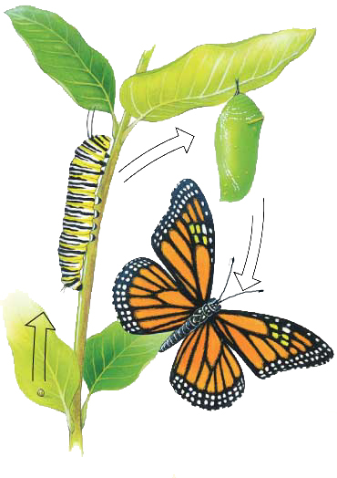
Intro
We are to be a people that has
been TRANSFORMED because of our love for God!

Slide 4
Transformation Over World
Transformation
Child of the World
OVER
Eph. 2:1-2
1. And you were dead in your trespasses and sins,
2. in which you formerly walked according to the course of this world, according to the prince of the power of the air, of the spirit that is now working in the sons of disobedience.
“For I am not ashamed of the gospel, for it is the power of God for salvation to everyone who believes, to the Jew first and also to the Greek. For in it the righteousness of God is revealed from faith to faith; as it is written, "BUT THE RIGHTEOUS man SHALL LIVE BY FAITH."
Romans 1:16-17
(Rom. 6:3-4, 11-13; Gal. 3:26-29)
I Jn. 3:1
“See how great a love the Father has bestowed on us, that we would be called children of God; and such we are. For this reason the world does not know us, because it did not know Him.”
Child of God
Notes:
“Transform” = metamorphoō [met-am-or-fo'-o] (G3339): to transform (The word we get “Metamorphosis” from); lit. “change form”

Slide 5
Transformation Over World
Rom. 12:1-2
1. Therefore I urge you, brethren, by the mercies of God, to present your bodies a living and holy sacrifice, acceptable to God, which is your spiritual service of worship.
2. And do not be conformed to this world, but be transformed by the renewing of your mind, so that you may prove what the will of God is, that which is good and acceptable and perfect.
Notes:
“Transform” = metamorphoō [met-am-or-fo'-o] (G3339): to transform (The word we get “Metamorphosis” from); lit. “change form”

Slide 6
Transformation Over World
LIVING SACRIFICE!
Jesus gave His all – expects our all (I Jn. 4:10, 19; Heb. 12:1-3)
Our bodies to be holy – I Pet. 1:15; 2:5, 9; I Jn. 5:4
Saints to be transformed! - II Pet. 1:4; I Jn. 4:4; I Cor. 6:18-20; Rom. 6:3-4
Titus 2:11-13
11. For the grace of God has appeared, bringing salvation to all men,
12. instructing us to deny ungodliness and worldly desires and to live sensibly, righteously and godly in the present age,
13. looking for the blessed hope and the appearing of the glory of our great God and Savior, Christ Jesus,

Slide 7
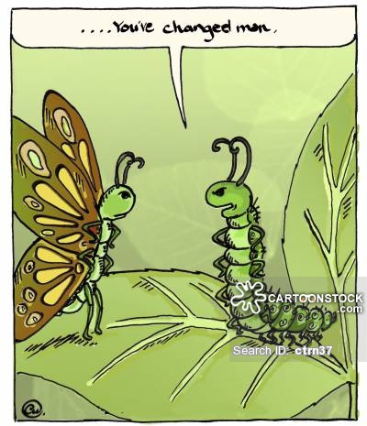
Transformation Over World
Saints are a people transformed from our old dead life of
sin in the world (Eph. 2:1-2) to a new life of service to
God and to one another! (I Pet. 4:1-5)

Slide 8
Transformation Over Fleshly Desires
Transformation
Fleshly Desires
OVER
Gal. 5:19-21 (I Cor. 6:9-10)
…immorality, impurity, sensuality, idolatry, sorcery, enmities, strife, jealousy, outbursts of anger, disputes, dissensions, factions, envying, drunkenness, carousing, and things like these…those who practice such things will not inherit the kingdom of God!
“AND YOU SHALL LOVE THE LORD YOUR GOD WITH ALL YOUR HEART, AND WITH ALL YOUR SOUL, AND WITH ALL YOUR MIND, AND WITH ALL YOUR STRENGTH.’
The second is this, 'YOU SHALL LOVE YOUR NEIGHBOR AS YOURSELF.' There is no other commandment greater than these."
Mark 12:30-31
Gal. 5:22-23
…love, joy, peace, patience, kindness, goodness, faithfulness, gentleness, self-control; against such things there is no law!
(Eph. 5:3; Col. 3:5; Jn. 15:10; I Jn. 4:16)
Fruit of the Spirit

Slide 9
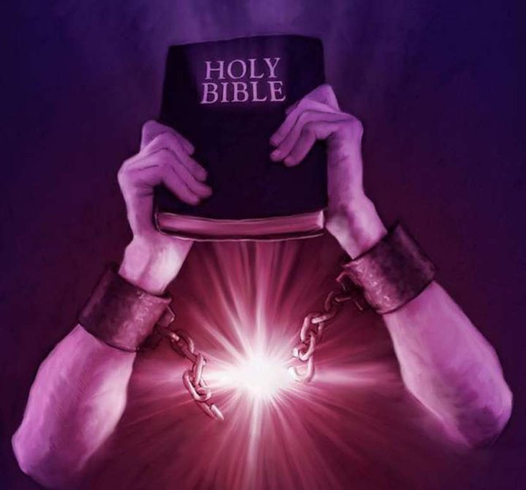
Transformation Over Fleshly Desires
Saints who love God with their whole being will be
transformed over the bonds of fleshly desires and abide
in the love of Jesus!

Slide 10
Transformation Over Apathy and Unfaithfulness
Apathy & Unfaithfulness
Transformation
OVER
Heb. 3:7-Heb. 4:11 (3:12-13)
…Take care, brethren, that there not be in any one of you an evil, unbelieving heart that falls away from the living God.
But encourage one another day after day, as long as it is still called "Today," so that none of you will be hardened by the deceitfulness of sin…
“AND YOU SHALL LOVE THE LORD YOUR GOD WITH ALL YOUR HEART, AND WITH ALL YOUR SOUL, AND WITH ALL YOUR MIND, AND WITH ALL YOUR STRENGTH.’
The second is this, 'YOU SHALL LOVE YOUR NEIGHBOR AS YOURSELF.' There is no other commandment greater
than these."
Mark 12:30-31 (Phil. 1:9-10; I Tim. 1:5; I Pet. 1:22)
II Pet. 1:5-7
…faith, moral excellence, knowledge, self-control, perseverance, godliness, brotherly kindness, love!
(I Cor. 15:58; Mt. 10:32-39;
Lk. 9:62)
Fruitful

Slide 11
Transformation Over Apathy and Unfaithfulness
Saints who love God will be transformed and wholly
devoted to Him and to one another!

Slide 12
Conclusion
When we are truly transformed in the image of Jesus (II Cor. 3:18), then there will be no place for fleshly
desires, apathy, unfaithfulness, or excuses of any kind!
“AND YOU SHALL LOVE THE LORD YOUR GOD WITH ALL YOUR HEART, AND WITH ALL YOUR SOUL, AND WITH ALL YOUR MIND, AND WITH ALL YOUR STRENGTH.’ The second is this, 'YOU SHALL LOVE YOUR NEIGHBOR AS YOURSELF.' There is no other commandment greater than these.”
Mk. 12:30-31
Evidenced
By:
Faithfulness
Steadfastness
Fruitfulness

Slide 13
Conclusion
I Cor. 15:51-53
51. Behold, I tell you a mystery; we will not all sleep, but we will all be changed,
52. in a moment, in the twinkling of an eye, at the last trumpet; for the trumpet will sound, and the dead will be raised imperishable, and we will be changed.
53. For this perishable must put on the imperishable, and this mortal must put on immortality.

Slide 14
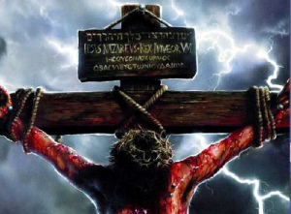
Conclusion
May we all be determined now to
serve our Savior with the same fervor
that He exemplified when He died for you and me!

Slide 15
“What Must I Do To Be Saved?”
Hear The Gospel (Jn. 5:24; Rom. 10:17)
Believe In Christ (Jn. 3:16-18; Jn. 8:24)
Repent Of Sins (Lk. 13:35; Acts 2:38)
Confess Christ (Mt. 10:32; Rom. 10:10)
Be Baptized (Mk. 16:16; Acts 22:16)
Remain Faithful (Jn. 8:31; Rev. 2:10)
For The Erring Child:
Repent (Acts 8:22), Confess (I Jn. 1:9),
Pray (Acts 8:22)

