Slide 1
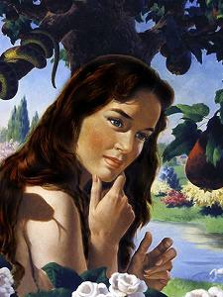
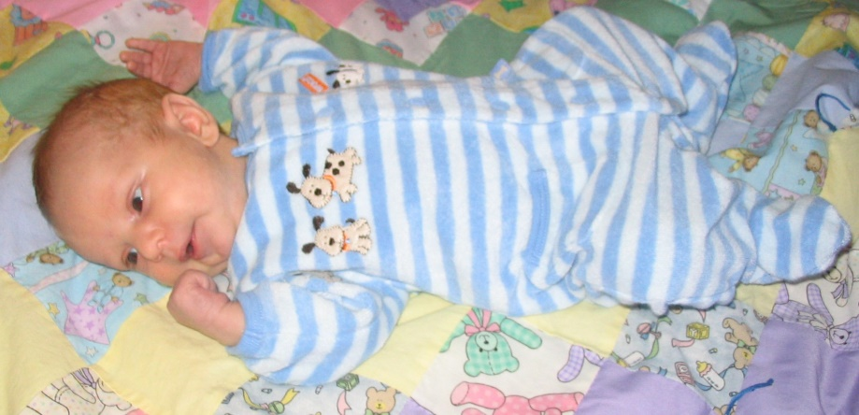
Three Births Of Life
Text: James 1:13-18
Notes:
By Nathan L Morrison
All Scripture given is from the NASB unless otherwise stated
For further study or if questions, please Call: 804-277-1983; or Visit: www.courthousechurchofchrist.com
Based on a lesson by Steve Wallace
Image of Child: Author’s son, Dracen, less than one month old

Slide 2
Intro
James 1:13-18
13. Let no one say when he is tempted, "I am being tempted by God"; for God cannot be tempted by evil, and He Himself does not tempt anyone.
14. But each one is tempted when he is carried away and enticed by his own lust.
15. Then when lust has conceived, it gives birth to sin; and when sin is accomplished, it brings forth death.
16. Do not be deceived, my beloved brethren.
17. Every good thing given and every perfect gift is from above, coming down from the Father of lights, with whom there is no variation or shifting shadow.
18. In the exercise of His will He brought us forth by the word of truth, so that we would be a kind of first fruits among His creatures.
Notes:
Emphasis in Scripture mine!

Slide 3
Intro
James 1:15, 18
15. Then when lust has conceived, it gives birth to sin; and when sin is accomplished, it brings forth death.
18. In the exercise of His will He brought us forth by the word of truth, so that we would be a kind of first fruits among His creatures.
Js. 1:15, 18 uses a word for birth twice:
“Birth” = G5088 tikto [tik'-to]: to produce (from seed, as a mother, a plant, the earth, etc.), literal or figurative: - bear, be born, bring forth, be delivered, be in travail (labor). (4 Macc. 15:16-17; Mt. 1:25; Lk. 2:7)
“Brought us forth” (KJV: “Begat”) = G616 apokueō [ap-ok-oo-eh'o]: to breed forth, that is (by transformation), to generate (figuratively): - beget (begat), bring forth.
Notes:
Emphasis in Scripture mine!

Slide 4
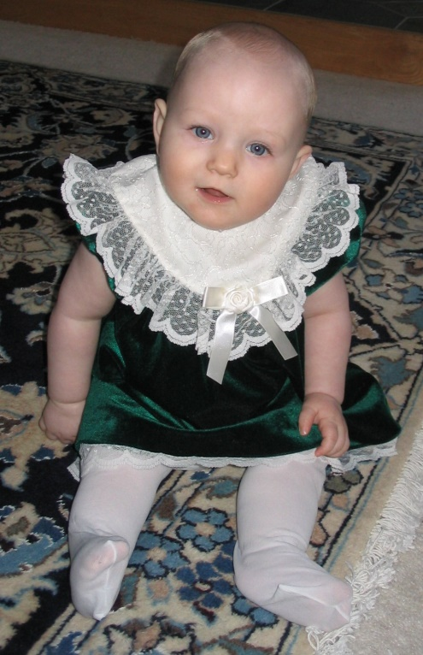
Intro
There are 3 births mentioned in the Scriptures
Physical birth
Birth of sin
Birth of one from the Word of God
All of us have gone through the first, but which of
the other two describe your life?!
Obey
?
SIN
?
Notes:
Image:
Author’s Daughter, Alana, 7 months old

Slide 5
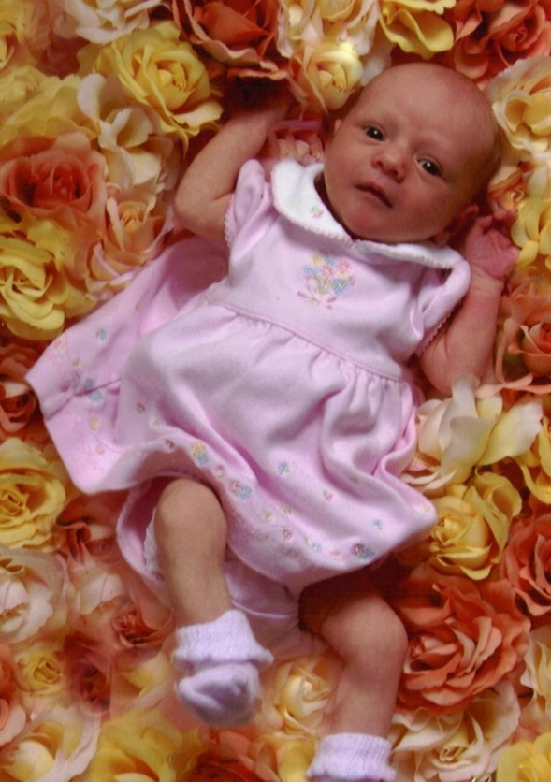
Physical Birth
Adam & Eve created – Not born!
(Gen. 1:27)
Everyone after them born according to law of reproduction!
(Gen. 4, 5, 10-11; I Chr. 1-2; Mt. 1)
Mt. 18:3
3. and said, "Truly I say to you, unless you are converted and become like children, you will not enter the kingdom of heaven.
Mt. 1:18-25: The account of the birth
of Jesus (Gr. Genesis/Lat. Nativity)
1:18: “The birth of Jesus” – G1078 genesis
1:25: “Gave birth “ – G5088 tikto
People are born innocent!
Ezek. 18:20; Mt. 18:3
If not, Jesus would have been born sinful, yet we read He was sinless (II Cor. 5:21) – If in sin, how was He atoned for? (Eph. 1:7)
Physical birth is the beginning of life
after Adam & Eve!
Notes:
Image:
Author’s Daughter, Alana, 1 day old

Slide 6
Birth of Sin
Js. 1:14-15 (Rom. 3:23)
14. But each one is tempted when he is carried away and enticed by his own lust.
15. Then when lust has conceived, it gives birth to sin; and when sin is accomplished, it brings forth death.
Sin “doesn’t just happen,” it is committed!
Man is active in the birth of sin!
Gen. 2:17; 3:1-6; Josh. 7:21; II Sam. 11:2-5
Eve saw the fruit as “pleasing to the eye”
Achan “coveted”
David lusted
The birth of sin begins with evil
desire and it is “brought forth”
into existence by people
committing it!

Slide 7
Birth Brought About by the Word of God
Js. 1:17-18: (Rom. 1:16; Heb. 4:12; I Cor. 4:15)
17. Every good thing given and every perfect gift is from above, coming down from the Father of lights, with whom there is no variation or shifting shadow.
18. In the exercise of His will He brought us forth by the word of truth, so that we would be a kind of first fruits among His creatures.
21. Therefore, putting aside all filthiness and all that remains of wickedness, in humility receive the word implanted, which is able to save your souls.
Process: Lust births Sin – Sinned and then “begotten
through gospel” = New Birth
Jn. 3:3, 5-6; I Pet. 1:22-23
One must obey the word
(II Thess. 1:8)
Ps. 19:7; I Pet. 1:22-23;
I Cor. 4:15

Slide 8
Birth Brought About by the Word of God
How does one obey the word to be “born again?”
Many in religious world teach man is born with sin on his soul (“Original Sin”)
They tell us to be saved requires the “Direct Operation of the Holy Spirit.”
They teach belief in God without action (Js. 2:14-26) saves through prayer, “spiritual experiences,” and appeals to emotions, etc.
Both Original Sin and Direct Operation of the Spirit are
contrary to the Scriptures!
Lk. 8:11-15: Parable of Sower
The sinner can have an “honest and good heart” so that the seed (word) may be planted there. Not original sin!
Further, the “seed” (word) was sown on all soils
The Holy Spirit operated through
the word, not directly!

Slide 9
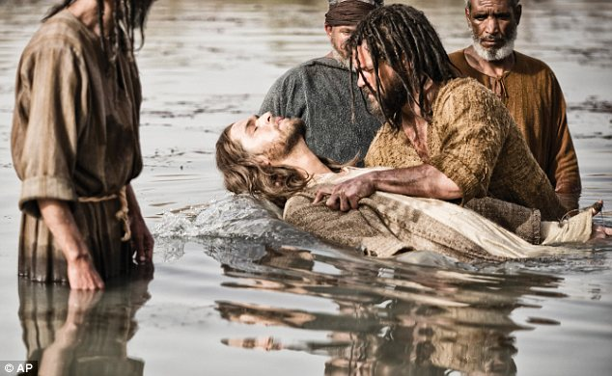
Birth Brought About by the Word of God
What does the word say one must do to be born again?
Jn. 3:3-7: Must be born again; born of water and the Spirit!
Mk. 16:16; Acts 2:38; 22:16: Baptism washes away our sins!
Gal. 3:26-27: After baptism we are His children, we have been “begotten.”
Acts 22:16
16. 'Now why do you delay? Get up and be baptized, and wash away your sins, calling on His name.'
Gal. 3:26-27
26. For you are all sons of God through faith in Christ Jesus.
27. For all of you who were baptized into Christ have clothed yourselves with Christ.
Obedience to the gospel “brings
forth” saints – children of God!
(Rom. 8:14-17)

Slide 10
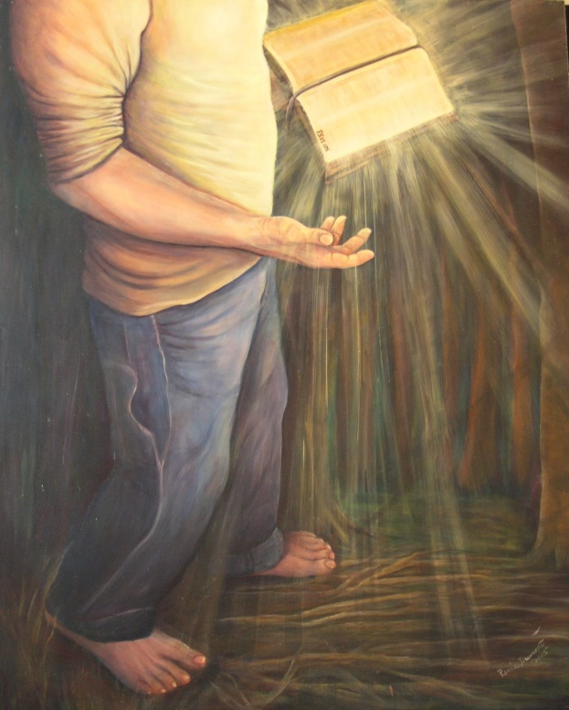
Conclusion
Man is active in becoming a sinner – Man is active in
responding to the word to be forgiven!
The Scriptures teach that man actively follows the devil
into sin (Js. 1:13-15) and actively follows God’s word
out of sin (Js. 1:17-18, 21)!
Birth is only the beginning;
One must live faithfully!
(Jn. 8:31)

Slide 11
Conclusion
Three births in the word of God!
Physical birth
Birth of sin
Birth of one from the Word of God
All of us have been
through the first birth…
Where are you in relation to the other two births?

Slide 12
“What Must I Do To Be Saved?”
Hear The Gospel (Jn. 5:24; Rom. 10:17)
Believe In Christ (Jn. 3:16-18; Jn. 8:24)
Repent Of Sins (Lk. 13:35; Acts 2:38)
Confess Christ (Mt. 10:32; Rom. 10:10)
Be Baptized (Mk. 16:16; Acts 22:16)
Remain Faithful (Jn. 8:31; Rev. 2:10)
For The Erring Child:
Repent (Acts 8:22), Confess (I Jn. 1:9),
Pray (Acts 8:22)

