Slide 1
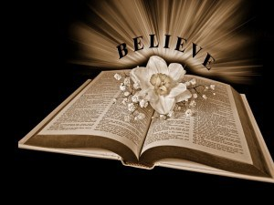
Three Actions Of Believers
Text: Heb. 11:6
Notes:
By Nathan L Morrison
All Scripture given is from NASB unless stated otherwise
For further study or if questions, Call: 804-277-1983 or visit www.courthousechurchofcrist.com

Slide 2
Intro
Heb. 11:6
6. And without faith it is impossible out to please Him, for he who comes to God must believe that He is and that He is a rewarder of those who seek Him.
“Faith” = G4102 pistis [pist’-is]: persuasion, moral conviction, belief (Required to please God!)
“Believe” = G4100 pisteuō [pist-yoo'-o]: From G4102; to have faith (in, upon, or with respect to, a person or thing), that is, credit; by implication to entrust (especially one’s spiritual well-being to Christ): believe (-r), commit (to trust), put in trust with.
“Seek” (NKJ: “Diligently Seek”) = G1567 ekzēteō [ek-zay-teh'-o]: to search out, that is, (figuratively) investigate, crave, demand, seek after (carefully, diligently).

Slide 3
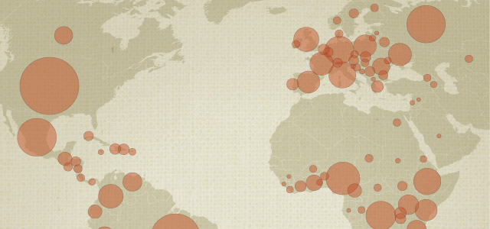
Intro
Statistics from 2010 show a 1/3 of the world’s population
claims to be Christian!
“As of 2010, Christianity was by far the world's largest religion, with an estimated 2.2 billion adherents, nearly a third (31 percent) of all 6.9 billion people on Earth, the Pew (pewforum.org) report says”
The report also says about 80% of US (approx. 37% of world population) are Christians
Are all these people
who claim to be
Christians true
believers as outlined
in Heb. 11:6?
There are three actions of believers! Believers Who Do…
Notes:
http://www.pewforum.org/2011/12/19/global-christianity-exec/
www.npr.org/.../muslim-population-will-surpass-christians-this-century-pew-says

Slide 4
…Nothing!
Believers Who Do…
Not speaking of atheists or agnostics, but those
individuals that claim to believe in God
Jn. 12:42-43: Jewish Rulers (Mt. 10:33)
Acts 24:24-26: Governor Felix
Acts 26:24-28: King Agrippa II (52-100 AD)
Js. 2:19: Demons (Mk. 5:7, 9; Lk. 8:31)
Not enough to claim belief or recognition in God,
but a person must act on that belief!

Slide 5
…the Wrong Thing
Believers Who Do…
There are those who profess belief and act on it, but they
do the wrong thing!
Mt. 6:1, 5; 23:14-15, 27-28: Scribes and Pharisees
(Mt. 15:3-9; Mk. 7:9)
Mt. 7:21-23: People on the Day of Judgment
Acts 22:3-5; 26:9-11: Apostle Paul (as Saul of Tarsus)
Rom. 10:1-3: Jews (as a nation)
Not enough to believe and just do anything,
but must do the right thing!

Slide 6
…the Right Thing
Believers Who Do…
There are those who profess belief and act on it according
to God’s way!
Acts 2:37-38, 41: Jews on Day of Pentecost
Acts 8:36-38: Ethiopian Eunuch
Acts 9:5-6, 17-18; 22:16: Apostle Paul (Saul of Tarsus)
Acts 16:30-34: Philippian Jailer
To be pleasing to God, one must
believe and obey His word in
“diligently seeking” Him!

Slide 7
Conclusion
The world is full of these 3 kinds of believers:
Believers who do nothing
Believers who do the wrong thing
Believers who do the right thing
Faith only will not save!
Disobedience will not save!
Obedience to the gospel saves! Heb. 5:9

Slide 8
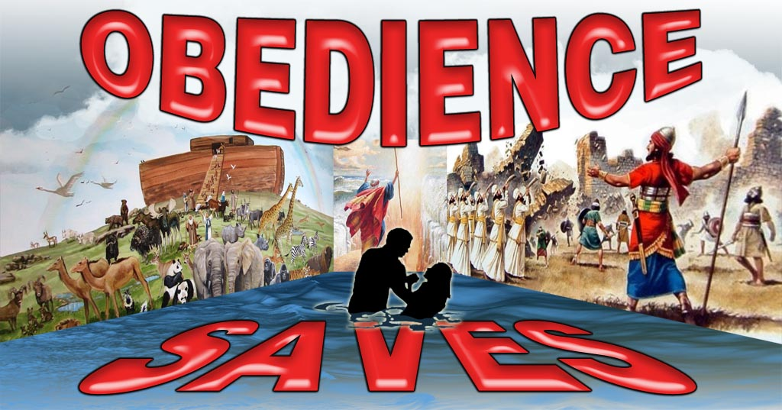
Conclusion
Only those who obey God will be pleasing to Him!
Mt. 7:21
21. "Not everyone who says to Me, 'Lord, Lord,' will enter the kingdom of heaven, but he who does the will of My Father who is in heaven will enter.
Heb. 5:9 (11:6: Without faith it’s impossible to please God)
9. And having been made perfect, He became to all those who obey Him the source of eternal salvation,
Js. 2:24
24. You see that a man is justified by works and not by faith alone.

Slide 9
Conclusion
Do you “diligently seek” after the right way to be pleasing
unto God? (Acts 17:11: Bereans)

Slide 10
“What Must I Do To Be Saved?”
Hear The Gospel (Jn. 5:24; Rom. 10:17)
Believe In Christ (Jn. 3:16-18; Jn. 8:24)
Repent Of Sins (Lk. 13:35; Acts 2:38)
Confess Christ (Mt. 10:32; Rom. 10:10)
Be Baptized (Mk. 16:16; Acts 22:16)
Remain Faithful (Jn. 8:31; Rev. 2:10)
For The Erring Child:
Repent (Acts 8:22), Confess (I Jn. 1:9),
Pray (Acts 8:22)

