Slide 1
He Became Frightened
Text: Acts 24:25
Notes:
By Nathan L Morrison
All Scripture Given is from NASB unless otherwise stated
For further study, or if questions, please Call: Call: 804-277-1983 or visit www.courthousechurchofcrist.com
References:
• http://jewishencyclopedia.com/view.jsp?artid=93&letter=F&search=Antonius%20Felix
• http://en.wikipedia.org/wiki/Antonius_felix
• http://en.wikipedia.org/wiki/Drusilla_of_Mauretania_(born_38)]
• http://en.wikipedia.org/wiki/Drusilla_(daughter_of_Agrippa_I)

Slide 2
Intro
Peter’s “Rooster Call” in Lk. 22:55-62 can be applied to
situations when we see the truth:
David – II Sam. 11-12
Naaman – II Kings 5
The Prodigal Son – Lk. 15
Judas – Mt. 27
Jews on Day of Pentecost – Acts 2
King Agrippa II – Acts 26
Before King Agrippa II there was Governor Felix!
Famous for saying, “Go away for now; when I have a convenient time I will call for you” (NKJ: Acts 24:25)

Slide 3
Intro
Felix had his “Rooster Call” and stands as an example of
the wrong response for people today
Now is the time to obey God (II Cor. 6:2); we may not have “a more convenient day!”

Slide 4
Felix’s Opportunity
Acts 24:10-11
10. When the governor had nodded for him to speak, Paul responded: "Knowing that for many years you have been a judge to this nation, I cheerfully make my defense,
11. since you can take note of the fact that no more than twelve days ago I went up to Jerusalem to worship.
Acts 24:22
22. But Felix, having a more exact knowledge about the Way, put them off, saying, "When Lysias the commander comes down, I will decide your case."
Acts 24:24
24. But some days later Felix arrived with Drusilla, his wife who was a Jewess, and sent for Paul and heard him speak about faith in Christ Jesus.
Notes:
Emphasis in Scripture mine!

Slide 5
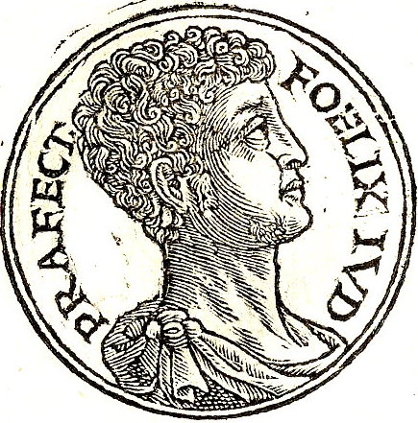
Felix’s Opportunity
Acts 24:24: “But some days later Felix arrived with Drusilla, his wife who was a Jewess, and sent for Paul and heard him speak about faith in Christ Jesus.”
Governor Antonius Felix (Governor of Judea 52-58 A.D.)
A Greek freedman, he was the first slave in Roman records to rise up to be governor. His brother was Secretary of Treasury under Claudius and Nero.
“He thought that he could do any evil act with impunity, backed up as he was by such power” (Tacitus: Annals Book 12 [54])
He was married three times:
1st wife: Drusilla of Mauretania, the great-granddaughter of Cleopatra.
2nd wife: Drusilla, a Jewish princess, daughter of King Agrippa I.
3rd wife: Unknown woman after death of Drusilla at Pompeii (79 A.D.)
Tacitus also said, “With all brutality and lust, ruled as a king with the mentality of a slave” (Tacitus: History Book 5 [9]).
Notes:
References:
• http://jewishencyclopedia.com/view.jsp?artid=93&letter=F&search=Antonius%20Felix
• http://en.wikipedia.org/wiki/Antonius_felix
• http://en.wikipedia.org/wiki/Drusilla_of_Mauretania_(born_38)]
• http://en.wikipedia.org/wiki/Drusilla_(daughter_of_Agrippa_I)
Image: Antonius Felix from Guillaume Rouillé's Promptuarii Iconum Insigniorum

Slide 6
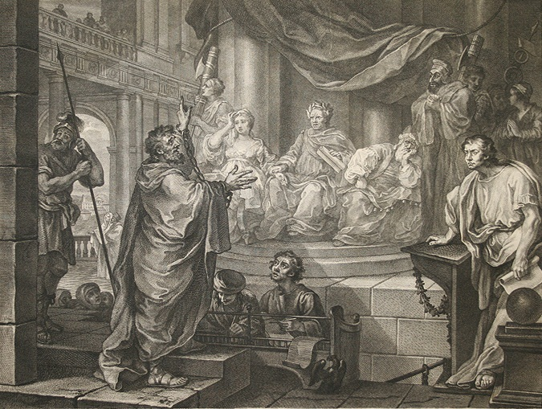
Felix’s Opportunity
Acts 24:24: “But some days later Felix arrived with Drusilla, his wife who was a Jewess, and sent for Paul and heard him speak about faith in Christ Jesus.”
Drusilla (38 – 79 A.D.)
Youngest daughter out of three of Herod Agrippa I (Acts 12 – 44 A.D.)
Married at age 15 to King Azizus of Emesa.
Left her lawful husband shortly after their marriage for an adulterous affair with Felix & later married him (ca. 54/55 A.D.).
She & her son perished in eruption of Mt. Vesuvius at Pompeii (25 August 79 A.D.)
Notes:
References:
• http://jewishencyclopedia.com/view.jsp?artid=93&letter=F&search=Antonius%20Felix
• http://en.wikipedia.org/wiki/Antonius_felix
• http://en.wikipedia.org/wiki/Drusilla_of_Mauretania_(born_38)]
• http://en.wikipedia.org/wiki/Drusilla_(daughter_of_Agrippa_I)
Image by William Hogarth, Paul before Felix, 1752. Drusilla is seated on Felix's right.

Slide 7
Felix’s Opportunity
Acts 24:25:
25. But as he was discussing righteousness, self-control and the judgment to come…
Righteousness – Needed to hear what to do!
I Jn. 3:7, 10: Those who do not practice righteousness are not of God, but of the devil.
Rom. 1:18: The wrath of God will fall on the unrighteous.
I Cor. 6:9: “Or do you not know that the unrighteous will not inherit the kingdom of God?”
Self-Control – Had no self-control!
Rom. 8:5-8: Felix lived his life according to the flesh.
Prov. 16:32; 25:28: One without self-control is like a city breached and invaded, a city without walls, laid bare.
Gal. 5:16-17: We are to walk by the Spirit so as to not do the will of the flesh (Gal. 5:19-21) or whatever we please!
Notes:
Emphasis in Scripture mine!

Slide 8
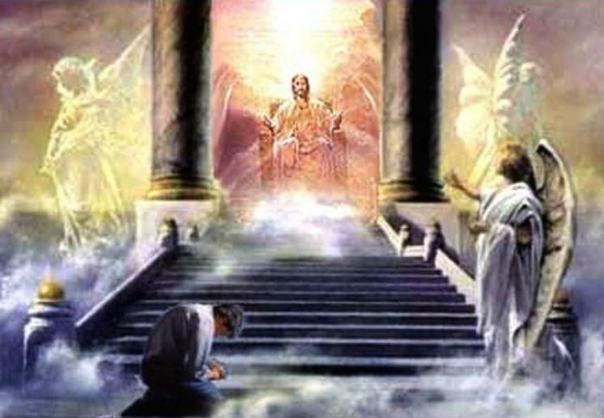
Felix’s Opportunity
Acts 24:25:
25. But as he was discussing righteousness, self-control and the judgment to come…
Judgment to come
Heb. 9:27; 10:26-31: Felix heard the message of this judgment. He had a choice to make, to keep on sinning or change his life.
I Pet. 4:17-18: There will be a day of reckoning for all of us, but for the ungodly it will be severe.
Felix’s “Rooster Call” was seeing himself as God saw him: unrighteous, unrestrained, and guilty of judgment!
Notes:
Emphasis in Scripture mine!

Slide 9
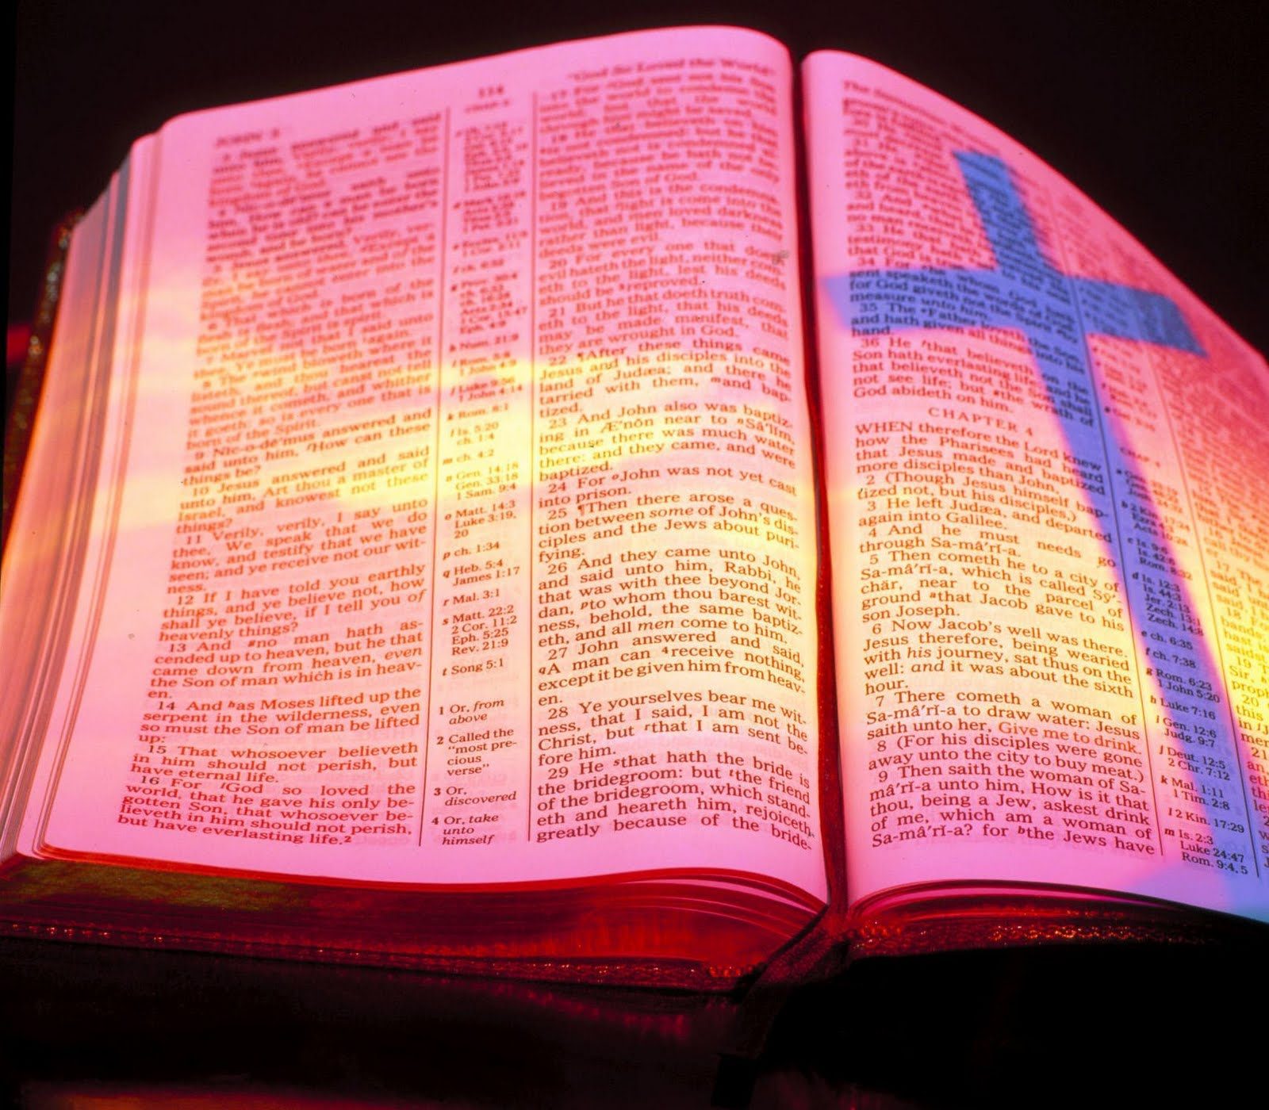
Felix’s Response
Once a person has heard the gospel, there are two
choices:
Refuse to obey (from hardened heart, or for another opportunity)
Obey the gospel
Felix did not react the same way as:
Stephen’s audience – Acts 7:51-60: They put him to death!
Some at Lystra – Acts 14:19-22: Stoned Paul & left him for dead.
The Athenians – Acts 17:32: Mocked Paul.

Slide 10
Felix’s Response
Acts 24:25:
25. But as he was discussing righteousness, self-control and the judgment to come, Felix became frightened…
Felix “became frightened”
He was not so hard of heart that he gave no response.
He trembled!
Men need to be frightened when their sin is confronted – Heb. 10:31
Heb. 10:31:
31. It is a terrifying thing to fall into the hands of the living God.
Felix’s response was a good start, for some obey out of
fear of the consequences!
Notes:
Emphasis in Scripture mine

Slide 11
Felix’s Uncertainty
Acts 24:25
25. But as he was discussing righteousness, self-control and the judgment to come, Felix became frightened and said, "Go away for the present, and when I find time I will summon you."
“Go away!”
He was looking to “a more convenient day” to do what is
right (Similar to Athenians in Acts 17:32)
That more convenient day may never come! (Prov. 27:1; Js. 4:13-16)
God commands all men everywhere to repent! (Acts 17:30-31)
Sin can harden the heart – Heb. 3:12-13
Death may overtake us, or Christ may return! (Heb. 9:27; Mt. 24:42)
There is danger in delaying obedience when we
hear the truth!
Notes:
Emphasis in Scripture Mine!

Slide 12
Conclusion
Felix and Drusilla had opportunity!
Felix was frightened by the message of the judgment, but
chose to delay!
There may be those today who look to
“a more convenient day” to obey the
gospel:
We may not have a “tomorrow” – Js. 4:14
Judgment will be terrible for those who have waited – II Thess. 1:7-9
“Now is the day of salvation!” – II Cor. 6:2

Slide 13
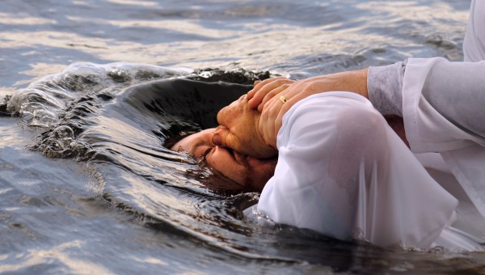
Conclusion
If righteousness, self-control, and the judgment to come
strike fear into your heart, then your heart is ready to
obey!
Do not make the mistake of Felix in making excuses!
That “more convenient day” may never come!
Obey the gospel from the heart and hold fast to the truth!

Slide 14
“What Must I Do To Be Saved?”
Hear The Gospel (Jn. 5:24; Rom. 10:17)
Believe In Christ (Jn. 3:16-18; Jn. 8:24)
Repent Of Sins (Lk. 13:35; Acts 2:38)
Confess Christ (Mt. 10:32; Rom. 10:10)
Be Baptized (Mk. 16:16; Acts 22:16)
Remain Faithful (Jn. 8:31; Rev. 2:10)
For The Erring Child of God:
Repent (Acts 8:22), Confess (I Jn. 1:9),
Pray (Acts 8:22)

