Slide 1
Grace: Deeper Than The Ocean
Text: Titus 2:11-14
“Deeper than the ocean and wider than the sea. Is the grace of the Savior, for sinners like me; Sent by the Father, and it
thrills my soul, Just to feel and to know, That His blood makes me whole.
His grace reaches me, yes, His grace reaches me,
And ‘twill last thru eternity;
Now I'm under His control and I'm happy in my soul,
Just to know that His grace reaches me.”
Notes:
By Nathan L Morrison
All Scripture given is from NASB unless otherwise stated
For further study or if questions, please Call: 804-277-1983; or Visit: www.courthousechurchofchrist.com
“His Grace Reaches Me” by Jewell Monroe “Whitey” Gleason

Slide 2
Intro
Titus 2:11-14
11. For the grace of God has appeared, bringing salvation to all men,
12. instructing us to deny ungodliness and worldly desires and to live sensibly, righteously and godly in the present age,
13. looking for the blessed hope and the appearing of the glory of our great God and Savior, Christ Jesus,
14. who gave Himself for us to redeem us from every lawless deed, and to purify for Himself a people for His own possession, zealous for good deeds.

Slide 3
Intro
Acts 11:19-23
19. So then those who were scattered because of the persecution that occurred in connection with Stephen made their way to Phoenicia and Cyprus and Antioch, speaking the word to no one except to Jews alone.
20. But there were some of them, men of Cyprus and Cyrene, who came to Antioch and began speaking to the Greeks also, preaching the Lord Jesus.
21. And the hand of the Lord was with them, and a large number who believed turned to the Lord.
22. The news about them reached the ears of the church at Jerusalem, and they sent Barnabas off to Antioch.
23. Then when he arrived and witnessed the grace of God, he rejoiced and began to encourage them all with resolute heart to remain true to the Lord;
Eph. 2:4-5, 8: “Saved by grace” (Titus 3:4-7)
“Grace” = charis [khar'-ece ] (G5485): unmerited favor; grace (ious), benefit, gift, joy of liberality, pleasure, thank(-s, -worthy).

Slide 4

Intro
Jewell Monroe “Whitey” Gleason
(1932-2007):
“His Grace Reaches Me” (1964)
Whitey Gleason (May 18, 1932 – June 30, 2007) was a minister, educator, and owner of a music store.
He wrote hundreds of songs in his career while accompanying various gospel singing groups on the piano.
He was inducted into the Gospel Music Hall of Fame as a member of the Blackwood Brothers Quartet.
The grace of God, through the blood of Christ, is deeper
than the ocean and wider than the sea!
Notes:
Read the article on Jewell Monroe “Whitey” Gleason
Image: Whitey Gleason (“Mr. Piano”) at the piano
Sources:
http://songscoops.blogspot.com/2009/12/his-grace-reaches-me-jewell.html

Slide 5

Sent By the Father
“Deeper than the ocean and wider than the sea, Is the grace of the Savior, for sinners like me; Sent by the Father, and it thrills my soul, Just to feel and to know, That His blood makes me whole.”
Eph. 3:14-19 (esp. vs. 18-19): Can we measure the love & grace of God? (Rom. 8:38-39)
Width — The world (John 3:16)
Length — Forever (I Cor. 13:8, 13)
Depth — Even death on the cross (Phil. 2:8)
Height — Heaven (I Jn. 3:1-2; I Pet. 1:4)

Slide 6

Sent By the Father
“Deeper than the ocean and wider than the sea, Is the grace of the Savior, for sinners like me; Sent by the Father, and it thrills my soul, Just to feel and to know, That His blood makes me whole.”
Eph. 2:4-5, 8 (Jn. 1:29; 3:16)
4. But God, being rich in mercy, because of His great love with which He loved us,
5. even when we were dead in our transgressions, made us alive together with Christ (by grace you have been saved),
8. For by grace you have been saved through faith; and that not of yourselves, it is the gift of God;

Slide 7

Sent By the Father
“Deeper than the ocean and wider than the sea, Is the grace of the Savior, for sinners like me; Sent by the Father, and it thrills my soul, Just to feel and to know, That His blood makes me whole.”
The reason for the grace of God:
Mankind is lost due to sin!
If grace brings salvation (Titus 2:11), there must be something to be saved from!
Eph. 2:1; 4:18: Sinners are “dead” people, alienated from the “life of God.”
God’s grace (through Christ) was
given because the world was lost in
sin and needed a Savior!

Slide 8
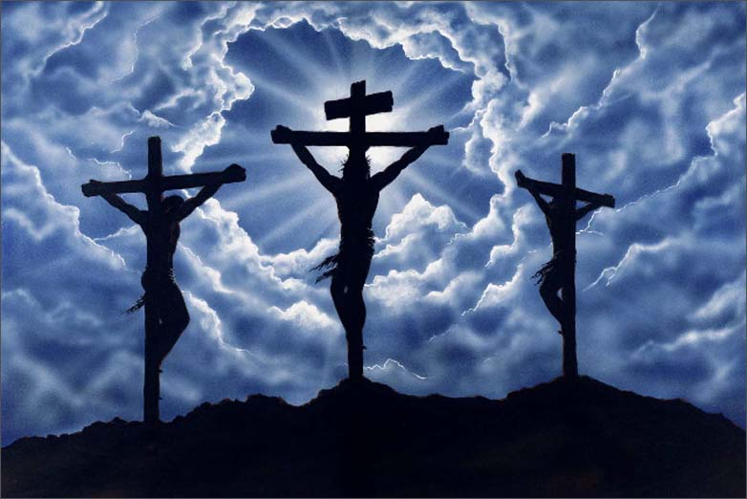
Offered At Calvary
“Higher than the mountains and brighter than the sun, It was offered at Calvary for ev'ry one; greatest of treasures, and it's mine today, Tho my sins were as scarlet, He has washed them away.”
The method of God’s grace:
Jesus Christ as revealed in the word of God!
Rom. 3:24; Heb. 2:9: Christ, by God’s grace, died for all!
Rom. 5:6-10: Jesus died so man may be saved from the wrath of God! Man was incapable of saving himself. Man was “helpless!”
Eph. 2:5; Acts 15:11: Salvation is by God’s grace.
Christ’s death and His blood open the door for all to come into His kingdom
God didn’t have to!

Slide 9
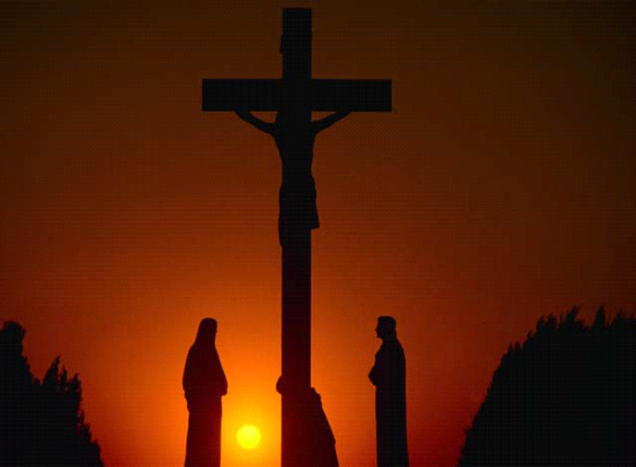
Offered At Calvary
“Higher than the mountains and brighter than the sun, It was offered at Calvary for ev'ry one; greatest of treasures, and it's mine today, Tho my sins were as scarlet, He has washed them away.”
The method of God’s grace:
Jesus Christ as revealed in the word of God!
Gal. 2:21: Man could not be saved by the Law of Moses (If so, Christ died needlessly)!
Acts 20:32: The word of God is the “word of His grace.”
Heb. 10:1-4: The Law of Moses involved the blood of animals.
Heb. 10:10-14, 29: The new covenant involves the blood of the Son of God. One sacrifice for all time (Heb. 9:28; 10:12)!
God didn’t have to!

Slide 10
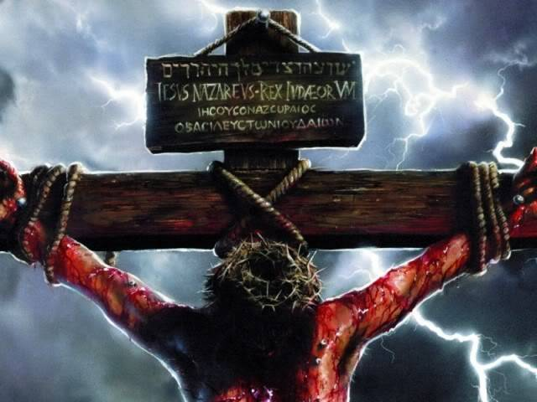
Offered At Calvary
“Higher than the mountains and brighter than the sun, It was offered at Calvary for ev'ry one; greatest of treasures, and it's mine today, Tho my sins were as scarlet, He has washed them away.”
While the world was helpless,
God’s grace provided a means for salvation!

Slide 11
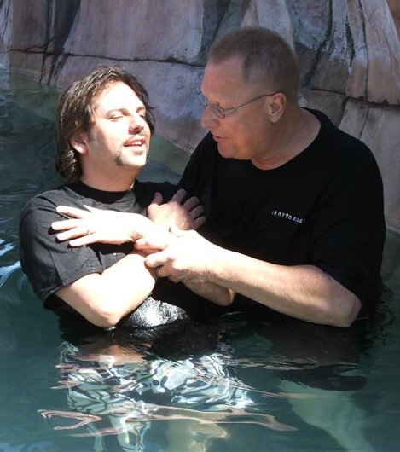
His Grace Reaches Me
“His grace reaches me, yes, His grace reaches me, And ‘twill last thru eternity; Now I'm under His control and I'm happy in my soul, Just to know that His grace reaches me.”
Acts 11:23
Barnabas arrived in Antioch and “witnessed the grace of God,” and rejoiced
God’s grace reaches us and washes away our sins! (Acts 22:16)
Titus 2:11
11. For the grace of God has appeared, bringing salvation to all men,
Titus 2:11
Eph. 1:7-8: “According to the riches of His grace which He lavished on us.”
Eph. 2:6-8: “Surpassing riches of His grace,” “it is the gift of God.”
Heb. 4:16: We have confidence in the grace Jesus provides!

Slide 12
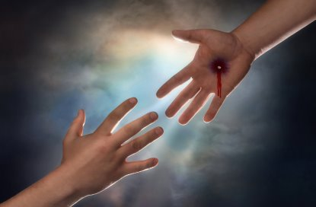
His Grace Reaches Me
“His grace reaches me, yes, His grace reaches me, And ‘twill last thru eternity; Now I'm under His control and I'm happy in my soul, Just to know that His grace reaches me.”
The means of receiving God’s grace:
Accept it through obedience!
Eph. 2:5, 8-9: Grace is in and by Christ (Titus 3:4-7)
Eph. 2:5, 8-9
5. even when we were dead in our transgressions, made us alive together with Christ (by grace you have been saved),
8. For by grace you have been saved through faith; and that not of yourselves, it is the gift of God;
9. not as a result of works, so that no one may boast.

Slide 13
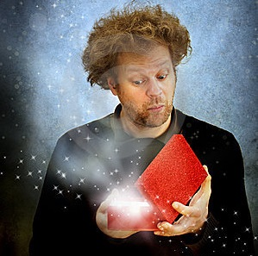

His Grace Reaches Me
“His grace reaches me, yes, His grace reaches me, And ‘twill last thru eternity; Now I'm under His control and I'm happy in my soul, Just to know that His grace reaches me.”
The means of receiving God’s grace:
Accept it through obedience!
OBEDIENCE
GRACE
GRACE
Notes:
Image of man opening gift: courtesy of dreamstime.com

Slide 14
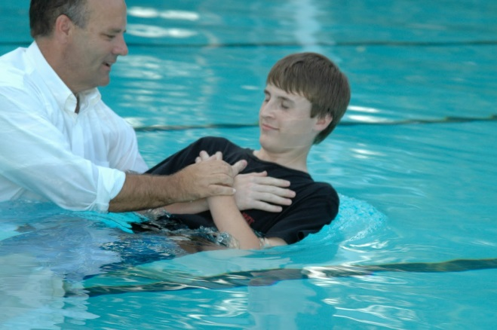
His Grace Reaches Me
“His grace reaches me, yes, His grace reaches me, And ‘twill last thru eternity; Now I'm under His control and I'm happy in my soul, Just to know that His grace reaches me.”
Heb. 5:9
9. And having been made perfect, He became to all those who obey Him the source of eternal salvation,
The means of receiving God’s grace:
Accept it through obedience!
Heb. 5:9: Jesus is the “source of eternal salvation” to those who obey Him!
Mk. 16:16 (Acts 20:32; Gal. 1:6)
Titus 2:11-14: Live sensibly, righteously,
  and godly, and be pure!
II Pet. 1:10-11: These qualities grant to us “the entrance into the eternal kingdom of our Lord and Savior Jesus Christ” (I Pet. 1:4-5)

Slide 15

His Grace Reaches Me
“His grace reaches me, yes, His grace reaches me, And ‘twill last thru eternity; Now I'm under His control and I'm happy in my soul, Just to know that His grace reaches me.”
Heaven is to be revealed as the ultimate expression of God’s grace:
An eternal rest!

Slide 16

Conclusion
Those obedient to God’s word truly receive a grace
“deeper than the ocean and wider than the sea; higher
than the mountains and brighter than the sun!”
Saved from the wrath of God! (Rom. 5:8-9)
Grace: Not unconditional – Col. 1:21-23 (Titus 2:12):
“if indeed you continue in the faith…”
Grace: Conditional – Heb. 5:9 (Titus 2:12):
Jesus is the “source of eternal salvation” to those who
obey Him!

Slide 17

Conclusion
Like Naaman (II Kings 5) mankind is given the cure for sin, but we must accept the terms!
“For the grace of God has appeared” (Titus 2:11), so let us sing,
“His Grace Reaches Me!”

Slide 18
“What Must I Do To Be Saved?”
Hear The Gospel (Jn. 5:24; Rom. 10:17)
Believe In Christ (Jn. 3:16-18; Jn. 8:24)
Repent Of Sins (Lk. 13:35; Acts 2:38)
Confess Christ (Mt. 10:32; Rom. 10:10)
Be Baptized (Mk. 16:16; Acts 22:16)
Remain Faithful (Jn. 8:31; Rev. 2:10)
For The Erring Child:
Repent (Acts 8:22), Confess (I Jn. 1:9),
Pray (Acts 8:22)

