Slide 1
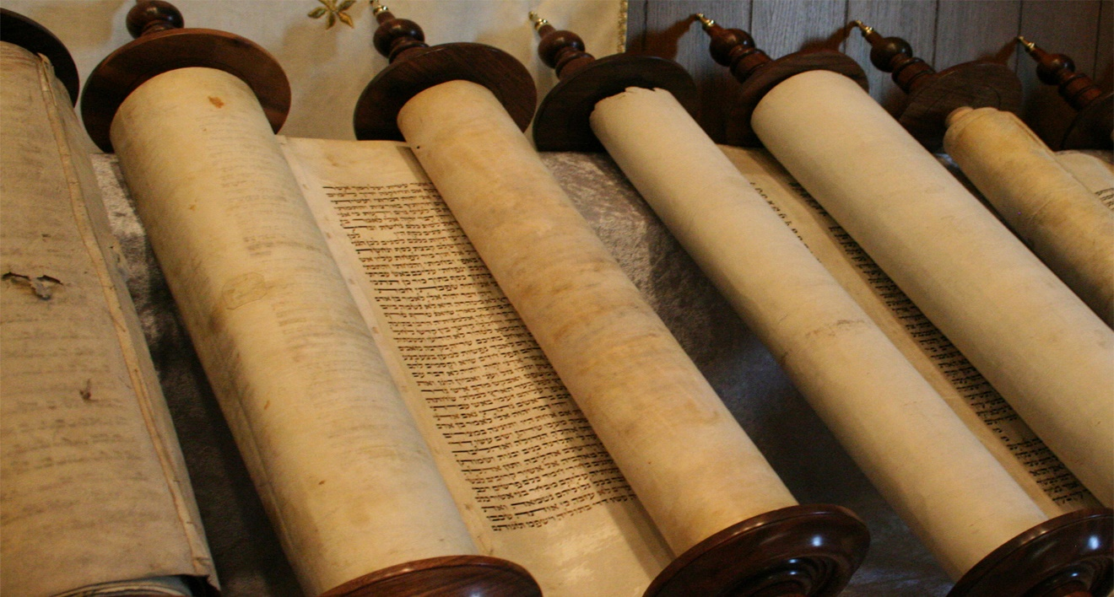
Ezra Prepared His Heart
Text: Ezra 7:8-10
Notes:
By Nathan L Morrison
All Scripture given is from NASB unless otherwise stated
For further study, or if questions, please Call: 804-277-1983; or Visit: www.courthousechurchofchrist.com
Based on a lesson by Richard Thetford, and an article by David Dann in Truth Magazine, July 2009

Slide 2
Intro
II Tim. 2:20-21
20. Now in a large house there are not only gold and silver vessels, but also vessels of wood and of earthenware, and some to honor and some to dishonor.
21. Therefore, if anyone cleanses himself from these things, he will be a vessel for honor, sanctified, useful to the Master, prepared for every good work.

Slide 3
Intro
In the first year of Cyrus’ reign, he decreed the Jewish
captives were free to return to their land and rebuild the
temple!
(Ezra 1 – after their 70 years in exile from Jer. 29:10)
In (approx.) 538-536 B.C. the first exiles returned to Jerusalem!
Ezra did not return with the first exiles but about 80 or 78
years later in 458 B.C.!

Slide 4
Intro
Ezra 7:8-10 (NKJ)
8. And Ezra came to Jerusalem in the fifth month, which was in the seventh year of the king.
9. On the first day of the first month he began his journey from Babylon, and on the first day of the fifth month he came to Jerusalem, according to the good hand of his God upon him.
10. For Ezra had prepared his heart to seek the Law of the LORD, and to do it, and to teach statutes and ordinances in Israel.

Slide 5
Intro
In the first year of Cyrus’ reign, he decreed the Jewish
captives were free to return to their land and rebuild the
temple!
(Ezra 1 – after their 70 years in exile from Jer. 29:10)
In (approx.) 538-536 B.C. the first exiles returned to Jerusalem!
Ezra did not return with the first exiles but about 80 or 78
years later in 458 B.C. (Ezra 7:8-10)
Ezra may not have been one of the first of his people to
return to Jerusalem but when he did his heart was well
prepared!

Slide 6
Ezra Prepared to SEEK the Law of God
Ezra 7:10 (NKJ): “For Ezra had prepared his heart to seek the Law of the LORD...”
To “seek” is to “study” (NASB)
God’s people were destroyed for lack of knowledge – Hos. 4:6
They had rejected the law of God; no longer were “seeking” it.
Before Jerusalem was destroyed God, through Jeremiah, said the people had forgotten Him – Jer. 2:32
Ezra was determined to not repeat the mistakes of the past!

Slide 7
Ezra Prepared to SEEK the Law of God
Ezra 7:10 (NKJ): “For Ezra had prepared his heart to seek the Law of the LORD...”
Before one can serve the Lord, the heart must be
prepared!
Eccl. 12:1: Youths are reminded to remember God, their Creator.
Eph. 6:4: Parents are to train up their children knowing God.
II Tim. 1:5: Timothy learned faith from his mother and grandmother!
Acts 10:32-33; 13:6-7: Cornelius sent for Peter & Sergius Paulus sent for Paul!

Slide 8
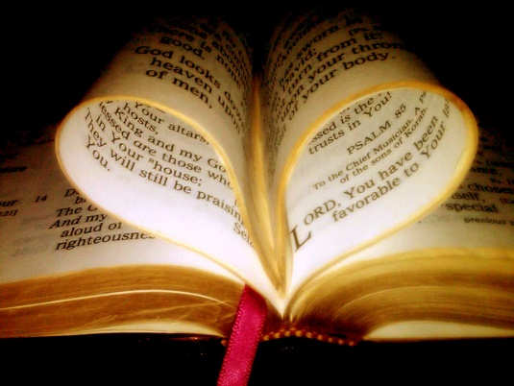
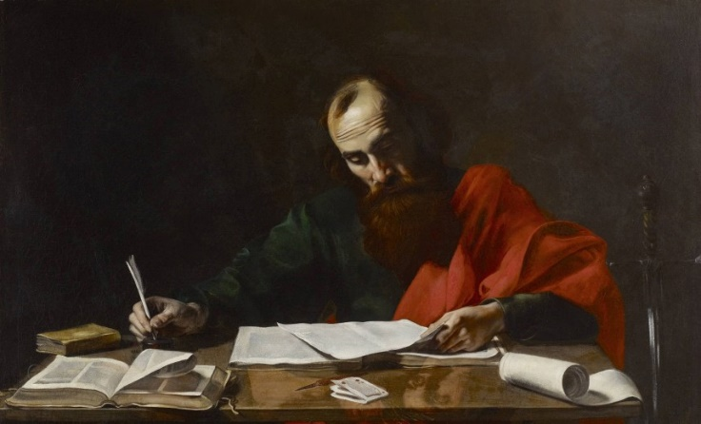
Ezra Prepared to SEEK the Law of God
Ezra 7:10 (NKJ): “For Ezra had prepared his heart to seek the Law of the LORD...”
Christians today need to “prepare” our hearts to study the
word of God
II Pet. 3:18: Child of God must “grow” in the knowledge of Christ.
Acts 17:11: Be like the Bereans who searched the Scriptures daily.
II Tim. 2:15: Must study to know how to “rightly divide the word of God!”
Heb. 11:6: God rewards those who diligently seek Him!
Ezra was prepared to do what was necessary to know
the will of God!

Slide 9
Ezra Prepared to OBEY the Law of God
Ezra 7:10 (NKJ): “For Ezra had prepared his heart to seek
the Law of the Lord, and to do it...”
There are those who hear it and are not prepared to do it
(Obey it)
Mt. 7:21-23: Condemnation to those who do not obey the word of God!
Jn. 12:48: Those who reject words of Jesus will be judged!
Js. 1:22-25: Those who hear and do not obey are like those who forget what they see in the mirror

Slide 10
Ezra Prepared to OBEY the Law of God
Ezra 7:10 (NKJ): “For Ezra had prepared his heart to seek
the Law of the Lord, and to do it...”
Christians today must be prepared to hear and obey the
word of God!
Js. 1:21-22: A saint is one who both hears and does the will of God!
Rom. 6:16-18: A slave of righteousness is one who obeys from the heart!
Heb. 5:9: Christ saves those who obey Him!
(Cornelius – Acts 10:47-48)
Jn. 13:17: “If you know these things, you are blessed if you do them.”
Ezra was prepared to obey what
he learned through study in
God’s word!

Slide 11
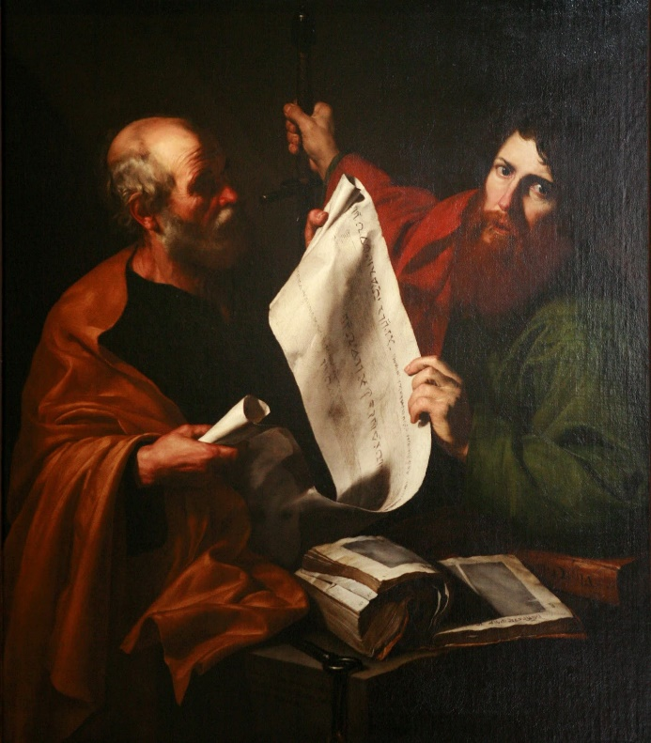
Ezra Prepared to TEACH the Law of God
Ezra 7:10 (NKJ): “For Ezra had prepared his heart to seek
the Law of the Lord, and to do it, and to teach statutes
and ordinances in Israel...”
Ezra knew it (Ezra 7:11-12), was prepared to obey it, and
was prepared to teach it to the people so that they would
not be ignorant (Hos. 4:6)
Ezra was involved in teaching (7:10) and was a “scribe skilled in the law of Moses.” (7:6)
Ezra was “learned (NKJ: “expert”) in the words of the commandments of the LORD and His statutes to Israel.” (7:11)
Ezra was given the charge to “appoint magistrates and judges that they may judge all the people” and teach the ignorant! (7:25)

Slide 12
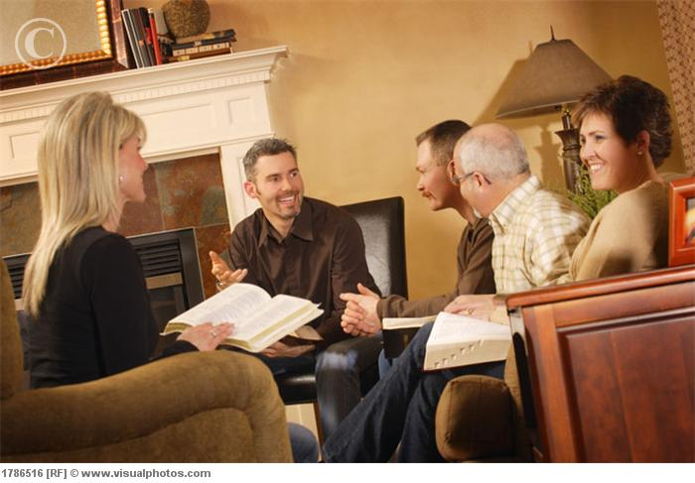
Ezra Prepared to TEACH the Law of God
Ezra 7:10 (NKJ): “For Ezra had prepared his heart to seek
the Law of the Lord, and to do it, and to teach statutes
and ordinances in Israel...”
Christians today need to be prepared to teach!
II Tim. 2:2: Paul told Timothy he must be able to teach, and those he taught must also be ready to teach!
I Tim. 3:2: Elders are to be “able to teach.”
II Tim. 2:24: Saints (bond-servants) are to be “able to teach.”
A faithful child of God will not be content to know and obey God’s word himself, but also see the need to teach others (Mt. 28:19; II Tim. 2:24).
Heb. 5:12-14: The Hebrews’ audience was unacceptable because they should have been teachers and were not!
Ezra was prepared to teach the law
of God to those who would listen!

Slide 13
Conclusion
Before leaving for Jerusalem, Ezra had a prepared heart to
Study
Obey
Teach
Ezra serves as an example for Christians today!
We choose if we will be a useful vessel of honor, “prepared for every good work!” (II Tim. 2:21)

Slide 14
Conclusion
Ezra was prepared!
ARE YOU?
Let us prepare our hearts to seek the law of the Lord and
show the word of God to others!

Slide 15
“What Must I Do To Be Saved?”
Hear The Gospel (Jn. 5:24; Rom. 10:17)
Believe In Christ (Jn. 3:16-18; Jn. 8:24)
Repent Of Sins (Lk. 13:35; Acts 2:38)
Confess Christ (Mt. 10:32; Rom. 10:10)
Be Baptized (Mk. 16:16; Acts 22:16)
Remain Faithful (Jn. 8:31; Rev. 2:10)
For The Erring Child of God:
Repent (Acts 8:22), Confess (I Jn. 1:9),
Pray (Acts 8:22)

