Slide 1
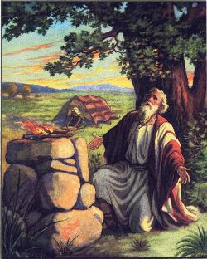
Advice From Samuel
Text: I Samuel 7:3
Notes:
By Nathan L Morrison
All Scripture given is from NASB unless otherwise stated
For further study or if questions, please Call: 804-277-1983; or Visit: www.courthousechurchofchrist.com

Slide 2
Romans 15:4
“For whatever was written in earlier times was written for our instruction, so that through perseverance and the encouragement of the Scriptures we might have hope.”
God’s word provides encouragement and hope!

Slide 3
Intro
Samuel’s leadership starts at a dark time for Israel
(I Samuel 7)
Israelites had just been defeated by the Philistines – I Samuel 4
The army was defeated – I Sam. 4:10
Their leaders were dead (Sons of Eli and Eli) – I Sam. 4:11, 18
The Ark of the Covenant had been taken away in battle – I Sam. 4:11-6:21
There must have been embarrassment and shame, for them and for God! These were God’s chosen people.
Then Israelites opened the Ark when it was returned to them in Beth-shemesh and God struck down 50,070 of the people – I Sam. 6:19
In this shameful position, as lost as they
could be, Samuel begins to lead as
Prophet, Priest, and Judge!

Slide 4
Intro
I Sam. 7:1-3
1. And the men of Kiriath-jearim came and took the ark of the LORD and brought it into the house of Abinadab on the hill, and consecrated Eleazar his son to keep the ark of the LORD.
2. From the day that the ark remained at Kiriath-jearim, the time was long, for it was twenty years; and all the house of Israel lamented after the LORD.
3. Then Samuel spoke to all the house of Israel, saying, "If you return to the LORD with all your heart, remove the foreign gods and the Ashtaroth from among you and direct your hearts to the LORD and serve Him alone; and He will deliver you from the hand of the Philistines."
Samuel’s advice is still relevant to not only
God’s people today but also all those who desire to turn to God!
(Rom. 15:4)

Slide 5
Turn Whole Heart to God
I Sam. 7:3: “Return to the LORD with all your heart”
Application
Mt. 22:37 (Quoted from Deut. 6:5): All people are to love the Lord with everything that they are: Heart, Soul, Mind, and Strength (Mk. 12:30) – Especially God’s people!
Jer. 31:31-34: New Covenant prophecy was that the people would turn their hearts to God (Heb. 8:8-13; Heb. 10:15-17)
Fulfilled in the blood of Jesus (Lk. 22:20; Heb. 9:15)
I Jn. 5:1-4: Turning to God with our whole heart is seen in our love for Him to obey His commands and in our overcoming faith!
Lk. 8:15: The good soil is “an honest and good heart” that hears the word and holds it fast, bearing fruit with perseverance! This takes turning our whole heart to God!
Turning our whole heart to God requires our submission to Him in obedience and faith!

Slide 6
Remove Idols
I Sam. 7:3: “Remove the foreign gods and the Ashtaroth from among you”
Application
I Thess. 1:9: The Thessalonians were an example of people who turned “from idols to serve a living and true God!”
I Jn. 5:21: Saints are to be aware of and avoid idols
What does modern day idolatry look like?

Slide 7
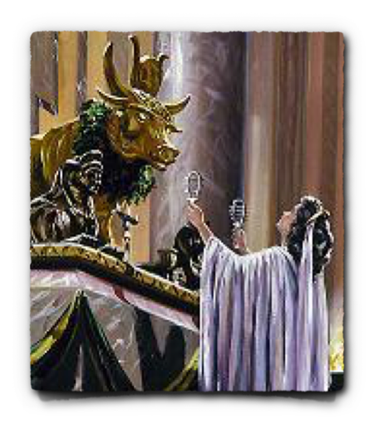
Remove Idols
What does modern day idolatry look like?
Material images are not necessary for one to practice idolatry!
Anything competing in our hearts with God when it comes to our trust, dependence, affection & love – Mt. 6:19-24; Phil. 3:18-19
Eph. 5:5; Col. 3:5: While some may not actually serve idols, there are things in our lives that can “amount to idolatry”: Greed, Covetousness…
Money, power, status, physical appearance, pleasure, leisure, social change, religion, etc…
Rom. 1:18-25 (1:29-31): Exchanged the truth for a lie – served the creature rather than the Creator!
False religion is idolatry (II Cor. 11:3-4; Gal. 1:6-9; II Jn. 9)!

Slide 8
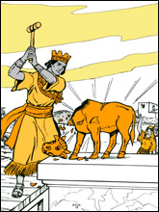
Remove Idols
I Sam. 7:3: “Remove the foreign gods and the Ashtaroth from among you”
Application
I Thess. 1:9: The Thessalonians were an example of people who turned “from idols to serve a living and true God!”
I Jn. 5:21: Saints are to be aware of and avoid idols
Heb. 12:1-2: Must be willing to give up whatever it is that stands between us and God, or what stands in the way of serving God!
Removing idols is getting rid of sin in our lives that entangle and hinder us!

Slide 9
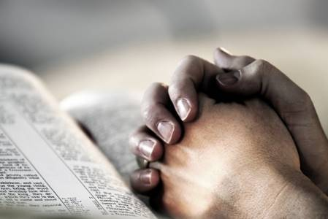
Serve God Alone
I Sam. 7:3: “Direct your hearts to the LORD and serve Him alone”
Application
Mt. 4:10 (Quoted from Deut. 6:13): Jesus told Satan, “Go, Satan! For it is written, 'YOU SHALL WORSHIP THE LORD YOUR GOD, AND SERVE HIM ONLY”
I Thess. 1:9: The Thessalonians turned from idols to serve God alone!
I Jn. 5:19-20: Jesus is the true God & in Him is eternal life! (Mt. 11:28-30) – We must know Him to serve Him! (Mt. 6:33; Col. 3:1-2)
Serving God alone is to make Him
our priority in life above all else!

Slide 10
Conclusion
I Samuel 7:4-15
Israel followed the words of Samuel.
They fasted, they prayed, they confessed, they put away the foreign gods, they sacrificed unto God, and they were delivered from their enemy (a great deliverance)!
What about YOU?
Are you separated from God?
Are you lost?
Is it possible that you find yourself in a dark place?
Have you found yourself in a shameful, or even an embarrassing place?

Slide 11
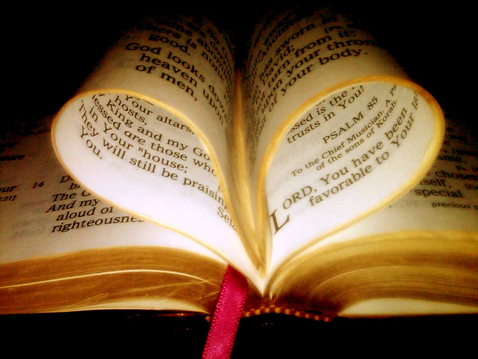
Conclusion
If so, help is not far away – Samuel’s advice to Israel is still applicable today (Rom. 15:4)!
You too can be delivered by turning to God,
putting away the sin in your life,
and serving Him above all else!

Slide 12
“What Must I Do To Be Saved?”
Hear The Gospel (Jn. 5:24; Rom. 10:17)
Believe In Christ (Jn. 3:16-18; Jn. 8:24)
Repent Of Sins (Lk. 13:35; Acts 2:38)
Confess Christ (Mt. 10:32; Rom. 10:10)
Be Baptized (Mk. 16:16; Acts 22:16)
Remain Faithful (Jn. 8:31; Rev. 2:10)
For The Erring Child of God:
Repent (Acts 8:22), Confess (I Jn. 1:9),
Pray (Acts 8:22)

