Slide 1
Windows Of Heaven
Text: Mal. 3:10-12
Notes:
By Nathan L Morrison
All Scripture given is from NASB unless otherwise stated
For further study or if questions, Call: 804-277-1983 or visit www.courthousechurchofcrist.com

Slide 2
Intro
Mal. 3:10-12
10. "Bring the whole tithe into the storehouse, so that there may be food in My house, and test Me now in this," says the LORD of hosts, "if I will not open for you the windows of heaven and pour out for you a blessing until it overflows.
11. "Then I will rebuke the devourer for you, so that it will not destroy the fruits of the ground; nor will your vine in the field cast its grapes," says the LORD of hosts.
12. "All the nations will call you blessed, for you shall be a delightful land," says the LORD of hosts.
II Kings 7:2, 19: The phrase “windows of Heaven” is used here to refer to the blessing of food and sustenance.
Ps. 78:23-25: From the “doors of Heaven” God gave the Israelites food in abundance

Slide 3
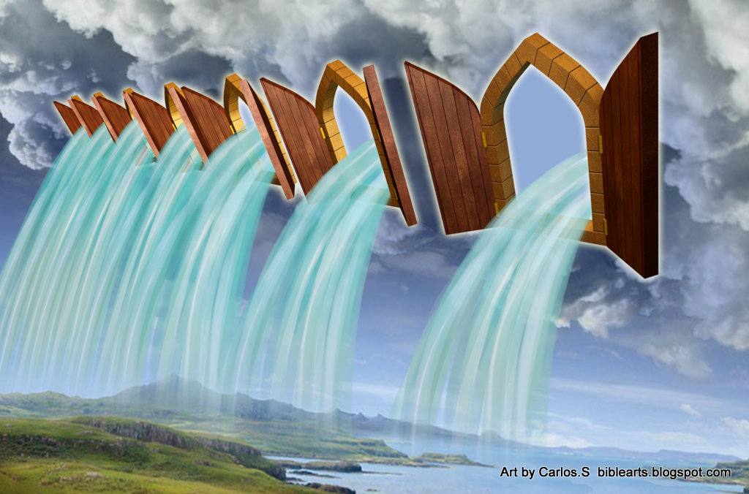
Intro
The Scriptures are full of instances of the
“windows of Heaven” being opened, even if the term isn’t
directly applied, and they are opened for
blessing and judgment!
We will focus on the two most important times the
“windows of Heaven” were opened, and one yet to come!
Notes:
Image: By Carlos S.

Slide 4
God Opened the Windows of Heaven and Sent the Savior
Jesus paid the great sacrifice for all mankind for all time!
(Heb. 10:12; I Pet. 3:18)
It was prophesied that He would come to bear our sins – Is. 53:4-5
Jesus died for our sins so that we might have redemption – Eph. 1:7
His blood washes away sins of the obedient – Acts 22:16; I Pet. 1:18-19; Rev. 1:5
Heb. 4:15-16
15. For we do not have a high priest who cannot sympathize with our weaknesses, but One who has been tempted in all things as we are, yet without sin.
16. Therefore let us draw near with confidence to the throne of grace, so that we may receive mercy and find grace to help in time of need.

Slide 5
God Opened the Windows of Heaven and Sent the Savior
Jesus was sent for 3 primary reasons!
To show us what God is like – Jn. 10:30; 14:6-10
Jn. 14:9
9. Jesus said to him, "Have I been so long with you, and yet you have not come to know Me, Philip? He who has seen Me has seen the Father; how can you say, 'Show us the Father'?

Slide 6
God Opened the Windows of Heaven and Sent the Savior
Jesus was sent for 3 primary reasons!
To show us what God is like – Jn. 10:30; 14:6-10
To teach us how to live – Jn. 8:12, 31-32; I Pet. 2:21-23
Jn. 8:12
12. Then Jesus again spoke to them, saying, "I am the Light of the world; he who follows Me will not walk in the darkness, but will have the Light of life."

Slide 7
God Opened the Windows of Heaven and Sent the Savior
Jesus was sent for 3 primary reasons!
To show us what God is like – Jn. 10:30; 14:6-10
To teach us how to live – Jn. 8:12, 31-32; I Pet. 2:21-23
To save us – Lk. 19:10; Jn. 1:29; 3:16; I Pet. 2:24-25
Jn. 1:29
29. The next day he saw Jesus coming to him and said, "Behold, the Lamb of God who takes away the sin of the world!

Slide 8
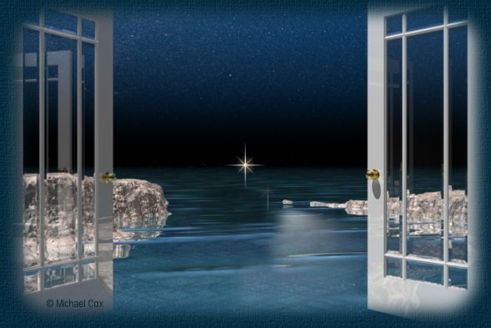
God Opened the Windows of Heaven and Sent the Savior
God opened the windows of
Heaven and sent man the Savior to wash away sin!
Notes:
Image: By Michael Cox

Slide 9
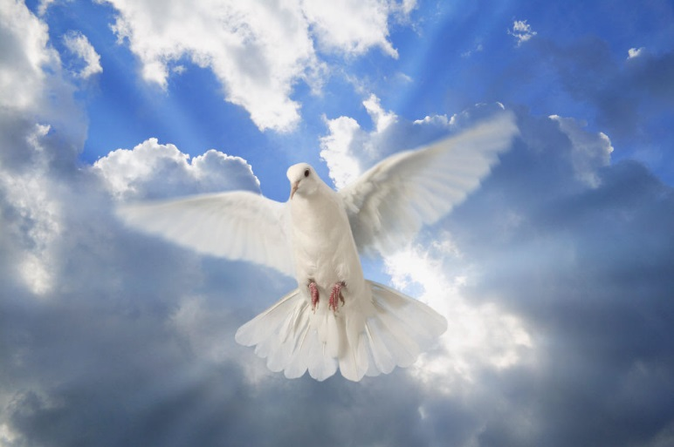
God Opened the Windows of Heaven and Sent the Holy Spirit
Jesus promised that when He departed He would send the
“Comforter,” the Holy Spirit!
Jn. 14:26: God sent the Holy Spirit in Jesus’ name (KJV: “Comforter”).
Jn. 15:26-27: The “Helper” (NAS), the Spirit of Truth, has shown us our Savior because He testified of Christ in the written word.
Jn. 16:13: The Spirit has revealed to the apostles “all the truth” in God’s word!
Jn. 16:13
13. "But when He, the Spirit of truth, comes, He will guide you into all the truth; for He will not speak on His own initiative, but whatever He hears, He will speak; and He will disclose to you what is to come.

Slide 10
God Opened the Windows of Heaven and Sent the Holy Spirit
The Holy Spirit has inspired and delivered the word of God
to men that we may know God’s will for our lives!
II Tim. 3:16-17: All Scripture is inspired by God (“God-breathed”).
Jude 3: The faith has been once delivered to all the saints
II Pet. 1:20-21: All prophecy is from the Holy Spirit
II Tim. 3:16-17
16. All Scripture is inspired by God and profitable for teaching, for reproof, for correction, for training in righteousness;
17. so that the man of God may be adequate, equipped for every good work.

Slide 11
God Opened the Windows of Heaven and Sent the Holy Spirit
Rom. 5:8: The Spirit convicts us of sin –In order to bring
us to and keep us in Christ
Eph. 4:30: The Spirit puts God’s seal upon us
Js. 1:5: He gives guidance in life’s choices, if we but ask
for wisdom from God!

Slide 12
God Opened the Windows of Heaven and Sent the Holy Spirit
He gives us comfort in sorrow—Through God’s word!
Reminding us of God’s presence and love despite life’s trials
II Cor. 1:3
3. Blessed be the God and Father of our Lord Jesus Christ, the Father of mercies and God of all comfort,

Slide 13
God Opened the Windows of Heaven and Sent the Holy Spirit
He gives us comfort in sorrow—Through God’s word!
Reminding us of God’s presence and love despite life’s trials (II Cor. 1:3-7)
Providing strength to go on
II Thess. 2:16-17
16. Now may our Lord Jesus Christ Himself and God our Father, who has loved us and given us eternal comfort and good hope by grace,
17. comfort and strengthen your hearts in every good work and word.

Slide 14
God Opened the Windows of Heaven and Sent the Holy Spirit
He gives us comfort in sorrow—Through God’s word!
Reminding us of God’s presence and love despite life’s trials
Providing strength to go on (II Thess. 2:16-17)
Reminding us of the Scriptures to lift our fallen and crushed spirits in time of need
Rom. 8:18
18. For I consider that the sufferings of this present time are not worthy to be compared with the glory that is to be revealed to us.

Slide 15
God Opened the Windows of Heaven and Sent the Holy Spirit
God opened the windows of Heaven
and sent the Holy Spirit to gave man His word!

Slide 16
God Will Open the Windows of Heaven Again and Send Back His Son
Acts 1:9-11
Jesus is now gone above to reign at God’s right hand (Col. 3:1) and waits till the time for His second coming (I Thess. 4:16-18) just as He promised! (Jn. 14:1-3)
All of mankind will see the glory of God when Christ
returns!
Rom. 8:18
18. For I consider that the sufferings of this present time are not worthy to be compared with the glory that is to be revealed to us.
Rev. 1:7
7. BEHOLD, HE IS COMING WITH THE CLOUDS, and every eye will see Him, even those who pierced Him; and all the tribes of the earth will mourn over Him. So it is to be. Amen.

Slide 17
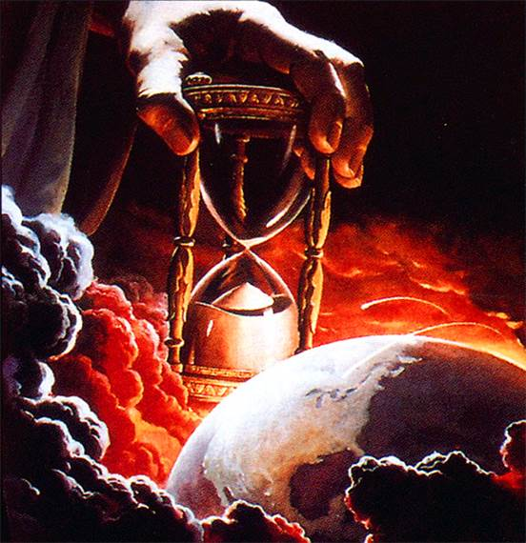
God Will Open the Windows of Heaven Again and Send Back His Son
He has promised to return and judge the world in
righteousness!
Mt. 25:31-46; II Thess. 1:7-9; II Tim. 4:8; I Pet. 4:17

Slide 18
God Will Open the Windows of Heaven Again and Send Back His Son
A complete contrast to the 1st time He came!
1st Time Jesus Came | 2nd Time Jesus Comes
He came as a lowly babe (Lk. 2:12) | He will come as a conquering King – Mt. 25:31-46; II Thess. 1:7-9
He came riding into Jerusalem on a donkey (Lk. 19:30-40) | He will come on a white horse – Rev. 19:11-16
He came as the sacrificial Lamb of God (Jn. 1:29; Acts 8:32) | He will come as the Lion of the tribe of Judah – Rev. 5:5
He had few friends (Is. 53:3; Mk. 14:50) | He will come with all the hosts of Heaven – II Thess. 1:7; Rev. 19:14
He came to suffer (Mt. 16:21; Lk. 24:24-26, 46-47) | He will come to bring judgment & salvation – Mt. 25:34, 41, 46; Heb. 9:27-28

Slide 19
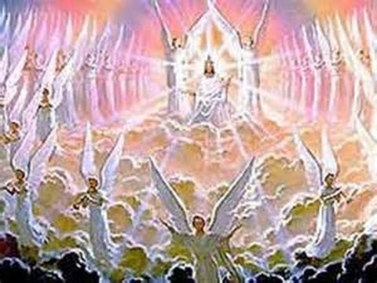
God Will Open the Windows of Heaven Again and Send Back His Son
God will one day open the windows of
Heaven again and send His Son to judge the wicked and reward the faithful! (Mt. 25:31-46)

Slide 20
Conclusion
Studying about the Windows of Heaven reminds us to be
grateful and praise God for:
Sending His Son to redeem us from our sins!
Sending the Holy Spirit to reveal His word and will for our lives!
Sending His Son again to judge the world & grant eternal life to saints!
May we ever give God the glory, praise, and
thanksgiving due Him for all He has done for us!
Ps. 96:1-3
1. Sing to the LORD a new song; Sing to the LORD, all the earth.
2. Sing to the LORD, bless His name; Proclaim good tidings of His salvation from day to day.
3. Tell of His glory among the nations, His wonderful deeds among all the peoples.

Slide 21
Conclusion
The “windows of Heaven” open to bless the faithful, and one day they will open to usher in
Eternity!
Where will you spend it?

Slide 22
“What Must I Do To Be Saved?”
Hear The Gospel (Jn. 5:24; Rom. 10:17)
Believe In Christ (Jn. 3:16-18; Jn. 8:24)
Repent Of Sins (Lk. 13:35; Acts 2:38)
Confess Christ (Mt. 10:32; Rom. 10:10)
Be Baptized (Mk. 16:16; Acts 22:16)
Remain Faithful (Jn. 8:31; Rev. 2:10)
For The Erring Child of God:
Repent (Acts 8:22), Confess (I Jn. 1:9),
Pray (Acts 8:22)

