Slide 1
Tickets To Paradise
Text: Eph. 1:7; I Pet. 1:3-4
Notes:
By Nathan L Morrison
All Scripture given is from NASB unless otherwise stated
For further study or if questions, Call: 804-277-1983, or Visit: www.courthousechurchofchrist.com

Slide 2
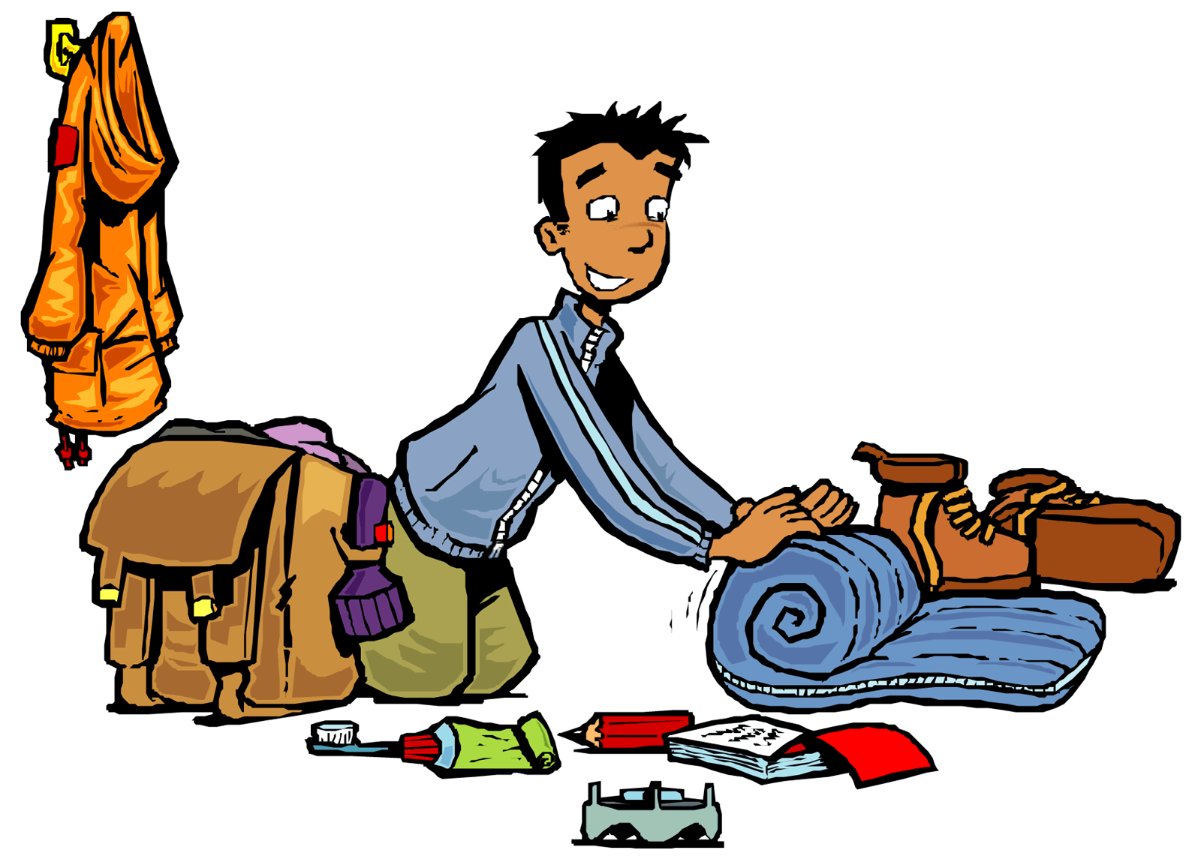
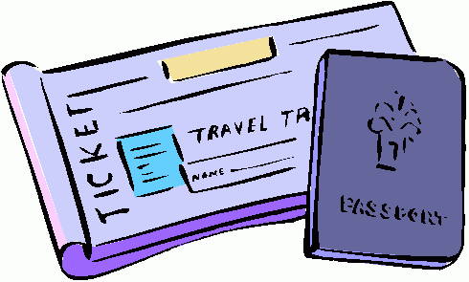
Intro
If someone were to pay for your ticket to go somewhere,
you would still need to prepare to be ready!
Pack your bags
Prepare yourself for your journey
Be Ready
Make reservations

Slide 3
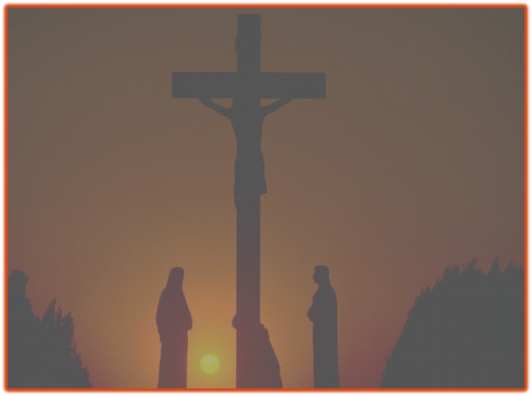
Intro
Jesus’ sacrifice on the cross shed His blood that paid our
debt of sin and made it possible for man to live forever
with Him in Heaven
Eph. 1:7
7. In Him we have redemption through His blood, the forgiveness of our trespasses, according to the riches of His grace
I Pet. 1:3-4
3. Blessed be the God and Father of our Lord Jesus Christ, who according to His great mercy has caused us to be born again to a living hope through the resurrection of Jesus Christ from the dead,
4. to obtain an inheritance which is imperishable and undefiled and will not fade away, reserved in heaven for you,

Slide 4
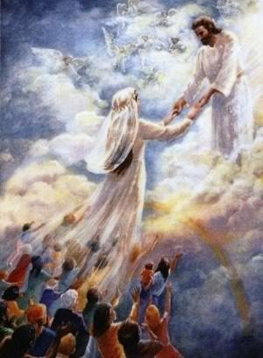
Intro
Marriage of the Lamb to the church (Rev. 19:7-9)
Matthew 22:1-14
“All things
are ready!”
“Many are
called”
“Few are
chosen!”
Few accept
The
invitation!
All are invited!
Notes:
Image 1 (Left): Painting by Pr. Welfany Nolasco Rodrigues (http://www.esbocosermao.com/search/label/escatologia)

Slide 5
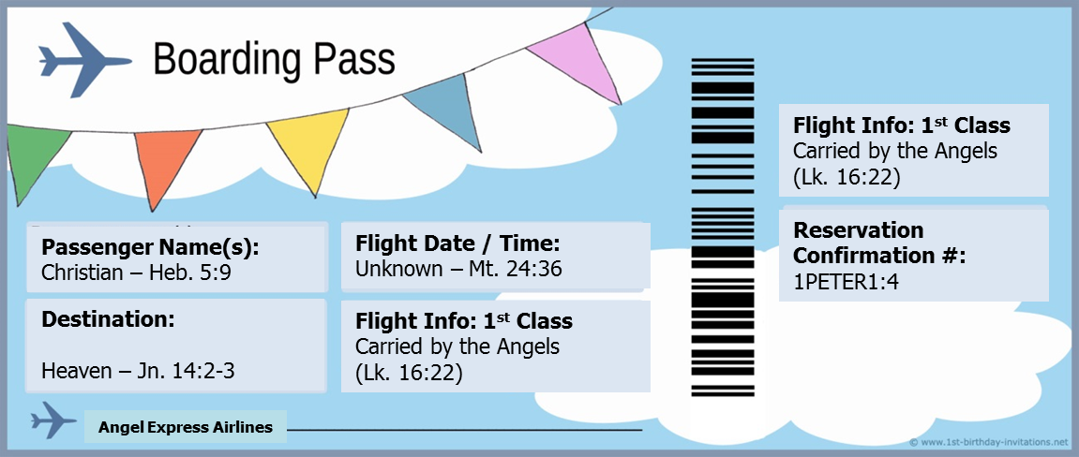
Intro
Jesus paid our ticket to Heaven & made our reservation
there, but we still have to prepare for that eternity!
Tickets to Paradise
Passenger Name(s):
Christian
(Acts 11:26; Heb. 5:9)

Slide 6
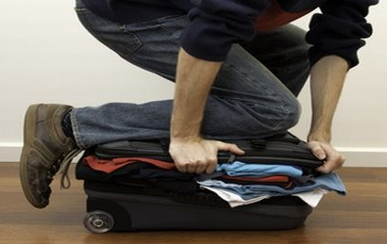
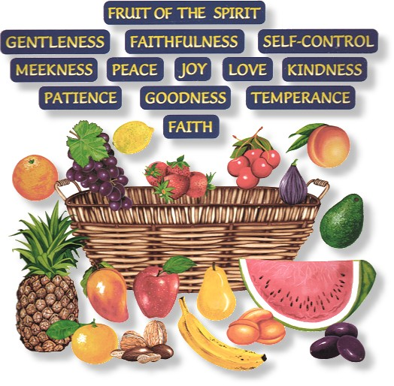
Packing Bags
Make sure your character is ready to move in a spiritual
sense, taking only what matters
II Tim. 2:15: Study to know God’s Word! (Heb. 5:14)
Gal. 5:22-25: Take the “Fruits of the Spirit”!
Heb. 12:1-2: Know what to leave behind! (Lk. 12:15, 20)
Gal. 5:22-25
22. But the fruit of the Spirit is love, joy, peace, patience, kindness, goodness, faithfulness,
23. gentleness, self-control; against such things there is no law.
24. Now those who belong to Christ Jesus have crucified the flesh with its passions and desires.
25. If we live by the Spirit, let us also walk by the Spirit.

Slide 7
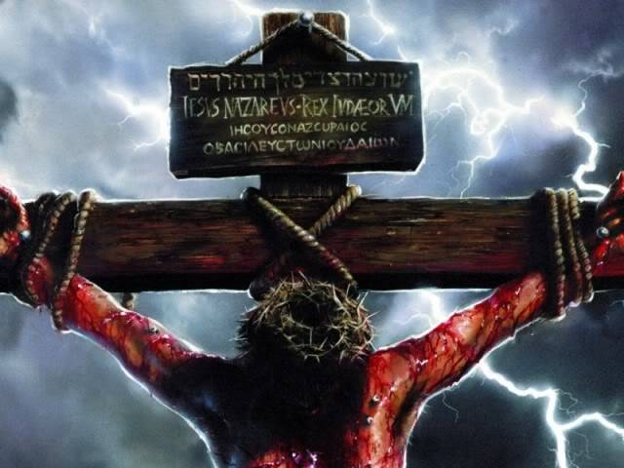
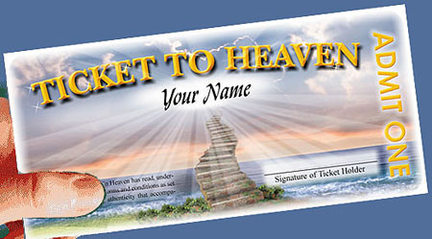
Packing Bags
Christ has bought our ticket to Heaven –
Are your spiritual bags packed by walking by the Spirit?

Slide 8
Preparing Ourselves
We must prepare ourselves spiritually to be ready for our
journey to Heaven!
Phil. 2:14-16: Live above reproach, as lights!
II Pet. 1:5-11: Practice the “Christian Virtues!”
Titus 2:11-14: Live “sensibly, righteously and godly”
Phil. 2:14-16
14. Do all things without grumbling or disputing;
15. so that you will prove yourselves to be blameless and innocent, children of God above reproach in the midst of a crooked and perverse generation, among whom you appear as lights in the world,
16. holding fast the word of life, so that in the day of Christ I will have reason to glory because I did not run in vain nor toil in vain.

Slide 9
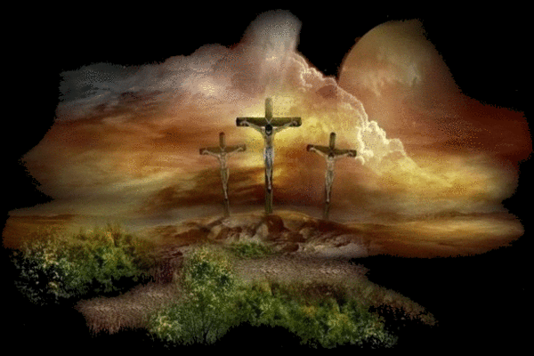
Preparing Ourselves
Christ has bought our ticket to Heaven –
Are you preparing yourself by living godly?

Slide 10
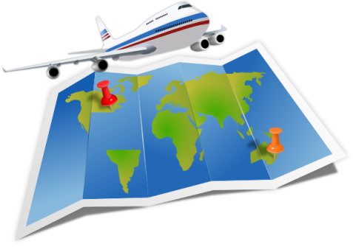
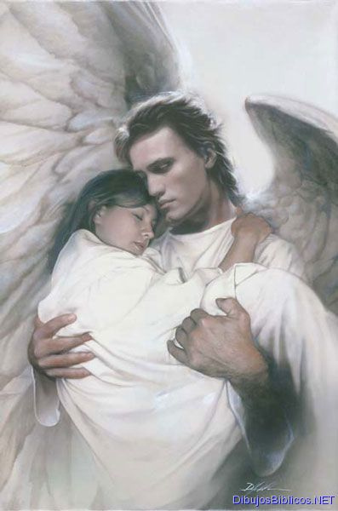
Being Ready
Be Aware, Be Alert! Be ready to catch your
“flight!”
II Pet. 3:9-12: Be ready! Live in holy & godly conduct!
Titus 2:13: Look forward to that day! (II Pet. 3:11)
I Thess. 5:2-8: Be “Daylight Disciples!”
Lk. 16:22-23: Catch your flight on the “Angel Express!”
Mk. 13:31-33: We don’t know when so “Watch and Pray!”
Mk. 13:31-33 (NKJ)
31. Heaven and earth will pass away, but My words will by no means pass away.
32. "But of that day and hour no one knows, not even the angels in heaven, nor the Son, but only the Father.
33. Take heed, watch and pray; for you do not know when the time is.

Slide 11
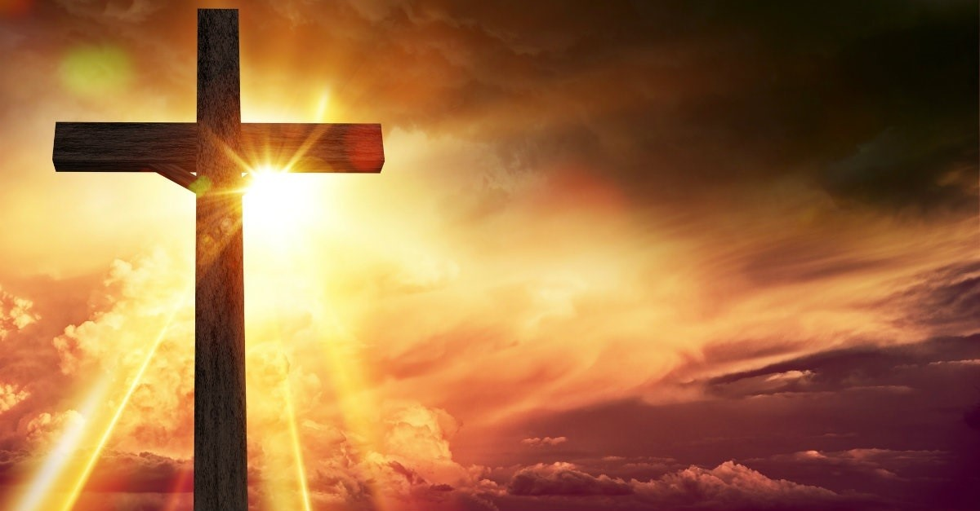
Being Ready
Christ has bought our ticket to Heaven –
Are you ready, alert, sober, and watching and praying?

Slide 12
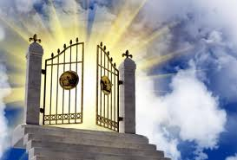
Making Reservations
We have a reservation already waiting but
we need to claim it!
I Pet. 1:3-4: Reserved in Heaven! (Heb. 5:9)
Lk. 10:17-20: Rejoice to be “enrolled in Heaven!”
Phil 4:3-4: Rejoice to be in the Book of Life!
Heb. 12:22-23: Those in the church are “enrolled in Heaven”
Rev. 20:12-15: Cannot afford to not be “written” in Book of Life!
Heb. 12:22-23
22. But you have come to Mount Zion and to the city of the living God, the heavenly Jerusalem, and to myriads of angels,
23. to the general assembly and church of the firstborn who are enrolled in heaven, and to God, the Judge of all, and to the spirits of the righteous made perfect,

Slide 13
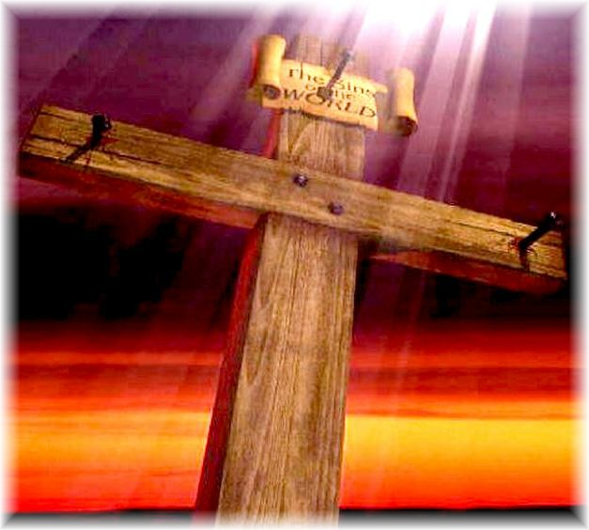
Making Reservations
Christ has bought our ticket to Heaven –
Are you looking forward to your reservation?

Slide 14
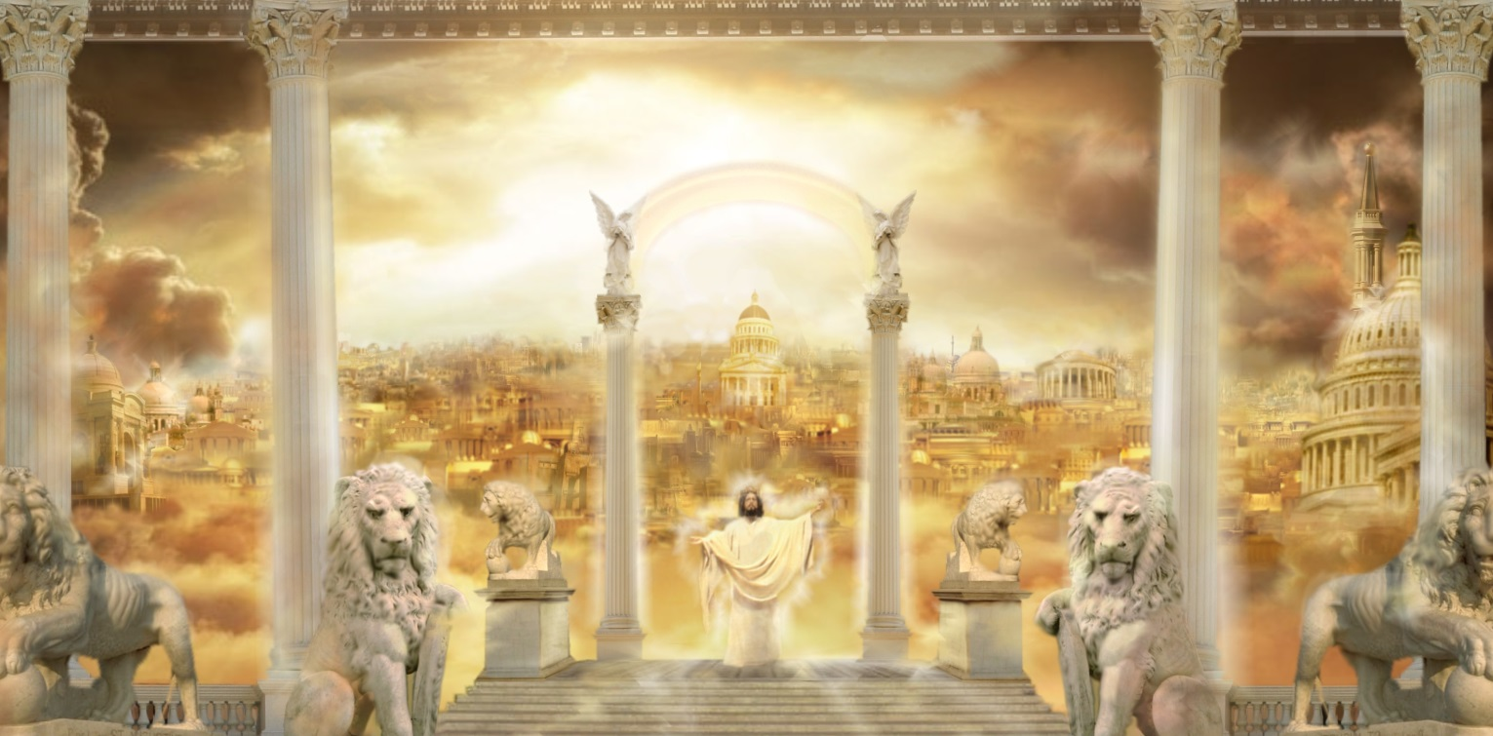
Conclusion
A physical principle of packing for a trip applies in the
spiritual, except really it is planning for a complete move
for we won’t be coming back!
Phil. 3:20
20. For our citizenship is in heaven, from which also we eagerly wait for a Savior, the Lord Jesus Christ;

Slide 15
Conclusion
Christ has paid our way to Heaven and made us
reservations there to live with God forever!
Have you packed your character with the fruits of the Spirit?
Have you prepared by living “sensibly, righteously, and godly?”
Are you ready for Christ’s 2nd coming by watching and praying?
Are you prepared to accept the reservation after the Judgment Day?
Christ has paid for our tickets to Paradise –
Let us be prepared!

Slide 16
“What Must I Do To Be Saved?”
Hear The Gospel (Jn. 5:24; Rom. 10:17)
Believe In Christ (Jn. 3:16-18; Jn. 8:24)
Repent Of Sins (Lk. 13:35; Acts 2:38)
Confess Christ (Mt. 10:32; Rom. 10:10)
Be Baptized (Mk. 16:16; Acts 22:16)
Remain Faithful (Jn. 8:31; Rev. 2:10)
For The Erring Child of God:
Repent (Acts 8:22), Confess (I Jn. 1:9),
Pray (Acts 8:22)

