Slide 1
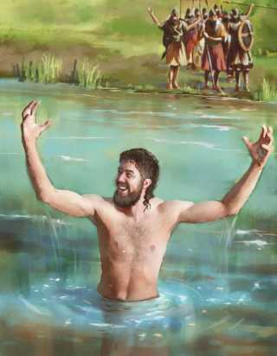
Saved Like Naaman
Text: II Kings 5:10-14
Notes:
By Nathan L Morrison
All Scripture given is from NASB unless otherwise stated
For further study or if questions, Call: 804-277-1983, or Visit: www.courthousechurchofchrist.com
Based on an article by Mike Pittman

Slide 2
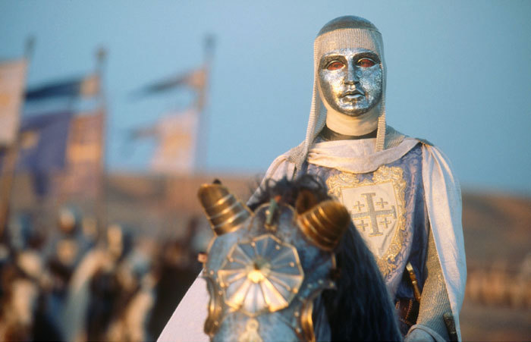
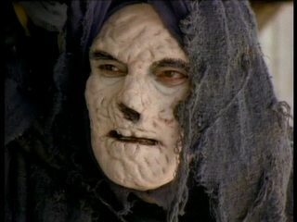
Intro
II Kings 5:1-5
Naaman was a Syrian (Arameans), an enemy and oppressor of Israel
Captain of the host (5:1)
Had taken captives, and a little Israelite girl served in his house (5:2)
He was a great and honorable man, a valiant warrior, and because of him, God gave him victory over Israel! (5:1)
He was also a leper!
Lk. 4:27
27. "And there were many lepers in Israel in the time of Elisha the prophet; and none of them was cleansed, but only Naaman the Syrian."
The case of Naaman’s salvation is the same case as people today!
Notes:
Images:
Top: King Baldwin IV wearing a “Leper Mask” as depicted in the movie “Kingdom of Heaven”
Bottom: A leper without a “leper mask”

Slide 3
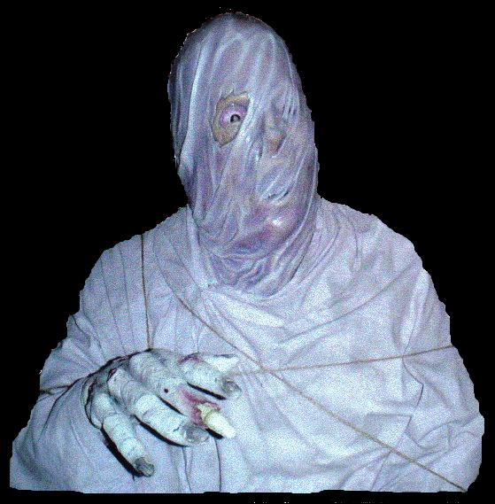
Case of Naaman – Seeking a Cure
Naaman had a serious need that he could not provide for
on his own – He was a leper!
Leprosy was a terrible disease that had dreadful effects.
A chronic, slowly progressing, mildly infectious disease, marked by destruction of tissue. Known today as Hansen’s Disease (Webster’s College Dictionary).
Their tissue rots (wastes away) from the inside till death!
“Walking Dead!”
Surely, if Naaman could have relieved himself of this problem he would
have done it!
He heard some good news!
A messenger was sent from one of God's prophets, telling Naaman: “Go and wash in the Jordan seven times, and your flesh will be restored to you and you will be clean” (II Kings 5:10).
God was the only one who could provide for his need!
Notes:
Image: A leper covered in gauze

Slide 4
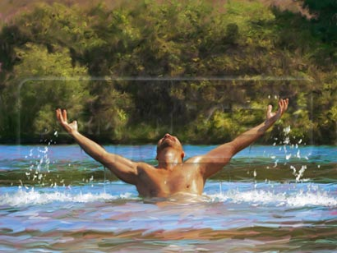
Case of Naaman – Seeking a Cure
Sadly, he was at first unwilling to put away his pride and
just submit to the clear instructions he had been given!
Looking to his own wisdom, he questioned why it had to be done that way (II Kings 5:11).
He wondered why “water” would have to be part of the plan.
If he did have to wash in water, why would it have to be the waters of the Jordan River? (Better waters back in Damascus)
Eventually, Naaman was persuaded to be
humble enough to submit to the simple
instructions from God (II Kings 5:13)
“So he went down and dipped himself seven times
in the Jordan, according to the word of the man of God; and his flesh was restored like the flesh of a
little child and he was clean” (II Kings 5:14)

Slide 5
Case of Naaman – Seeking a Cure
Naaman was saved by grace through faith!
Grace is “unmerited favor.”
No one can conclude that this leper “merited” his cleansing by performing a good work about which he could boast (II Kings 5:13).
His cleansing was not of himself (didn't come from his own power).
It was the gift of God! (no one can doubt that)
Naaman did what God said to do and was saved from
his incurable state!

Slide 6
Case of Sinners Today – Seeking a Cure
We have a serious need that we cannot provide for on our
own – We are sinners!
Sin is likened in Scripture to a terrible disease and it has dreadful effects (Ps. 38 [esp. vss. 3-8, 18-19]; Mt. 9:11-13) – God has only cure!
Rom. 3:23: All have sinned and fallen short of the glory of God.
Rom. 6:23: Wages of sin is death; God gives the free gift of eternal life in Christ.
Eph. 2:1-2: People lost in sin are “dead in their transgressions!”
“Walking Dead!”
Surely, if we could relieve ourselves of this problem we would do it!
We've heard the gospel (“good news”)!
A messenger (Ananias) was sent from one of God's men telling Saul of Tarsus: “Go and wash!”
Acts 22:16: “Now why do you delay? Get up and be baptized, and wash away your sins, calling on His name.” (I Cor. 6:9-11; NKJ: Rev. 1:5)
God is the only one (through the blood of Jesus – Eph. 1:7) who can provide for our need! (Eph. 5:25-27)

Slide 7
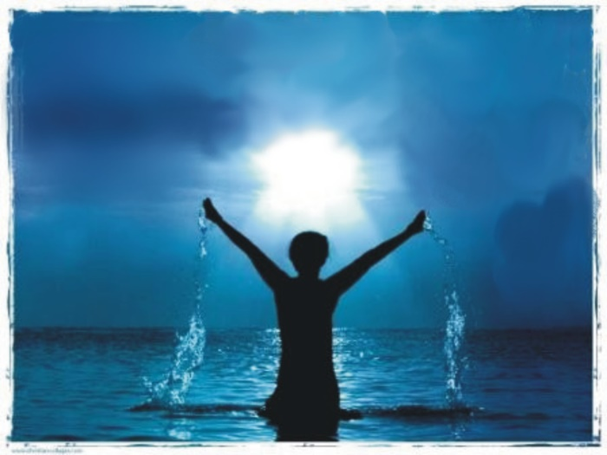
Case of Sinners Today – Seeking a Cure
Sadly, some are unwilling to put away their pride and just
submit to the clear instructions!
Looking to their own wisdom, they question why it has to be done that way.
They wonder why “water” would have to be part of the plan (They instead teach to say a prayer!)
Others are humble enough to submit to
the very simple instructions that have
been given through the messengers of
God
What was Saul's response when he was instructed to “get up and be baptized, and wash …”? “He got up and was baptized” (Acts 9:18)

Slide 8
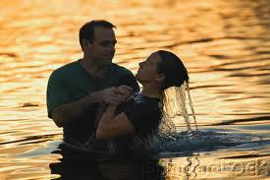
Case of Sinners Today – Seeking a Cure
Sinners are saved by grace through faith (Eph. 2:8-9)!
No one of sound mind would conclude that this sinner (Saul) merited his cleansing by performing a good work about which he could boast (Gal. 6:13-14; Eph. 2:8-9: His cleansing was not himself or his own power).
Eph. 2:8-9
8. For by grace you have been saved through faith; and that not of yourselves, it is the gift of God;
9. not as a result of works, so that no one may boast.
It was the gift of God! (no one can doubt that)
When sinners “Go and Wash” as God
has said to do they are saved from
their incurable state!

Slide 9
Conclusion
The case of Naaman also refutes mistakes commonly
made in the religious world today:
No substitutes will be accepted – II Jn. 9-11 (Waters of Damascus)
Man’s way will not prevail, and is sinful – Rom. 5:6-10 (Wanted a show)
Man must obey God and remain obedient to His word – Heb. 5:9 (Turned away enraged)
As Naaman was doomed if he refused to obey, so are
those who do not obey the gospel:
II Thess. 1:7-9: No excuses for not knowing God and not obeying Him!
The result: Eternal separation from God!

Slide 10
Conclusion
People today are still saved like Naaman!
Sinners are told the same as Naaman was once told,
“Go and wash” (Acts 22:16; I Cor. 6:9-11)
Sinners must humbly obey and be baptized to receive
salvation, the forgiveness of sins!
(Mk. 16:16; Acts 2:38; Eph. 1:7; Rev. 7:14)

Slide 11
“What Must I Do To Be Saved?”
Hear The Gospel (Jn. 5:24; Rom. 10:17)
Believe In Christ (Jn. 3:16-18; Jn. 8:24)
Repent Of Sins (Lk. 13:35; Acts 2:38)
Confess Christ (Mt. 10:32; Rom. 10:10)
Be Baptized (Mk. 16:16; Acts 22:16)
Remain Faithful (Jn. 8:31; Rev. 2:10)
For The Erring Child:
Repent (Acts 8:22), Confess (I Jn. 1:9),
Pray (Acts 8:22)

