Slide 1
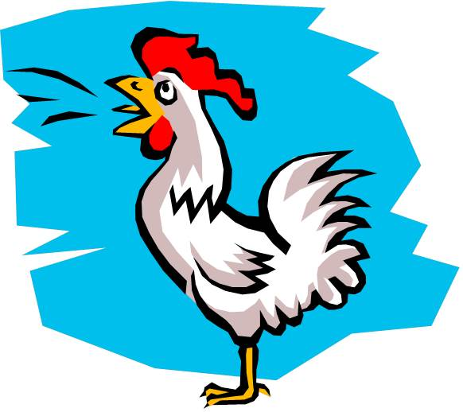
The "Rooster Call"
Text: Luke 22:31-34, 55-62
Notes:
By Nathan L Morrison
All Scripture given is from NASB unless otherwise stated
For further study or if questions, Call: 804-277-1983 or visit www.courthousechurchofcrist.com
Based on an article by Dick Blackford (2009)

Slide 2
Intro
There are times in life where we have that “rooster call
moment” as Peter did in Lk. 22:55-62!
Lk. 22:31-34
31. "Simon, Simon, behold, Satan has demanded permission to sift you like wheat;
32. but I have prayed for you, that your faith may not fail; and you, when once you have turned again, strengthen your brothers."
33. But he said to Him, "Lord, with You I am ready to go both to prison and to death!"
34. And He said, "I say to you, Peter, the rooster will not crow today until you have denied three times that you know Me."

Slide 3
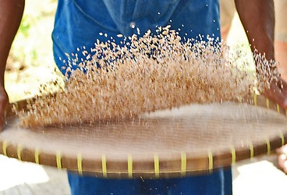
Intro
Peter later reveals Satan’s methods of “sifting”
I Peter 1:6-9: Trials that will test one’s faith.
I Peter 1:14-16, 2:11: Lusts of the flesh.
I Peter 4:1-5: Persecutions: Verbal abuse.
I Peter 4:12-16: Persecutions: Physical abuse.

Slide 4
Intro
Lk. 22:54-62
54. Having arrested Him, they led Him away and brought Him to the house of the high priest; but Peter was following at a distance.
55. After they had kindled a fire in the middle of the courtyard and had sat down together, Peter was sitting among them.
56. And a servant-girl, seeing him as he sat in the firelight and looking intently at him, said, "This man was with Him too."
57. But he denied it, saying, "Woman, I do not know Him."
58. A little later, another saw him and said, "You are one of them too!" But Peter said, "Man, I am not!"
59. After about an hour had passed, another man began to insist, saying, "Certainly this man also was with Him, for he is a Galilean too."
60. But Peter said, "Man, I do not know what you are talking about." Immediately, while he was still speaking, a rooster crowed.
61. The Lord turned and looked at Peter. And Peter remembered the word of the Lord, how He had told him, "Before a rooster crows today, you will deny Me three times."
62. And he went out and wept bitterly.

Slide 5
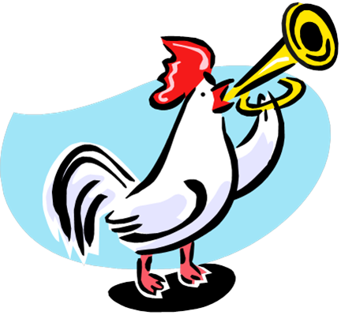
Intro
It’s important to recognize when the “rooster crows” in our own lives and respond properly!

Slide 6
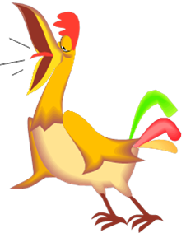
The Rooster Call
David – II Sam. 11-12 (Sin and cover-up with Bathsheba)
David had committed sin with Bathsheba and continued to sin trying to cover it up.
Rooster Call: “You are the man!” (II Sam. 12:7). Secret (II Sam. 12:12) out in the open!
II Sam. 12:7
7. Nathan then said to David, "You are the man! Thus says the LORD God of Israel, 'It is I who anointed you king over Israel and it is I who delivered you from the hand of Saul.

Slide 7
The Rooster Call
Naaman – II Kings 5:13
Naaman came to Elisha expecting a show and a miracle! (5:11-12)
Rooster Call: His servants confronted him with the truth of the matter.
II Kings 5:13
13. Then his servants came near and spoke to him and said, "My father, had the prophet told you to do some great thing, would you not have done it? How much more then, when he says to you, 'Wash, and be clean'?"

Slide 8
The Rooster Call
The Prodigal Son – Lk. 15:13-17
Young son squandered his inheritance with “loose living” (Lk. 15:13).
Rooster Call: A Jew among the swine (unclean animal)! And he envied their food! (Lk. 15:15-17)
Lk. 15:15-17
15. "So he went and hired himself out to one of the citizens of that country, and he sent him into his fields to feed swine.
16. "And he would have gladly filled his stomach with the pods that the swine were eating, and no one was giving anything to him.
17. "But when he came to his senses, he said, 'How many of my father's hired men have more than enough bread, but I am dying here with hunger!

Slide 9
The Rooster Call
Judas – Mt. 27:3
He was a friend & Apostle of Jesus and betrayed Him for 30 pieces of silver (Mt. 26:14-15).
Rooster Call: Judas “saw that He (Jesus) had been condemned” (Mt. 27:3)
Mt. 27:3
3. Then when Judas, who had betrayed Him, saw that He had been condemned, he felt remorse and returned the thirty pieces of silver to the chief priests and elders,

Slide 10
The Rooster Call
Jews on Pentecost – Acts 2
Heard Peter’s sermon, and there were among them those who delivered up Jesus.
Rooster Call: “This Jesus whom you crucified (Lord and Christ)” (Acts 2:36-37)
Acts 2:36
36. "Therefore let all the house of Israel know for certain that God has made Him both Lord and Christ--this Jesus whom you crucified."

Slide 11
The Rooster Call
King Agrippa II – Acts 26:5, 26-27
Paul gave his defense before King Agrippa II, and had said the Jews knew he (Paul) was of the strictest sect of the Jews.
Rooster Call: “King Agrippa, do you believe the Prophets? I know that you do” (Acts 26:27)
Acts 26:27
27. "King Agrippa, do you believe the Prophets? I know that you do."

Slide 12
The Rooster Call
David – II Sam. 12:7
Naaman – II Kings 5:13
The Prodigal Son – Lk. 15:15-17
Judas – Mt. 27:3
Jews on Pentecost – Acts 2:36-37
King Agrippa II – Acts 26:27
We may all experience that “rooster call” moment at one
point in our lives, but what separates us from others is
how we respond to the truth of what we have done!

Slide 13
Proper Response
Character | Rooster Call | Response
David | II Sam. 12:7
Naaman | II Kings 5:13
The Prodigal Son | Lk. 15:15-17
Judas | Mt. 27:3
Jews On Pentecost | Acts 2:36-37
King Agrippa II | Acts 26:27
Proper Response: “I have sinned against the LORD”
(II Sam. 12:13)
Proper Response: He obeyed God and was cleansed!
(II Kings 5:14-15)
Proper Response: He went to
his father, confessed his sin, and repented!
(Lk. 15:17, 21)
Proper Response: From being pricked in their hearts they asked what to do, and when told, they obeyed and were saved, added to the church (Acts 2:38-41, 47)

Slide 14
Proper Response
David – II Sam. 12:13
Naaman – II Kings 5:14-15
The Prodigal Son – Lk. 15:17, 21
Jews on Pentecost – Acts 2:37-41, 47
Sometimes it takes “the Rooster Call”
to wake us up and do what is right!

Slide 15
Improper Response
Character | Rooster Call | Response
David | II Sam. 12:7
Naaman | II Kings 5:13
The Prodigal Son | Lk. 15:15-17
Judas | Mt. 27:3
Jews On Pentecost | Acts 2:36-37
King Agrippa II | Acts 26:27
Proper Response:
II Sam. 12:13
Proper Response:
II Kings 5:14-15
Proper Response:
Lk. 15:17, 21
Improper Response:
He felt remorse but “went away and hanged himself”
(Mt. 27:3-5; Acts 1:18)
Proper Response
Acts 2:38-41, 47
Improper Response:
“In a short time you will
persuade me to become a
Christian” (NKJ: “Almost”)
(Acts 26:28)

Slide 16
Improper Response
Judas – Mt. 27:3-5; Acts 1:18
King Agrippa II – Acts 26:28
Some people upon hearing
“the Rooster Call” continue
to sin and make things worse!

Slide 17
Conclusion
The lesson of Peter’s rooster call serves as example and
warning to us to not become “overconfident”
Mt. 26:35: Peter not alone in boasting, “All the disciples said the same thing too.”
They all fled and deserted Christ too – Mt. 26:56
Sometimes we don’t recognize or realize the sin we have
committed, the hurt and pain caused to others,
discouragement or bad example we have become to
others, till the rooster crows!
We need to hear it and make the changes
needed to come back to God!
(Peter “remembered” – Mt. 26:75)

Slide 18
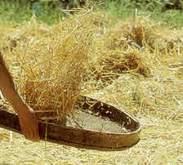
Conclusion
Think of the great service Peter rendered God and man
after his “sifting!”
Peter wept bitterly but came back to stand against a massive crowd on the day of Pentecost and accused them of the Lord’s murder! (Acts 2:14-39)
Suffered stripes for his preaching of Jesus. (Acts 5:40)
Preached to the Gentiles first. (Acts 10)
Suffered imprisonment. (Acts 12)
Became an elder of the Lord’s church. (I Pet 5:1)
Ultimately gave his life as a martyr in the service of the Lord. (Jn. 21:18-19; II Pet. 1:14)
Jesus knew Peter would fail,
but told him to strengthen
his brothers when he returned!
(Lk 22:32)

Slide 19
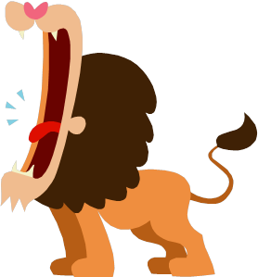
Conclusion
Peter strengthens all of us by letting us know we are
not alone in our struggles
I Pet. 5:8-11
8. Be of sober spirit, be on the alert. Your adversary, the devil, prowls around like a roaring lion, seeking someone to devour.
9. But resist him, firm in your faith, knowing that the same experiences of suffering are being accomplished by your brethren who are in the world.
10. After you have suffered for a little while, the God of all grace, who called you to His eternal glory in Christ, will Himself perfect, confirm, strengthen and establish you.
11. To Him be dominion forever and ever. Amen.

Slide 20
Conclusion
For Peter, it took a rooster to wake him up to the state
he was in (What God saw him as)
Have you heard the “Rooster Call”
in your life?
How will you respond?

Slide 21
“What Must I Do To Be Saved?”
Hear The Gospel (Jn. 5:24; Rom. 10:17)
Believe In Christ (Jn. 3:16-18; Jn. 8:24)
Repent Of Sins (Lk. 13:35; Acts 2:38)
Confess Christ (Mt. 10:32; Rom. 10:10)
Be Baptized (Mk. 16:16; Acts 22:16)
Remain Faithful (Jn. 8:31; Rev. 2:10)
For The Erring Child:
Repent (Acts 8:22), Confess (I Jn. 1:9),
Pray (Acts 8:22)

