Slide 1
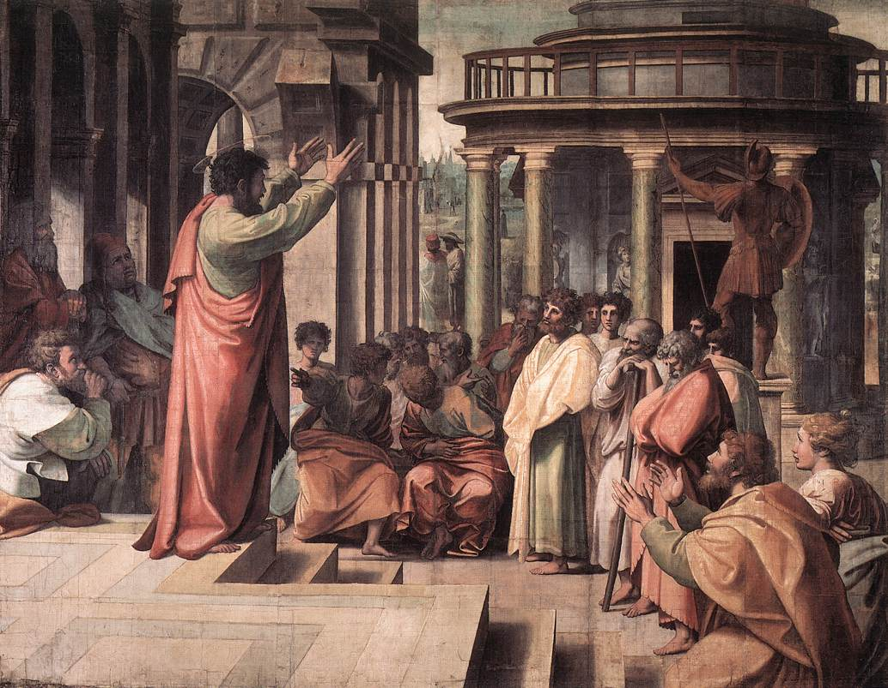
Preaching Like Paul Text: Ephesians 4:14-16
Notes:
By Nathan L Morrison
All Scripture given is from NASB unless otherwise stated
For further study or if questions, Call: 804-277-1983, or Visit: www.courthousechurchofchrist.com
Some points from an article by Hugh DeLong

Slide 2
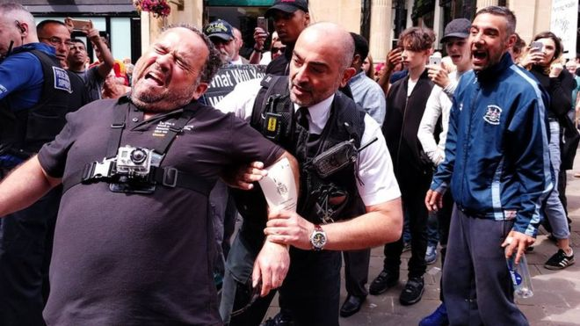
Intro
Two “street preachers” arrested in Bristol, England!
Four preachers, Michael Overd, Adrian Clark, Michael Stockwell and Don Karns, were arrested after preaching in a Bristol, England shopping area in July, 2016
Police told them they were “causing a disturbance” and “not welcome,” and that they had “gone over the top” and “wound up people.”
Two men were let go but Michael Overd and Michael Stockwell were charged with “causing a disturbance” and engaging in “anti-social behavior” after some listeners became offended by their speech about issues such as Islam, Buddhism, homosexuality and divorce
Notes:
Image: Michael Overd being arrested
Sources:
• http://www.bbc.com/news/uk-england-bristol-39118846
• https://www.lifesitenews.com/news/christian-evangelists-found-guilty-of-disorderly-conduct-for-preaching-gods
• https://www.premier.org.uk/News/UK/Bristol-street-preachers-guilty-of-public-order-offences
• http://shoebat.com/2017/02/23/uk-arrests-and-prosecutes-christian-preachers-for-declaring-allah-does-not-exist-mohammed-was-a-false-prophet-and-you-will-go-to-hell-if-you-keep-following-them/
• http://constitution.com/two-christians-arrested-fined-preaching-uk/
• http://christiannews.net/2017/02/24/trial-underway-in-uk-for-preachers-arrested-for-anti-social-opposition-to-islam-homosexuality/
• https://thepreachersword.com/2017/03/02/two-evangelists-charged-tried-convicted/
• HTTPS://JAMESBISHOPBLOG.COM/2017/02/26/CHRISTIAN-STREET-PREACHERS-ARRESTED-IN-BRISTOL-ENGLAND/
• http://www.bristolpost.co.uk/news/bristol-news/street-preachers-arrested-front-cheering-2656
• http://www.dailymail.co.uk/news/article-3680470/US-Christian-street-preachers-arrested-cheers-home-allegedly-shouted-Muslims-burn-hell-Bristol-city-centre.html

Slide 3
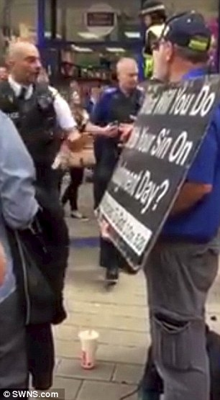
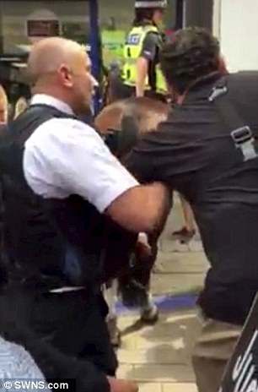
Intro
The Arrest – July 2016
“Allah does not exist” and “all Muslims will burn in Hell!”
“David Cameron is no more a Christian than my dogs”
“Allah is the greatest deceiver—that’s in the Koran”
“False religion leads men to the gates and the very depth of Hell”
“Animals”
“Disgusting”
Refused to cooperate!
Notes:
Image on Left: Police Officer arresting Michael Overd
Image on Right: One of the four preachers holding a sign
Sources:
• http://www.bbc.com/news/uk-england-bristol-39118846
• https://www.lifesitenews.com/news/christian-evangelists-found-guilty-of-disorderly-conduct-for-preaching-gods
• https://www.premier.org.uk/News/UK/Bristol-street-preachers-guilty-of-public-order-offences
• http://shoebat.com/2017/02/23/uk-arrests-and-prosecutes-christian-preachers-for-declaring-allah-does-not-exist-mohammed-was-a-false-prophet-and-you-will-go-to-hell-if-you-keep-following-them/
• http://constitution.com/two-christians-arrested-fined-preaching-uk/
• http://christiannews.net/2017/02/24/trial-underway-in-uk-for-preachers-arrested-for-anti-social-opposition-to-islam-homosexuality/
• https://thepreachersword.com/2017/03/02/two-evangelists-charged-tried-convicted/
• HTTPS://JAMESBISHOPBLOG.COM/2017/02/26/CHRISTIAN-STREET-PREACHERS-ARRESTED-IN-BRISTOL-ENGLAND/
• http://www.bristolpost.co.uk/news/bristol-news/street-preachers-arrested-front-cheering-2656
• http://www.dailymail.co.uk/news/article-3680470/US-Christian-street-preachers-arrested-cheers-home-allegedly-shouted-Muslims-burn-hell-Bristol-city-centre.html

Slide 4
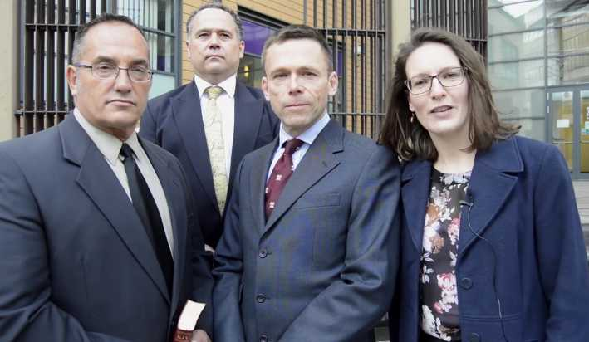
Intro
The Trial – February 2017
Prosecutor Ian Jackson, claimed: “To say to someone that Jesus is the only God is not a matter of truth. To the extent that they are saying that the only way to God is through Jesus, that cannot be a truth.”
The prosecutor also said, “Some of the statements made by the preachers may have been in the King James Bible, translated in 1611, but that did not mean they were acceptable in 2016” and then claimed that quoting parts of the King James Bible in the context of modern British society “must be considered to be abusive and is a criminal matter.”
The prosecutor argued that free speech must yield to multicultural reality in modern Britain, and that there was a clear threat to violence due to the words of the preachers and the criticism of Islam
Notes:
Image: Michael Stockwell, Michael Overd, and Adrian Clark with a representative from Christian Concern
Sources:
• http://www.bbc.com/news/uk-england-bristol-39118846
• https://www.lifesitenews.com/news/christian-evangelists-found-guilty-of-disorderly-conduct-for-preaching-gods
• https://www.premier.org.uk/News/UK/Bristol-street-preachers-guilty-of-public-order-offences
• http://shoebat.com/2017/02/23/uk-arrests-and-prosecutes-christian-preachers-for-declaring-allah-does-not-exist-mohammed-was-a-false-prophet-and-you-will-go-to-hell-if-you-keep-following-them/
• http://constitution.com/two-christians-arrested-fined-preaching-uk/
• http://christiannews.net/2017/02/24/trial-underway-in-uk-for-preachers-arrested-for-anti-social-opposition-to-islam-homosexuality/
• https://thepreachersword.com/2017/03/02/two-evangelists-charged-tried-convicted/
• HTTPS://JAMESBISHOPBLOG.COM/2017/02/26/CHRISTIAN-STREET-PREACHERS-ARRESTED-IN-BRISTOL-ENGLAND/
• http://www.bristolpost.co.uk/news/bristol-news/street-preachers-arrested-front-cheering-2656
• http://www.dailymail.co.uk/news/article-3680470/US-Christian-street-preachers-arrested-cheers-home-allegedly-shouted-Muslims-burn-hell-Bristol-city-centre.html

Slide 5
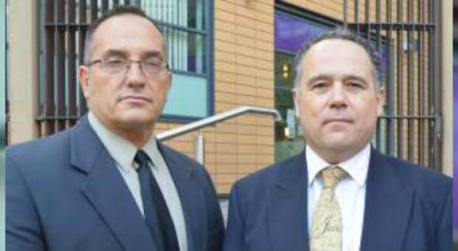
Intro
The Conviction – February 2017
The two men were found guilty of “intentionally alarming” the public with open-air preaching, under Section 31 of the Crime and Disorder Act 1998, for using “threatening or abusive words or behavior or disorderly behavior within the hearing or sight of a person likely to be, caused harassment, alarm or distress, thereby, and the offence was religiously aggravated.”
“The court has determined that these men crossed that line and used their platform to comment on other religions and sexuality using disparaging and offensive language.”
“They were fully aware of the impact their preaching was having on their audience and the resulting tension it was causing” and were there “to cause a fight.”
The men were fined £300 each and faced up to six months in jail
(Appealed in May 2017 & won!)
Notes:
Image: Michael Stockwell and Michael Overd
Sources:
• http://www.bbc.com/news/uk-england-bristol-39118846
• https://www.lifesitenews.com/news/christian-evangelists-found-guilty-of-disorderly-conduct-for-preaching-gods
• https://www.premier.org.uk/News/UK/Bristol-street-preachers-guilty-of-public-order-offences
• http://shoebat.com/2017/02/23/uk-arrests-and-prosecutes-christian-preachers-for-declaring-allah-does-not-exist-mohammed-was-a-false-prophet-and-you-will-go-to-hell-if-you-keep-following-them/
• http://constitution.com/two-christians-arrested-fined-preaching-uk/
• http://christiannews.net/2017/02/24/trial-underway-in-uk-for-preachers-arrested-for-anti-social-opposition-to-islam-homosexuality/
• https://thepreachersword.com/2017/03/02/two-evangelists-charged-tried-convicted/
• HTTPS://JAMESBISHOPBLOG.COM/2017/02/26/CHRISTIAN-STREET-PREACHERS-ARRESTED-IN-BRISTOL-ENGLAND/
• http://www.bristolpost.co.uk/news/bristol-news/street-preachers-arrested-front-cheering-2656
• http://www.dailymail.co.uk/news/article-3680470/US-Christian-street-preachers-arrested-cheers-home-allegedly-shouted-Muslims-burn-hell-Bristol-city-centre.html
• http://www.bbc.com/news/uk-england-bristol-40448925 - Appeals Case won and convictions and fines were overturned (June 29, 2017)

Slide 6
Intro
Preaching like Paul?
Many religious articles recorded the words of the prosecutor and say the men were only reading from the KJV Bible, but left out direct quotes!
Reading the records of what they said indicated that their problems were the result of the attitude and methods and not the gospel message!
Eph. 4:15 tells saints to “Speak(ing) the truth in love” (Paul to the Ephesians)
While what they said was true on many topics, the way they said it and presented the gospel was belligerent to say the least. (That still doesn’t excuse the erroneous statements made by the prosecutor!)
Some say the truth is the truth and doesn’t matter how it is presented or stated! (They forget about Love – Eph. 4:15 & Gentleness – II Tim. 2:24)
Eph. 4:15 (4:14 says not to fall for false doctrine)
15. but speaking the truth in love, we are to grow up in all aspects into Him who is the head, even Christ,
Were these men preaching like Paul?
Let us look at the way Paul preached!
Notes:
Emphasis in Scripture mine!

Slide 7
Preaching Like Paul
II Tim. 2:24-26 (Paul to Timothy, see also II Tim. 4:2)
24. The Lord's bond-servant must not be quarrelsome, but be kind to all, able to teach, patient when wronged,
25. with gentleness correcting those who are in opposition, if perhaps God may grant them repentance leading to the knowledge of the truth,
26. and they may come to their senses and escape from the snare of the devil, having been held captive by him to do his will.
Notes:
Emphasis in Scripture mine!

Slide 8
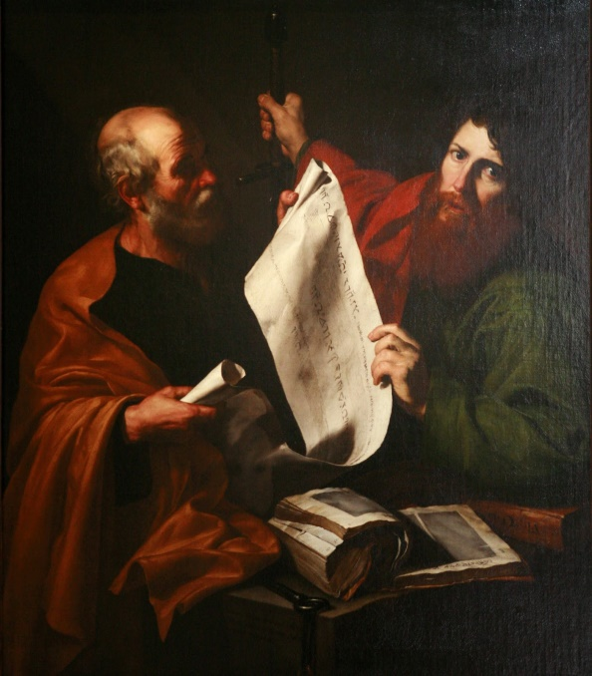
Preaching Like Paul
Some of Paul’s methods when teaching the gospel…
Acts 17:2 (Paul to the Thessalonians – 17:1)
2. And according to Paul's custom, he went to them, and for three Sabbaths reasoned with them from the Scriptures,
Acts 17:17 (vs. 18: “conversing”)
(Paul to the Athenians – 17:16)
17. So he was reasoning in the synagogue with the Jews and the God-fearing Gentiles, and in the market place every day with those who happened to be present.
Notes:
Emphasis in Scripture mine!

Slide 9
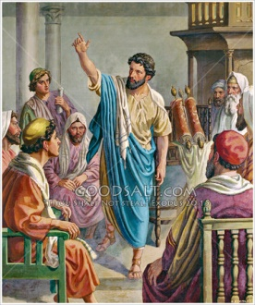
Preaching Like Paul
Some of Paul’s methods when teaching the gospel…
Acts 18:4 (Paul to the Corinthians – 18:1)
4. And he was reasoning in the synagogue every Sabbath and trying to persuade Jews and Greeks.
Acts 18:19 (Paul to the Ephesians)
19. They came to Ephesus, and he left them there. Now he himself entered the synagogue and reasoned with the Jews.
Notes:
Emphasis in Scripture mine!

Slide 10
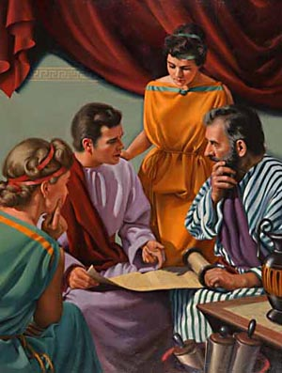
Preaching Like Paul
Some of Paul’s methods when teaching the gospel…
Acts 19:8-9 (Paul to the Ephesians – 19:1)
8. And he entered the synagogue and continued speaking out boldly for three months, reasoning and persuading them about the kingdom of God.
9. But when some were becoming hardened and disobedient, speaking evil of the Way before the people, he withdrew from them and took away the disciples, reasoning daily in the school of Tyrannus.
Acts 24:25 (Paul to Felix)
25. But as he was discussing righteousness, self-control and the judgment to come, Felix became frightened and said, "Go away for the present, and when I find time I will summon you."
Notes:
Emphasis in Scripture mine!

Slide 11
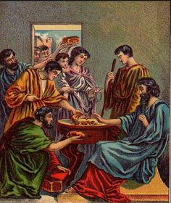
Preaching Like Paul
In any such reasoning with people, there will be
“argument,” and a give and take in explaining viewpoints
– can even get heated or call for “speaking out boldly”
(Acts 19:8-9)
Paul “reasoned” & “discussed” without name-calling! (Col. 3:8: “Abusive Speech”)
II Timothy 2:26: We teach gently so the lost may “escape from the snare of the devil”
Col. 3:8
8. But now you also, put them all aside: anger, wrath, malice, slander, and abusive speech from your mouth.
The goal of our preaching and teaching
is to save souls, not to start a fight just
to be offensive!
Notes:
Emphasis in Scripture mine!

Slide 12
Conclusion
Paul was concerned with how the gospel was presented!
I Timothy 1:5
5. But the goal of our instruction is love from a pure heart and a good conscience and a sincere faith.
Col. 4:6 (Note: NOT with salty speech!)
6. Let your speech always be with grace, as though seasoned with salt, so that you will know how you should respond to each person.
Offending people with the gospel is easy!
To the world and now even the court in Britain, the Bible isn’t for the modern world!
When sneered at, “Paul went out of their midst” – Acts 17:32-33
Notes:
Emphasis in Scripture mine!

Slide 13
Conclusion
Reasoning with people with grace, patience,
and gentleness often proves more difficult!
Even following Paul’s example
and instruction can end up
in one being arrested
(Acts 21:27-33), but we will
have presented the gospel in a
godly and reasonable manner!
(I Peter 4:14-16)
Is your manner of teaching like
Paul, motivated out of love for the
lost, or looking to start a fight?

Slide 14
“What Must I Do To Be Saved?”
Hear The Gospel (Jn. 5:24; Rom. 10:17)
Believe In Christ (Jn. 3:16-18; Jn. 8:24)
Repent Of Sins (Lk. 13:35; Acts 2:38)
Confess Christ (Mt. 10:32; Rom. 10:10)
Be Baptized (Mk. 16:16; Acts 22:16)
Remain Faithful (Jn. 8:31; Rev. 2:10)
For The Erring Child:
Repent (Acts 8:22), Confess (I Jn. 1:9),
Pray (Acts 8:22)

