Slide 1
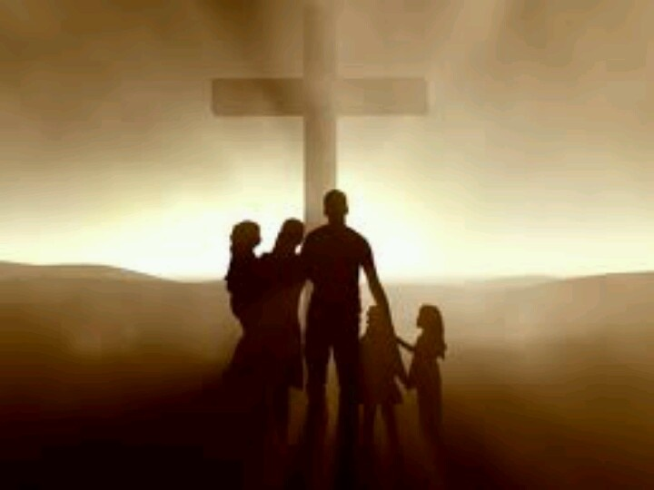
Portraits Of The Church
Text: Mark 10:28-30;
Matthew 12:46-50
Notes:
By Nathan L Morrison
All Scripture given is from NASB unless otherwise stated
For further study or if questions, Call: 804-277-1983 or visit www.courthousechurchofcrist.com

Slide 2
Intro
Part of the blessings of being a member of the Lord’s church is that we are family – A Kingdom without borders!
Mk. 10:28-30: As saints we have spiritual family the world over!
Mk. 10:28-30
28. Peter began to say to Him, "Behold, we have left everything and followed You."
29. Jesus said, "Truly I say to you, there is no one who has left house or brothers or sisters or mother or father or children or farms, for My sake and for the gospel's sake,
30. but that he will receive a hundred times as much now in the present age, houses and brothers and sisters and mothers and children and farms, along with persecutions; and in the age to come, eternal life.

Slide 3
Intro
Part of the blessings of being a member of the Lord’s church is that we are family – A Kingdom without borders!
Mt. 12:46-50: Jesus says His family are “whoever does the will of My Father who is in heaven” – obedience makes one a member of God’s family (Gal. 3:27; Rom. 8:14-17; I Cor. 12:13)
Mt. 12:46-50
46. While He was still speaking to the crowds, behold, His mother and brothers were standing outside, seeking to speak to Him.
47. Someone said to Him, "Behold, Your mother and Your brothers are standing outside seeking to speak to You."
48. But Jesus answered the one who was telling Him and said, "Who is My mother and who are My brothers?"
49. And stretching out His hand toward His disciples, He said, "Behold My mother and My brothers!
50. "For whoever does the will of My Father who is in heaven, he is My brother and sister and mother."

Slide 4
Intro
The Scriptures describe the church in ways that show it
is important to God and to man!
The Body of Christ (Eph. 1:22-23)
The Household of God (Eph. 2:19)
The Temple of God (Eph. 2:21-22)
The Kingdom of God (Eph. 5:5)
The Bride of Christ (Eph. 5:23-32; Rev. 19:7)
In looking closely at the church being “the household
(family) of God” we can see the relationships of the saints
to the church! (To each other)
Eph. 2:19-21; Rom. 12:4; Acts 20:28: We see the church is a close-knit family!
Let us examine the portraits of the church to see what God wants us to be!

Slide 5
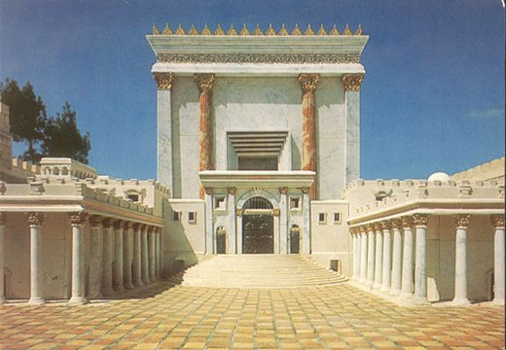
Blocks
Eph. 2:19-22:
The church is God’s “holy temple,” with each member a block fitted together (“Living Stones” – I Pet. 2:5)
Eph. 2:19-22
19. So then you are no longer strangers and aliens, but you are fellow citizens with the saints, and are of God's household,
20. having been built on the foundation of the apostles and prophets, Christ Jesus Himself being the corner stone,
21. in whom the whole building, being fitted together, is growing into a holy temple in the Lord,
22. in whom you also are being built together into a dwelling of God in the Spirit.
I Pet. 2:5
5. you also, as living stones, are being built up as a spiritual house for a holy priesthood, to offer up spiritual sacrifices acceptable to God through Jesus Christ.

Slide 6
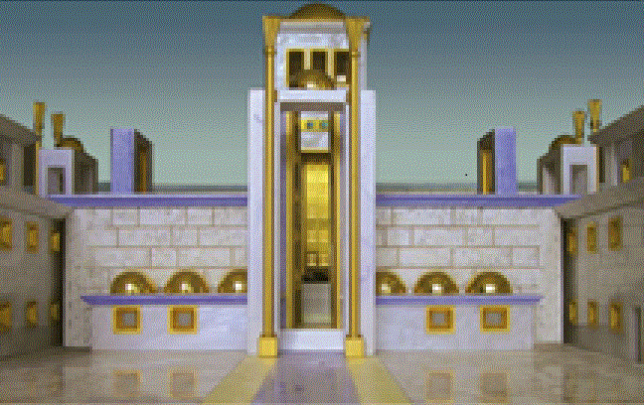
Blocks
Is. 28:16; I Pet. 2:5-7: This building has a sure foundation
Mt. 16:18: Jesus said , “I will build My church.”
Its foundation is built upon the fact that Christ is “the Son of the living God” (Mt. 16:16)
I Cor. 3:10-14: Christ is the strong foundation!
Is. 28:16; Acts 2:24: It is a foundation tested by the greatest power over man: death.
As “Living Stones” saints comprise the blocks that fit
together to make the church!
I Tim. 3:15: The church is the “pillar and support of the truth.”
One block can be easily knocked over;
but try kicking in the support wall!
Saints are to be built up together—on
the chief corner stone, which is Christ!

Slide 7
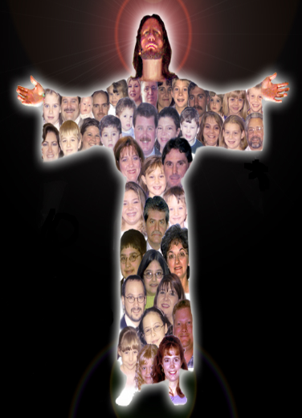
Body
Rom. 12:4-5 (I Cor. 12:13)
4. For just as we have many members in one body and all the members do not have the same function,
5. so we, who are many, are one body in Christ, and individually members one of another.
all in all.
Blessings in the body
Eph. 1:23: The “fullness of God!”
Like blocks that are
fitted together to
make the whole, so
are the members of
the body!
I Cor. 12:12-14, 19-20, 27; Js. 5:19-20; Jn. 15:4-6
Eph. 2:16: Reconciliation to God
Eph. 5:23: Salvation is in the body
The church is the body of Christ;
must be a member to be saved!

Slide 8
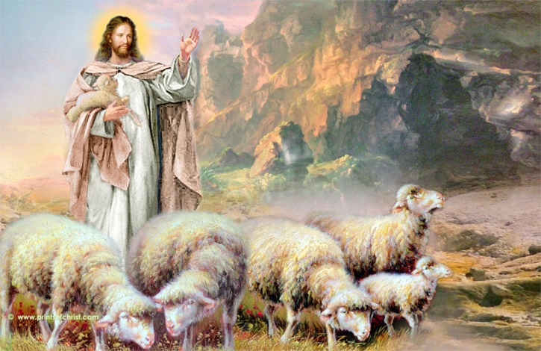
Flock
Acts 20:28: The church is called the “flock”
Acts 20:28
28. "Be on guard for yourselves and for all the flock, among which the Holy Spirit has made you overseers, to shepherd the church of God which He purchased with His own blood.

Slide 9
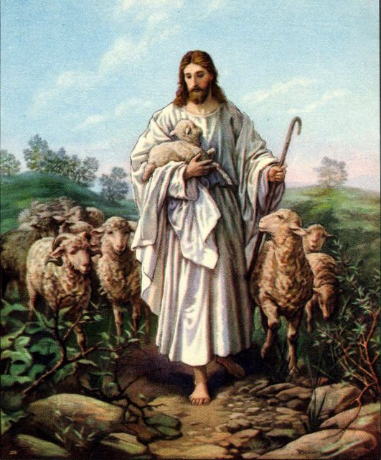
Flock
Jn. 10:1-5, 7-11, 14-17, 27-30: Jesus calls His sheep!
When we answer His call, He will give us rest (Mt. 11:28-30).
He will give us eternal life (Mt. 25:34, 46; Jn. 10:27-28).
If we walk off or go astray, we have heeded the voice of a stranger and are on the path of death and destruction (Jn. 10:10).
Heed His voice; no one can take us
from His fold or lead us astray
We choose to hear a stranger’s voice or not!
Rom. 8:35-39: “Self” can take us out!
As the flock of God we are promised eternal life by the Good Shepherd!

Slide 10
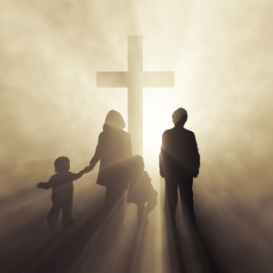
Family
Eph. 2:19:
Saints are “no longer strangers and aliens,” but are “of God’s household!”
Eph. 2:19
19. So then you are no longer strangers and aliens, but you are fellow citizens with the saints, and are of God's household,
I Tim. 3:15: God’s “house” identifies His family
Rom. 8:14-17: God’s children are in His family
Those led by the Spirit are sons of God (Jn. 1:12)
Children by adoption (Can call God, “Abba! Father! – Mk. 14:36; Gal. 4:6-7)
Heirs of God; fellow heirs with Christ
If suffer with Him, will also be glorified
with Him! (Rom. 8:17)

Slide 11
Family
The family metaphor emphasizes the importance of the
saint’s relationship to God! (Honor, responsibility)
Eph. 5:7-11 (Must live as a child of God!)
7. Therefore do not be partakers with them;
8. for you were formerly darkness, but now you are Light in the Lord; walk as children of Light
9. (for the fruit of the Light consists in all goodness and righteousness and truth),
10. trying to learn what is pleasing to the Lord.
11. Do not participate in the unfruitful deeds of darkness, but instead even expose them;

Slide 12
Family
Two figures are used to show the means of entrance into God’s family:
Eph. 1:5: Adopted by God as His children (Rom. 8:15-16)
I Peter 1:22-23: A new birth.
(Baptism: Jn. 3:3-5; I Cor. 12:13-14; Gal. 3:27)
By obedience to the gospel saints are
members of the family of God!

Slide 13
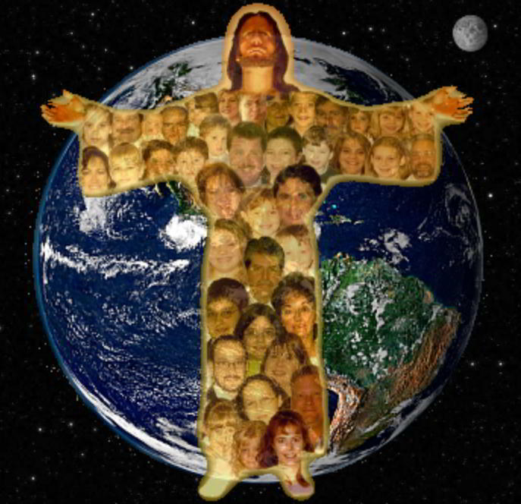
Conclusion
Eph. 3:5-6: The church breaks cultural & ethnic barriers
to welcome ALL in!
Eph. 5:25: The church was important enough to Jesus that
He died for it! (Acts 20:28)
God has described the church in ways saints can see the
closeness to each other and to God!
Blocks (Living Stones)
Body of Christ
Flock (Christ’s Flock)
Household of God

Slide 14
Conclusion
The church is important to God and to man!
It is important and essential to salvation to be a member
of the church Jesus built and died for!
Saints must work together in being built
up, and to be the “the pillar and support
of the truth!”

Slide 15
“What Must I Do To Be Saved?”
Hear The Gospel (Jn. 5:24; Rom. 10:17)
Believe In Christ (Jn. 3:16-18; Jn. 8:24)
Repent Of Sins (Lk. 13:35; Acts 2:38)
Confess Christ (Mt. 10:32; Rom. 10:10)
Be Baptized (Mk. 16:16; Acts 22:16)
Remain Faithful (Jn. 8:31; Rev. 2:10)
For The Erring Child:
Repent (Acts 8:22), Confess (I Jn. 1:9),
Pray (Acts 8:22)

