Slide 1
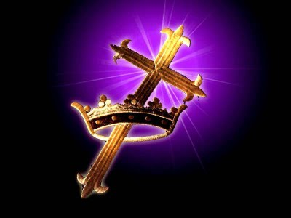
The Kingdom Of God
Text: Heb. 12:28-29
Notes:
By Nathan L Morrison for Sunday October 22nd, 2017
All Scripture given is from the NASB, unless otherwise stated
For further study or if questions, Call: 804-277-1983, or Visit: www.courthousechurchofchrist.com

Slide 2
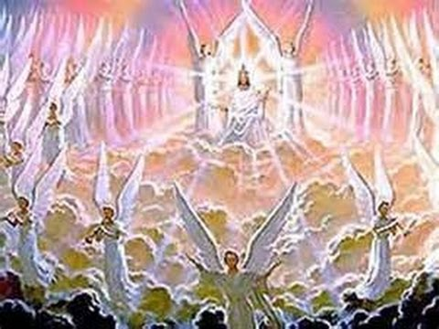
Intro
The Kingdom of God (the church), was foretold long ago and came into power in the 1st c. on the Day of Pentecost as recorded in Acts 2!
Dan. 2:44: A Kingdom that would never be destroyed!
Mk. 9:1: People in Jesus’ time would see it come with power!
Acts 2:29-33, 36 (Rev. 22:16): Kingdom of God came in power! Jesus is the promised descendant of David and sits at the right hand of God!
Acts 10:34-35: The Kingdom is open for all who do what is right!
Col. 1:13: Saints now are rescued “from the domain of darkness, and transferred us to the kingdom of His beloved Son!”
Heb. 12:28-29: This Kingdom will never be shaken! (As foretold by Daniel – Dan. 2:44)

Slide 3
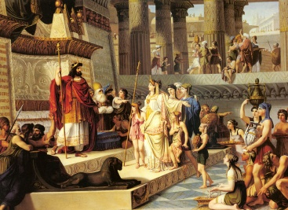
Intro
What makes up a Kingdom?
Four Things Necessary To Constitute A Kingdom
King | Territory | Subjects | Law
All four of these criteria are present in the Kingdom of God!

Slide 4
The Kingdom of God
The Kingdom of God
KING
TERRITORY
SUBJECTS
LAW
Christ the Lord! Jer. 23:5-6 (Acts 2:29-33; Rev. 22:16); Ps. 89:27 (Rev. 1:5); I Tim. 6:15 (Rev. 19:6); Mt. 2:2; Lk. 1:31-33; Jn. 18:33-37
On His Throne Is. 9:6-7; Mt. 2:2 (Jn. 18:33-37); Acts 2:22-36; Heb. 1:8; 4:16; 8:1; 12:2
Now Reigns Acts 2:30-33; I Cor. 15:24-26; Eph. 1:22-23; Col. 1:13
All the World Mt. 28:18-20; Mk. 16:15-16
Every Nation Is. 2:2-3 (Acts 2:4-11); Col. 1:5-6; Rom. 16:25-27 (Jude 3)
All Nations Is. 2:2-3; Acts 10:34-35 (Mk. 16:15-16)
Every Creature Mt. 28:18-20; Mk. 16:15-16; Acts 5:14; 8:12 (2:47)
Whosoever Will Rom. 10:13 (Acts 2:21, 38; 22:16); Rev. 22:17
Word of God Ps. 19:7; Is. 2:3; Js. 2:12; Col. 1:5-6
Perfect Law Jn. 12:48; Js. 1:25 (Ps. 19:7; Js. 2:12)
All-Sufficient Eph. 3:1-7; II Tim. 3:16-17; II Pet. 1:3 (Gal. 1:6-9)

Slide 5
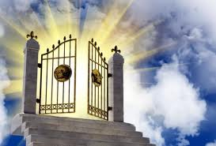
Conclusion
The Kingdom of God came with power as foretold and
will never be destroyed!
Saints are citizens of this eternal Kingdom!
(Phil. 3:20; II Pet. 1:11)
The Kingdom of God
(the church and Heaven) is
open for all who will
humbly obey and submit to
the King!
(“Whosoever will!” –
KJV: Rev. 22:17)

Slide 6
“What Must I Do To Be Saved?”
Hear The Gospel (Jn. 5:24; Rom. 10:17)
Believe In Christ (Jn. 3:16-18; Jn. 8:24)
Repent Of Sins (Lk. 13:35; Acts 2:38)
Confess Christ (Mt. 10:32; Rom. 10:10)
Be Baptized (Mk. 16:16; Acts 22:16)
Remain Faithful (Jn. 8:31; Rev. 2:10)
For The Erring Child:
Repent (Acts 8:22), Confess (I Jn. 1:9),
Pray (Acts 8:22)

