Slide 1
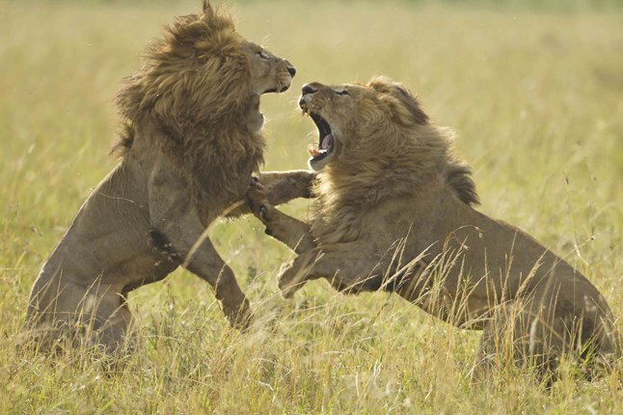
BATTLE OF LIONS
Text: Mt. 4:1-11
Notes:
Prepared by Nathan L Morrison
All Scripture given is from NASB unless otherwise stated
For further study, or if questions, please Call: 804-277-1983 or visit www.courthousechurchofcrist.com

Slide 2
Intro
Two figures in the Scriptures that are described
as lions but have distinct and different traits from each
other: Jesus and Satan
Lions
Alpha male lions own a pride and are very territorial.
If another male (or more) challenge the alpha lion, the lion king must fight to hold on to his pride.
If the challenger succeeds, he usually kills the cubs and other young males the alpha may have sired.
For a lion king, there is no such thing as retirement – He must fight for his throne or be cast aside.
A lion's roar can be heard up to five miles away and is done marking territory, talking to pride members, and for catching prey.
The sound of the roar confuses and scares the prey. The result is that the prey becomes easily trapped and caught by the lion.
Notes:
Sources:
http://web.archive.org/web/20120415054339/http://www.phoenixzoo.org/learn/animals/animal_detail.aspx?FACT_SHEET_ID=100001
http://video.nationalgeographic.com/video/worlds-deadliest/deadliest-lions-vs
http://www.barkingzebratours.com/roaring-lions/

Slide 3
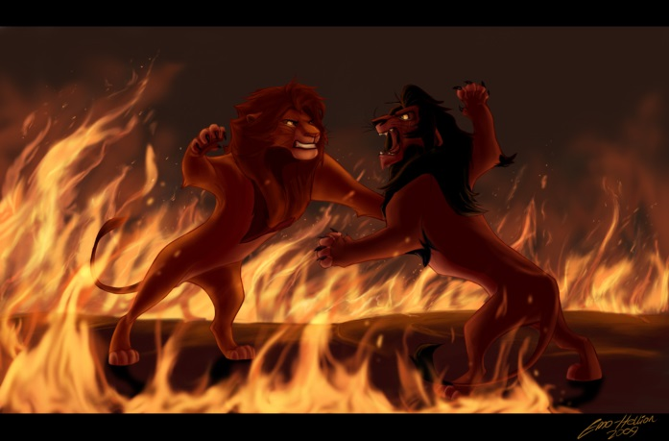
Intro
The Scriptures present to us a “Battle of Lions!”
Jesus
Lamb of sacrifice to save the world from sin (Jn. 1:29); King of the line of David, and the Lion of Judah (Mt. 25:31, 34; Heb. 9:28; Rev. 5:5).
A lion fights to protect his pride; The church is the bride of Jesus and His body (I Cor. 12:13; Eph. 5:23) that He saves!
Jesus’ roar is to His bride and is reassuring and one of hope and peace.
Satan
Described in various ways and creatures; also described as a roaring lion seeking someone to devour (I Pet. 5:8).
The world was created by Jesus (Col. 1:16); but Satan is described as “the prince of this world” (Jn. 12:31) and “the god of this world” (II Cor. 4:4), and as such he fights with Christ for control of souls!
Satan’s roar is to confuse, frighten and deceive!
In the wilderness after 40 days of
fasting, we see a “Battle of Lions!”
Notes:
Image: “The Final Battle” by Emo Hellion (2009) – Simba and Scar from ‘The Lion King’

Slide 4
The Temptation of Christ: Battle of Lions
Mt. 4:1-10: The Battle of Lions: Lion of Judah (Rev. 5:5)
Vs. The Roaring Lion (I Pet. 5:8)
After Jesus’ baptism by John in the Jordan (Mt. 3:13-17), Satan came at Jesus in three different areas.
It is not a sin to be tempted (Heb. 4:15) but we sin when we yield to temptation (Js. 1:14-15). God always provides a way of escape so that we can handle any temptations that come our way (I Cor. 10:13).

Slide 5
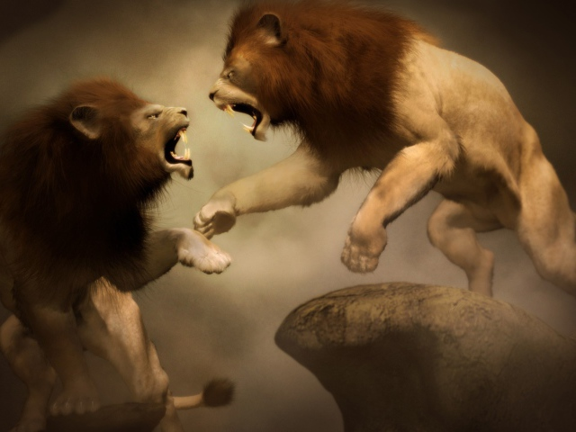
Battle of Lions: Temptation #1
Mt. 4:3
3. And the tempter came and said to Him, "If You are the Son of God, command that these stones become bread."
Temptation #1 – Self-satisfaction
Lust of the flesh (I Jn. 2:16): “For all that is in the world, the lust of the flesh…is not from the Father, but is from the world.
It was a temptation to act independently of God.
Satan often uses a legitimate need but tempts us by seeking to fulfill that need in an illegitimate way (Gal. 5:19-21; I Cor. 6:9-10; Heb. 13:4)

Slide 6
Battle of Lions: Response #1
Response #1
“But He answered and said, “It is written, ‘Man shall not live on bread alone, but on every word that proceeds out of the mouth of God.’” (Mt. 4:4)
True life depends not upon satisfying material wants but upon obedience in following God (Heb. 5:9)!

Slide 7
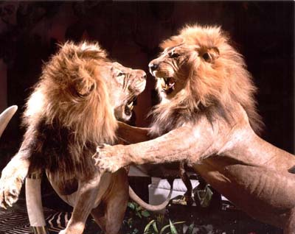
Battle of Lions: Temptation #2
Mt. 4:5-6
5. Then the devil took Him into the holy city and had Him stand on the pinnacle of the temple,
6. and said to Him, "If You are the Son of God, throw Yourself down; for it is written, 'HE WILL COMMAND HIS ANGELS CONCERNING YOU'; and 'ON their HANDS THEY WILL BEAR YOU UP, SO THAT YOU WILL NOT STRIKE YOUR FOOT AGAINST A STONE.'"
Temptation #2 – Self-accomplishment
Pride of life (I Jn. 2:16): “For all that is in the world, the lust of the flesh…and the boastful pride of life, is not from the Father, but is from the world.
Jesus could have leapt from the temple and be borne up by angels!
Sensationalism appeals to the flesh but Jesus wants men’s hearts. Jesus was to be a servant, not a dynamic celebrity!

Slide 8
Battle of Lions: Response #2
Response #2
“Jesus said to him, “On the other hand, it is written, ‘You shall not put the Lord your God to the test.’” (Mt. 4:7)
Focus on God’s plan, not your own!

Slide 9
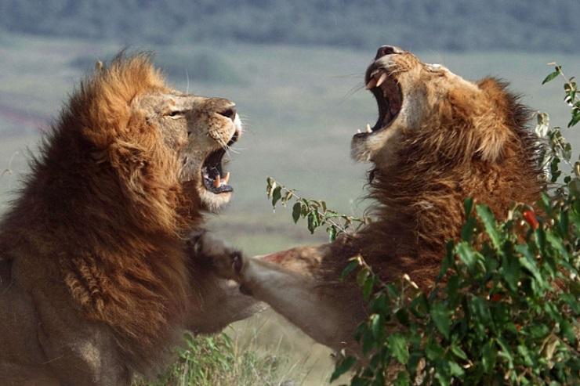
Battle of Lions: Temptation #3
Mt. 4:8-9
8. Again, the devil took Him to a very high mountain and showed Him all the kingdoms of the world and their glory;
9. and he said to Him, "All these things I will give You, if You fall down and worship me."
Temptation #3 – Self-glorification
Lust of the eyes (I Jn. 2:16): “For all that is in the world, the lust of the flesh and the lust of the eyes and the boastful pride of life, is not from the Father, but is from the world.
Instead of enduring the long, bitter, humiliating, and painful road to the cross, Jesus could rule the world now! (Overthrow Caesar!) Not physical – Jn. 18:36!

Slide 10
Battle of Lions: Response #3
Response #3
“Then Jesus said to him, “Go, Satan! For it is written, ‘You shall worship the Lord your God, and serve Him only.’” (Mt. 4:10)
“Worship the Lord your God, and
serve Him only!

Slide 11
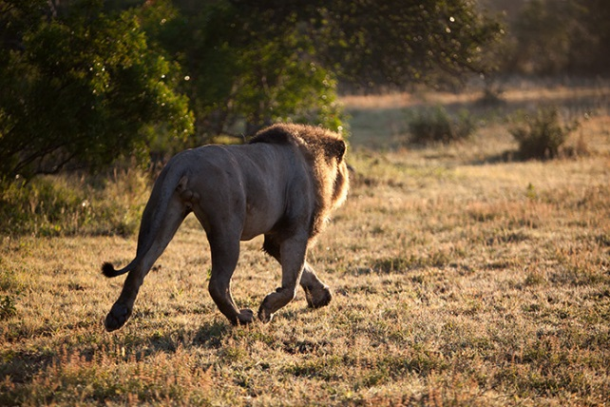
Battle of Lions: Result
Mt. 4:11
11. Then the devil left Him; and behold, angels came and began to minister to Him.
Js. 4:7; I Pet. 5:9
Christ seeks to save and protect those who belong to Him, while Satan seeks to destroy all men, especially those belonging to Christ
Like Jesus, saints can cause Satan to flee from us when we stand firm in our faith!

Slide 12
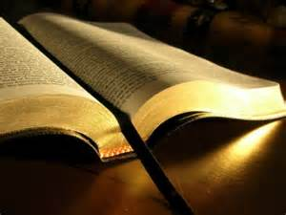
Battle of Lions: Result
We must know the Scriptures well to battle Satan and the
twists his false teachers spin as truth
II Tim. 2:15: (KJV) “Study to show yourself approved to God…” (Ps. 119:105)
Titus 2:9-10: We are to “adorn the doctrine of God our Savior in every respect.”
The Battle of Lions demonstrates
the fight for men’s souls!

Slide 13
Two Lions: A Contrast
Characteristic | Jesus | Satan
Purpose | Lead people to salvation (Jn. 1:29; Heb. 5:9) | Lead people into sin (II Cor. 11:3; II Tim. 2:26)
Methods | Tells people the truth (Jn. 8:45; 16:13; 17:17) | Tells people lies (Jn. 8:44)
Motivation | Love (Jn. 3:16) | Hate (Jn. 15:18-19; 17:14)
Followers Experience | Love, joy, peace, patience, kindness, goodness, faithfulness, gentleness and self-control (Gal. 5:22-25) | Sexual immorality, impurity, debauchery, idolatry, drug use, hatred, discord, jealousy, rage, selfish, dissensions, envy, drunkenness (Gal. 5:19-21)
Following leads to | Freedom from sin (Eph. 1:7; Rev. 1:5) | Enslaved to sin (Jn. 8:34; Rom. 6:16-18; II Tim. 2:26)
Followers‘ Outcome | Alive in Christ (Eph. 2:5-6); Eternal life (Mt. 25:34, 46) | Dead in sins (Eph. 2:1-3); Eternal punishment (Mt. 25:41, 46)

Slide 14
Two Lions: A Contrast
Whose roar will we listen to?
(Both desire your soul!)

Slide 15
Conclusion
When Satan tempted Jesus he was challenging the kind of
Messiah Jesus would be:
A Messiah who focuses only on felt needs (“Turn stones to bread”)
A Messiah who entertains (“Jump from the Temple”)
A Messiah who compromises (“Worship Satan”)
It is no surprise that the followers of Jesus battle the
same 3 temptations in doing the work of the church:
Will we be a people that primarily focuses on felt needs or will we remember that we are first and foremost to address people’s spiritual needs?
Will we be a people that confuses entertainment with worship or will we be a church that always asks, “Is God or the worshipper glorified through our worship practices?”
Will we be a people that compromises so we can have bigger numbers or will we regard faithfulness as more important than earthly success?

Slide 16
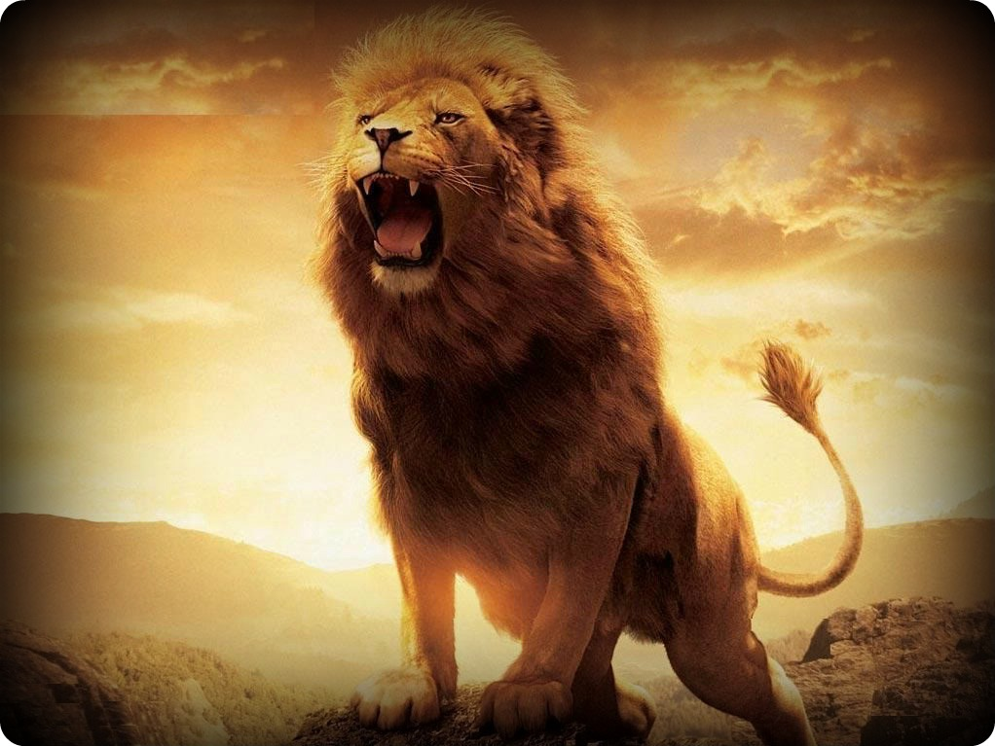
Conclusion
The Battle of Lions rages on: One roar is a call to obey and
be blessed for eternity (Jesus), and the other roar is to
confuse and deceive you into staying in sin (Satan);
Whose roar will you listen to?

Slide 17
“What Must I Do To Be Saved?”
Hear The Gospel (Jn. 5:24; Rom. 10:17)
Believe In Christ (Jn. 3:16-18; Jn. 8:24)
Repent Of Sins (Lk. 13:35; Acts 2:38)
Confess Christ (Mt. 10:32; Rom. 10:10)
Be Baptized (Mk. 16:16; Acts 22:16)
Remain Faithful (Jn. 8:31; Rev. 2:10)
For The Erring Child:
Repent (Acts 8:22), Confess (I Jn. 1:9),
Pray (Acts 8:22)

