Slide 1
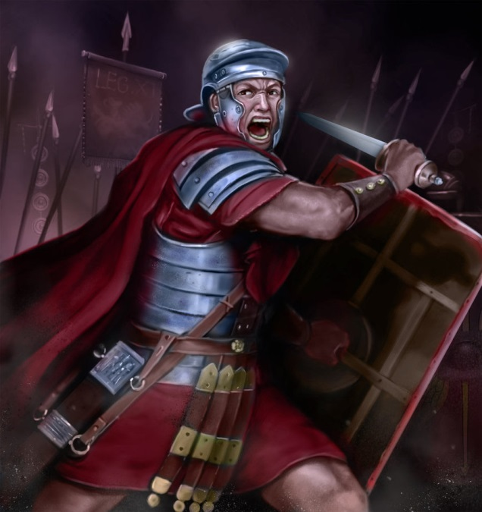
“They Did Their Duty
Into Eternity”
Text: Heb. 10:34-39
Notes:
By Nathan L Morrison for Sunday PM 05/21/17 @ Courthouse CoC in Chesterfield, VA
All Scripture given is from NASB unless otherwise stated
For further study or if questions, Call: 907-252-3708, or Visit: www.frr-churchofchrist-ak.org
Inspired by “The Last Six Seconds,” a speech given by Lt. Gen. John Kelly, 11/13/10 before the Semper Fi Society in St. Louis, MO about two US Marines involved in an incident on April 22, 2008

Slide 2
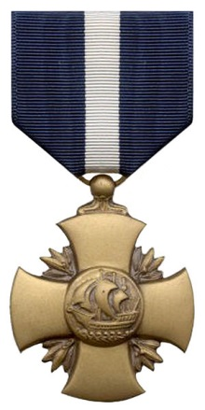
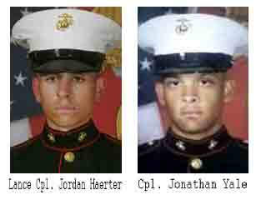
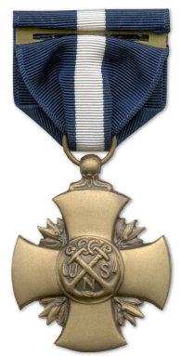
Intro
“The Last Six Seconds” by Lt. Gen. John Kelly
Two Corporals in the U.S. Marines (from different backgrounds) assigned to guard a gate and told, “Let no unauthorized personnel or vehicle pass.”
Suicide bomber in truck barreled down on their position.
They stood their ground, fired their weapons, and did “their duty into eternity” as the truck exploded killing them but saving the 150 lives inside the complex.
Incident caught on film and records “the last six seconds” of their lives.
They were awarded The Navy Cross on 02/20/2009 (CBS News, L.A. Times).
U.S. Navy Cross (Front)
U.S. Navy Cross (Reverse)
Notes:
Excerpt of “The Last Six Seconds” speech by Lt. Gen. John Kelly, “Six Seconds,” 11/13/10
http://thebulletproofmonk.blogspot.com/2010/12/last-six-seconds.html
http://www.cbsnews.com/news/six-seconds-of-iraq-valor-saved-dozens/
http://articles.latimes.com/2009/feb/21/nation/na-marines21

Slide 3
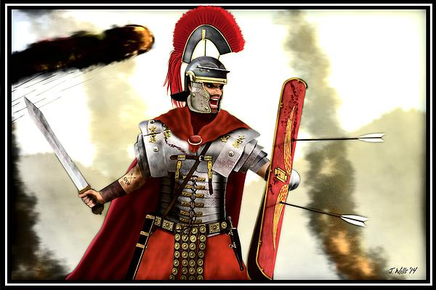
Intro
As Christians, we may not have to physically exemplify
the valor of those two men, but saints are warriors and
are to have the same “warrior spirit” of not “shrinking
back!”

Slide 4
Intro
Heb. 10:34-39
34. For you showed sympathy to the prisoners and accepted joyfully the seizure of your property, knowing that you have for yourselves a better possession and a lasting one.
35. Therefore, do not throw away your confidence, which has a great reward.
36. For you have need of endurance, so that when you have done the will of God, you may receive what was promised.
37. FOR YET IN A VERY LITTLE WHILE, HE WHO IS COMING WILL COME, AND WILL NOT DELAY.
38. BUT MY RIGHTEOUS ONE SHALL LIVE BY FAITH; AND IF HE SHRINKS BACK, MY SOUL HAS NO PLEASURE IN HIM.
39. But we are not of those who shrink back to destruction, but of those who have faith to the preserving of the soul.
It should be said of us in summary of our lives (not just 6 seconds) that we stood our ground, used our (spiritual) weapons, and did our “duty into eternity!”
Notes:
Emphasis in Scripture mine

Slide 5
Stand Firm
The two Marines “never hesitated, stepped back, stepped aside, or even shifted their weight.”
Heb. 10:36-39: Not to “shrink back”
Saints are to have endurance, to be able to stand firm, not “shrinking back.”
Js. 1:2-4
2. Consider it all joy, my brethren, when you encounter various trials,
3. knowing that the testing of your faith produces endurance.
4. And let endurance have its perfect result, so that you may be perfect and complete, lacking in nothing.
Heb. 10:36-39: Not to “shrink back”
Joshua is an example (Josh. 1:7)…
King David was used as an example (II Kings 22:2: Josiah) of one who does not “turn aside to the right or to the left.”

Slide 6

Stand Firm
Eph. 6:10-13
10. Finally, be strong in the Lord and in the strength of His might.
11. Put on the full armor of God, so that you will be able to stand firm against the schemes of the devil.
12. For our struggle is not against flesh and blood, but against the rulers, against the powers, against the world forces of this darkness, against the spiritual forces of wickedness in the heavenly places.
13. Therefore, take up the full armor of God, so that you will be able to resist in the evil day, and having done everything, to stand firm.
The armor of God is given to help
the Saint “stand firm”
Ex. 15:3: God is a Warrior! His children are Warriors!
The saint is to stand against the schemes of the devil! (I Cor. 15:58)
Eph. 6:13: In the moment of “evil” the saint is to be prepared to resist, “having done everything, to stand firm.”

Slide 7
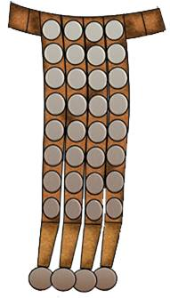
Stand Firm
Eph. 6:14: Stand firm therefore, HAVING GIRDED YOUR LOINS WITH TRUTH…
Belt of Truth – Eph. 6:14
This was not an ornament—it bound the other pieces together and gave the soldier freedom of movement.
The center of our armor is truth – Jn. 17:17
Jn. 17:17
17. "Sanctify them in the truth; Your word is truth.

Slide 8
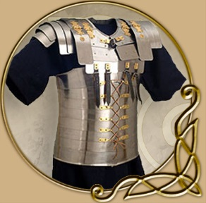
Stand Firm
Eph. 6:14: … and HAVING PUT ON THE BREASTPLATE OF RIGHTEOUSNESS,
Breastplate of Righteousness – Eph. 6:14
The breastplate was used to protect the heart and vital organs from attack.
Our lives are to be righteous as defense against evil – I Pet. 2:12
I Pet. 2:12
12. Keep your behavior excellent among the Gentiles, so that in the thing in which they slander you as evildoers, they may because of your good deeds, as they observe them, glorify God in the day of visitation.

Slide 9
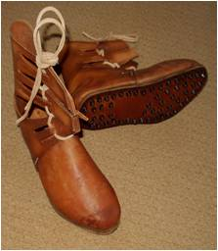
Stand Firm
Eph. 6:15: and having shod YOUR FEET WITH THE PREPARATION OF THE GOSPEL OF PEACE;
Feet Shod – Eph. 6:15
Roman soldiers wore cleats on their sandals that made it easy to grind in, and difficult to walk backwards.
Our footing must be supplied by the gospel of peace – Rom. 10:15
Saints are to be prepared for battle & “be strong
in the Lord and in the strength of His might!”

Slide 10

Know the Word of God
The two Marines fired their weapons with accuracy in the last remaining seconds they had.
II Cor. 10:3-4:
Our weapons are not carnal (fleshly), but are spiritual – and powerful!
When opportunities open, we should be prepared and
ready in the knowledge of the word!
I Pet. 3:15: Be ready to give defense to anyone who asks!
That requires knowledge of God’s word and being ready when the moment comes.

Slide 11
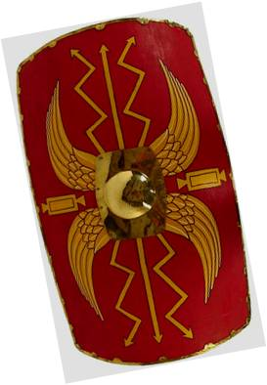
Know the Word of God
Eph. 6:16: in addition to all, taking up the shield of faith with which you will be able to extinguish all the flaming arrows of the evil one.
Shield of Faith – Eph. 6:16
The Roman shield was as feared as the weapons they used, and with them they withstood great armies, and advanced the empire.
We are to have a conquering faith – I Jn. 5:4
I Jn. 5:4
4. For whatever is born of God overcomes the world; and this is the victory that has overcome the world--our faith.

Slide 12
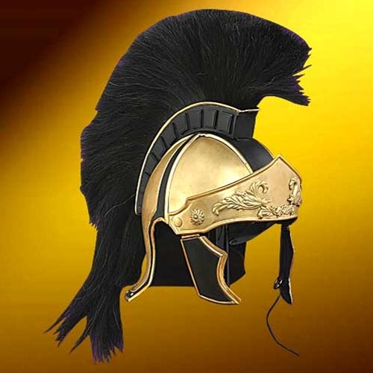
Know the Word of God
Eph. 6:17: And take THE HELMET OF SALVATION…
Helmet of Salvation – Eph. 6:17
No matter how armored a soldier was, without a helmet, he was vulnerable.
We are to take this helmet from God—it is our salvation – Eph. 2:8-9
Eph. 2:8-9
8. For by grace you have been saved through faith; and that not of yourselves, it is the gift of God;
9. not as a result of works, so that no one may boast.

Slide 13
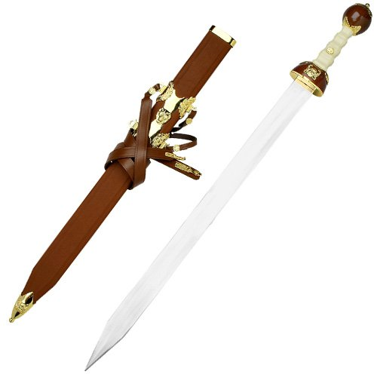
Know the Word of God
Eph. 6:17: … and the sword of the Spirit, which is the word of God.
Sword of the Spirit – Eph. 6:17
Roman soldiers were deadly with their weapons; their swords were feared.
We are to be trained with our “Sword” – II Tim. 2:15
Heb. 4:12
For the word of God is living and active and sharper than any two-edged sword, and piercing as far as the division of soul and spirit, of both joints and marrow, and able to judge the thoughts and intentions of the heart.

Slide 14
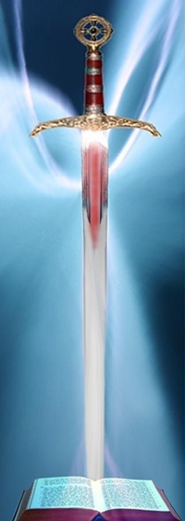
Know the Word of God
We need to know the word of God and be able to use it to
teach!
II Tim. 4:2: “Be ready in season and out of season…”
Acts 17:11; Eph. 6:18: Study the word “daily” and pray often!
II Pet. 3:18: “Grow in the grace and knowledge of our Lord.”
It’s not enough to be armed but must know
how to use the “Sword of the Spirit!”

Slide 15
Remain Faithful Till Death
The Two Marines “did their duty into eternity” not letting any unauthorized personnel pass.
Rev. 2:10
Christ knew the church at Smyrna was suffering and told them it would get worse, but their duty: “Remain faithful until death.”
II Tim. 2:1-6; 4:5
Paul told Timothy, “Suffer hardship with me, as a good soldier of Christ Jesus.”
He also told him, “Do the work of an evangelist, fulfill your ministry.”
II Tim. 4:6-8 (Mt. 10:32-33)
Paul was able to say, “I have fought the good fight, I have finished the course, I have kept the faith.” (I have done my duty)

Slide 16
Remain Faithful Till Death
Mt. 25:21, 23, 34 (NKJ)
21. His lord said to him, 'Well done, good and faithful servant; you were faithful over a few things, I will make you ruler over many things. Enter into the joy of your lord.'
23. His lord said to him, 'Well done, good and faithful servant; you have been faithful over a few things, I will make you ruler over many things. Enter into the joy of your lord.'
34. Then the King will say to those on His right hand, 'Come, you blessed of My Father, inherit the kingdom prepared for you from the foundation of the world:
Those who do “their duty into eternity” will inherit
Heaven! (Rev. 21:7)
In our faithful walk with God we are not to turn aside,
turn back, but be “faithful till death!”

Slide 17
Conclusion
As Christians we all come from different backgrounds
(Eph. 2; 3:4-7) and stand together united in one mind and
one purpose (I Cor. 1:10)
We will give an account to God whether or not we stood
our ground, knew His word, and remained faithful till
death
We walk by faith (Rom. 1:17) to be “faithful till death” and “not shrink back!”
We must “stand firm” and "earnestly contend for the faith" (Eph. 6:13; Jude 3)
God said He is not pleased with the one who shrinks back – Heb. 10:38; Lk. 9:62

Slide 18
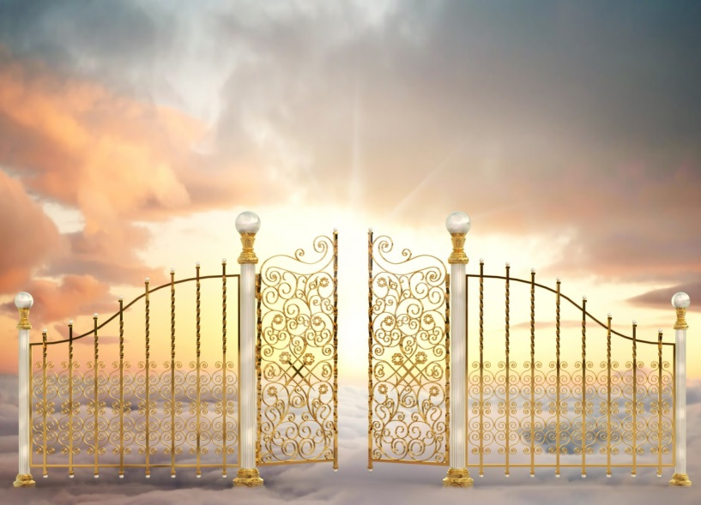
Conclusion
Our reward in Heaven is not perishable but an eternal
reward! (I Cor. 9:25; I Pet. 1:3-4)
Paul was able to comfort Timothy saying he had fought
the fight, he had finished the course
Can it be said of us?
(Up to this point in our lives?)

Slide 19
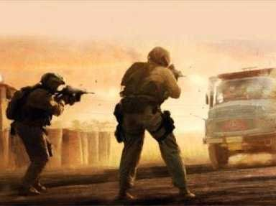
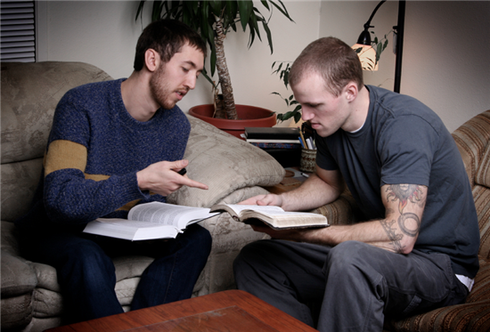
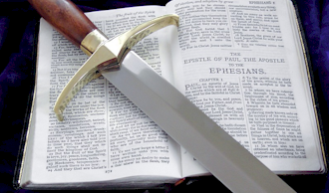
Conclusion
In the final tally, it should be said of all saints that they
lived their lives unwaveringly, not shrinking back, used
their spiritual weapons and did “their duty into eternity!”
“We are not of those who shrink back to destruction, but of those who have faith to the preserving of the soul!” (Heb. 10:39)

Slide 20
“What Must I Do To Be Saved?”
Hear The Gospel (Jn. 5:24; Rom. 10:17)
Believe In Christ (Jn. 3:16-18; Jn. 8:24)
Repent Of Sins (Lk. 13:35; Acts 2:38)
Confess Christ (Mt. 10:32; Rom. 10:10)
Be Baptized (Mk. 16:16; Acts 22:16)
Remain Faithful (Jn. 8:31; Rev. 2:10)
For The Erring Saint:
Repent (Acts 8:22), Confess (I Jn. 1:9),
Pray (Acts 8:22)

