Slide 1
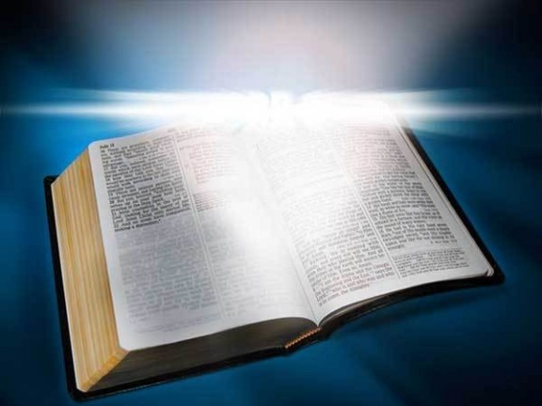
“Send The Light”
Text: II Cor. 4:6
Notes:
By Nathan L Morrison
All Scripture given is from NASB unless otherwise stated
“Send The Light” hymn by Charles H Gabriel
For further study or if questions, Call: 804-277-1983, or Visit: www.courthousechurchofchrist.com

Slide 2
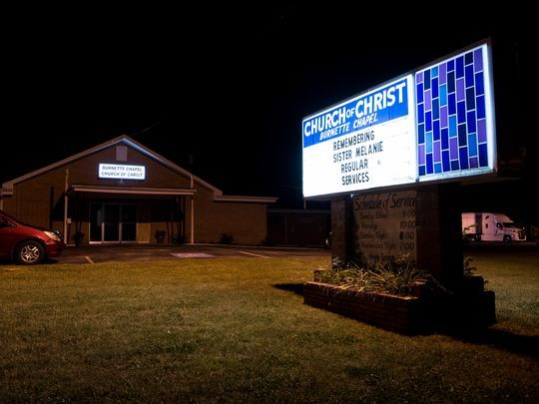
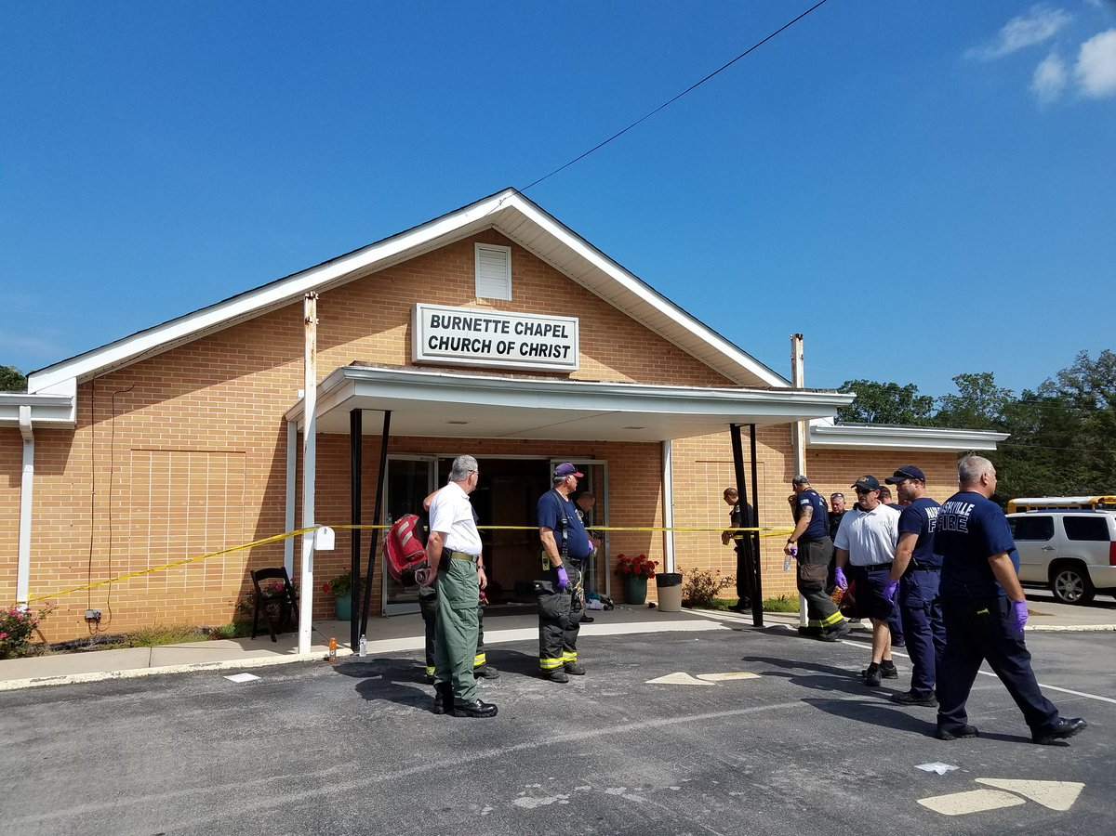
Intro
Current events highlight the evil and immoral choices mankind continues to make! (Darkness)
Burnette Chapel church of Christ Shooting in Antioch, TN (September 24th, 2017): 1 Killed, 7 Injured
Notes:
Sources:
Burnette Chapel church of Christ Shooting in Antioch, TN (September 24th, 2017): 1 Killed, 7 Injured:
http://www.tennessean.com/story/news/crime/2017/09/25/how-nashville-church-shooting-burnette-chapel-church-christ-unfolded-timeline/700049001/
http://www.nydailynews.com/news/crime/church-shooter-referenced-revenge-dylann-roof-massacre-article-1.3531505
Route 91 Harvest Festival Shooting (Massacre) from the Mandalay Bay Hotel, Las Vegas, NV (October 1st, 2017): 59 Killed, 500+ Injured:
http://theboot.com/route-91-harvest-festival-shooting/
b. http://www.billboard.com/articles/news/7981940/las-vegas-shooting-route-91-harvest-festival-shooter-dead
https://www.usatoday.com/story/life/music/2017/10/03/las-vegas-shooting-route-91-harvest-festival-completely-devastated-over-sundays-violence/726414001/
http://abcnews.go.com/US/las-vegas-massacre/story?id=50246458
http://www.msn.com/en-us/news/us/girlfriend-of-las-vegas-gunman-says-she-had-no-idea-he-was-planning-attack/ar-AAsSWGd?li=BBnb7Kz

Slide 3
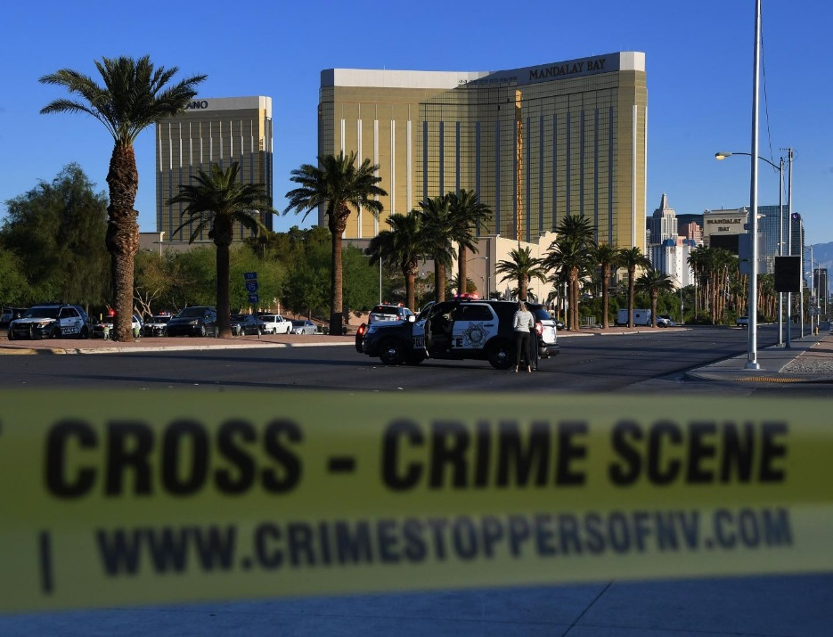
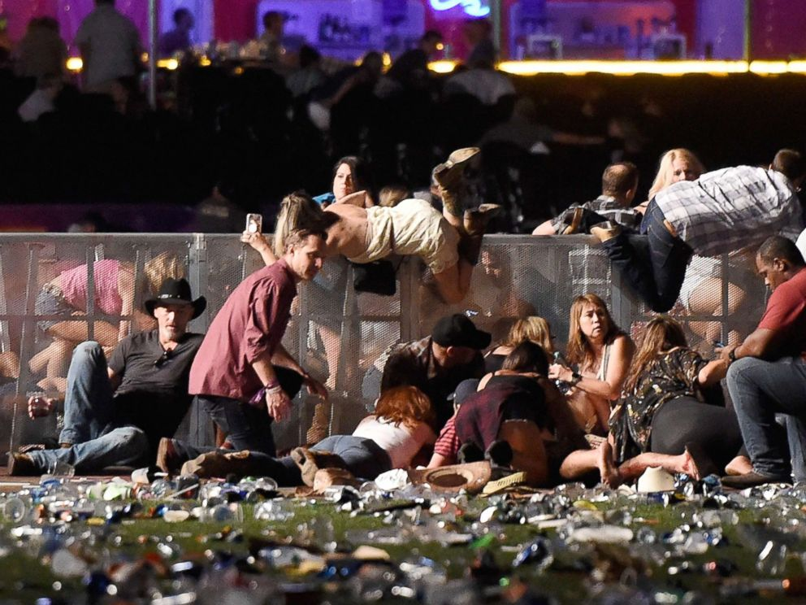
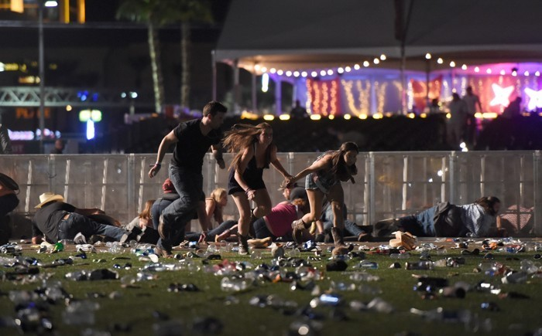
Intro
Current events highlight the evil and immoral choices mankind continues to make! (Darkness)
Route 91 Harvest Festival Shooting (Massacre) from the Mandalay Bay Hotel,
Las Vegas, NV (October 1st, 2017): 59 Killed, 489+ Injured
Notes:
Sources:
Burnette Chapel church of Christ Shooting in Antioch, TN (September 24th, 2017): 1 Killed, 7 Injured:
http://www.tennessean.com/story/news/crime/2017/09/25/how-nashville-church-shooting-burnette-chapel-church-christ-unfolded-timeline/700049001/
http://www.nydailynews.com/news/crime/church-shooter-referenced-revenge-dylann-roof-massacre-article-1.3531505
Route 91 Harvest Festival Shooting (Massacre) from the Mandalay Bay Hotel, Las Vegas, NV (October 1st, 2017): 59 Killed, 500+ Injured:
http://theboot.com/route-91-harvest-festival-shooting/
b. http://www.billboard.com/articles/news/7981940/las-vegas-shooting-route-91-harvest-festival-shooter-dead
https://www.usatoday.com/story/life/music/2017/10/03/las-vegas-shooting-route-91-harvest-festival-completely-devastated-over-sundays-violence/726414001/
http://abcnews.go.com/US/las-vegas-massacre/story?id=50246458
http://www.msn.com/en-us/news/us/girlfriend-of-las-vegas-gunman-says-she-had-no-idea-he-was-planning-attack/ar-AAsSWGd?li=BBnb7Kz

Slide 4
Intro
Instead of calling something “evil” as it is, within minutes
of a tragedy people begin politicizing it for their own
personal agendas! (Want someone/thing to blame!)
Our society has become one that refuses to call evil “evil,”
but finds ways to excuse evil actions, so evil will continue
What evil needs is to hear the gospel!

Slide 5
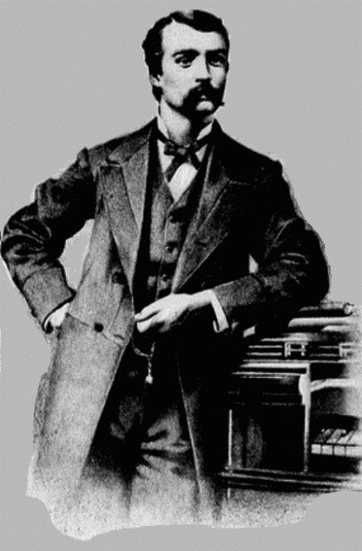
Intro
Col. 3:16
Let the word of Christ richly dwell within you, with all wisdom teaching and
admonishing one another with psalms and hymns and spiritual songs, singing
with thankfulness in your hearts to God.
Charles H Gabriel (1856-1932):
“Send The Light” (1890)
Son of a farmer, taught himself music and was teaching his own singing school at 17 years old!
Throughout his hymn-writing career, he used several pseudonyms, including Charlotte G. Homer, H. A. Henry, and S. B. Jackson.
He wrote and/or composed between 7,000 and 8,000 songs.
“Send The Light” was his first commercial success and the one he is most known for, but he did write many others!
The darkness of the world needs to hear the gospel –
Who will “Send the Light?”
Notes:
Read the article on Charles H Gabriel
Sources:
https://groups.yahoo.com/neo/groups/hymnoftheday/conversations/messages/496
http://en.wikipedia.org/wiki/Charles_H._Gabriel

Slide 6
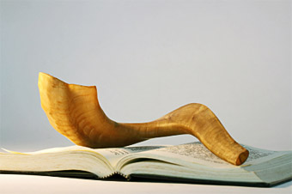
Souls to Save
“There's a call come's ringing o'er the restless wave, 'Send the light! Send the light!' There are
souls to rescue, there are souls to save; Send the light! Send the light!”
II Thess. 2:14 (Lk. 19:10; II Cor. 4:6)
14. It was for this He called you through our gospel, that you may gain the glory of our Lord Jesus Christ.
Mt. 16:26:
This call reminds us that souls need to be rescued because they are precious – Most valuable thing we possess is our souls!
Rom. 3:23; 6:23:
Because these precious souls have sinned, they need to be saved
There are souls to save so saints need to “Send the Light!”

Slide 7
Help of the Gospel
“We have heard the Macedonian call today: 'Send the light! Send the light!' And a golden offering
at the cross we lay; Send the light! Send the light!”
II Cor. 4:5-6
5. For we do not preach ourselves but Christ Jesus as Lord, and ourselves as your bond-servants for Jesus' sake.
6. For God, who said, "Light shall shine out of darkness," is the One who has shone in our hearts to give the Light of the knowledge of the glory of God in the face of Christ.
Acts 16:9-10:
The man from Macedonia who appeared to Paul in a vision asking for help saying, “Come over to Macedonia and help us.”
Paul and the others with him understood that they needed to go preach the gospel to the people of Macedonia!

Slide 8
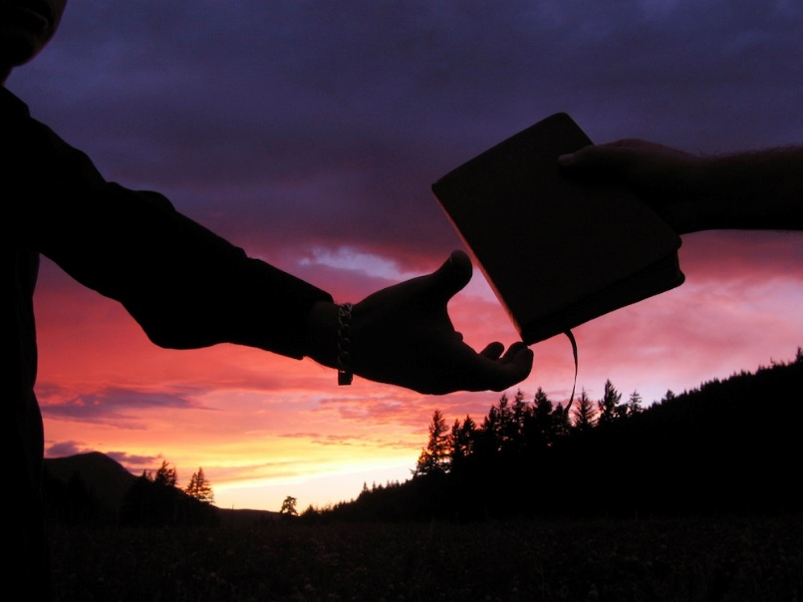
Help of the Gospel
“We have heard the Macedonian call today: 'Send the light! Send the light!' And a golden offering
at the cross we lay; Send the light! Send the light!”
When Paul received the plea for help…
He did not go and build homes and orphanages in Macedonia.
He wasn’t sending in food and other rations.
He didn’t take up a collection of funds to send!
He did not set up a sponsoring church to send funds to for them to distribute to the Macedonians!
He knew that the best way to help the Macedonians was
to make sure the gospel was heard by the people!
(Acts 16:11-15)
Phil. 4:15-16; II Cor. 9:6-7:
While we should go where we can, no one individual can go everywhere, but all of us can give a “golden offering” so that those who can go to other places can be supported!

Slide 9
Help of the Gospel
“We have heard the Macedonian call today: 'Send the light! Send the light!' And a golden offering
at the cross we lay; Send the light! Send the light!”
The gospel is the best “help” for a dark and evil world!
(Jn. 3:19-21)
The gospel is God’s power to save (Rom. 1:16); learn of sin, & the cure (Rom. 3:23; Jn. 3:16).
Christ: He came to earth (Mt. 1; Lk. 2), taught the truth (Mt. 5-7), & died on the cross “for forgiveness of sins” (Mt. 20:28, 26:28; Eph. 1:7).
His victory over death at His resurrection & His ascension (Lk. 24:1-9; Acts 1:9-11; I Cor. 15:1-8).
Hearing, believing in Christ & being baptized “for the forgiveness of sins” (Mk. 16:16; Acts 2:38) is the beginning of a new life & walk with God (Rom. 6:3-8)
When people hear, believe, & obey the Lord’s plan of salvation, this is when they are truly helped! (Js. 1:21; Jn. 12:48; II Thess. 1:7-9)
True “help” comes by introducing sinful man to Christ and
showing them the Lord’s plan of salvation –
“Send the Light” into the dark world!

Slide 10
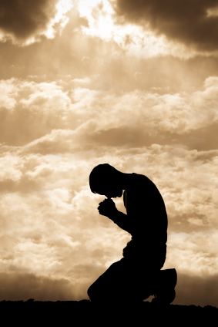
Pray
“Let us pray that grace may everywhere abound; Send the light! Send the light! And a Christ-like
spirit everywhere be found; Send the light! Send the light!”
Rom. 10:1:
God's people should pray, especially for those who are lost! (Paul prayed for the Jews to come to the knowledge of God and obey – 10:2)
Rom. 10:1
1. Brethren, my heart's desire and my prayer to God for them is for their salvation.

Slide 11
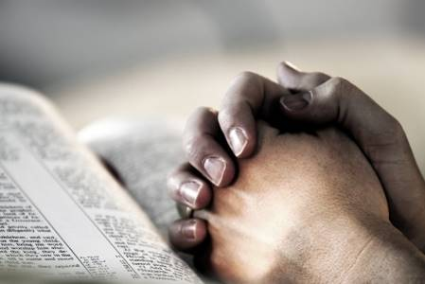
Pray
“Let us pray that grace may everywhere abound; Send the light! Send the light! And a Christ-like
spirit everywhere be found; Send the light! Send the light!”
Rom. 5:15-21; 6:1-2:
We should pray that through the preaching of the gospel grace may everywhere abound & for opportunities to teach (“open doors”)
Col. 4:2-4
2. Devote yourselves to prayer, keeping alert in it with an attitude of thanksgiving;
3. praying at the same time for us as well, that God will open up to us a door for the word, so that we may speak forth the mystery of Christ, for which I have also been imprisoned;
4. that I may make it clear in the way I ought to speak.

Slide 12
Pray
“Let us pray that grace may everywhere abound; Send the light! Send the light! And a Christ-like
spirit everywhere be found; Send the light! Send the light!”
Rom. 8:9; Titus 2:11-14:
We should also pray that as the gospel is preached a Christ-like spirit will be found.
Titus 2:11-14
As we “Send the Light,” let us pray hearts will be opened
to the truth and that they will obey!

Slide 13
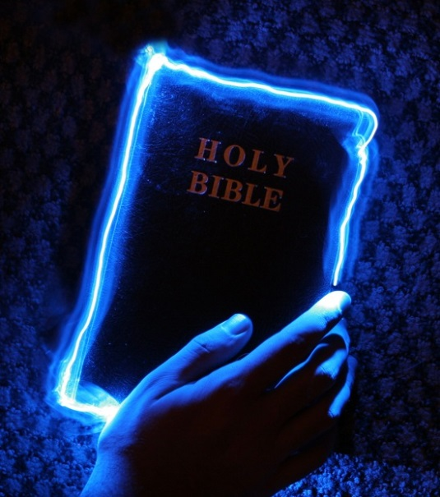
Not Grow Weary
“Let us not grow weary in the work of love; Send the light! Send the light! Let us gather jewels
for a crown above; Send the light! Send the light!”
Gal. 6:9-10
9. Let us not lose heart in doing good, for in due time we will reap if we do not grow weary.
10. So then, while we have opportunity, let us do good to all people, and especially to those who are of the household of the faith.
Gal. 6:9-10; II Tim. 2:24-26:
In the work of sending the light, we must not grow
weary!
I Tim. 2:3-4; II Pet. 3:9:
Don’t grow weary – We are gathering up God's “jewels”
Phil. 4:1:
The “jewels” we gather will also be our joy and crown.

Slide 14
Not Grow Weary
“Let us not grow weary in the work of love; Send the light! Send the light! Let us gather jewels
for a crown above; Send the light! Send the light!”
Mt. 6:19-21; Heb. 12:1-3; Col. 3:1-3:
Seek the treasures of Heaven, not of earth!
Let us not grow weary and lose heart, but continue
to “Send the Light!”

Slide 15
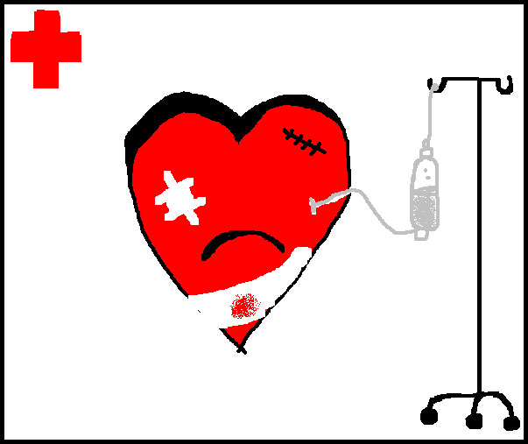
Conclusion
“Send the light! the blessed gospel light! Let it shine from shore to shore. Send the light!
the blessed gospel light! Let it shine forevermore.”
Evil cannot be legislated out, because it is a heart
problem!

Slide 16
Conclusion
The gospel can change hearts and transform lives!
“Send the Light!”
I Cor. 6:9-11
9. Or do you not know that the unrighteous will not inherit the kingdom of God? Do not be deceived; neither fornicators, nor idolaters, nor adulterers, nor effeminate, nor homosexuals,
10. nor thieves, nor the covetous, nor drunkards, nor revilers, nor swindlers, will inherit the kingdom of God.
11. Such were some of you; but you were washed, but you were sanctified, but you were justified in the name of the Lord Jesus Christ and in the Spirit of our God.

Slide 17
“What Must I Do To Be Saved?”
Hear The Gospel (Jn. 5:24; Rom. 10:17)
Believe In Christ (Jn. 3:16-18; Jn. 8:24)
Repent Of Sins (Lk. 13:35; Acts 2:38)
Confess Christ (Mt. 10:32; Rom. 10:10)
Be Baptized (Mk. 16:16; Acts 22:16)
Remain Faithful (Jn. 8:31; Rev. 2:10)
For The Erring Child:
Repent (Acts 8:22), Confess (I Jn. 1:9),
Pray (Acts 8:22)

