Slide 1
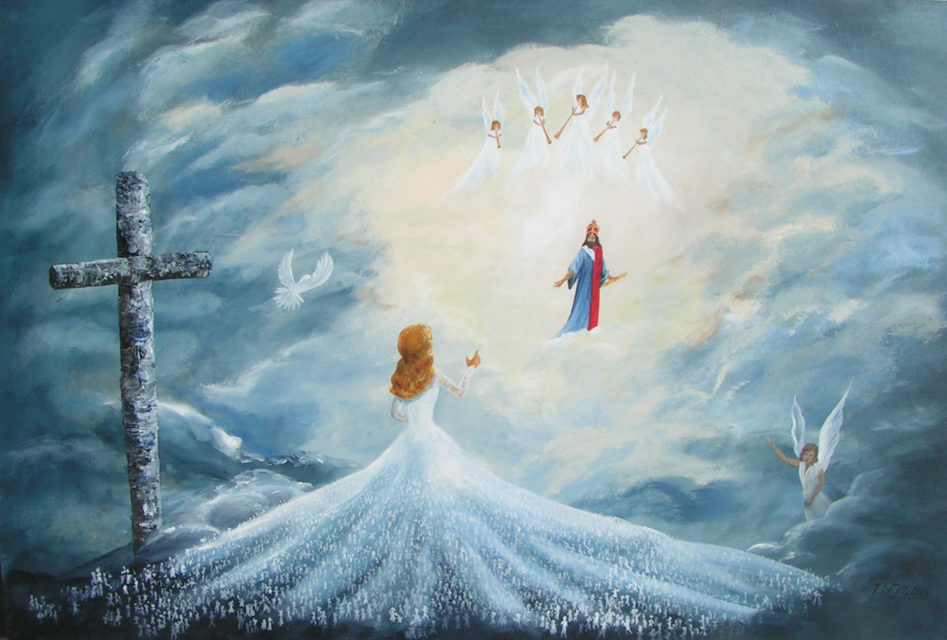
Invited:
Proper Attire Required
Text: Rev. 19:8
Notes:
By Nathan L Morrison
All Scripture given is from NASB unless otherwise stated
For further study or if questions, Call: 804-277-1983, or Visit: www.courthousechurchofchrist.com
Image: Painting by Pat Miller

Slide 2
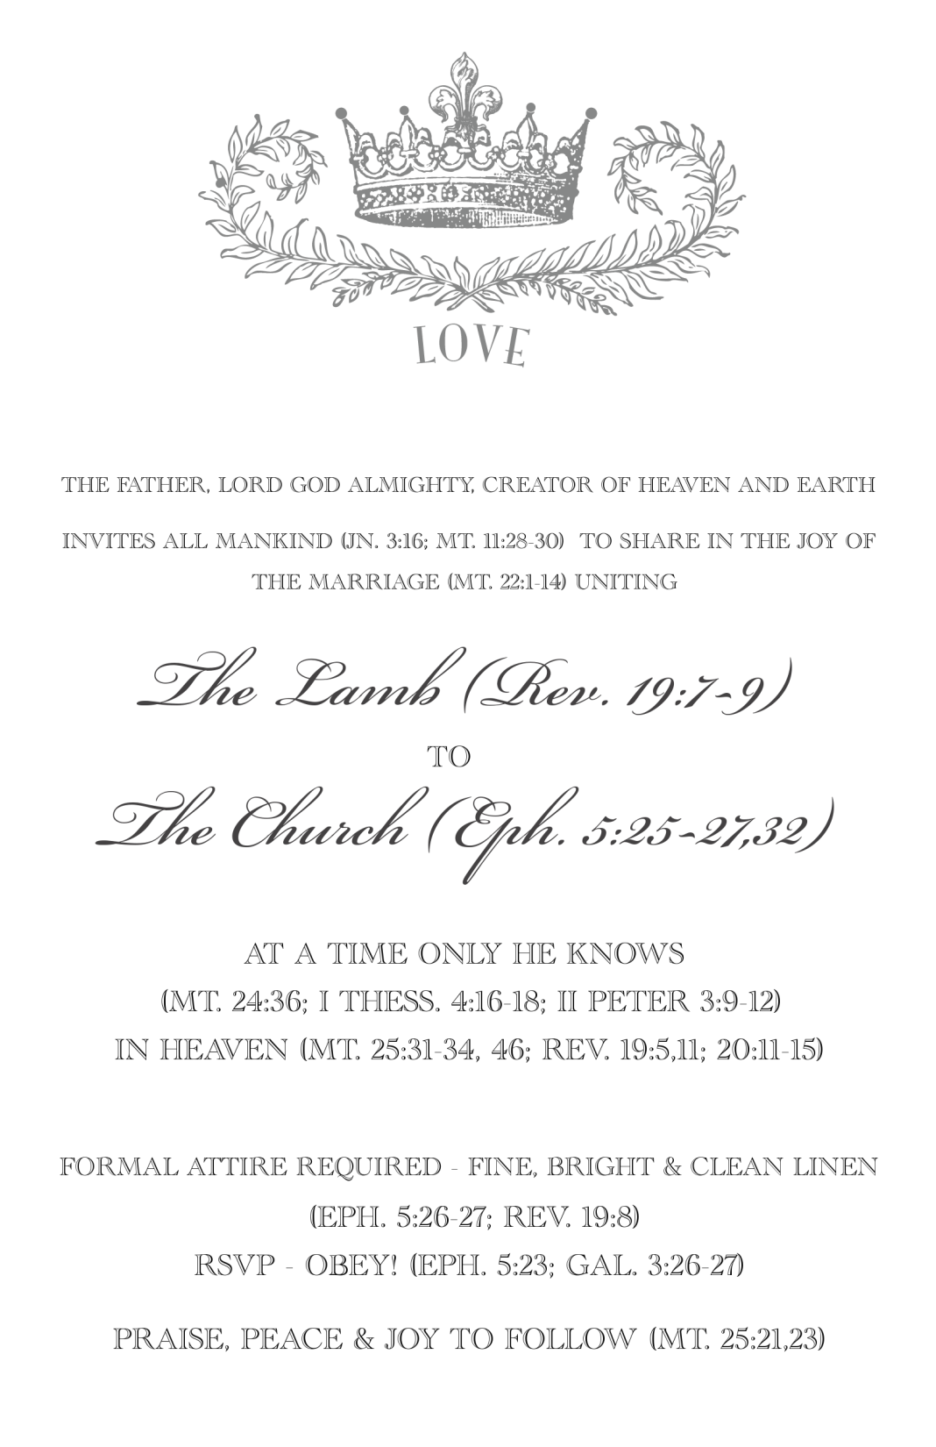
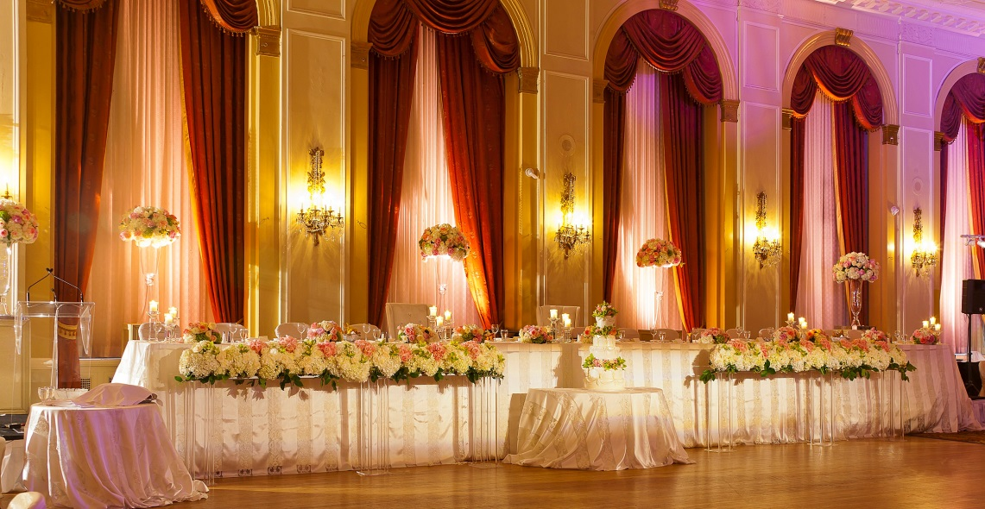
Intro
God has made the invitation:
“All things are ready!
Come to the Feast!”
These things are in God’s control!
The way we respond is under our control!
Created by Nathan L Morrison, nmorrison1939@gmail.com

Slide 3
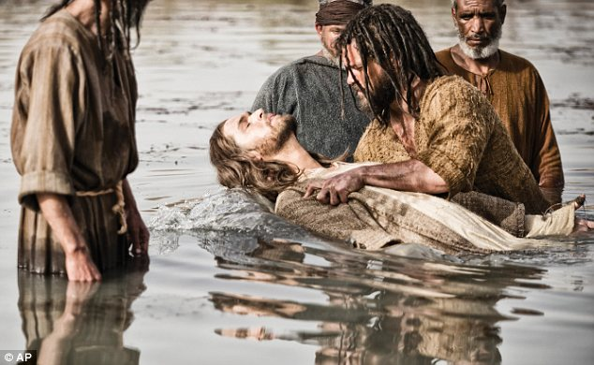
Intro
To be properly attired and RSVP requires obedience to the
gospel through baptism
Gal. 3:26-27: In baptism we “clothe” ourselves “with Christ.”
Baptism, the new birth, not only clothes us with Christ (Rom. 13:14: “Put on the Lord Jesus Christ”) but places us into the church, the body of Christ (I Cor. 12:13), which will be saved (Eph. 5:23)!
Gal. 3:26-27
26. For you are all sons of God through faith in Christ Jesus.
27. For all of you who were baptized into Christ have clothed yourselves with Christ.

Slide 4
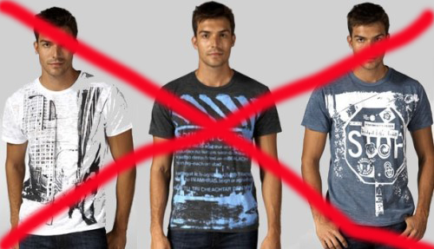
Intro
This attire is NOT optional! – Mt. 22:11-14
Those who come unprepared (not properly attired) are thrown out!
Mt. 22:11-14
11. "But when the king came in to look over the dinner guests, he saw a man there who was not dressed in wedding clothes,
12. and he said to him, 'Friend, how did you come in here without wedding clothes?' And the man was speechless.
13. "Then the king said to the servants, 'Bind him hand and foot, and throw him into the outer darkness; in that place there will be weeping and gnashing of teeth.'
14. "For many are called, but few are chosen."

Slide 5
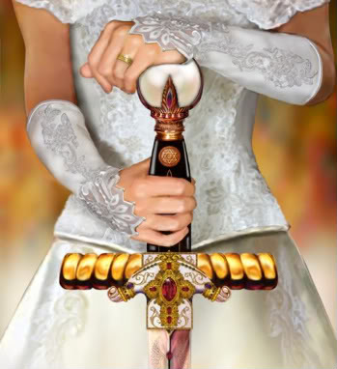
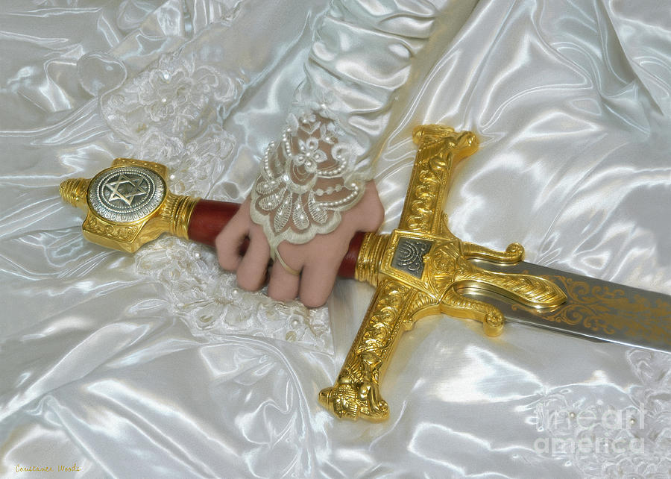
Intro
This attire is NOT optional! – Mt. 22:11-14
This parable about a physical marriage feast applies to the spiritual invitation (Rev. 19:7-9) and thus involves our character, which is to properly clothe our hearts! (Rev. 19:8: “Formal” attire required!)
Rev. 19:7-9
7. "Let us rejoice and be glad and give the glory to Him, for the marriage of the Lamb has come and His bride has made herself ready."
8. It was given to her to clothe herself in fine linen, bright and clean; for the fine linen is the righteous acts of the saints.
9. Then he said to me, "Write, 'Blessed are those who are invited to the marriage supper of the Lamb.'" And he said to me, "These are true words of God."
Notes:
Both Images: Art by Constance Woods

Slide 6
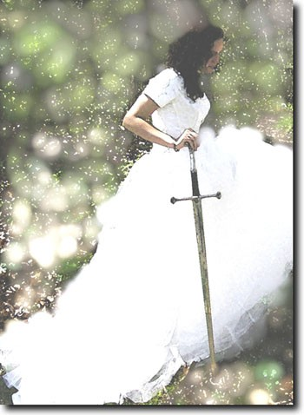
Intro
As a bride gets ready for the marriage feast by adorning
herself in white, the church ought to be preparing to
clothe itself in fine and bright linen,
the “righteous acts of the saints!”
Notes:
Image: Unknown, from pinterest.com

Slide 7
God Judges the Heart
Invited: Proper Attire Required
The world is obsessed with appearances!
Celebrity worship
Fashion
Cosmetics
Surgeries
“Fashion of the Stars” Articles

Slide 8
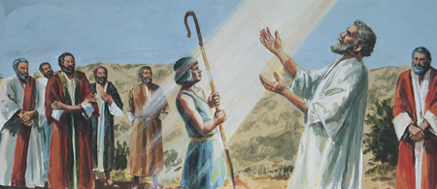
God Judges the Heart
World: Judges by appearance (I Sam. 16:7)
I Sam. 16:1-11: Samuel had anointed Saul (head and shoulders taller than any man in Israel, handsome – I Sam. 9:2).
When anointing the next king, he was looking at physical stature.
Perhaps he was looking for the next “Saul.”
I Sam. 16:7
7. But the LORD said to Samuel, "Do not look at his appearance or at the height of his stature, because I have rejected him; for God sees not as man sees, for man looks at the outward appearance, but the LORD looks at the heart."

Slide 9
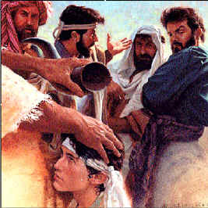
God Judges the Heart
The godly approach is: spend time on inner appearance (I Pet. 3:3-4)
God: Judges the heart (I Sam. 16:7; Heb. 4:12)
I Sam. 16:12-13: David, the “runt of the litter” so to speak is anointed King!
I Sam. 13:14: David is the man “after God’s own heart.”
How much time do we spend on our inner self?
As much time as on the outer?
While Samuel was looking at the physical,
God was looking at the spiritual!

Slide 10
Adorning the Heart with Required Attire
We know how to adorn ourselves physically
Clothing – We have our casual, formal wear, and favorites
Hair – We all have our own individual styles, likes and dislikes
Cosmetics – Many people use things to try and cover up and emphasize
Jewelry – Has always been a well-sought after physical adornment
Fragrances – Some people spend lots of time on their perfume/cologne

Slide 11

Adorning the Heart with Required Attire
Essential that we know what to adorn our Inner Self with
Pure character springs from the fear of God!
Eccl. 12:13-14 (NKJ)
13. Let us hear the conclusion of the whole matter: Fear God and keep His commandments, For this is man's all.
14. For God will bring every work into judgment, Including every secret thing, Whether good or evil.

Slide 12
Adorning the Heart with Required Attire
Essential that we know what to adorn our Inner Self with
Pure character springs from the fear of God!
In baptism we “clothe” ourselves “with Christ” (RSVP)
  Baptism not only clothes us with Christ (Rom. 13:14: “Put on the Lord Jesus Christ”) but places us into the church, the body of Christ, which will be saved! – I Cor. 12:13; Eph. 5:23
Gal. 3:26-27
26. For you are all sons of God through faith in Christ Jesus.
27. For all of you who were baptized into Christ have clothed yourselves with Christ.

Slide 13
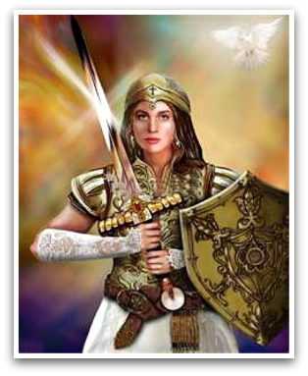
Adorning the Heart with Required Attire
Essential that we know what to adorn our Inner Self with
Pure character springs from the fear of God!
In baptism we “clothe” ourselves “with Christ”
The church (Bride of Christ – II Cor. 11:2) is a warrior-bride (II Tim. 2:3-4) and wears the full Armor of God! – Eph. 6:10-18
Eph. 6:10-13
10. Finally, be strong in the Lord and in the strength of His might.
11. Put on the full armor of God, so that you will be able to stand firm against the schemes of the devil.
12. For our struggle is not against flesh and blood, but against the rulers, against the powers, against the world forces of this darkness, against the spiritual forces of wickedness in the heavenly places.
13. Therefore, take up the full armor of God, so that you will be able to resist in the evil day, and having done everything, to stand firm.
Notes:
Image: Painting “Warrior Bride” by Todd Thomas, 2011
http://www.artmajeur.com/en/artist/dreamscape/collection/faith/1009124/artwork/warrior-bride-of-christ/5586655

Slide 14

Adorning the Heart with Required Attire
Essential that we know what to adorn our Inner Self with
Pure character springs from the fear of God!
In baptism we “clothe” ourselves “with Christ”
Saints wear the full Armor of God!
Saints “put on” or “wear” the “doctrine of God”
  Manner of life must be “worthy of the gospel of Christ” – Phil. 1:27
  How we “speak and act”
Titus 2:9-10 (2:11-14)
9. Urge bondslaves to be subject to their own masters in everything, to be well-pleasing, not argumentative,
10. not pilfering, but showing all good faith so that they will adorn the doctrine of God our Savior in every respect.

Slide 15
Adorning the Heart with Required Attire
II Pet. 1:5-11
5. Now for this very reason also, applying all diligence, in your faith supply moral excellence, and in your moral excellence, knowledge,
6. and in your knowledge, self-control, and in your self-control, perseverance, and in your perseverance, godliness,
7. and in your godliness, brotherly kindness, and in your brotherly kindness, love.
8. For if these qualities are yours and are increasing, they render you neither useless nor unfruitful in the true knowledge of our Lord Jesus Christ.
9. For he who lacks these qualities is blind or short-sighted, having forgotten his purification from his former sins.
10. Therefore, brethren, be all the more diligent to make certain about His calling and choosing you; for as long as you practice these things, you will never stumble;
11. for in this way the entrance into the eternal kingdom of our Lord and Savior Jesus Christ will be abundantly supplied to you.

Slide 16
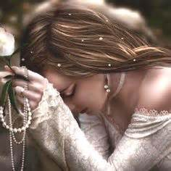
Adorning the Heart with Required Attire
Peter tells us how to adorn our hearts – II Pet. 1:5-11
Moral Excellence (Virtue): Determination to do what’s right (Dan. 1:8)
Knowledge: Knowledge of the word of God (Rom. 1:16-17)
Self-control: Application of that knowledge to your life (I Cor. 9:25-27)
Perseverance: Remain steadfast to the Lord & His cause (Heb. 10:36)
Godliness: Being like God, as He would have you to be (Eph. 4:22-24)
Brotherly kindness: Tender affection toward brethren (Col. 3:12-14)
Love: Devotion to God, Christ and fellow man (Col. 3:12-14: “Put on”)

Slide 17
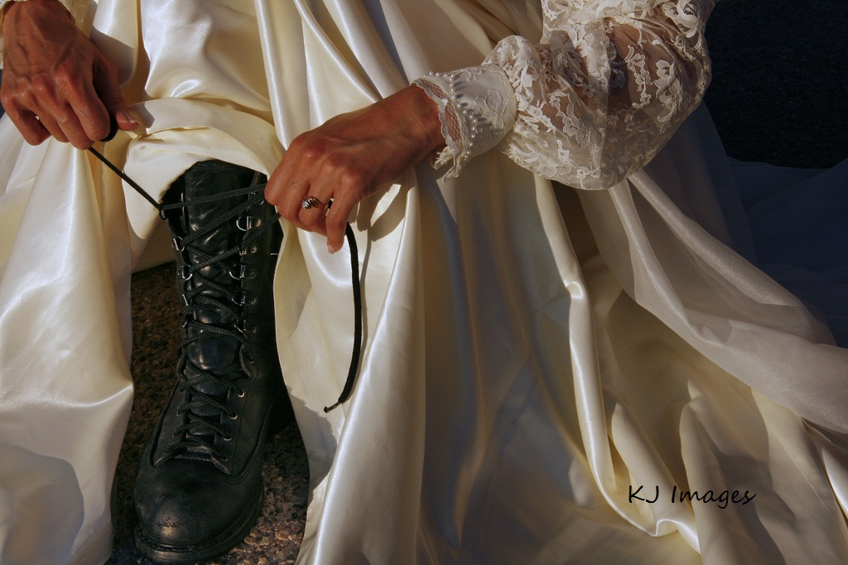
Adorning the Heart with Required Attire
Essential that we know what to adorn our Inner Self with
Pure character springs from the fear of God!
In baptism we “clothe” ourselves “with Christ”
Saints wear the full Armor of God!
Saints “put on” or “wear” the “doctrine of God”
Peter tells us how to adorn our hearts – II Pet. 1:5-11
Adorning our hearts with
the required wedding attire
is essential to entering
Heaven!
Notes:
Image: KJ Images
http://kwinrc.blogspot.com/2011/08/prophetic-photography-warrior-bride.html

Slide 18
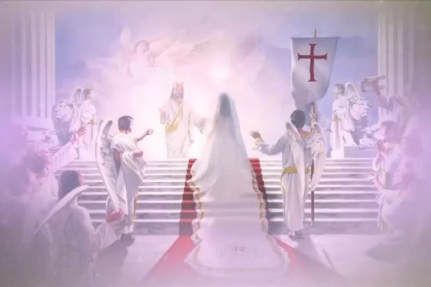
Conclusion
II Cor. 11:2-3 (“Betrothed to Deity!”)
2. For I am jealous for you with a godly jealousy; for I betrothed you to one husband, so that to Christ I might present you as a pure virgin.
3. But I am afraid that, as the serpent deceived Eve by his craftiness, your minds will be led astray from the simplicity and purity of devotion to Christ.
Christ will present to Himself the church as
“holy and blameless!” (Eph. 5:26-27)
Notes:
Image: http://just4kidsmagazine.com/BrideofChrist.html; also sermonspice.com

Slide 19
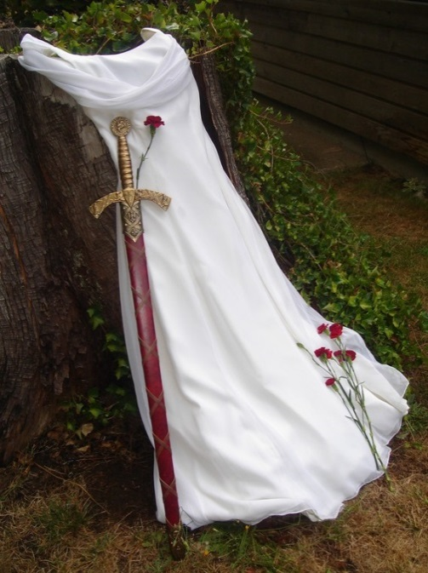
Conclusion
There is great emphasis placed on white
garments, spiritually symbolic of purity:
Rev. 3:4-5: Some in Sardis who were still White & unsoiled.
Rev. 6:9-11: Martyrs are clothed in White robes.
Rev. 7:9-17: Those who overcome the world will be clothed in White and will be in the presence of God!
Rev. 19:8: Proper attire for the bride of Christ is “fine linen, Bright and clean; for the fine linen is the righteous acts of the saints!” Bright: “White” (KJV) = Radiant (G2986).
Rev. 19:11-16: Christ the conqueror on His White horse followed by His army of saints in White robes on White horses.
Notes:
Image: https://www.pinterest.com/mrslucylou/warrior-bride-of-christ

Slide 20
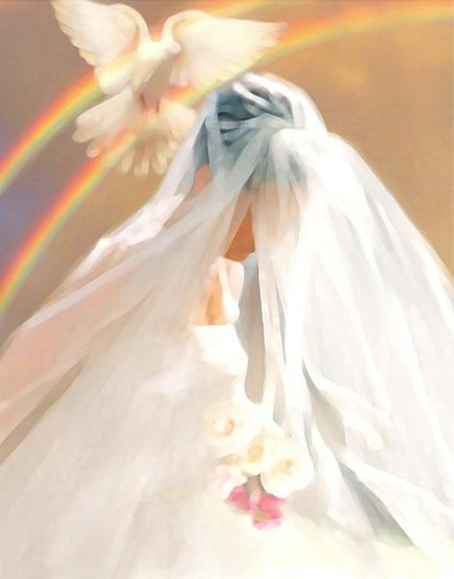
Conclusion
Our eternity with God Almighty is dependent on how we
adorn our hearts with the required attire for the Wedding
Feast of the Lamb!
Rev. 19:8; Eph. 5:26-27; II Cor. 11:2; Mt. 22:11-14
Notes:
Image: https://rhemasong.wordpress.com/tag/bride-of-christ/

Slide 21
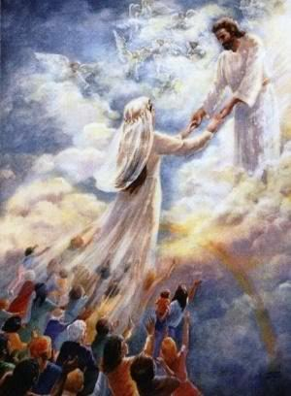
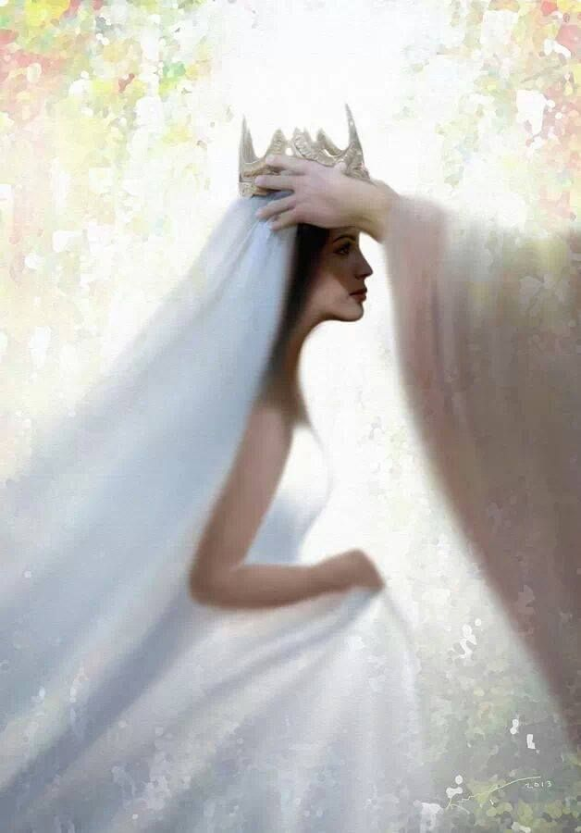
Conclusion
The invitation has been sent out…we are not only invited
but as the church we are the Bride!
Let us be ready to attend properly attired in “fine linen,
bright and clean,” our hearts adorned with the
“righteous acts of the saints!”
Notes:
Image 1 (Left): Painting by Pr. Welfany Nolasco Rodrigues (http://www.esbocosermao.com/search/label/escatologia)
Image 2 (Right): from pinterest.com

Slide 22
“What Must I Do To Be Saved?”
Hear The Gospel (Jn. 5:24; Rom. 10:17)
Believe In Christ (Jn. 3:16-18; Jn. 8:24)
Repent Of Sins (Lk. 13:35; Acts 2:38)
Confess Christ (Mt. 10:32; Rom. 10:10)
Be Baptized (Mk. 16:16; Acts 22:16)
Remain Faithful (Jn. 8:31; Rev. 2:10)
For The Erring Child:
Repent (Acts 8:22), Confess (I Jn. 1:9),
Pray (Acts 8:22)

