Slide 1
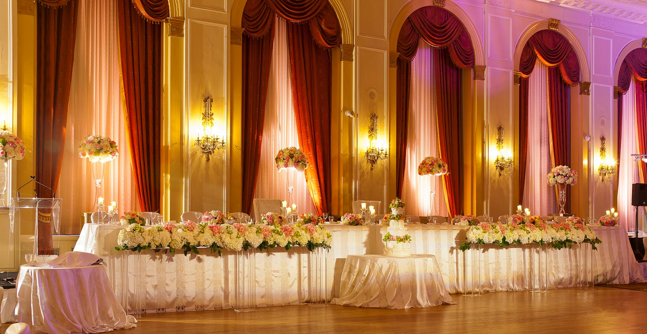
Invited!
Text: Rev. 19:7-9
Notes:
By Nathan L Morrison
All Scripture given is from NASB unless otherwise stated
For further study or if questions, Call: 804-277-1983, or Visit: www.courthousechurchofchrist.com

Slide 2
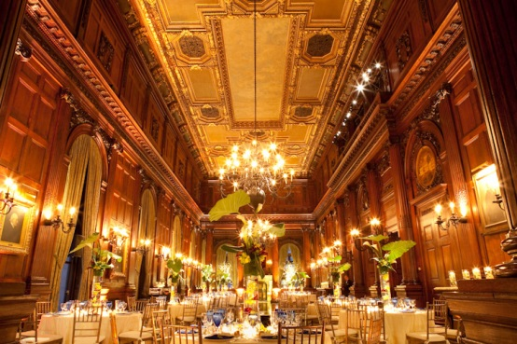
Intro
Rev. 19:7-9
7. "Let us rejoice and be glad and give the glory to Him, for the marriage of the Lamb has come and His bride has made herself ready."
8. It was given to her to clothe herself in fine linen, bright and clean; for the fine linen is the righteous acts of the saints.
9. Then he said to me, "Write, 'Blessed are those who are invited to the marriage supper of the Lamb.'" And he said to me, "These are true words of God."

Slide 3
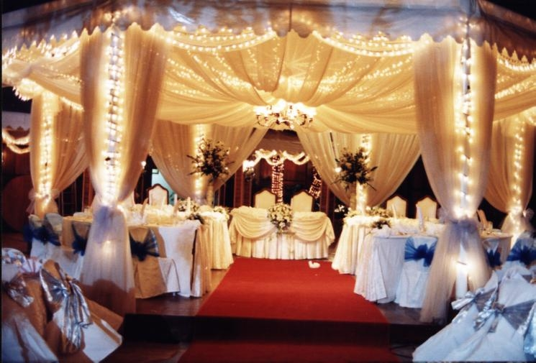
Intro
Mt. 22:1-14 (Vss. 1-7)
1. Jesus spoke to them again in parables, saying,
2. "The kingdom of heaven may be compared to a king who gave a wedding feast for his son.
3. "And he sent out his slaves to call those who had been invited to the wedding feast, and they were unwilling to come.
4. "Again he sent out other slaves saying, 'Tell those who have been invited, "Behold, I have prepared my dinner; my oxen and my fattened livestock are all butchered and everything is ready; come to the wedding feast."'
5. "But they paid no attention and went their way, one to his own farm, another to his business,
6. and the rest seized his slaves and mistreated them and killed them.
7. "But the king was enraged, and he sent his armies and destroyed those murderers and set their city on fire.

Slide 4
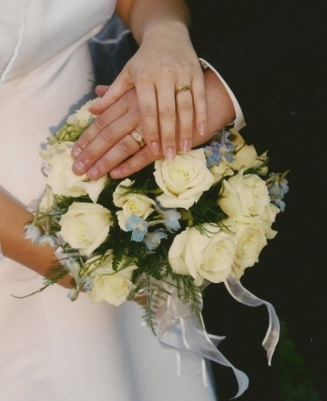
Intro
Mt. 22:1-14 (Vss. 8-14)
8. "Then he said to his slaves, 'The wedding is ready, but those who were invited were not worthy.
9. 'Go therefore to the main highways, and as many as you find there, invite to the wedding feast.'
10. "Those slaves went out into the streets and gathered together all they found, both evil and good; and the wedding hall was filled with dinner guests.
11. "But when the king came in to look over the dinner guests, he saw a man there who was not dressed in wedding clothes,
12. and he said to him, 'Friend, how did you come in here without wedding clothes?' And the man was speechless.
13. "Then the king said to the servants, 'Bind him hand and foot, and throw him into the outer darkness; in that place there will be weeping and gnashing of teeth.'
14. "For many are called, but few are chosen."
The angel said, “Blessed are those
who are invited to the marriage
supper of the Lamb!”

Slide 5
Invited!
What:
Who:
When:
Where:
The Marriage of the Lamb to the church
Rev. 19:7-9; Mt. 22:1-4; Eph. 5:25-27, 32; II Cor. 11:2
All Mankind!
Jn. 3:16; Mt. 11:28-30; Mt. 22:9-10 (Rom. 1:16; Rev. 22:17)
Only God knows when
Mt. 24:36; 25:13; I Thess. 4:16-18; II Pet. 3:9-12
Heaven
Mt. 25:31-34, 46; Rev. 19:5, 11; 20:11-15 (I Pet. 1:4)

Slide 6
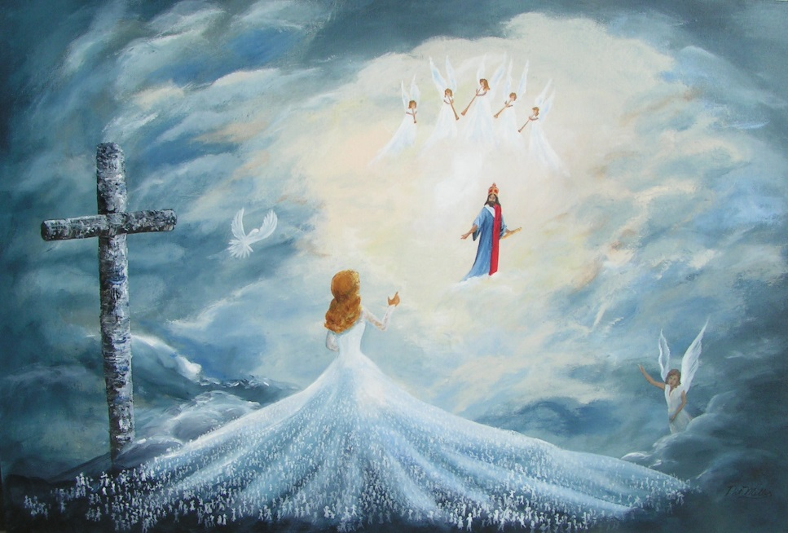
Invited!
Attire:
RSVP:
(Required) Fine, Bright and Clean Linen
Eph. 5:26-27; Rev. 19:8 (Rom. 13:14; Eph. 4:24; Phil. 2:15; Col. 3:12-14; II Pet. 3:11); Gal. 3:26-27; Titus 2:11-14
Obedience to the gospel!
Gal. 3:26-27; Eph. 5:23; Heb. 5:9 (Mt. 7:13-14; 22:14); Mt. 25:21, 23

Slide 7
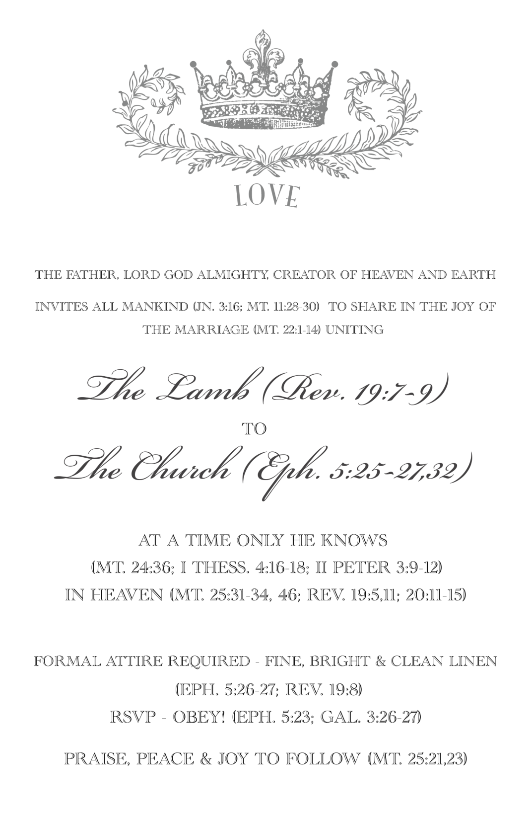
Invited!
God has made preparation:
“All things are ready!
Come to the Feast!”
Created by Nathan L Morrison, nmorrison1939@gmail.com

Slide 8
“What Must I Do To Be Saved?”
Hear The Gospel (Jn. 5:24; Rom. 10:17)
Believe In Christ (Jn. 3:16-18; Jn. 8:24)
Repent Of Sins (Lk. 13:35; Acts 2:38)
Confess Christ (Mt. 10:32; Rom. 10:10)
Be Baptized (Mk. 16:16; Acts 22:16)
Remain Faithful (Jn. 8:31; Rev. 2:10)
For The Erring Child:
Repent (Acts 8:22), Confess (I Jn. 1:9),
Pray (Acts 8:22)

