Slide 1
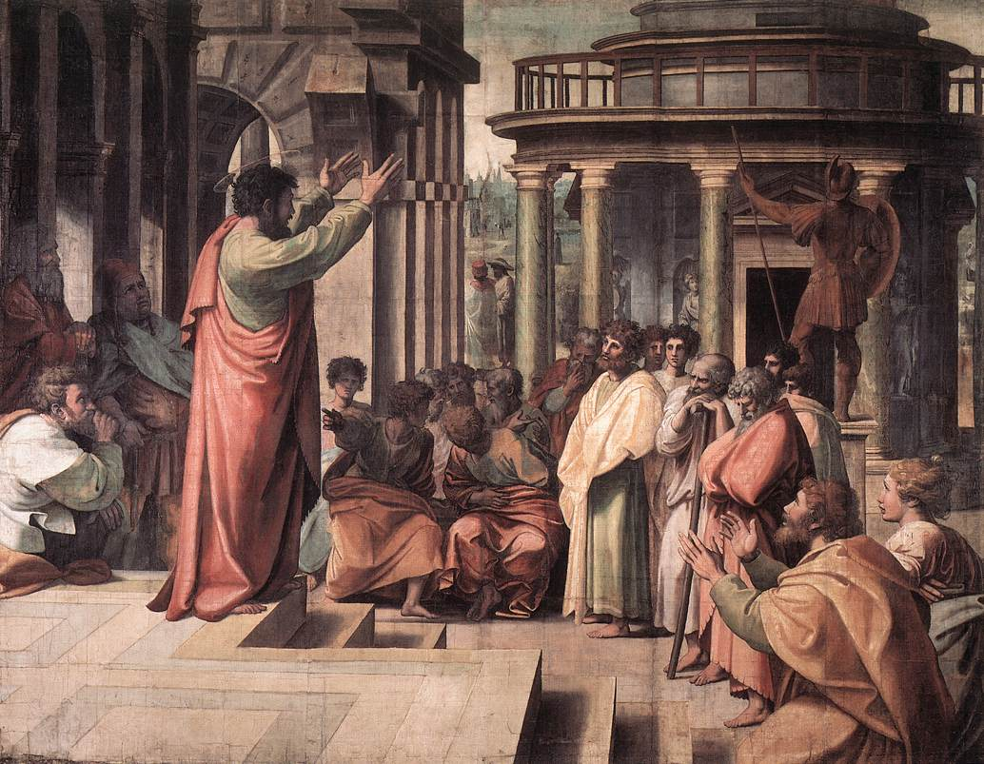
First Gospel Sermon Preached
Text: Acts 2
Notes:
By Nathan L Morrison
All Scripture given is from NASB unless otherwise stated
For further study or if questions, Call: 804-277-1983, or Visit: www.courthousechurchofchrist.com
Based on a lesson by Ron Halbrook

Slide 2
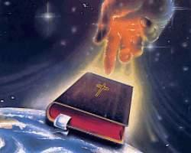
Intro
The answer to the darkness of sin in the world is what it
has always been: the word of God
To the Jews: The Law of Moses set them apart from the world! (Deut. 26:17-19; 33:29)
To the Jews/Gentiles/World: The gospel is to be preached! (Rom. 1:16; James 1:21)
Jesus Christ as Savior is central to God’s Word!
(Gen. 3:15; 12:3; Acts 5:31; 13:23; Gal. 3:26-29)
Light is the answer to darkness!
(Jn. 1:4-5; II Cor. 4:6)

Slide 3
Intro
Acts 2 is central to the promised day of salvation
All previous promises point forward to Acts 2
Isaiah (Is. 2:1-3)
Jesus (Mk. 9:1; Acts 1:8)
All references to present reality of salvation point back to Acts 2!
Salvation to the Jews (Acts 3:24-26)
Salvation to the Gentiles/World (Acts 11:17-18)
Last work of Christ on earth was to prepare Apostles for
the events of Acts 2!
Mk. 16:15-20: The Great Commission
Acts 1:8: Begin at Jerusalem (Is. 2:1-3)
Let us learn the valuable lessons found in the
1st gospel sermon!

Slide 4
Acts 2:1-13: Proof of Divine Origin of Gospel
2:1-4: Miraculous Signs Heard & Seen
Evidence to ears: sound of stormy wind
Evidence to eyes: appearance of fire
Evidence to mind: spoke in foreign languages
Clear evidence of divine power! (II Pet. 1:19-21)
2:5-13: Amazed: Preaching in All Languages
(II Pet. 1:19-21)
“Tongue” (Acts 2:4, 8, 11) = “language” (vs. 6)
Galileans preaching in 15 languages!
What is the meaning & purpose of this miracle?
Proves divine origin of message! (Heb. 2:1-4)

Slide 5
Acts 2:1-13: Proof of Divine Origin of Gospel
Not Like Modern Claims of Miracles & Tongues
No sound of storm, only confused shouting
No appearance of fire, only banners & pictures
No preaching in foreign languages known by audience but not by speakers, only unintelligible babble
False claims expose false message(s)!
The Holy Spirit filling the apostles confirmed the word
as from God and not men!

Slide 6
Acts 2:14-21: New Age of Revelation & Salvation
2:14-15: Peter refutes charge that they were drunk
2:16-21: God’s Promise Fulfilled: New Age of
Revelation & Salvation
2:16: Prophecy in Joel 2:28-32
2:17-18: New revelations given
2:19-20: Old order to be replaced
A new covenant & a new Israel replace old order as when God replaced Babylon (Is. 13:1, 9-11; Jer. 31:31-34; Lk. 22:20)
2:21: The day of salvation has come!

Slide 7
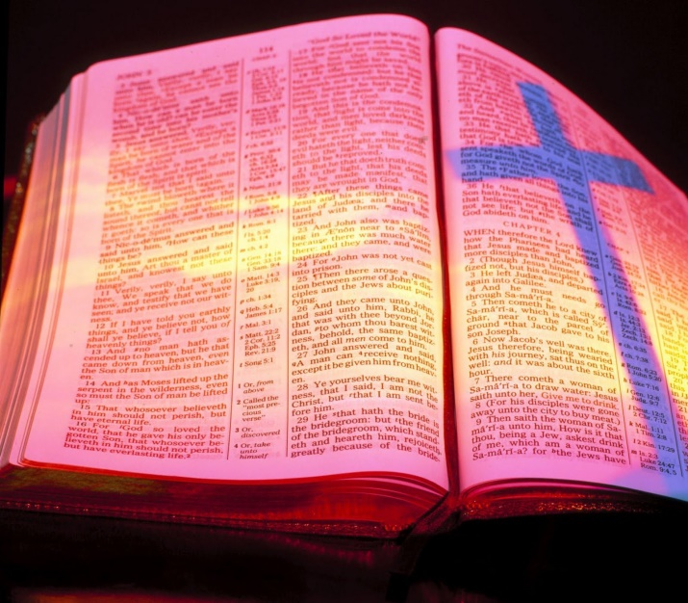
Acts 2:14-21: New Age of Revelation & Salvation
In Contrast to False Theories Today
Not teaching continuance of Law of Moses but the end of this old order which cannot save (Hebrews 9-10; esp. 9:13-23; 10:1-4)
Not teaching “one covenant” theory
Theory denies “old” & “new” covenants
Theory claims one moral law in all ages!
Peter confirms that the new covenant foretold of by
the prophets was fulfilled in Christ!

Slide 8
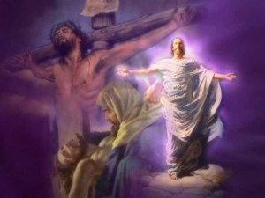
Acts 2:22-36: Death & Resurrection of Christ
2:22-24: Jesus Christ Crucified & Risen
(According to the Scriptures –
I Cor. 15:3-4)
2:25-28: David Prophesied the Savior’s
Resurrection (Ps. 16:8-11)
2:27: Soul not remain in hades (receptacle of the dead – Lk. 16:19-31)
2:27: Body not decay
2:29-36: David’s Prophecy Fulfilled by Christ Not by
David
Proof that Jesus Christ and Not David Raised!
2:29-31: David still in tomb, Christ raised to sit on his throne
2:32: Apostles were eye-witnesses (Lk. 1:2; Jn. 1:14; Acts 1:8; II Pet. 1:16; I Jn. 1:3)
2:33: Christ sent the Holy Spirit and caused the Pentecost miracles! (Acts 1:8)
2:34-36: David’s soul in hades, Jesus raised as Lord & Christ!

Slide 9
Acts 2:22-36: Death & Resurrection of Christ
Not Teaching Human Theories
Theory of materialism denies soul
Acts 2:26-27, 31, 34: Body in grave, soul in hades
Theory of reincarnation denies resurrection
Acts 2:24, 30-32: Raised up, resurrection-affirmed & proven
Theory of modernism denies miracles as historical events
Acts 2:1-4, 22-24: Events witnessed as real (Lk. 1:2; Acts 1:8; I Cor. 15:3-8; II Pet. 1:16; I Jn. 1:3)
Acts 2:29-36: One tomb occupied, the other empty!
Theory of premillennialism denies Christ is now ruling in His kingdom
Acts 2:30, 36: Raised to reign on His throne
If promised kingdom failed 1st time, why believe Him
again?
Jesus lived, died for sins, was buried, and was
resurrected, and now reigns in Heaven!

Slide 10
Acts 2:37-40: Conditions of Pardon
Acts 2:37
37. Now when they heard this, they were pierced to the heart, and said to Peter and the rest of the apostles, "Brethren, what shall we do?"
2:37: Many Convinced, But Do Not Know How to Receive
Salvation
Must “call” (ask in proper way, 2:21)
HOW?

Slide 11
Acts 2:37-40: Conditions of Pardon
Acts 2:38-39
38. Peter said to them, "Repent, and each of you be baptized in the name of Jesus Christ for the forgiveness of your sins; and you will receive the gift of the Holy Spirit.
39. "For the promise is for you and your children and for all who are far off, as many as the Lord our God will call to Himself."
2:38-39: How to Receive Salvation
“Whosoever” (vs. 21): all men invited (vs. 39)
“Call” (vs. 21; Joel 2:32): repent & immersed (2:38; 22:16; Rom. 10:12-13)
“Name of the Lord [YHWH]” (vs. 21: “Kurios”): “Jesus Christ” (Phil. 2:9)
“Saved” (vs. 21): “forgiveness of sins” (vs. 38)
“Gift of the Holy Spirit:” (vs. 38):
Restored to fellowship with God (II Cor. 13:14)
All spiritual blessings (Eph. 1:3)
“The promise of the Spirit” given to Abraham: “In you shall all nations be blessed” (Gen. 12:3; Gal. 3:8, 14, 26-29)
“The promise” to all who obey the gospel (Acts 2:39; Gal. 3:26-29)

Slide 12
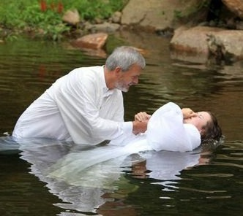
Acts 2:37-40: Conditions of Pardon
Acts 2:40
40. And with many other words he solemnly testified and kept on exhorting them, saying, "Be saved from this perverse generation!"
2:40: Gospel Invitation Urgent!
(Mt. 25:34, 41, 46; Rev. 20:11-15; 21:3-7)
Many other words warning, pleading!
Souls valuable!
Hell eternal: torment, anguish, regret!
Heaven eternal: unbroken fellowship with God, no sin, sickness, or death!

Slide 13
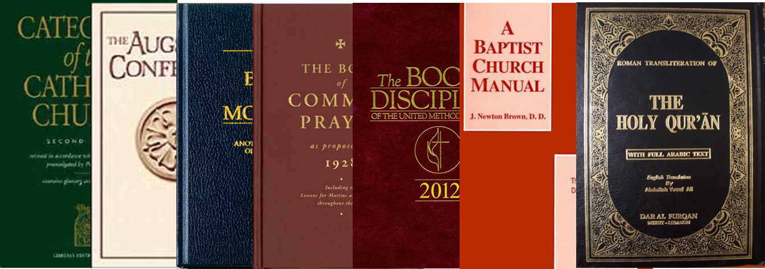
Acts 2:37-40: Conditions of Pardon
Not Preaching Doctrines of Men
Not baby baptism:
2:21: Must call on the Lord’s name to be saved
2:36-38: Must believe, repent, & be immersed to ask pardon
Not salvation by faith only:
2:21: Must call on the Lord’s name to be saved—How call?
2:36-38: Must believe, repent, & be immersed to ask pardon (22:16)
The first gospel sermon preached called upon men to
repent and be baptized for the forgiveness of sins, and
thus calling on the name of the Lord for salvation!

Slide 14
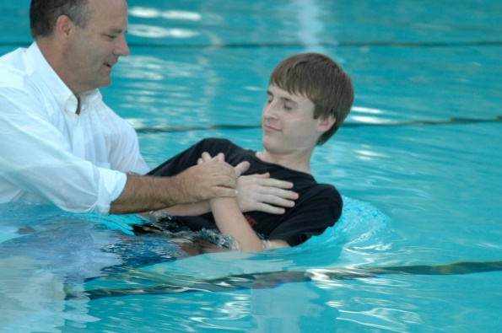
Acts 2:41-47: Response & Results
2:41: Many Received Salvation (3,000 souls)
Baptized immediately, no delay
All baptized to receive salvation
No leading the crowd into a prayer for salvation!
No direct operation of the Holy Spirit on the sinner’s soul
Not accept Jesus before & without water baptism
How to Receive Salvation: Contrast Peter & Religious World’s Sinner’s Prayer
Peter: “Repent, and each of you be baptized in the name of Jesus Christ for the forgiveness of your sins; and you will receive the gift of the Holy Spirit” (Acts 2:38).
Sinner’s Prayer: Repent and pray to Jesus asking for forgiveness and invite Him into your heart and you will be saved!
God added them all together as one body in Christ - not separated into denominational bodies!

Slide 15
Acts 2:41-47: Response & Results
2:42: United and devoted to the apostles’ teaching
Apostles of Christ inspired by the Holy Spirit to teach them (II Pet. 1:19-21)
2:43: Apostles Teaching Confirmed by Signs
As Jesus promised (Mk. 16:15-20)
Gospel message fully revealed & confirmed in New Testament–nothing can be added – Heb. 2:1-4; Jude 3 (Gal. 1:6-9)
2:44-45: Use of Church Treasury
Kept by Apostles, used as they instructed by inspiration (Acts 4:35, 37; 5:2)
“In common” = fellowship with God expressed in fellowship with needy saints
Treasury not used to entertain or for sinners in the world (Acts 3:1-8)

Slide 16
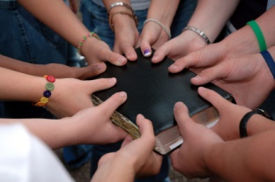
Acts 2:41-47: Response & Results
2:46-47: Spirit of Unity in Christ
Daily meetings in the temple: teaching, teaching, & more teaching!
Hospitality: social gatherings in homes (Heb. 13:1-2)
Their godly lives distinctive, admired by unbelievers (Mt. 5:16; I Pet. 2:12)
Constant evangelism: sinners baptized, added by Christ to His church (NKJ)
The response and results of the 1st gospel sermon was
many souls were saved and they were united in faith and
practice as the church of Christ!

Slide 17
Conclusion
Valuable lessons in the 1st gospel sermon:
One true church established by Christ, NOT diverse bodies with earthly headquarters, boards, powerful executives, & human names
Guided strictly by the Apostles’ doctrine, NOT diverse doctrines of men
Pattern of worship revealed by Apostles, NOT diverse forms of worship
United work of evangelism, edification, & benevolence, NOT fragmented in factions by human leaders, competition, jealousy, obsessive opinionated bickering, grudges, bitterness, etc.
The first gospel sermon preached saved souls from the
inspiration of the word of God, NOT through
entertainment or human wisdom and doctrines of men!
To answer the need of souls lost in sin
around us, let us simply preach
the gospel!

Slide 18
“What Must I Do To Be Saved?”
Hear The Gospel (Jn. 5:24; Rom. 10:17)
Believe In Christ (Jn. 3:16-18; Jn. 8:24)
Repent Of Sins (Lk. 13:35; Acts 2:38)
Confess Christ (Mt. 10:32; Rom. 10:10)
Be Baptized (Mk. 16:16; Acts 22:16)
Remain Faithful (Jn. 8:31; Rev. 2:10)
For The Erring Saint:
Repent (Acts 8:22), Confess (I Jn. 1:9),
Pray (Acts 8:22)

