Slide 1
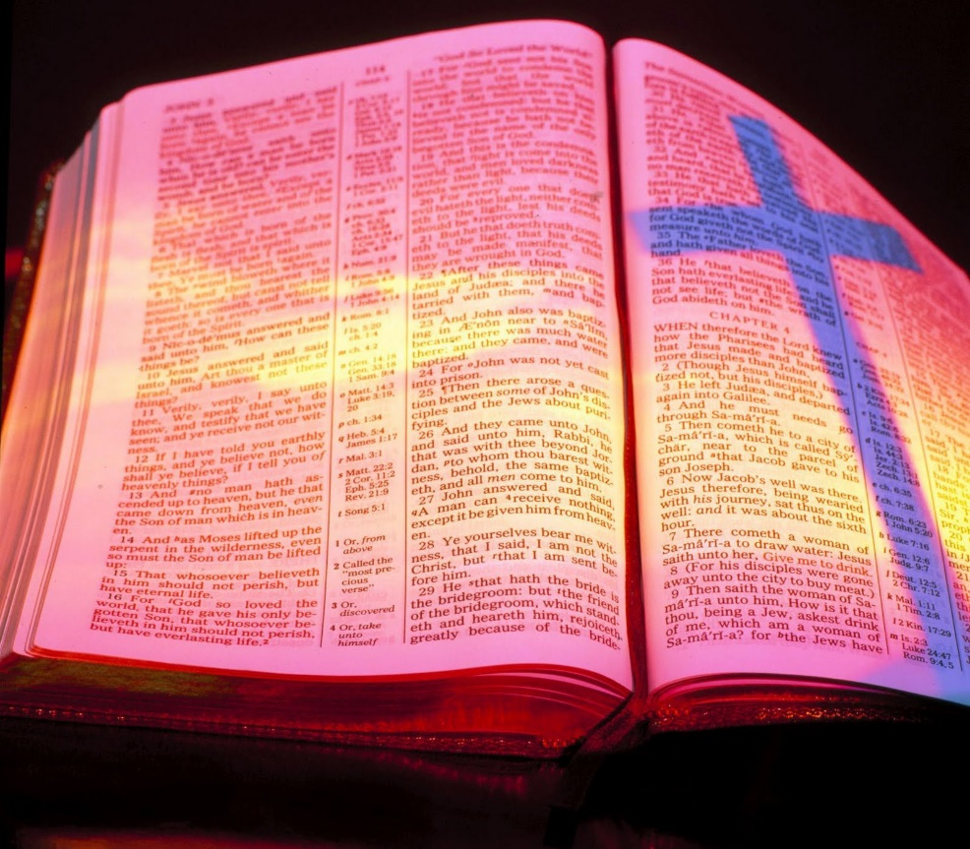
Examples Of Faith, Love & Hope
Text: Colossians 1:3-8
Notes:
By Nathan L Morrison
All Scripture given is from NASB unless otherwise stated
For further study or if questions, Call: 804-277-1983, or Visit: www.courthousechurchofchrist.com

Slide 2
Intro
I Cor. 13:13 (I Cor. 15:58; Heb. 10:32-39)
But now faith, hope, love, abide these three; but the greatest of these is love.
The saints at Colossae were a great example of this!

Slide 3
Intro
Colossians 1:3-8 (vss. 3-5)
3. We give thanks to God, the Father of our Lord Jesus Christ, praying always for you,
4. since we heard of your faith in Christ Jesus and the love which you have for all the saints;
5. because of the hope laid up for you in heaven, of which you previously heard in the word of truth, the gospel

Slide 4
Intro
Colossians 1:3-8 (vss. 6-8)
6. which has come to you, just as in all the world also it is constantly bearing fruit and increasing, even as it has been doing in you also since the day you heard of it and understood the grace of God in truth;
7. just as you learned it from Epaphras, our beloved fellow bond-servant, who is a faithful servant of Christ on our behalf,
8. and he also informed us of your love in the Spirit.

Slide 5
Intro
The gospel was effective in their faith, their love, and their hope! (I Cor. 13:13)
In remaining steadfast in faith, love, and hope we proclaim the gospel at work in our lives!

Slide 6
Faith
Col. 1:4 (James 2:14-26)
…since we heard of your faith in Christ Jesus and the love which you have for all the saints;
Notes:
Emphasis in Scripture Mine!

Slide 7
Faith
Col. 1:4 (I Cor. 13:13; Eph. 4:5)
Paul had heard of their faith – faith manifests itself (Js. 2:14-26: Faith without works is dead)
They were obedient to Christ’s command--let their light shine (Mt. 5:13-16)
Heb. 11:1: “Now faith is the assurance of things hoped for, the conviction of things not seen.”

Slide 8
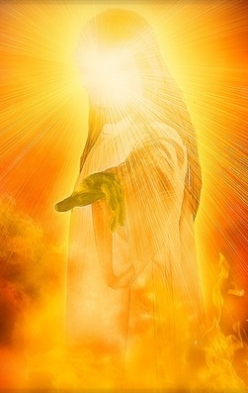
Faith
The gospel leads to faith in Christ – Nature of Christ
(Col. 1:13-18)
He has a kingdom – 1:13 (King – Jn. 18:37)
He is the Son of God – 1:13
He is the Redeemer – 1:14
He is the One in whom we have forgiveness of
sins – 1:14
He is the image of God the Father – 1:15
He is the Creator – 1:16
He is the Head of the church – 1:18
He is risen from the dead – 1:18
The gospel will produce faith in Christ
that leads to obedience (Col. 1:5;
Mk. 16:15-16)
Rom. 1:16: The gospel is God’s power for salvation!

Slide 9
Faith
The gospel will produce
saving faith! (I Pet. 1:9)
Any message that denies Christ as Son of God is not the gospel!
Any message that denies Christ as Head of the church is not the gospel!
Any message that does not lead to obedience is not the gospel!
The gospel has given us faith
in Christ that will lead to the salvation of our souls!
“Obtaining as the outcome of your faith the salvation of your souls.” (I Peter 1:9)

Slide 10
Love for Brethren
Col. 1:4 (I Cor. 13:13; Jn. 15:12)
…since we heard of your faith in Christ Jesus and the love which you have for all the saints;
Notes:
Emphasis in Scripture Mine!

Slide 11
Love for Brethren
I Cor. 13:4-7
Love = agape (G26): Love seeks the welfare of all (Vine)
Faith in Christ and love for the
Brethren go hand-in-hand:
Jn. 13:34-35: Jesus said the world would know His disciples by the way they loved one another (Jn. 15:12).
Paul heard of their love – Col. 1:4, 7-8
I Jn. 4:7-8, 11-12, 20-21: Cannot love God and not love our brethren.
I Pet. 1:22: Saints after obedience to the gospel are to “fervently love one another from the heart” (III Jn. 5-8)
“This is My commandment, that you love one another, just as I have loved you.” (John 15:12)

Slide 12
Love for Brethren
Application
Phil. 2:3-4; Js. 2:15-16; I Jn. 3:17-18
The Colossian brethren were great examples of
faith and love!
May we ever be known for our love for
“all the saints!” (III John 5-8)

Slide 13
Hope of Heaven
Col. 1:5 (I Cor. 13:13; Eph. 4:4)
because of the hope laid up for you
in heaven, of which you previously
heard in the word of truth, the gospel
Notes:
Emphasis in Scripture Mine!

Slide 14
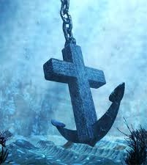
Hope of Heaven
The gospel provides that hope in
Christ who was raised from the
dead (1:18)
Rom. 8:24-25; II Pet. 3:10-12: We eagerly wait for what we do not see!
Heaven identified:
Col. 3:1-3: Where Christ is (Jn. 14:2-3)
I Pet. 1:3-4: “Reserved in heaven for you.”
Heb. 6:18-20: This hope is an anchor for the soul, sure and steadfast!
“This hope we have as an anchor of the soul, a hope both sure and steadfast…” (Hebrews 6:19)

Slide 15
Hope of Heaven
Other messages pervert the hope of Heaven!
Premillennialism places emphasis on an earthly kingdom – a blissful reunion with Christ on earth!
The “Social Gospel” places emphasis on the earthly kingdom as well – “reserved at the fellowship hall for you”
Secularism in the church all points to “this world” activism!
Col. 3:1-3: We are to focus on Christ and heavenly things
(Col. 1:13)
In the gospel we have the hope of an eternal
home in Heaven with God!

Slide 16
Conclusion
The pure gospel affects our lives:
Obedience to the truth (Col. 1:5-6; Mk. 16:16)
Faith in Christ (Col. 1:4)
Love for brethren (Col. 1:4)
Hope of Heaven (Col. 1:5)
We need to be teaching it so that it can spread
throughout all the world (Col. 1:6)!

Slide 17
Conclusion
Despite the problems the church at Colossae faced,
the members were strong in the faith:
Col. 2:5-7: Theirs was a stable faith.
Paul had heard of their faith & love!
We must make sure the gospel has taken hold of our lives
so that we are living proof of it!

Slide 18
Conclusion
Let us proclaim the gospel in the way we live our
lives and be examples of faith, love & hope!

Slide 19
“What Must I Do To Be Saved?”
Hear The Gospel (Jn. 5:24; Rom. 10:17)
Believe In Christ (Jn. 3:16-18; Jn. 8:24)
Repent Of Sins (Lk. 13:35; Acts 2:38)
Confess Christ (Mt. 10:32; Rom. 10:10)
Be Baptized (Mk. 16:16; Acts 22:16)
Remain Faithful (Jn. 8:31; Rev. 2:10)
For The Erring Child:
Repent (Acts 8:22), Confess (I Jn. 1:9),
Pray (Acts 8:22)

