Slide 1
ABIDE IN FAITH, HOPE & LOVE
Text: I Cor. 13:13; 15:58
Notes:
By Nathan L Morrison
All Scripture given is from NASB unless otherwise stated
For further study or if questions, Call: 804-277-1983, or Visit: www.courthousechurchofchrist.com

Slide 2
Intro
I Cor. 13:13 (I John 3:2)
But now faith, hope, love, abide these three; but the greatest of these is love.
First Century | Present | After Christ Returns
Spiritual Gifts
Faith | Faith
Hope | Hope
Love | Love | Love

Slide 3
Intro
I Cor. 15:58
Therefore, my beloved brethren, be steadfast, immovable, always abounding in the work of the Lord, knowing that your toil is not in vain in the Lord.

Slide 4
Intro
Heb. 10:32-39 (vss. 32-35)
32. But remember the former days, when, after being enlightened, you endured a great conflict of sufferings,
33. partly by being made a public spectacle through reproaches and tribulations, and partly by becoming sharers with those who were so treated.
34. For you showed sympathy to the prisoners and accepted joyfully the seizure of your property, knowing that you have for yourselves a better possession and a lasting one.
35. Therefore, do not throw away your confidence, which has a great reward.

Slide 5
Intro
Heb. 10:32-39 (vss. 36-39)
36. For you have need of endurance, so that when you have done the will of God, you may receive what was promised.
37. FOR YET IN A VERY LITTLE WHILE, HE WHO IS COMING WILL COME, AND WILL NOT DELAY.
38. BUT MY RIGHTEOUS ONE SHALL LIVE BY FAITH; AND IF HE SHRINKS BACK, MY SOUL HAS NO PLEASURE IN HIM.
39. But we are not of those who shrink back to destruction, but of those who have faith to the preserving of the soul.

Slide 6
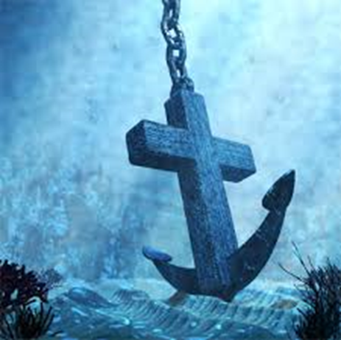
Intro
The symbolic “storms of life” we encounter in our lives are
very real
Economic (jobs), physiological (health), psychological (mental) and philosophical (faith)!
Unseen reefs of false doctrine; treacherous shoals of discouragement; dangerous rocks of pride, covetousness, doubts and fears!
What holds us together during these
“stormy” times in our life?
Be steadfast to abide in faith,
hope & love!

Slide 7
Faith
I Cor. 13:13
But now faith, hope, love, abide these three; but the greatest of these is love.
Notes:
Emphasis in Scripture Mine!

Slide 8
Faith
I Cor. 13:13 (I John 3:2)
Faith, along with hope and love will abide till the 2nd Coming of Christ!
“Faith" defined:
Heb. 11:1: “Now faith is the assurance of things hoped for, the conviction of things not seen.”
I Jn. 3:2: Will be done away with when we see Christ face-to-face!
I Cor. 16:13: “Stand firm in the faith, act like men, be strong”
In the face of storms of life – Faith anchors us:
Eph. 4:11-15: Against false doctrine!
Eph. 6:16: Against temptation!
I Jn. 5:4: Against the world!
I Pet. 1:9: To Eternal Life!

Slide 9
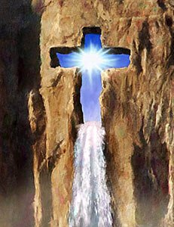
Faith
Faith (Eph. 4:5: One Faith) in Christ
(by grace) saves us! (Eph. 2:8-9; I Pet. 1:9)
Abiding in faith grounds us to the Rock (I Cor. 10:4: Christ), and if strong, cannot be moved!

Slide 10
Hope
I Cor. 13:13
But now faith, hope, love, abide these three; but the greatest of these is love.
Notes:
Emphasis in Scripture Mine!

Slide 11
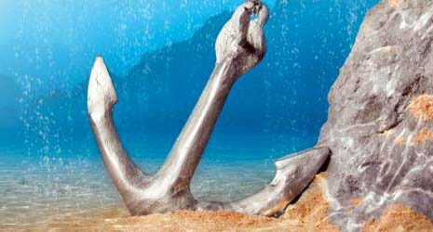
Hope
I Cor. 13:13 (I John 3:2)
Hope, along with faith and love will abide till the 2nd Coming of Christ!
“Hope" defined:
Rom. 8:24-25; II Pet. 3:10-12: We eagerly wait for what we do not see
G1680 elpis [el-pece']: To anticipate, usually with pleasure; expectation (abstract or concrete) or confidence: faith, hope (Rom. 8:25).
Hope is desire mingled with expectation!
In the face of storms of life – Hope anchors us:
Heb. 6:17-20: Sure and steadfast!
Heb. 6:17-18: To eternal life in the promises of God!
(Rom. 15:4, 13)

Slide 12
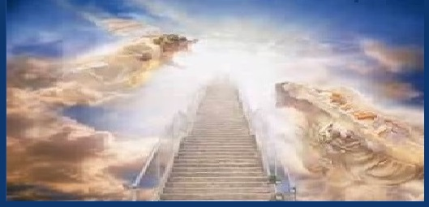
Hope
Eph. 4:4-6: Saints are called to “one hope!”
Abiding in hope grounds us to the promise of
eternal life! ( I Jn. 2:25; I Pet. 1:9)!

Slide 13
Love
I Cor. 13:8, 13
8. Love never fails; but if there are gifts of prophecy, they will be done away; if there are tongues, they will cease; if there is knowledge, it will be done away.
13. But now faith, hope, love, abide these three; but the greatest of these is love.
Notes:
Emphasis in Scripture Mine!

Slide 14
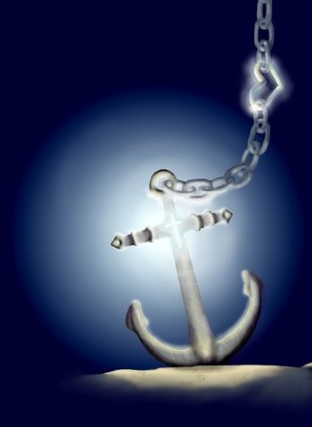
Love
I Cor. 13:8, 13
“Love never fails,” for even though one day “faith” and “hope” will no longer be necessary (When Christ comes again), love will endure!
For it was with love God sent His Son (Jn. 3:16), and from
love that Christ died for us (Rom. 5:8), and it is love for us
that saints are promised eternal life! (Jude 21)
In the face of storms of life – Love
(I Cor. 13:4-7: Defined) anchors us:
To God: Jn. 14:15; I Jn. 2:4-6; 5:2-3
To one another: Jn. 13:35; 15:12; I Jn. 3:17-18, 23;
4:7-11, 20-21 (I Cor. 16:14: Do all things in love)
To the world: Acts 20:27; 24:25; II Tim. 2:24-26; Jude 22-23

Slide 15
Love
Abiding in love grounds us to God, one another, and to our purpose in saving the lost!
(Rom. 1:16)

Slide 16
Steadfastness
I Cor. 15:58
Therefore, my beloved brethren, be steadfast, immovable, always abounding in the work of the Lord, knowing that your toil is not in vain in the Lord.
Notes:
Emphasis in Scripture mine!

Slide 17
Steadfastness
I Cor. 15:58
Steadfastness is required to endure to the finish line!
In the face of storms of life – Steadfastness anchors us:
Jn. 8:31: In God’s word!
Heb. 10:35-39; Js. 1:2-4: In trials!
II Pet. 1:5-7: In godliness!
Js. 1:12; Rev. 2:10: In winning the
“crown of life!”

Slide 18
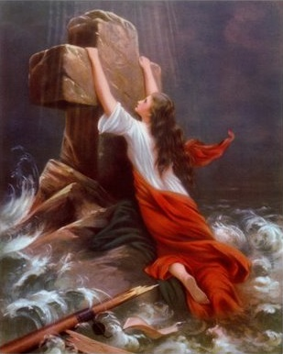
Steadfastness
Heb. 10:35-39: The “storms of life” will test us, even our
faith, and we must have endurance to not throw away our
confidence and “not shrink back” (Heb. 10:32-35)!

Slide 19
Steadfastness
Abiding in faith, hope & love requires
steadfastness and grounds us to God, for we are
“those who have faith to the preserving of the
soul!” (Heb. 10:39)

Slide 20
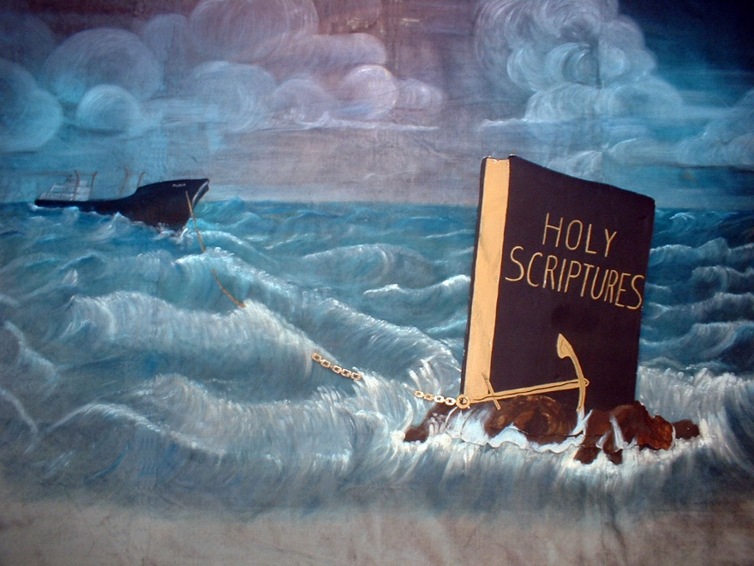
Conclusion
These anchors of the soul help us to have that
endurance to be “faithful till death” as Christ admonished
the church at Smyrna to do in Rev. 2:10
When the storms of life hit us with its troubles and
persecutions, if anchored firmly in Christ, though tossed
about, we will remain grounded
Our faith, hope, love, and steadfastness (I Cor. 13:7) in Christ ought to be immovable if grounded on the Rock (Christ – I Cor. 10:4)!
The promises of God are unbreakable! (Heb. 6:18-19)

Slide 21
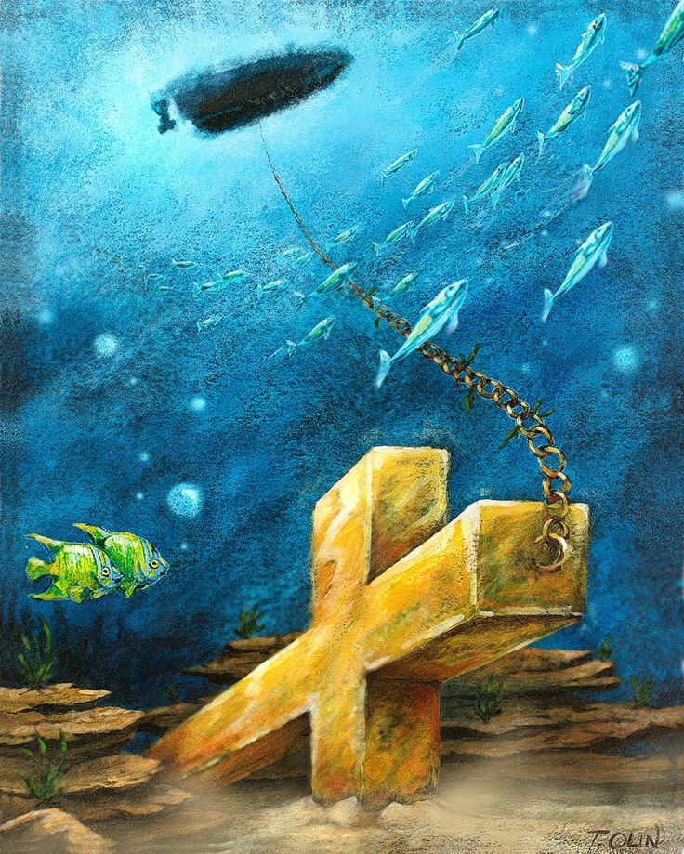
Conclusion
Anchored to the Rock that is Christ
(I Cor. 10:4) let us abide
in faith, hope & love and
nothing will move us or
shake us, but we will
weather the storms
(trials) of life!

Slide 22
“What Must I Do To Be Saved?”
Hear The Gospel (Jn. 5:24; Rom. 10:17)
Believe In Christ (Jn. 3:16-18; Jn. 8:24)
Repent Of Sins (Lk. 13:35; Acts 2:38)
Confess Christ (Mt. 10:32; Rom. 10:10)
Be Baptized (Mk. 16:16; Acts 22:16)
Remain Faithful (Jn. 8:31; Rev. 2:10)
For The Erring Child:
Repent (Acts 8:22), Confess (I Jn. 1:9),
Pray (Acts 8:22)

