Slide 1
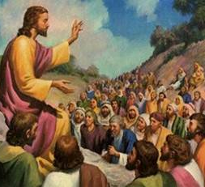
Parables Of Godly Living
Text:
Matthew 25:13
Notes:
By Nathan L Morrison for Sunday January 7th, 2024
All Scripture given is from NASB unless otherwise stated
For further study, or if questions, please Call: 804-277-1983 or Visit www.courthousechurchofchrist.com
Adapted from a chart by Steven Rudd
Logo art provided by www.vecteezy.com

Slide 2
Intro
As one year fades into the archives of history, many people turn their attention and focus on the new year
For the Christian, another year is another opportunity to live for God and get that much closer to eternity
We don’t know if we will be given the whole year, so we live daily for Him!

Slide 3
Intro
Matthew 24:36; 25:13
Matthew 24:36: “But of that day and hour no one knows, no, not even the angels of heaven, but My Father only.”
Matthew 25:13: “Watch therefore, for you know neither the day nor the hour in which the Son of Man is coming.” (NKJV)

Slide 4
Intro
New Year’s Resolutions seem to be made in jest as a thing to do this time of year, or made as some lofty, out of reach goal that is soon forgotten!
Let us look at the teachings of Jesus and see parables for living godly in our daily lives!

Slide 5
Godly Living
Love Neighbor/Enemies

Slide 6
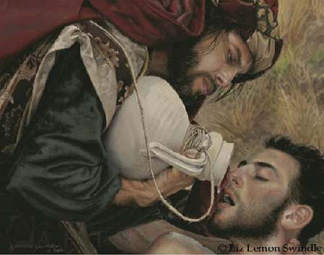
Parable 1: Love for Neighbor/Enemy
Jesus said to love your neighbor and your enemy (Matthew 5:43-45)
Luke 10:25-37: The Good Samaritan
Acts of kindness to all people are things we can do daily in our everyday lives!
Notes:
Image by Liz Lemon Swindle

Slide 7
Godly Living
Love Neighbor/Enemies
Wealth

Slide 8
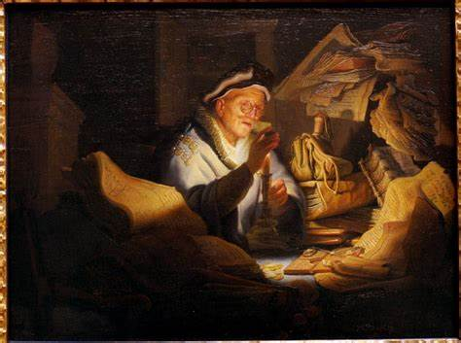
Parable 2: Wealth
Jesus said, “But store up for yourselves treasures in heaven” and, “You cannot serve God and wealth” (Matthew 6:19-21, 24)
Luke 12:16-21: The Rich Fool
I Timothy 6:17-19
Being grateful to God for His blessings, content with what we have and sharing with others as we have opportunity are ways we can have the proper attitude towards wealth daily!
Notes:
Image by Liz Lemon Swindle

Slide 9
Godly Living
Love Neighbor/Enemies
Wealth
Prayer

Slide 10
Parable 3: Prayer
Jesus told “them a parable to show that at all times they ought to pray and not to lose heart” (Luke 18:1)
Luke 11:5-10: Friend’s Request at Midnight
Luke 18:2-8: Widow and the Unjust Judge
We are to pray to God daily and not to lose heart!
Notes:
Image by Liz Lemon Swindle

Slide 11
Godly Living
Love Neighbor/Enemies
Wealth
Prayer
Humility

Slide 12
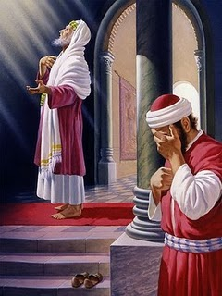
Parable 4: Wealth
Jesus tells another parable to warn against self-righteousness and contempt for others
Luke 18:9-14: Pharisee and the Tax Collector
James 4:10: “Humble yourselves in the presence of the Lord, and He will exalt you”
In our daily everyday lives if we are focused on our own relationship to God and have humility, we won’t have time to judge others and look down on anyone!
Notes:
Image by Liz Lemon Swindle

Slide 13
Godly Living
Love Neighbor/Enemies
Wealth
Prayer
Forgiveness
Humility

Slide 14
Parable 5: Forgiveness
Jesus was asked how many times must one forgive and told them a parable (Matthew 18:21-22)
Matthew 18:23-35: Unmerciful Servant
Colossians 3:12-14; Luke 7:40-43
In our daily everyday lives don’t look for the wrongs, but for ways to forgive from the heart and reconcile!
Notes:
Image by Liz Lemon Swindle

Slide 15
Godly Living
Love Neighbor/Enemies
Wealth
Alertness
Prayer
Forgiveness
Humility

Slide 16
Parable 6: Alertness
Jesus said, “Take heed, keep on the alert; for you do not know when the appointed time will come” (Mark 13:32-33)
Mark 13:34-37: Watchful Servants
I Thessalonians 5:6; I Peter 5:8
In our daily everyday lives don’t forget Who we serve and what event we are hoping for and looking forward to: The return of Jesus Christ, our Lord!
Notes:
Image by Liz Lemon Swindle

Slide 17
Godly Living
Love Neighbor/Enemies
Steadfastness
Wealth
Alertness
Prayer
Forgiveness
Humility

Slide 18
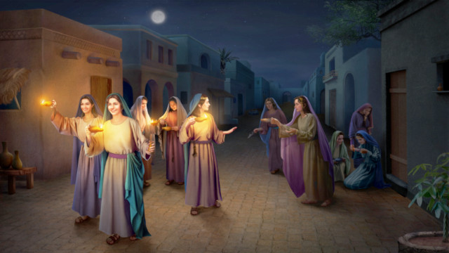
Parable 7: Steadfastness
Jesus told another parable on being steadfast and being ready
Matthew 25:1-13: Ten Virgins
“Therefore keep watch, because you do not know the day or the hour.”
Jesus taught the need to not only be on the alert but to be ready!
In our daily everyday lives let us be ready, “with our lamps all trimmed and bright,” for that glorious day!
(from the hymn, Will Jesus Find Us Watching by Fanny J Crosby, 1876)
Notes:
Image by Liz Lemon Swindle

Slide 19
Godly Living
Love Neighbor/Enemies
Steadfastness
Wealth
Alertness
Prayer
Forgiveness
Humility
When we reflect on the last year, we can ask ourselves if we have done these things, and if we haven’t, let us “forget what lies behind” & reach “forward to what lies ahead” as the apostle Paul said (Philippians 3:13)!

Slide 20
Godly Living
Good Samaritan
Ten Virgins
Rich Fool
Watchful Servants
Friend’s Request at Midnight
Unmerciful Servant
Pharisee &
Tax Collector
Jesus taught in parables so that we could understand what He was saying!

Slide 21
Godly Living
Love Neighbor/Enemies
Steadfastness
Wealth
Alertness
Prayer
Forgiveness
Humility
These are parables that apply to our everyday lives so let us not make lofty goals that may be unachievable and forgotten later, but strive to live godly in our everyday daily lives!

Slide 22
“What Must I Do To Be Saved?”
Hear The Gospel (John 5:24; Romans 10:17)
Believe In Christ (John 3:16-18; John 8:24)
Repent Of Sins (Luke 13:3-5; Acts 2:38)
Confess Christ (Matthew 10:32; Romans 10:10)
Be Baptized (Mark 16:16; Acts 22:16)
Remain Faithful (John 8:31; Revelation 2:10)
For The Erring Saint:
Repent (Acts 8:22), Confess (I John 1:9),
Pray (Acts 8:22)

