Slide 1
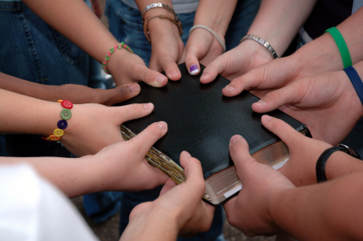
“On My Mind, In My Heart, In My Prayers” Text: Philippians 1:3-11
Notes:
By Nathan L Morrison for Sunday December 3, 2023
All Scripture given is from NASB unless otherwise stated
For further study, or if questions, please Call: 804-277-1983 or Visit www.courthousechurchofchrist.com

Slide 2
Intro
Fellowship: “Koinos” (G2839) is “sharing something with someone, a partner, companion, partaker”
Luke 5:10: James and John were “partners” with Peter (G2844 koinonos)
I John 1:3: We are enabled to enjoy “fellowship” (G2842 koinōnia) with the Apostles, God and Christ through the Gospel (I Cor. 10:16)
I John 1:6-7: Through the blood of Christ and walking in His light, we have fellowship with God and with one another (G2842)

Slide 3
Intro
Fellowship:
The word for fellowship definitely means something far deeper than sharing a meal, coffee, pie, or a golf game, etc.!
While we “share” or “partake” together in those activities, the fellowship with God, the apostles, and with each other is from the sharing and partnering in the gospel & in the blood of Jesus Christ – I John 1:3-7.
It is possible to be physically close but miles apart spiritually.
It is possible to be close spiritually but miles apart physically.
The source of true joy in fellowship is Jesus Christ!

Slide 4
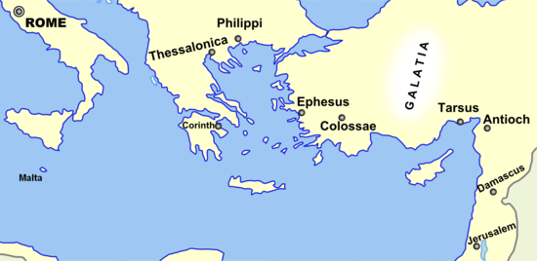
Intro
Fellowship produces joy – Philippians 1:3-11:
Paul is in Rome, miles away from the brethren at Philippi (approx. 800 miles away!)
Epaphroditus brought Paul a gift from the Philippian brethren – 4:18
He got sick and nearly died, but when he was better he takes Paul’s letter to the Philippians (along with Timothy) – 2:19-30
Paul’s imprisonment for the cause of Christ is well known by the Praetorian Guard and everyone else – 1:12-14
Paul sends greetings from saints in Caesar’s household – 4:22
Though miles away, Paul says his fellowship through the gospel with the saints at Philippi brought him joy! – Phil. 1:3-11
Despite the miles apart, Paul says the saints at Philippi are “On My Mind, In My Heart, & In My Prayers!”
Notes:
Distance from Rome to Philippi: (https://www.distancebetweencities.net/rome_italy_and_macedonia_kavala-prefecture_greece/)

Slide 5
I Have You On My Mind
Philippians 1:3-5
3. I thank my God in all my remembrance of you,
4. always offering prayer with joy in my every prayer for you all,
5. in view of your participation in the gospel from the first day until now.
Philippians 1:3-5

Slide 6
I Have You On My Mind
He tells them every recollection of them brings him joy!
Their “participation in the gospel from the first day till now” points to Acts 16 when he 1st came to Philippi.
It is fun to imagine that Lydia (Acts 16:12-15, 40) and the Jailer (Acts 16:23-40) might be in the assembly when this letter is read to all!
Paul had told the Thessalonian brethren how he “suffered” and was “mistreated” in Philippi (I Thess. 2:2)
Yet, here he says when he thinks of them, he has joyful thoughts!
As Paul awaited trial in Rome he wasn’t thinking of himself but of the saints in Philippi!

Slide 7
Application!
I Have You On mY Mind
Am I the kind of Christian that brings joy to other Christians when they think of me?

Slide 8
I Have You In My Heart
Philippians 1:6-7
6. For I am confident of this very thing, that He who began a good work in you will perfect it until the day of Christ Jesus.
7. For it is only right for me to feel this way about you all, because I have you in my heart, since both in my imprisonment and in the defense and confirmation of the gospel, you all are partakers of grace with me.
Philippians 1:6-7

Slide 9
I Have You In My Heart
It is possible to think of people (have them on your mind) but not have them in your heart
Their love for Paul is evidenced in their standing with him when he preached and when he was imprisoned – They supported him and continued to do so (Phil. 4:15-18).
Paul considered his imprisoned circumstances an opportunity for preaching the gospel – Phil. 1:12-14: He said others were emboldened to preach the gospel without fear!
Their fellowship with Paul in the gospel has them on his mind & in his heart!

Slide 10
Application!
I Have You In mY Heart
Am I the kind of Christian others hold in their hearts and thank God for?

Slide 11
I Have You In My Prayers
Philippians 1:4, 9
4. always offering prayer with joy in my every prayer for you all,
9. And this I pray, that your love may abound still more and more in real knowledge and all discernment,
Philippians
1:4, 9

Slide 12
I Have You In My Prayers
Have abounding & discerning love (Phil. 1:9)
Approve excellent things (Phil. 1:10)
“Be sincere and blameless” (Phil. 1:10)
“Be filled with fruit” (Phil. 1:11)
Paul said they were on his mind, in his heart, and in his payers –
He prayed for them to…

Slide 13
Application!
I Have You In mY Prayers
Am I the kind of Christian others think about and pray for?

Slide 14
Conclusion
Do we think of others in the faith?
Do we hold others in our hearts enough to think about them?
Do we think about and love others enough to pray for them?
“I have you on my mind…in my heart…in my prayers”

Slide 15
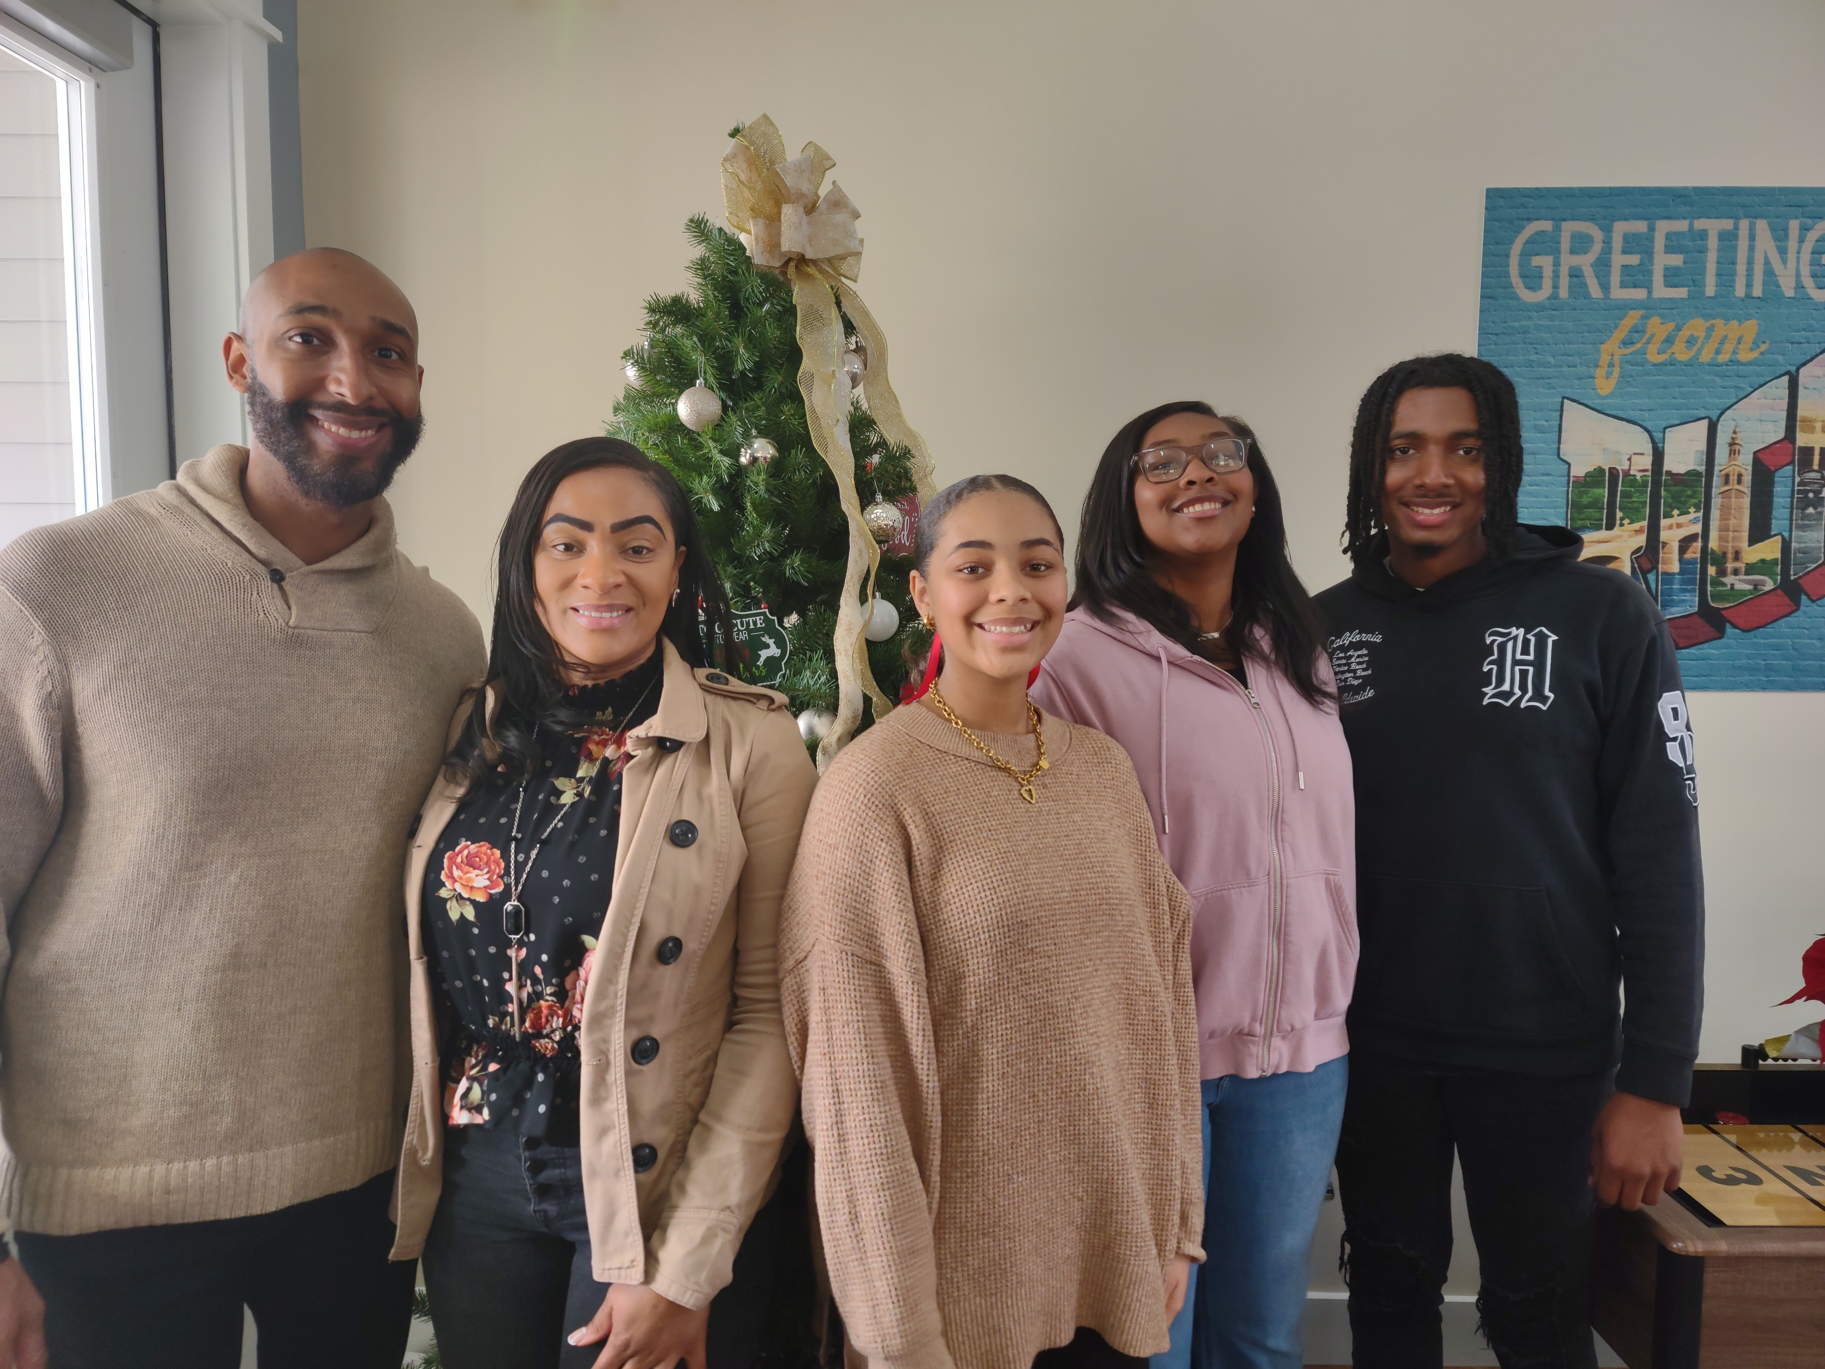
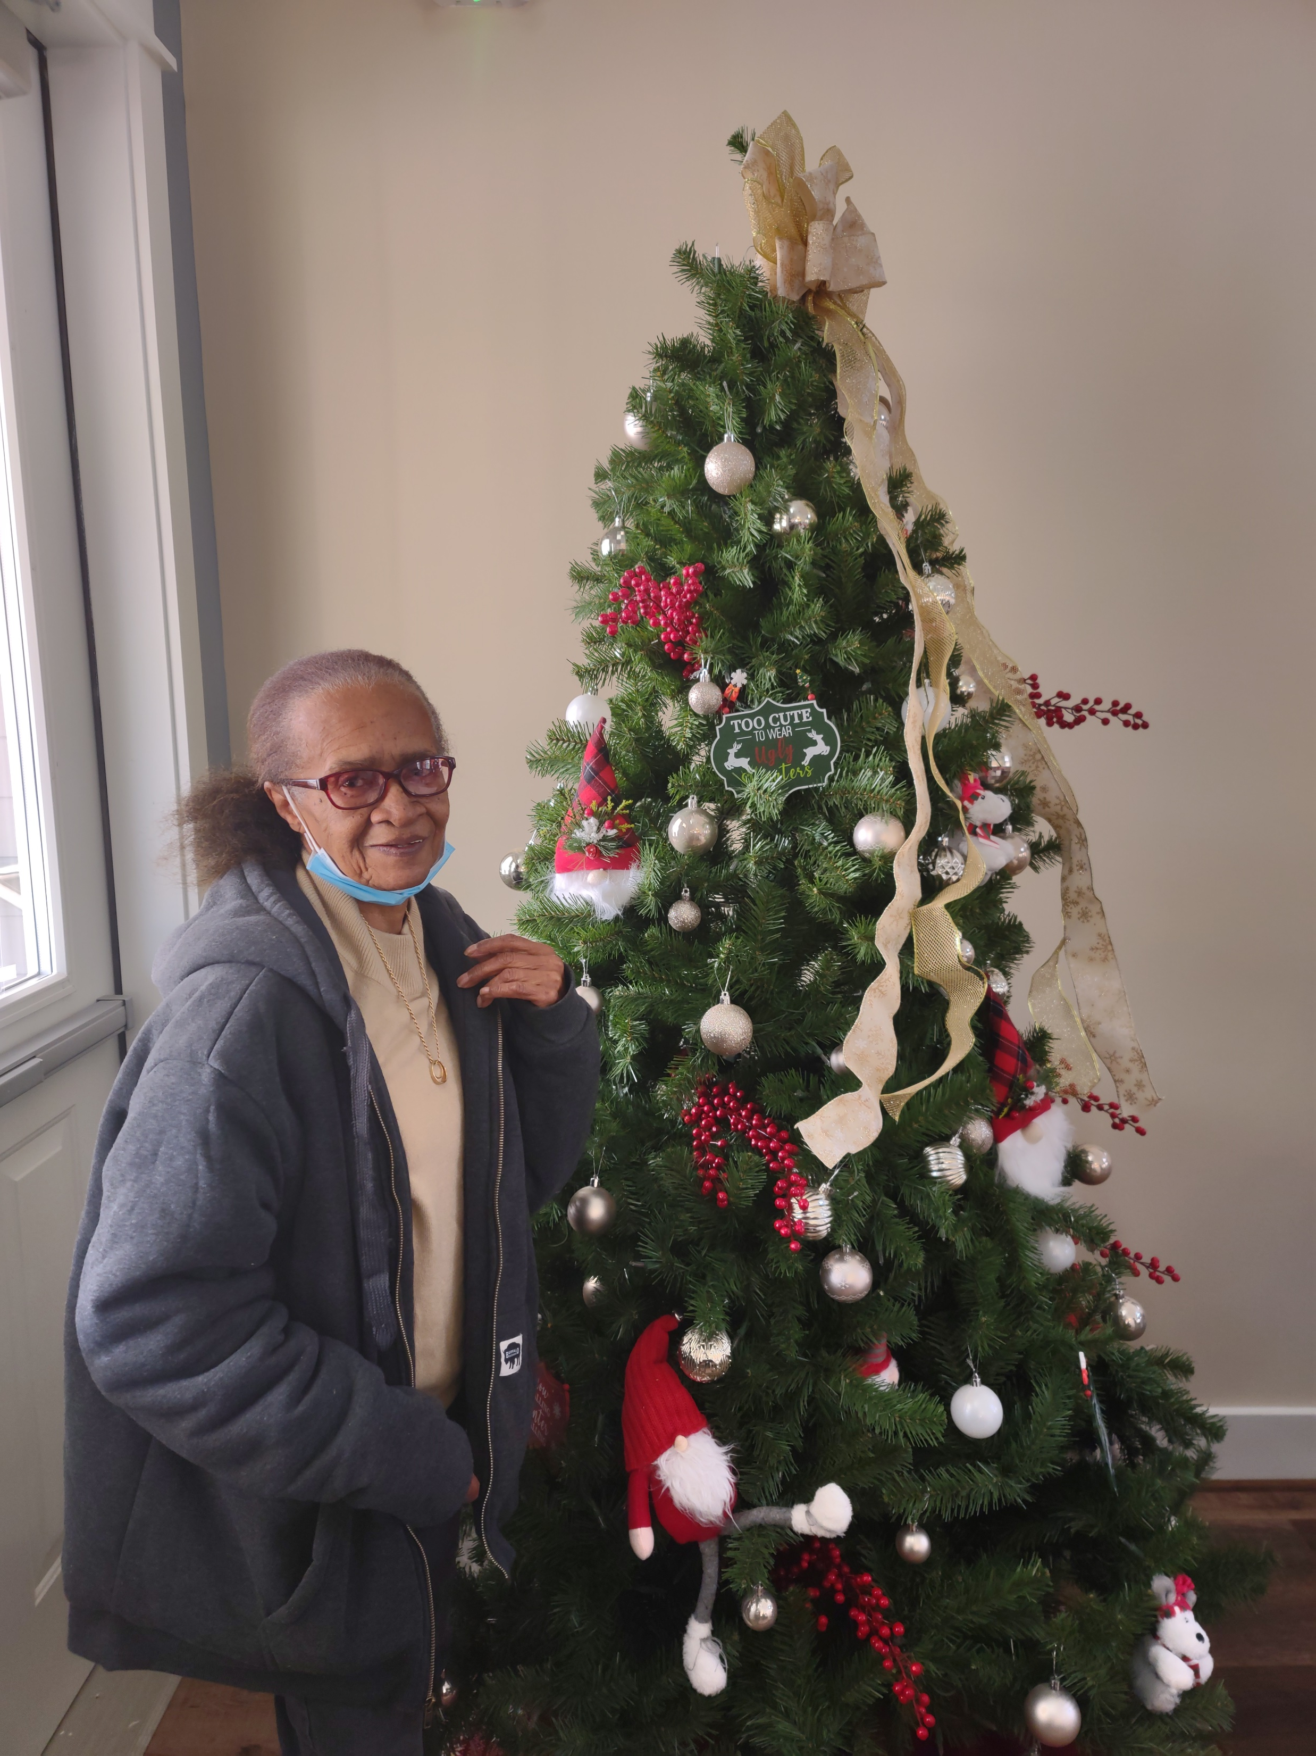
Conclusion
Sister Dorothy and the McClendon Family, you will be on our minds, in our hearts, and in our prayers!

Slide 16
Conclusion
III John 4
4. I have no greater joy than this, to hear of my children walking in the truth.
The fellowship we have with God, Jesus, the apostles, and with each other is the kind of fellowship that produces joy!
Let us pray for all the saints (Ephesians 6:18) and keep one another in our thoughts, hearts, and prayers!

Slide 17
“What Must I Do To Be Saved?”
Hear The Gospel (John 5:24; Romans 10:17)
Believe In Christ (John 3:16-18; John 8:24)
Repent Of Sins (Luke 13:3-5; Acts 2:38)
Confess Christ (Matthew 10:32; Romans 10:10)
Be Baptized (Mark 16:16; Acts 22:16)
Remain Faithful (John 8:31; Revelation 2:10)
For The Erring Saint:
Repent (Acts 8:22), Confess (I John 1:9),
Pray (Acts 8:22)

