Slide 1
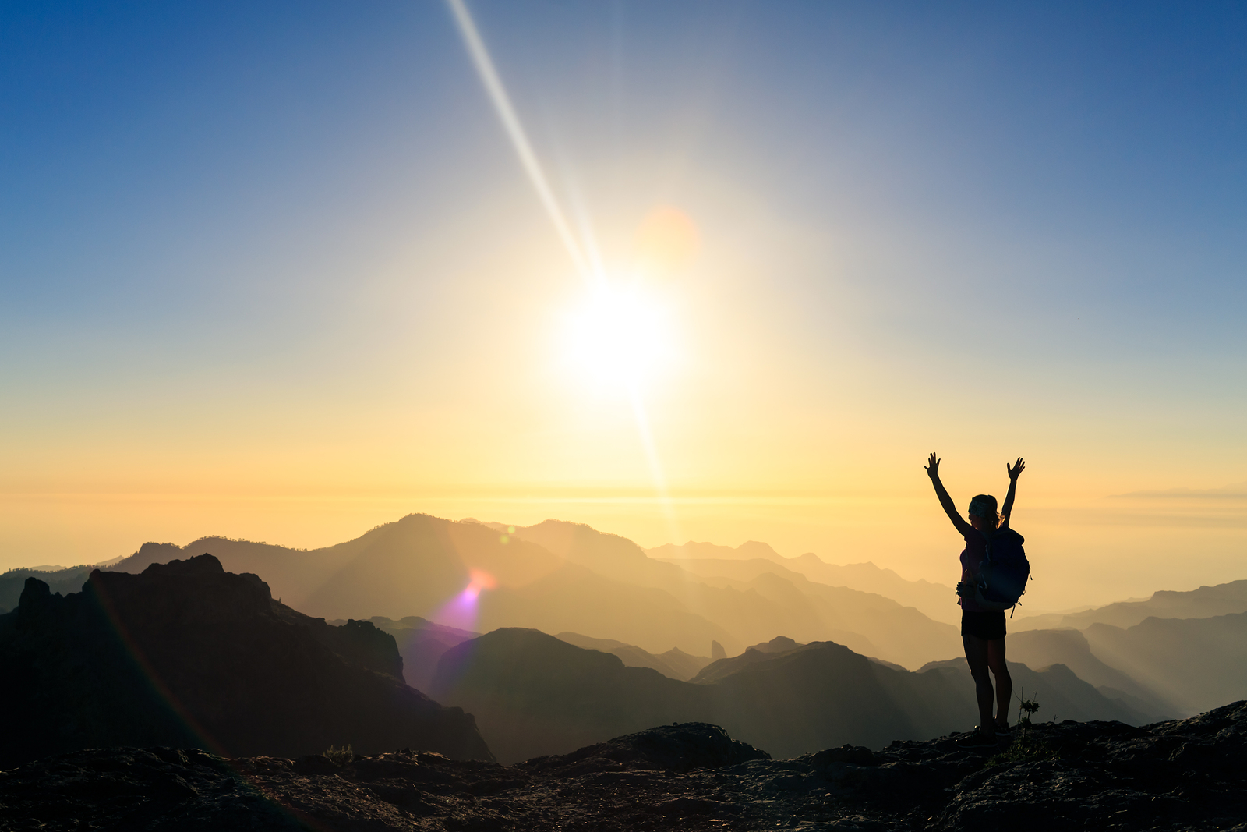
A Psalm For Thanksgiving
Text:
Psalm 100
Notes:
By Nathan L Morrison for Sunday November 12, 2023
All Scripture given is from NASB unless otherwise stated
For further study, or if questions, please Call: 804-277-1983 or Visit www.courthousechurchofchrist.com
Adapted from a lesson by Daniel Howell

Slide 2
Intro
Thanksgiving: A Time for giving thanks!
Ingratitude can be seen in the attitudes and actions of many people, and sometimes even Christians!
Christians are to make a habit of giving thanks for all things at all times! (Colossians 3:17)

Slide 3
Intro
Psalm 100
“A Psalm for Thanksgiving”
It is also affectionately known as "Old Hundredth," from its tune in the Geneva Psalter (1551)
Some have called this Psalm the “Pilgrims’ Psalm” because it was especially cherished by the Puritans who felt it was an appropriate description of their experiences in coming to the New World

Slide 4
Intro
Psalm 100
1. A Psalm for Thanksgiving. Shout joyfully to the LORD, all the earth.
2. Serve the LORD with gladness; Come before Him with joyful singing.
3. Know that the LORD Himself is God; It is He who has made us, and not we ourselves; We are His people and the sheep of His pasture.
4. Enter His gates with thanksgiving And His courts with praise. Give thanks to Him, bless His name.
5. For the LORD is good; His lovingkindness is everlasting And His faithfulness to all generations.

Slide 5
A CALL to Give Thanks (Psalm 100:1-2, 4)
“Shout joyfully to the LORD” (v. 1)
The Hebrew here literally means to “shout,” or practically speaking, to “sing loudly.”
“Shout…all the earth” (v. 1)
This is a reminder that ALL of the earth is subject to God.
Every knee should & will bow before him (Philippians 2:10)

Slide 6
A CALL to Give Thanks (Psalm 100:1-2, 4)
“Serve the Lord” (v. 2)
To worship is to show adoration. One Greek word translated in the New Testament as “worship” literally means “to prostrate oneself; to bow down before” (G4352 proskyneo [pros-koo-neh'-o] from John 4:23-24)
“Serve… with gladness” (v. 2)
Serving the Lord shouldn’t be seen as drudgery, but as a grand opportunity, with joy in your heart!

Slide 7
A CALL to Give Thanks (Psalm 100:1-2, 4)
“Come into His presence” (v. 2)
A picture of going to the Tabernacle or the Temple.
In David’s great psalm of repentance (Psalm 51) he begs God, “Cast me not away from your presence” (v. 11)
“Come… with singing” (v. 2)
Singing was done in Israel as part of worship.
It’s still a major part of our assembling together (Heb. 13:15)

Slide 8
A CALL to Give Thanks (Psalm 100:1-2, 4)
“Enter His gates…courts” (v. 4)
King Solomon recognized that no Tabernacle or Temple could hold God (I Kings 8:27).
Steven said, “The Most High does not dwell in houses made by hands” (Acts 7:48-49)
“Enter…with thanksgiving… praise” (v. 4)
We come into his presence with the only gift we truly have to offer God: our sacrifice of gratitude and praise (Psalm 50:10-15; 116:12)

Slide 9
A CALL to Give Thanks (Psalm 100:1-2, 4)
“Give thanks” (v. 4)
Sacrifices weren’t just made for sin.
Some were made as free-will offerings, possibly of gratitude to the Lord (Ezra 3:5).
That’s also our purpose in our worship
“Give… bless His name” (v. 4)
Just as God has blessed us, we are called to “bless” Him

Slide 10
A CALL to Give Thanks (Psalm 100:1-2, 4)
Colossians 3:17
Whatever you do in word or deed, do all in the name of the Lord Jesus, giving thanks through Him to God the Father

Slide 11
A CALL to Give Thanks (Psalm 100:1-2, 4)
We’ve seen God’s love, mercy, kindness, compassion, and grace expressed in a way the writer of this psalm had never seen! “Behold, the Lamb of God who takes away the sin of the world!” (John 1:29)
Our hearts are to be filled with thanksgiving to God through Jesus and should be heard and seen in our words and actions!
(Colossians 3:17)

Slide 12
A CAUSE to Give Thanks (Psalm 100:3, 5)
He is our Creator (v. 3)
Since He created us, we belong to Him.
We are His possession, in a special way in Christ (I Peter 2:9)
He is our Shepherd (v. 3)
Jesus is our Good Shepherd (John 10:11), our guide, our protector, our provider.
We are His sheep (John 10:11-18, 26-30: We know His voice)

Slide 13
A CAUSE to Give Thanks (Psalm 100:3, 5)
He is Good (v. 5)
The Hebrew word here refers to something that is desirable, beautiful, or pleasing.
David wrote in Psalm 34:8, “O taste and see that the LORD is good; How blessed is the man who takes refuge in Him!”
He is Loving (v. 5)
The Hebrew term here (H2617 chêsêd [kheh'-sed]) could be thought of as the Old Testament counterpart to the New Testament’s “agape” love (G26)

Slide 14
A CAUSE to Give Thanks (Psalm 100:3, 5)
He is Faithful (v. 5)
God is honest, steadfast, trustworthy.
God is a God of integrity, of consistency.
He keeps His promises.
He who calls us is faithful, as Paul wrote in I Thessalonians 5:24.
God never lies, as Paul also wrote in Titus 1:2.
God’s truth endures. His promises never fail. Never.

Slide 15
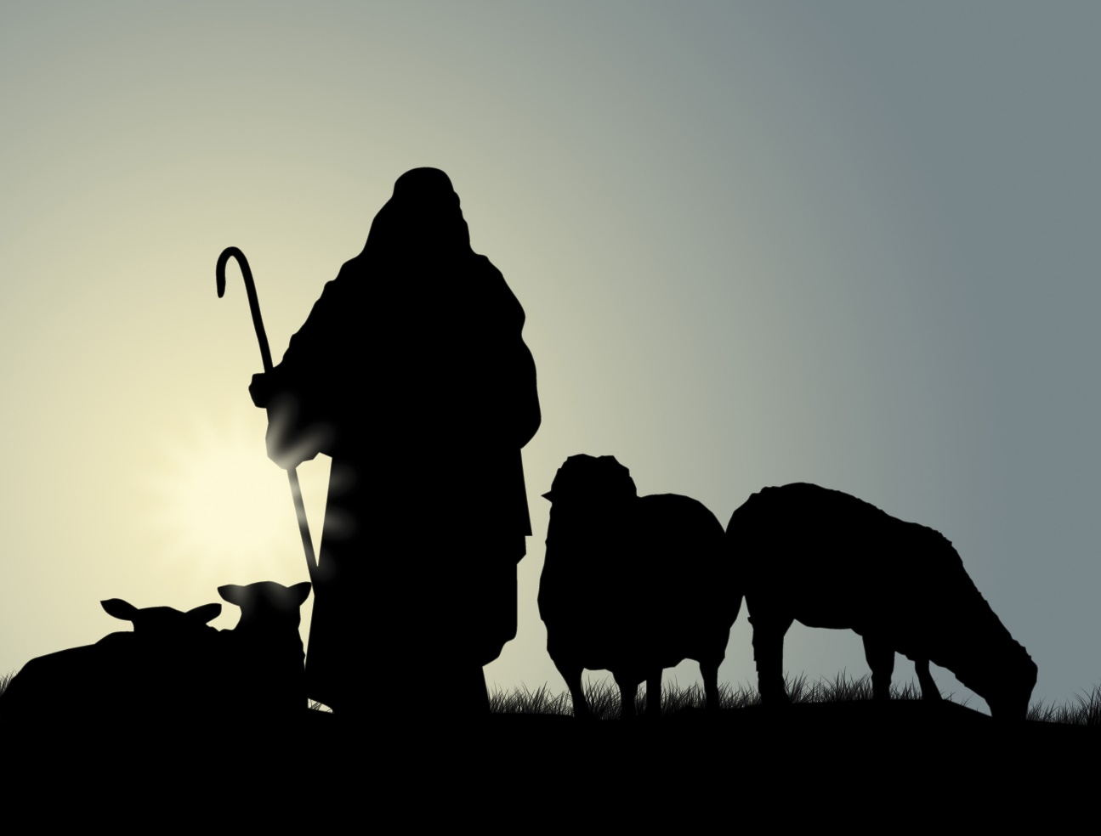
A CAUSE to Give Thanks (Psalm 100:3, 5)
We serve an Awesome God, a God who is Loving & Faithful, our Creator and Good Shepherd, Who laid down His life for His sheep that we might be washed from our sins and one day enter into His eternal rest and be with Him forever!

Slide 16
Conclusion
It’s all these attributes combined that call us to praise Him, to give thanks to Him, to worship Him
No one else has the power to give and sustain life.
No one else guides, protects, and cares for us like God does.
No one else is as glorious and completely beautiful as God.
No one loves with the same loyal, eternal love as God has.
No one else keeps their promises as God keeps His.
There is no one like the Lord!

Slide 17
Conclusion
So…
Shout joyfully to Him!
Serve Him with gladness in your heart.
Come into His presence with singing from your heart!
Enter His gates with thanksgiving! Because he is our creator, sustainer, and guide.
We are His people, for His own possession, to do His will.

Slide 18
Conclusion
All people that on earth do dwell,
Sing to the Lord with cheerful voice;
Him serve with mirth, His praise forth tell!
Come ye before Him and rejoice.
Know that the Lord is God indeed;
Without our aid He did us make;
We are His flock, He doth us feed,
And for His sheep, He doth us take.
Oh, enter then His gates with praise
Approach with joy His courts unto;
Praise, laud, and bless His name always,
For it is seemly so to do.
For why? the Lord our God is good,
His mercy is forever sure;
His truth at all times firmly stood,
And shall from age to age endure
The Scottish Psalter as it appeared in the Geneva Psalter (1551)

Slide 19
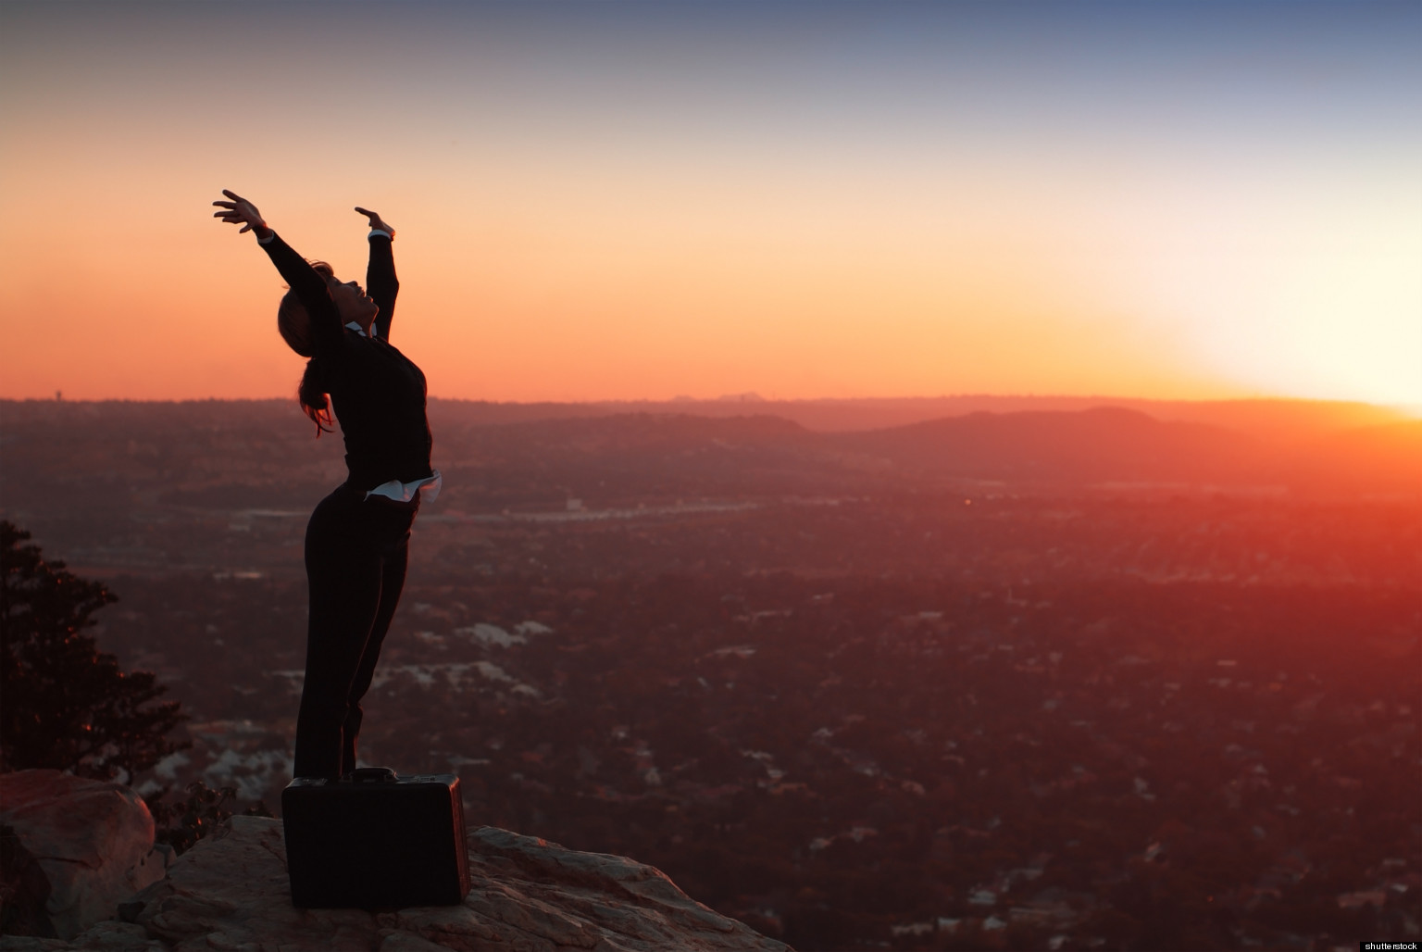
Conclusion
“But you are A CHOSEN RACE, A royal PRIESTHOOD, A HOLY NATION, A PEOPLE FOR God's OWN POSSESSION, so that you may proclaim the excellencies of Him who has called you out of darkness into His marvelous light” (I Peter 2:9)
Anyone and everyone should be thankful to God for their existence, and God’s providing care
Only those who are His children can proclaim His excellencies to the world around them!

Slide 20
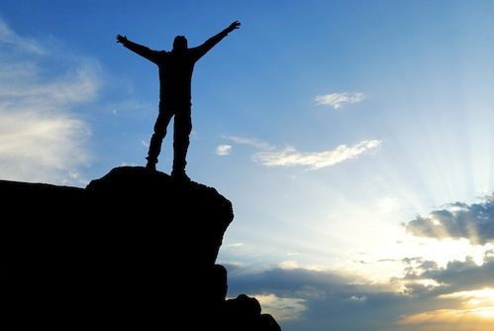
Conclusion
Only those who have come out of darkness and into light by obeying the gospel can truly, and fully give thanks to God -- Can you?

Slide 21
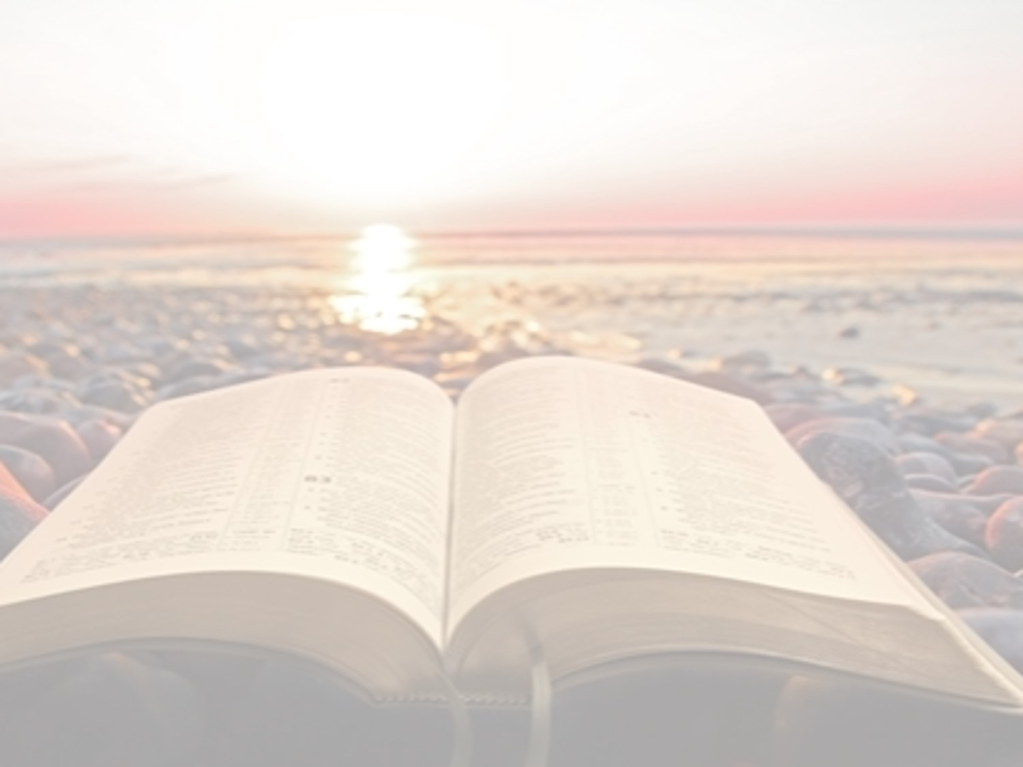
“What Must I Do To Be Saved?”
Hear The Gospel (John 5:24; Romans 10:17)
Believe In Christ (John 3:16-18; John 8:24)
Repent Of Sins (Luke 13:3-5; Acts 2:38)
Confess Christ (Matthew 10:32; Romans 10:10)
Be Baptized (Mark 16:16; Acts 22:16)
Remain Faithful (John 8:31; Revelation 2:10)
For The Erring Saint:
Repent (Acts 8:22), Confess (I John 1:9),
Pray (Acts 8:22)

