Slide 1
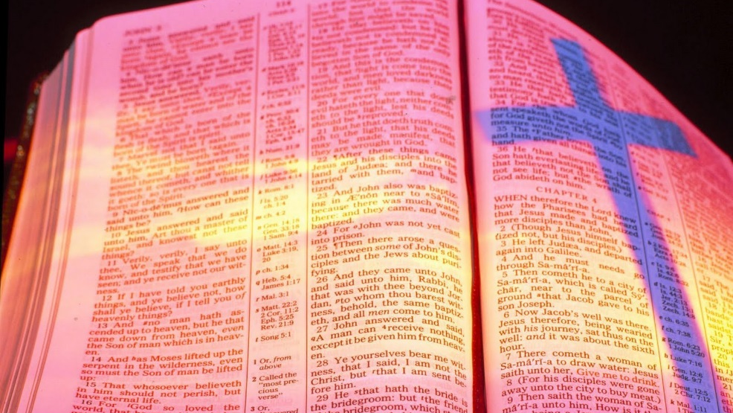
Lives Of Faith, Love & Hope
Text: Colossians 1:3-8
Notes:
By Nathan L Morrison for Sunday October 29, 2023
All Scripture given is from NASB unless otherwise stated
For further study or if questions, Call: 804-277-1983, or Visit: www.courthousechurchofchrist.com

Slide 2
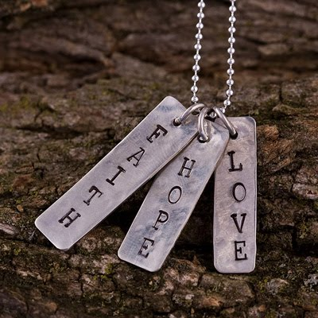
Intro
I Corinthians 13:13 (I Corinthians 15:58; Heb. 10:32-39)
But now faith, hope, love, abide these three; but the greatest of these is love.
The saints at Colossae were a great example of this!

Slide 3
Intro
Colossians 1:3-8 (vss. 3-5)
3. We give thanks to God, the Father of our Lord Jesus Christ, praying always for you,
4. since we heard of your faith in Christ Jesus and the love which you have for all the saints;
5. because of the hope laid up for you in heaven, of which you previously heard in the word of truth, the gospel

Slide 4
Intro
Colossians 1:3-8 (vss. 6-8)
6. which has come to you, just as in all the world also it is constantly bearing fruit and increasing, even as it has been doing in you also since the day you heard of it and understood the grace of God in truth;
7. just as you learned it from Epaphras, our beloved fellow bond-servant, who is a faithful servant of Christ on our behalf,
8. and he also informed us of your love in the Spirit.

Slide 5
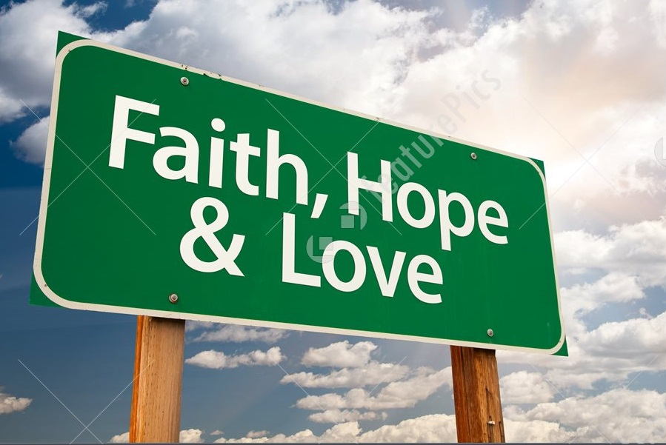
Intro
The gospel was effective in their faith, their love, and their hope! (I Corinthians 13:13)
Being steadfast in faith, love, and hope we proclaim the gospel as effective in our lives!

Slide 6
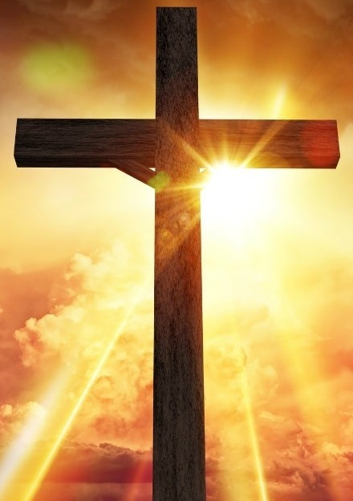
Faith
Colossians 1:4
(I Peter 1:6-9)
…since we heard of your faith in Christ Jesus and the love which you have for all the saints;
“Obtaining as the outcome of your faith the salvation of your souls.” (I Peter 1:9)
Lives Of Faith, Love & Hope
Notes:
Emphasis in Scripture Mine!

Slide 7
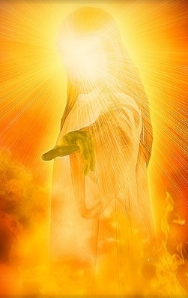
Faith
The gospel leads to faith in Christ – Nature of Christ (Colossians 1:13-18)
He has a kingdom – 1:13 (King – John 18:37)
He is the Son of God – 1:13
He is the Redeemer – 1:14
He is the One in whom we have forgiveness of sins – 1:14
He is the image of God the Father – 1:15
He is the Creator – 1:16
He is the Head of the church – 1:18
He is risen from the dead – 1:18
The gospel will produce faith in Christ that leads to obedience (Colossians 1:5; Mark 16:15-16).
The gospel will produce saving faith (I Peter 1:6-9: The result of faith: “the salvation of your souls!”)

Slide 8
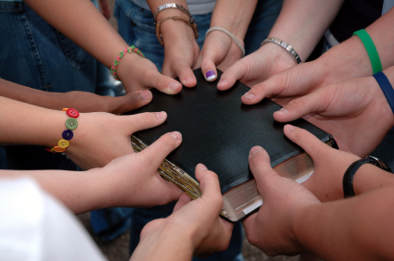
Application!
Faith
Us – How will we be known for our faith?
There are many among us who are great examples of faith!
Notes:
E. Application: Us – How will we be known for our faith?
1. Reuben: Faced a chronic illness and an organ transplant with the kind of faith I want to emulate should I ever face that possibility!
a. Reuben says the faith he had before the transplant doesn’t compare to the faith he has now: It is stronger now!
b. He says it was truly refined by fire (I Peter 1:6-7). There was testing and refining but going through the fire took his faith to new heights.
c. I and many others here have Type 2 Diabetes and could face that possibility.
2. There are many who have struggled with chronic illness and maintained their faith in God!
a. There are many cancer survivors with us and their faith encourages us!
3. There are many who have gone through the trial of losing a loved one and maintained their faith.
4. There are many among us who are great examples of faith!

Slide 9
Faith
The gospel has given us faith in Christ that will lead to the salvation of our souls!
“Obtaining as the outcome of your faith the salvation of your souls.” (I Peter 1:9)

Slide 10
Love for Brethren
Colossians 1:4
(John 15:12)
…since we heard of your faith in Christ Jesus and the love which you have for all the saints;
“This is My commandment, that you love one another, just as I have loved you.” (John 15:12)
Lives Of Faith, Love & Hope
Notes:
Emphasis in Scripture Mine!

Slide 11
Love for Brethren
I Corinthians 13:4-7
Love = agape (G26): Love seeks the welfare of all (Vine)
Colossians 3:12-14: Saints put on “Love” & Forgiveness!

Slide 12
Love for Brethren
Faith in Christ and love for the Brethren go hand-in-hand:
John 13:34-35: Jesus said the world would know His disciples by the way they loved one another (John 15:12).
Paul heard of their love – Colossians 1:4, 7-8
I John 4:7-8, 11-12, 20-21: Cannot love God and not love our brethren.
I Peter 1:22: Saints after obedience to the gospel are to “fervently love one another from the heart” (III John 5-8)
“This is My commandment, that you love one another, just as I have loved you.” (John 15:12)

Slide 13
Application!
Love for Brethren
Us – How will we be known for our love of the brethren?
There are many here who demonstrate their love for the brethren!
Notes:
Application: Us – How will be known for our love of the brethren?
Richard & Cindy Foy: We were strangers when we moved here 6 years ago from Alaska and the Foy’s took us in and let us live in their upstairs and placed our pets (at the time: a dog and 3 cats) in Cindy’s garage.
In similar situations we have seen an arrangement like that go south!
But the Foy’s made us feel like family and provided a home for us until the sale of our house in Alaska. They called us their “Upstairs Family.”
We lived with them for over 5 months and we only grew closer.
When we left there were tears all around. For a while after we moved into a house of our own, the often still called us their “Upstairs Family.”
There are many here who demonstrate their love for the brethren!
Love requires one to “put on a heart of compassion, kindness, humility, gentleness and patience…love” (Colossians 3:12-14).

Slide 14
Application!
Love for Brethren
Us – How will we be known for our forgiving others as Jesus forgave us?
There are many here have had to forgive out of great loss and pain!
Notes:
Application: Us – How will we be known for our forgiving others as Jesus forgave us?
Zuberi Mwakyami: A great example of forgiveness!
On the way to the river to baptize his son Ambwene, we ran into the man who tried to rape his then-3-year old daughter Abigail (now 4 years old) last year. The man was 68 at the time and Zuberi didn’t want him to die in prison so he and his family chose to forgive the man!
Zuberi greeted him but the man ignored us. Zuberi said the man has ignored him ever since!
That is truly forgiving as Christ forgave! (Colossians 3:13)
I know there are many here who have had to forgive out of great loss and pain.
Jesus says when we forgive others from our heart we will be forgiven (Matthew 18:35; Ephesians 4:32)

Slide 15
Love for Brethren
The Colossian brethren were great examples of
faith and love!
May we ever be known for our love for “all the saints!” & forgive others from our hearts!

Slide 16
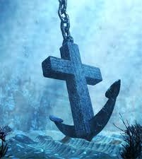
Hope of Heaven
Colossians 1:5
(Hebrews 6:18-20)
because of the hope laid up for you in heaven, of which you previously heard in the word of truth, the gospel
“This hope we have as an anchor of the soul, a hope both sure and steadfast…” (Hebrews 6:19)
Notes:
Emphasis in Scripture Mine!

Slide 17
Hope of Heaven
Heaven identified:
Colossians 3:1-3: Where Christ is (John 14:2-3)
I Peter 1:3-4: “Reserved in heaven for you.”
Hebrews 6:18-20: This hope is an anchor for the soul, sure and steadfast!
“This hope we have as an anchor of the soul, a hope both sure and steadfast…” (Hebrews 6:19)

Slide 18
Application!
Hope of Heaven
Us – How will we be known for our hope of Heaven?
There are many here who have lost loved ones or came close to death’s door themselves and are great examples of hope!
Notes:
Application: Us – How will we be known for our hope of Heaven?
Lori & Norma: Both of these dear sisters faced the possibility of death and their imminent departure with unwavering hope!
They both spoke of “going home” to “be with the Lord.”
It is not a morbid thought but a glorious one, to face the inevitable outcome of life with the hope the gospel gives: to see Jesus and be with Him forever!
There are many here who have lost loved ones or came close to death’s door themselves and are great examples of hope!

Slide 19
Hope of Heaven
In the gospel we have the hope of an eternal home in Heaven with God!
“This hope we have as an anchor of the soul, a hope both sure and steadfast…” (Hebrews 6:19)

Slide 20
Conclusion
Paul knew these brethren just as we know one another and can think of personal examples of each member here giving us strength to face our own trials because of their faith, love and hope!
The pure gospel affects our lives:
Obedience to the truth (Colossians 1:5-6; Mk. 16:16)
Faith in Christ (Colossians 1:4)
Love for brethren (Colossians 1:4)
Hope of Heaven (Colossians 1:5)
We need to be teaching it so that it can spread
throughout all the world (Colossians 1:6)!

Slide 21
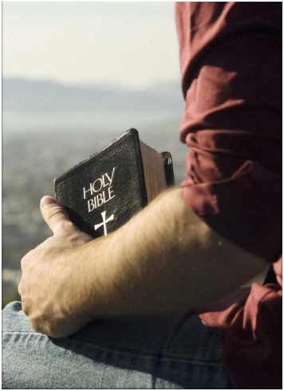
Conclusion
Despite the problems the church at Colossae faced, the members were strong in the faith:
Colossians 2:5-7: Theirs was a stable and established faith.
Paul had heard of their faith & love!
We must make sure the gospel has taken hold of our lives so that we are living proof of it!

Slide 22
Conclusion
Let us proclaim the gospel in the way we live our
lives and be examples of faith, love & hope!

Slide 23
“What Must I Do To Be Saved?”
Hear The Gospel (John 5:24; Romans 10:17)
Believe In Christ (John 3:16-18; John 8:24)
Repent Of Sins (Luke 13:3-5; Acts 2:38)
Confess Christ (Matthew 10:32; Romans 10:10)
Be Baptized (Mark 16:16; Acts 22:16)
Remain Faithful (John 8:31; Revelation 2:10)
For The Erring Saint:
Repent (Acts 8:22), Confess (I John 1:9),
Pray (Acts 8:22)

