Slide 1
Glorifying God Through Social Media Text: Matthew 28:18-20
Notes:
Prepared by Nathan L Morrison for Sunday August 6, 2023
All Scripture given is from NASU unless otherwise stated
For further study, or if questions, please Call: 804-277-1983 or Visit www.courthousechurchofchrist.com
The logo art was used by permission by www.vecteezy.com

Slide 2
Intro
Social Media: We are all too familiar with the dangers and consequences
Social Media is a tool and a tool used for the right reason and function can also be awesome!
We can use social media to glorify God!

Slide 3
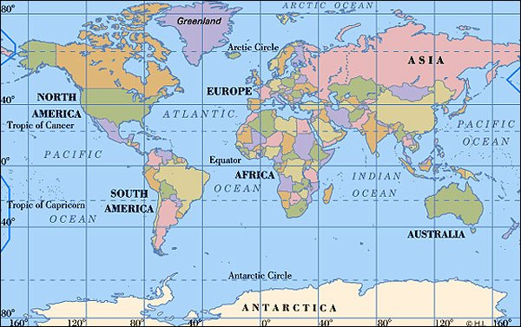
Intro
Jesus told His apostles, “Go” & “Teach”
Matthew 28:18-20
18. And Jesus came up and spoke to them, saying, "All authority has been given to Me in heaven and on earth.
19. "Go therefore and make disciples of all the nations, baptizing them in the name of the Father and the Son and the Holy Spirit,
20. teaching them to observe all that I commanded you; and lo, I am with you always, even to the end of the age."

Slide 4
Intro
Jesus’ “Mission Statement”
Luke 19:10
"For the Son of Man has come to seek and to save that which was lost."

Slide 5
Intro
Even though saints today do not live in the 1st century, we are also to “Go” and “Teach”
II Timothy 2:2: Teach faithful “men” (mankind)
II Timothy 2:24-26: “Able to teach” (skilled)
I Peter 3:15: “Be ready always”
Paul says all saints are to be “able to teach” and Peter says all saints are “always” to be ready to give a defense (that is an answer) for the hope within us.
While not all saints have the ability to or should publicly teach (James 3:1), all saints can teach through their influence and example.
Social Media is a great tool for such a thing!

Slide 6
Intro
“Go” and “Teach” was not just to the 1st century saints but that we have a charge still today in the 21st century to teach the gospel and bring mankind closer to God!

Slide 7
Evangelism in the 21st Century
“Go”
Walking
Ride/Drive: Various means
Water Travel
Air Travel (Fly)
Phones
Internet
“Teach”
Preaching and teaching: Various ways
Letters
Visual Aides/props
Debates and gospel meetings
Print (Publications)
Internet
Modern day saints are without excuse if they are not
utilizing these tools in evangelism to “Go” and “Teach!”

Slide 8
Glorifying God Through Social Media
While social media can be a tool for both good and evil, it is our responsibility to ensure that we use it as a means to glorify our Heavenly Father!
Exemplifying Christ-like Character
Matthew 5:16; Philippians 2:15
Teaching the Gospel
Mark 16:15-16; Ephesians 4:15
Practicing Discernment and Wisdom
Proverbs 4:23; Philippians 4:8

Slide 9
Glorifying God Through Social Media
Practicing Discernment and Wisdom
Pray before you post
Ephesians 6:18-20
Encourage others
I Thessalonians 5:11
Remember who is watching you on social media
Matthew 5:16
Use social media as an opportunity to demonstrate the fruit of the Spirit
Galatians 5:22-23
Respond with a gentle spirit
Colossians 3:12-15

Slide 10
Glorifying God Through Social Media
Let us not become apathetic to our teaching the gospel, but use the technology at hand to “Go” and “Teach” the lost of the world!

Slide 11
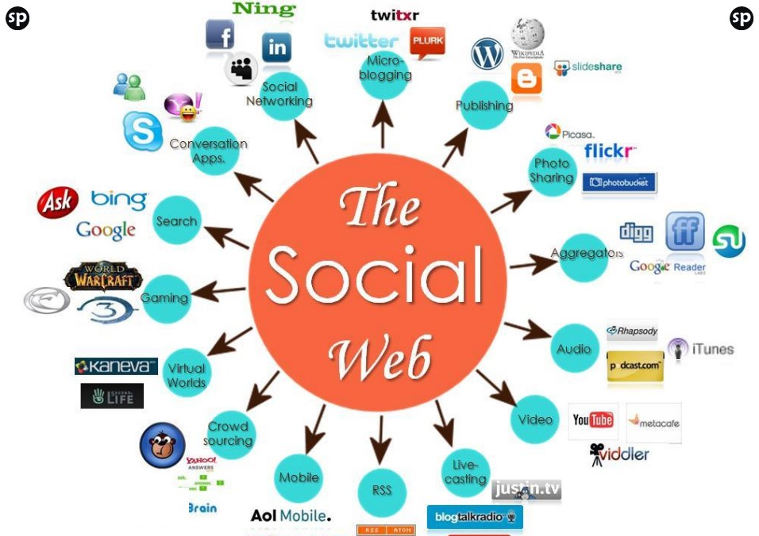
Further Ways to Use Social Media to Glorify God

Slide 12
Further Ways to Use Social Media to Glorify God
Give Service Times And Information

Slide 13
Further Ways to Use Social Media to Glorify God
Give A Preview Of What To Expect At Your Congregation

Slide 14
Further Ways to Use Social Media to Glorify God
Quote Worship Lyrics From A Song You Sing

Slide 15
Further Ways to Use Social Media to Glorify God
Share A Link To Your Live Stream

Slide 16
Further Ways to Use Social Media to Glorify God
Share A Clip From Sunday’s Message

Slide 17
Further Ways to Use Social Media to Glorify God
Share A Quote From A Recent Message

Slide 18
Further Ways to Use Social Media to Glorify God
Recap Exciting Moments From Sunday

Slide 19
Further Ways to Use Social Media to Glorify God
Express Gratitude For Answered Prayers and for Teachers

Slide 20
Further Ways to Use Social Media to Glorify God
Quote A Meaningful Bible Verse

Slide 21
Further Ways to Use Social Media to Glorify God
Promote Events And Classes

Slide 22
Further Ways to Use Social Media to Glorify God
Share Articles or Podcasts

Slide 23
Conclusion
In all things that we do, remember who we are and Who we represent!
Our purpose remains the same as it was in the 1st century: to glorify God in all that we do. To teach and save the lost!
Social media can be a powerful tool when used with wisdom, intentionality, and a desire to honor our Heavenly Father

Slide 24
Conclusion
By exemplifying Christ-like character, teaching the Gospel, and practicing discernment, we can transform these virtual spaces into avenues of God's grace, love, and truth
Commit yourselves to use social media as a means of spreading the light of Christ and bringing glory to His holy name

Slide 25
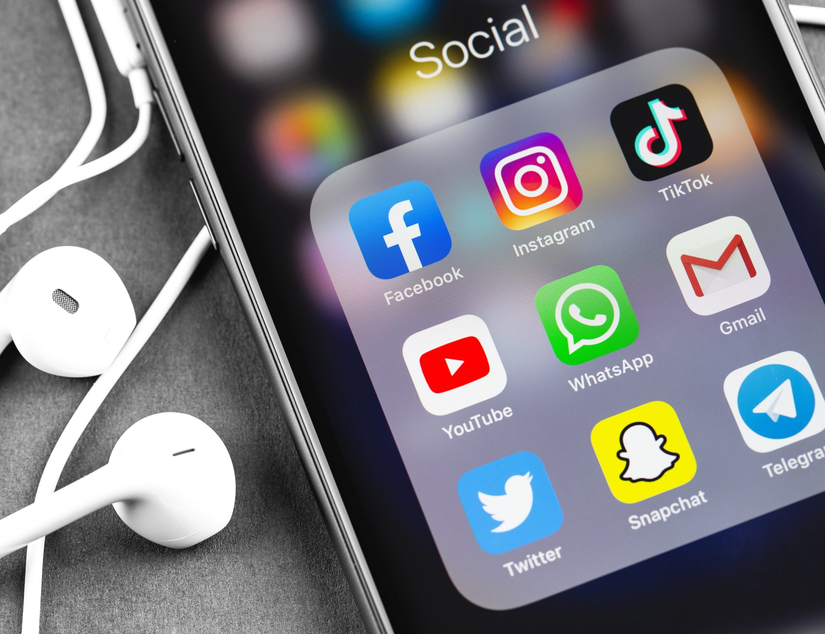
Conclusion
Colossians 3:17
"Whatever you do in word or deed, do all in the name of the Lord Jesus, giving thanks through Him to God the Father."

Slide 26
Conclusion
Know the dangers and be aware of the consequences of using social media in an ungodly way, and let us choose instead to use this great tool and resource to reach out to the whole world and glorify God!

Slide 27
“What Must I Do To Be Saved?”
Hear The Gospel (Jn. 5:24; Rom. 10:17)
Believe In Christ (Jn. 3:16-18; Jn. 8:24)
Repent Of Sins (Lk. 13:3-5; Acts 2:38)
Confess Christ (Mt. 10:32; Rom. 10:10)
Be Baptized (Mk. 16:16; Acts 22:16)
Remain Faithful (Jn. 8:31; Rev. 2:10)
For The Erring Saint:
Repent (Acts 8:22), Confess (I Jn. 1:9),
Pray (Acts 8:22)

