Slide 1
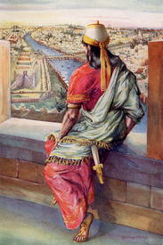
David's 2nd Look Text: II Samuel 11
Notes:
Prepared by Nathan L Morrison for Sunday July 9, 2023
All Scripture given is from NASU unless otherwise stated
For further study, or if questions, please Call: 804-277-1983 or Visit www.courthousechurchofchrist.com

Slide 2
Intro
II Samuel 11 records one of the most infamous accounts in Old Testament history: The lowest point in King David’s life
David’s army at war. He is at home in Jerusalem
Walk on roof top at night
Sees beautiful woman bathing
Inquires about her
She is Bathsheba, wife of Uriah the Hittite, daughter of Eliam, and also granddaughter of Ahithophel the Gilonite
Notes:
Image: David and Bathsheba (1951) with Gregory Peck and Susan Hayward
Intro
II Samuel 11 records one of the most infamous accounts in Old Testament history: The lowest point in King David’s life.
David’s army is out battling the sons of Ammon and besieged Rabbah because…Spring Time! But David stays in Jerusalem.
He has trouble sleeping one night and walks along his roof (innocently) and then sees a beautiful woman bathing.
He didn’t avert his eyes: he took a 2nd look, which led to him inquiring about her.
He finds out she is Bathsheba, the daughter of Eliam, one of his mighty men (II Samuel 11:3; 23:34), which makes her the granddaughter of Ahithophel the Gilonite, the king’s counselor (I Chronicles 27:33) and the wife of Uriah the Hittite, one of his mighty men (II Samuel 23:39).
He took a 3rd look and asked her to be brought to him. It didn’t even matter if she was married or not because David was married!
He committed adultery with her (II Samuel 11:4)
By the end of the chapter we find out Bathsheba is pregnant, he tries to cover up his sin and ends up murdering her husband Uriah the Hittite, marries her and she bears him a son, and David thinks he has gotten away with it all.
It all comes to light in II Samuel 12. David admits sin and is forgiven but has judgment pronounced upon him and the consequences start with the death of his child with Bathsheba.
While David did it in secret and tried to cover up his murder of Uriah the Hittite (II Samuel 12:9-12), God doesn’t allow the record to forget Uriah but says his name 27 times, including in the genealogy of Jesus in Matthew 1:6.

Slide 3
Intro
II Samuel 11 records one of the most infamous accounts in Old Testament history: The lowest point in King David’s life
He sends for her!
He committed adultery with her (II Samuel 11:4), which could also qualify as rape.
By the end of II Samuel 11: Adultery, pregnancy, murder, marriage, birth!
It all comes to light in II Samuel 12.
God doesn’t let the record forget Uriah the Hittite (see Matthew 1:6)
Notes:
Image: David and Bathsheba (1951) with Gregory Peck and Susan Hayward
Intro
II Samuel 11 records one of the most infamous accounts in Old Testament history: The lowest point in King David’s life.
David’s army is out battling the sons of Ammon and besieged Rabbah because…Spring Time! But David stays in Jerusalem.
He has trouble sleeping one night and walks along his roof (innocently) and then sees a beautiful woman bathing.
He didn’t avert his eyes: he took a 2nd look, which led to him inquiring about her.
He finds out she is Bathsheba, the daughter of Eliam, one of his mighty men (II Samuel 11:3; 23:34), which makes her the granddaughter of Ahithophel, the king’s counselor (I Chronicles 27:33) and the wife of Uriah the Hittite, one of his mighty men (II Samuel 23:39).
He took a 3rd look and asked her to be brought to him. It didn’t even matter if she was married or not because David was married!
He committed adultery with her (II Samuel 11:4)
By the end of the chapter we find out Bathsheba is pregnant, he tries to cover up his sin and ends up murdering her husband Uriah the Hittite, marries her and she bears him a son, and David thinks he has gotten away with it all.
It all comes to light in II Samuel 12. David admits sin and is forgiven but has judgment pronounced upon him and the consequences start with the death of his child with Bathsheba.
While David did it in secret and tried to cover up his murder of Uriah the Hittite (II Samuel 12:9-12), God doesn’t allow the record to forget Uriah but says his name 27 times, including in the genealogy of Jesus in Matthew 1:6.

Slide 4
Intro
When it comes to using social media, something innocent in and of itself, there are dangers and lessons we can learn from David in II Samuel 11 as we talk about David’s 2nd Look!
Notes:
Intro
II Samuel 11 records one of the most infamous accounts in Old Testament history: The lowest point in King David’s life.
David’s army is out battling the sons of Ammon and besieged Rabbah because…Spring Time! But David stays in Jerusalem.
He has trouble sleeping one night and walks along his roof (innocently) and then sees a beautiful woman bathing.
He didn’t avert his eyes: he took a 2nd look, which led to him inquiring about her.
He finds out she is Bathsheba, the daughter of Eliam, one of his mighty men (II Samuel 11:3; 23:34), which makes her the granddaughter of Ahithophel, the king’s counselor (I Chronicles 27:33) and the wife of Uriah the Hittite, one of his mighty men (II Samuel 23:39).
He took a 3rd look and asked her to be brought to him. It didn’t even matter if she was married or not because David was married!
He committed adultery with her (II Samuel 11:4)
By the end of the chapter we find out Bathsheba is pregnant, he tries to cover up his sin and ends up murdering her husband Uriah the Hittite, marries her and she bears him a son, and David thinks he has gotten away with it all.
It all comes to light in II Samuel 12. David admits sin and is forgiven but has judgment pronounced upon him and the consequences start with the death of his child with Bathsheba.
While David did it in secret and tried to cover up his murder of Uriah the Hittite (II Samuel 12:9-12), God doesn’t allow the record to forget Uriah but says his name 27 times, including in the genealogy of Jesus in Matthew 1:6.
When it comes to using social media, something innocent in and of itself, there are dangers and lessons we can learn from David in II Samuel 11 as we talk about David’s 2nd Look!

Slide 5
Don’t Take the 2nd Look
Imagine David in today’s world using Facebook
David is up late, having trouble sleeping, so he mindlessly scrolls through his social media account
There is nothing evil or sinister in this, but innocently done, just as in David walking along his roof top.
Probably something he had done many times before
Notes:
Don’t Take the 2nd Look
We are going to imagine David in today’s world using Facebook. It really can work for any social media.
David is up late, having trouble sleeping, so he mindlessly scrolls through his social media account, in this example: Facebook.
There is nothing evil or sinister in this, but innocently done, just as in David walking along his roof top. Probably something he had done many times before.

Slide 6
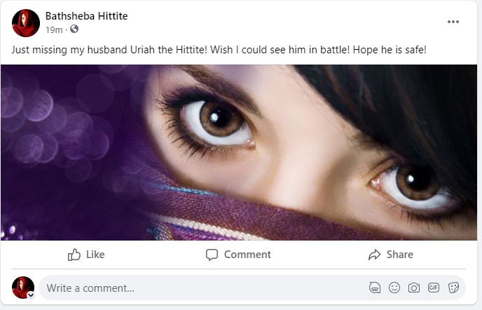
Don’t Take the 2nd Look
Scrolling…
Notes:
Don’t Take the 2nd Look
We are going to imagine David in today’s world using Facebook. It really can work for any social media.
David is up late, having trouble sleeping, so he mindlessly scrolls through his social media account, in this example: Facebook.
There is nothing evil or sinister in this, but innocently done, just as in David walking along his roof top. Probably something he had done many times before.
Scrolling…
He may come across a post saying, “Just missing my husband Uriah the Hittite! Wish I could see him in battle! Hope he is safe!” Just keeps scrolling without even looking who posted it.

Slide 7
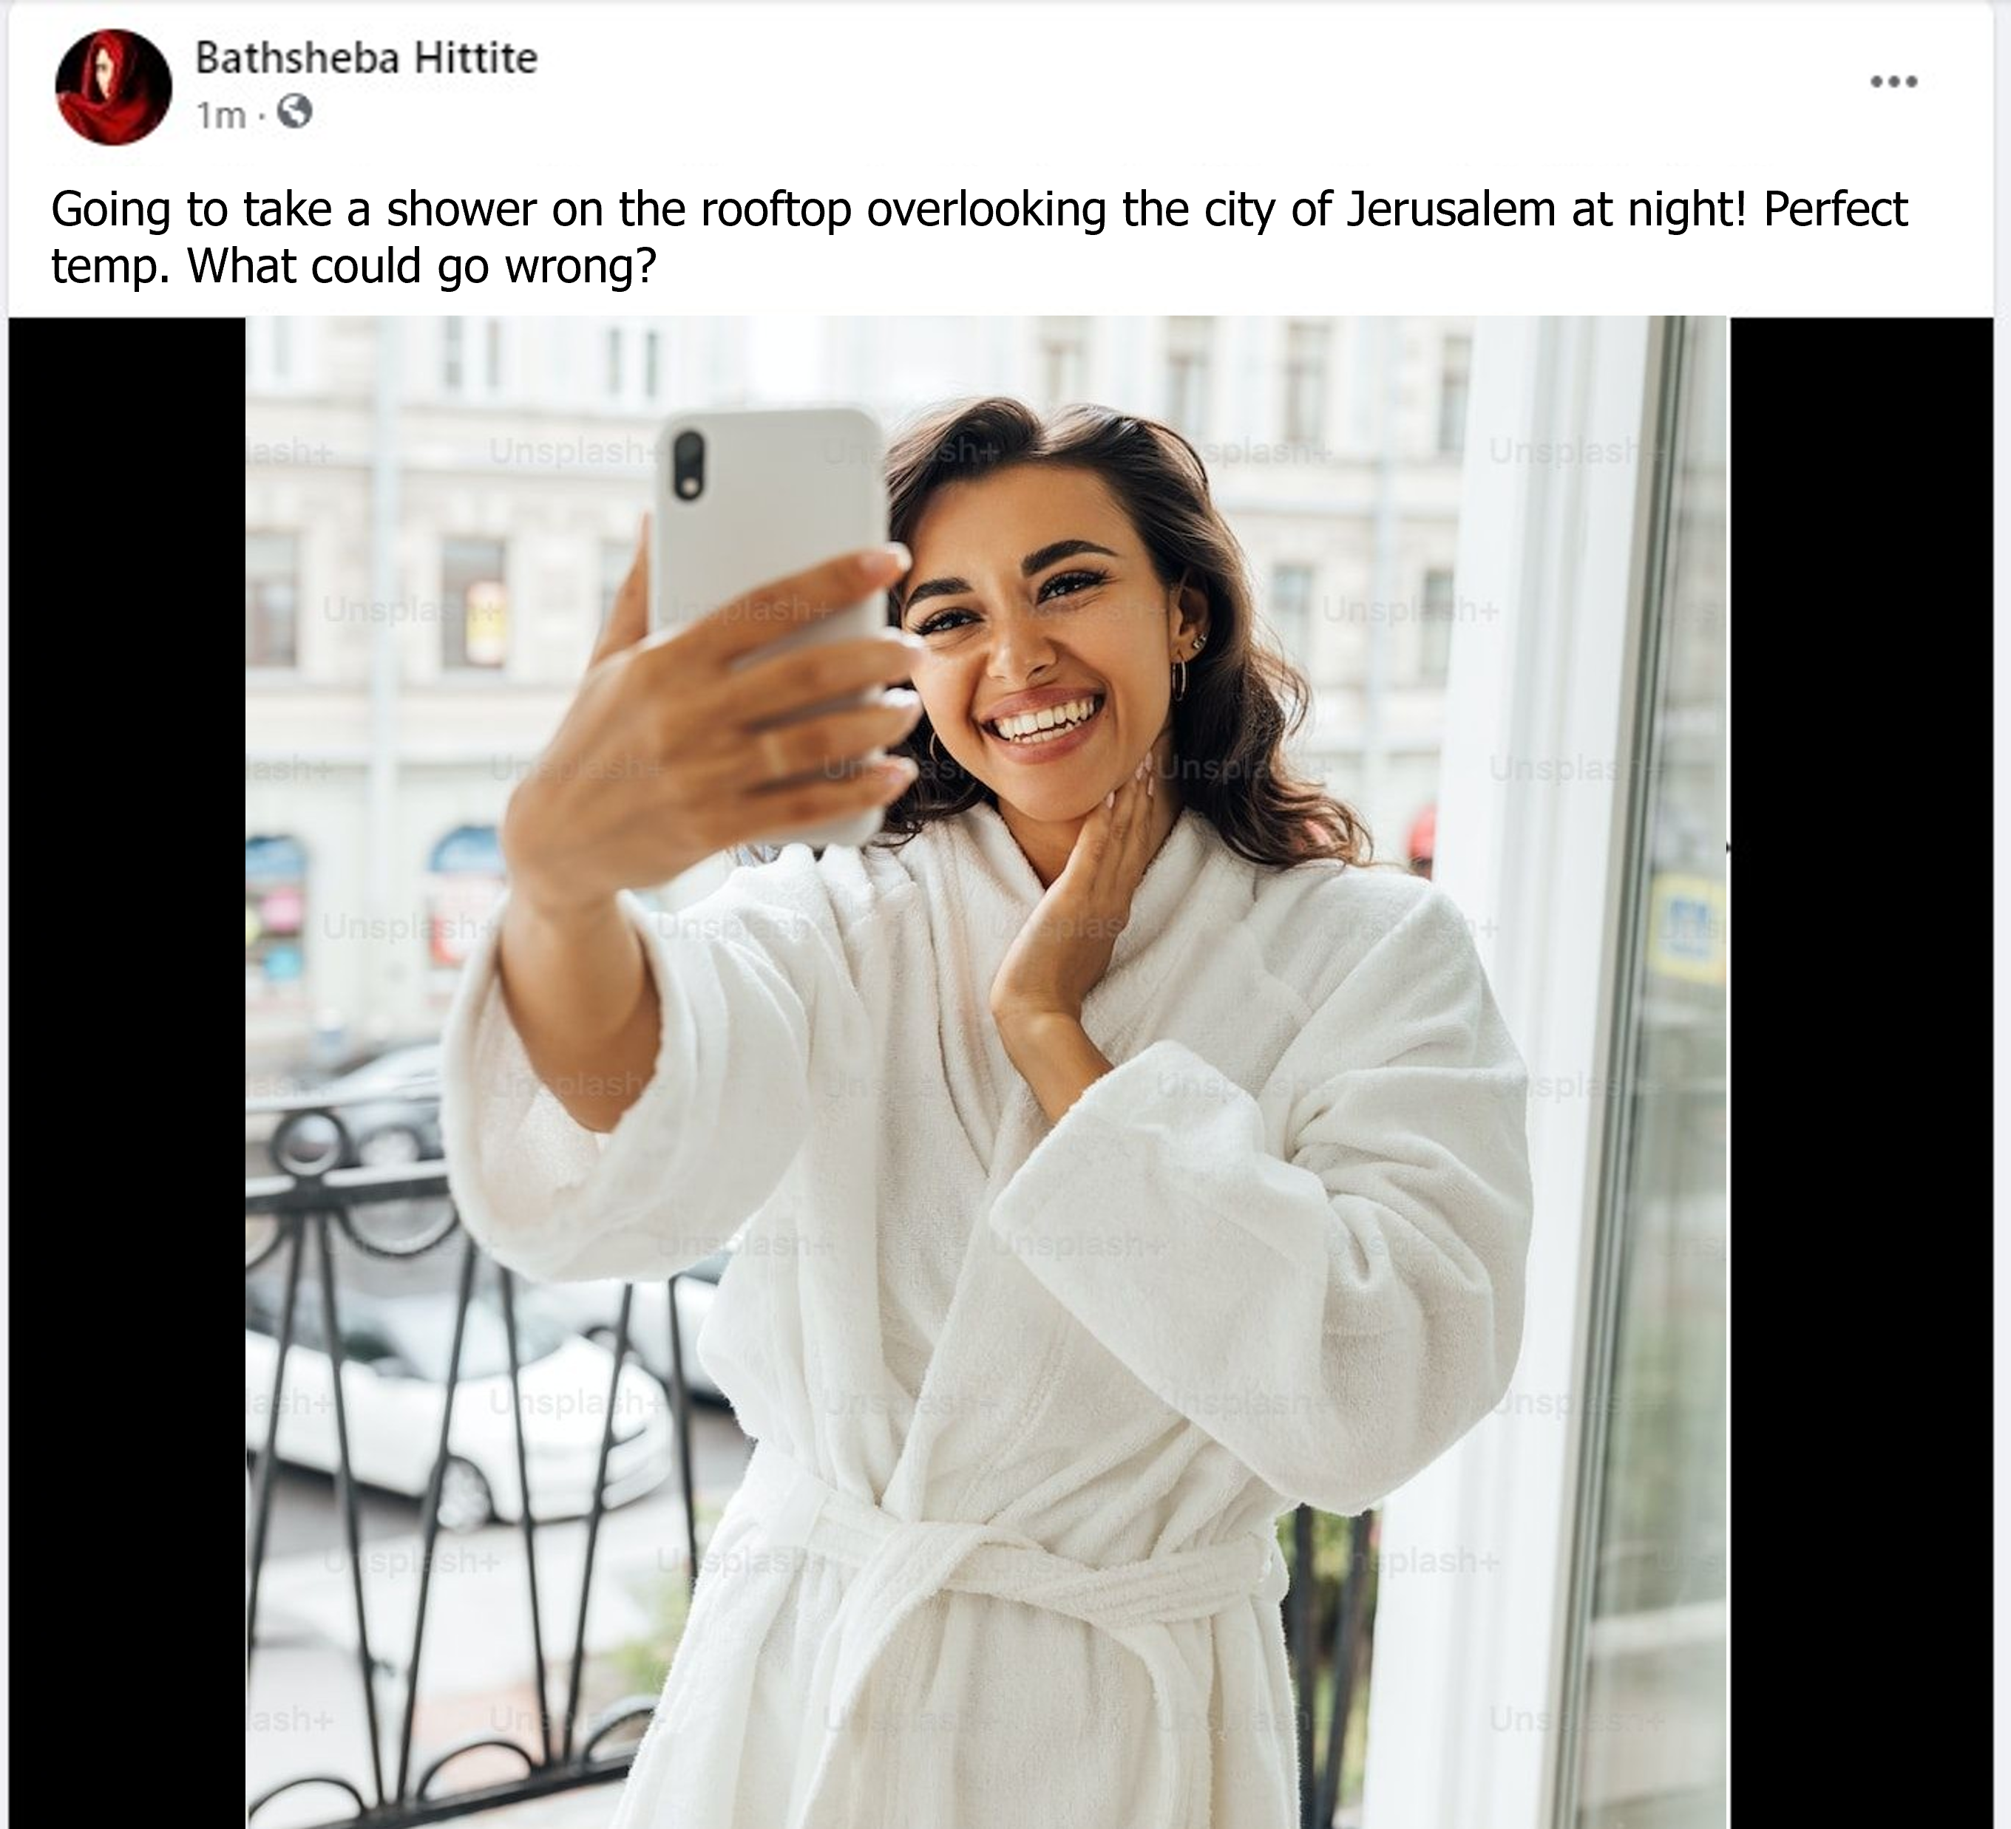
Don’t Take the 2nd Look
Going to take a shower on the rooftop overlooking the city of Jerusalem at night! Perfect temp. What could go wrong?
Scrolling…
Notes:
Don’t Take the 2nd Look
We are going to imagine David in today’s world using Facebook. It really can work for any social media.
David is up late, having trouble sleeping, so he mindlessly scrolls through his social media account, in this example: Facebook.
There is nothing evil or sinister in this, but innocently done, just as in David walking along his roof top. Probably something he had done many times before.
Scrolling…
He may come across a post saying, “Just missing my husband Uriah the Hittite! Wish I could see him in battle! Hope he is safe!” Just keeps scrolling without even looking who posted it.
Then he comes across something startling! A little later he scrolls upon a picture of a beautiful woman showering outside! The post says, “Going to take a shower on the rooftop overlooking the city of Jerusalem at night! Perfect temp. What could go wrong?”
He doesn’t see the “Censored” version.
He could keep scrolling or…take a 2nd look.
He decides he wants to know more about her and takes a 2nd look…

Slide 8
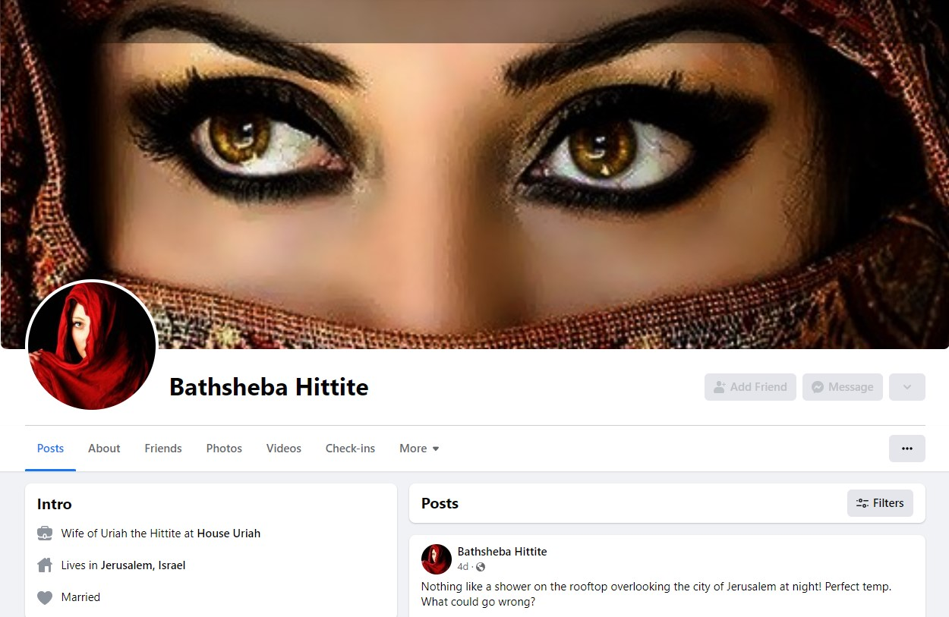
Don’t Take the 2nd Look
The 2nd Look…
Notes:
Don’t Take the 2nd Look
We are going to imagine David in today’s world using Facebook. It really can work for any social media.
David is up late, having trouble sleeping, so he mindlessly scrolls through his social media account, in this example: Facebook.
There is nothing evil or sinister in this, but innocently done, just as in David walking along his roof top. Probably something he had done many times before.
Scrolling…
He may come across a post saying, “Just missing my husband Uriah the Hittite! Wish I could see him in battle! Hope he is safe!” Just keeps scrolling without even looking who posted it.
Then he comes across something startling! A little later he scrolls upon a picture of a beautiful woman showering outside! The post says, “Nothing like a shower on the rooftop overlooking the city of Jerusalem at night!
Perfect temp. What could go wrong?” He doesn’t see the “Censored” version.
He could keep scrolling or…take a 2nd look.
He decides he wants to know more about her and takes a 2nd look…
The 2nd Look
He clicks on her Profile and sees she is married to Uriah the Hittite.
Her About Page reveals she is the daughter of Eliam, meaning both her father and her husband are Mighty Men! (II Samuel 23:34, 39)
The family ramifications go deeper in that it also means she is the granddaughter of his counselor, Ahithophel the Gilonite, the man whose word is like listening to the voice of God (II Samuel 23:34; 16:23; I Chr. 27:33).
He should stop looking! But he doesn’t.
Knowing full well who she is he contacts her and sends for her.

Slide 9
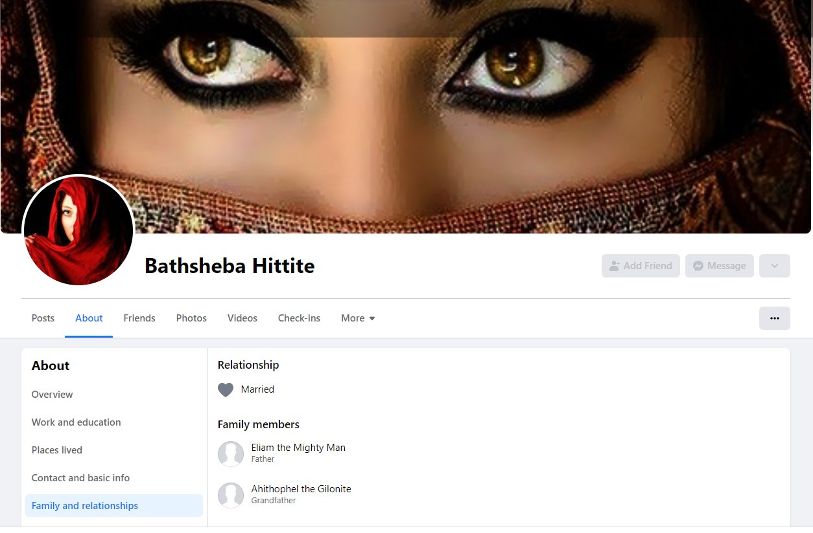
Don’t Take the 2nd Look
The 2nd Look…
Notes:
Don’t Take the 2nd Look
We are going to imagine David in today’s world using Facebook. It really can work for any social media.
David is up late, having trouble sleeping, so he mindlessly scrolls through his social media account, in this example: Facebook.
There is nothing evil or sinister in this, but innocently done, just as in David walking along his roof top. Probably something he had done many times before.
Scrolling…
He may come across a post saying, “Just missing my husband Uriah the Hittite! Wish I could see him in battle! Hope he is safe!” Just keeps scrolling without even looking who posted it.
Then he comes across something startling! A little later he scrolls upon a picture of a beautiful woman showering outside! The post says, “Nothing like a shower on the rooftop overlooking the city of Jerusalem at night!
Perfect temp. What could go wrong?” He doesn’t see the “Censored” version.
He could keep scrolling or…take a 2nd look.
He decides he wants to know more about her and takes a 2nd look…
The 2nd Look
He clicks on her Profile and sees she is married to Uriah the Hittite.
Her About Page reveals she is the daughter of Eliam, meaning both her father and her husband are Mighty Men! (II Samuel 23:34, 39)
The family ramifications go deeper in that it also means she is the granddaughter of his counselor, Ahithophel the Gilonite, the man whose word is like listening to the voice of God (II Samuel 23:34; 16:23; I Chr. 27:33).
He should stop looking! But he doesn’t.
Knowing full well who she is he contacts her and sends for her.

Slide 10
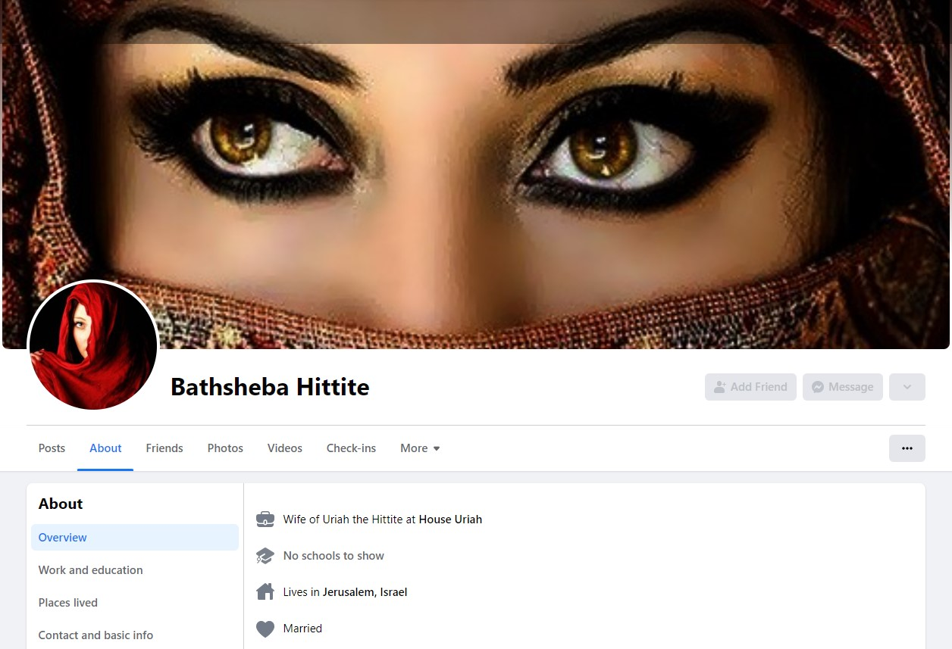
Don’t Take the 2nd Look
The 2nd Look…
Notes:
Don’t Take the 2nd Look
We are going to imagine David in today’s world using Facebook. It really can work for any social media.
David is up late, having trouble sleeping, so he mindlessly scrolls through his social media account, in this example: Facebook.
There is nothing evil or sinister in this, but innocently done, just as in David walking along his roof top. Probably something he had done many times before.
Scrolling…
He may come across a post saying, “Just missing my husband Uriah the Hittite! Wish I could see him in battle! Hope he is safe!” Just keeps scrolling without even looking who posted it.
Then he comes across something startling! A little later he scrolls upon a picture of a beautiful woman showering outside! The post says, “Nothing like a shower on the rooftop overlooking the city of Jerusalem at night!
Perfect temp. What could go wrong?” He doesn’t see the “Censored” version.
He could keep scrolling or…take a 2nd look.
He decides he wants to know more about her and takes a 2nd look…
The 2nd Look
He clicks on her Profile and sees she is married to Uriah the Hittite.
Her About Page reveals she is the daughter of Eliam, meaning both her father and her husband are Mighty Men! (II Samuel 23:34, 39)
The family ramifications go deeper in that it also means she is the granddaughter of his counselor, Ahithophel the Gilonite, the man whose word is like listening to the voice of God (II Samuel 23:34; 16:23; I Chr. 27:33).
He should stop looking! But he doesn’t.
Knowing full well who she is he contacts her and sends for her.

Slide 11
Don’t Take the 2nd Look
This story could be any of our story
Something innocent can turn so wrong.
Innocently shopping: See immodestly. You have a choice: Keep walking, averting your eyes, or take a 2nd look.
Innocently scrolling Social Media: See provocative pictures or videos, immodestly dressed or posed. You have a choice: Close the app, keep scrolling, or take a 2nd look.
If you are single or married, it still matters what we purposefully look at and seek after (Philippians 4:8)
Notes:
Don’t Take the 2nd Look
We are going to imagine David in today’s world using Facebook. It really can work for any social media.
This story could be any of our story!
Something innocent can turn so wrong.
You could be innocently out shopping and see someone dressed immodestly. You have a choice: Keep walking, averting your eyes, or take a 2nd look.
You could be innocently scrolling through Facebook or Instagram or whatever social media account you enjoy and encounter provocative pictures or videos of someone immodestly dressed or posed. You have a choice: Close the app, keep scrolling, or take a 2nd look.
Social media makes it so easy to take a 2nd look: You can click their profile and learn as much about them as they are willing to post.
If you are married it doesn’t matter if they are or not.
If you are single or married, it still matters what we purposefully look at and seek after (Philippians 4:8)
Don’t take the 2nd look!

Slide 12
Don’t Take the 2nd Look
Philippians 4:8
Finally, brethren, whatever is true, whatever is honorable, whatever is right, whatever is pure, whatever is lovely, whatever is of good repute, if there is any excellence and if anything worthy of praise, dwell on these things.

Slide 13
Don’t Take the 2nd Look!

Slide 14
Conclusion
Something innocent can turn sinful when we take a 2nd look
David had many opportunities to look away.
He could have averted his eyes or went back into his room.
When he inquired of her and found out who she was, her marital status and family history, he could have let the matter drop.
But he sent for her and sinned!

Slide 15
Conclusion
When you are using social media you have lots of opportunities to look away
You can close the app, you can keep scrolling, you can refresh the page!
Don’t use social media to play with fire by engaging with immorality and immodesty, and thus commit the sin of the lust of the flesh or the lust of the eyes (I John 2:15-17)

Slide 16
Conclusion
Learn the lesson from David: Look away!

