Slide 1
Godly Father: Job Prayed For His Children
Text:
Job 1:1-5
Notes:
By Nathan L Morrison for Sunday 06/18/2023
All Scripture given is from NASU unless otherwise stated
For further study, or if questions, please Call: 804-277-1983 or Visit: www.courthousechurchofchrist.com
The logo art was used by permission by www.vecteezy.com

Slide 2
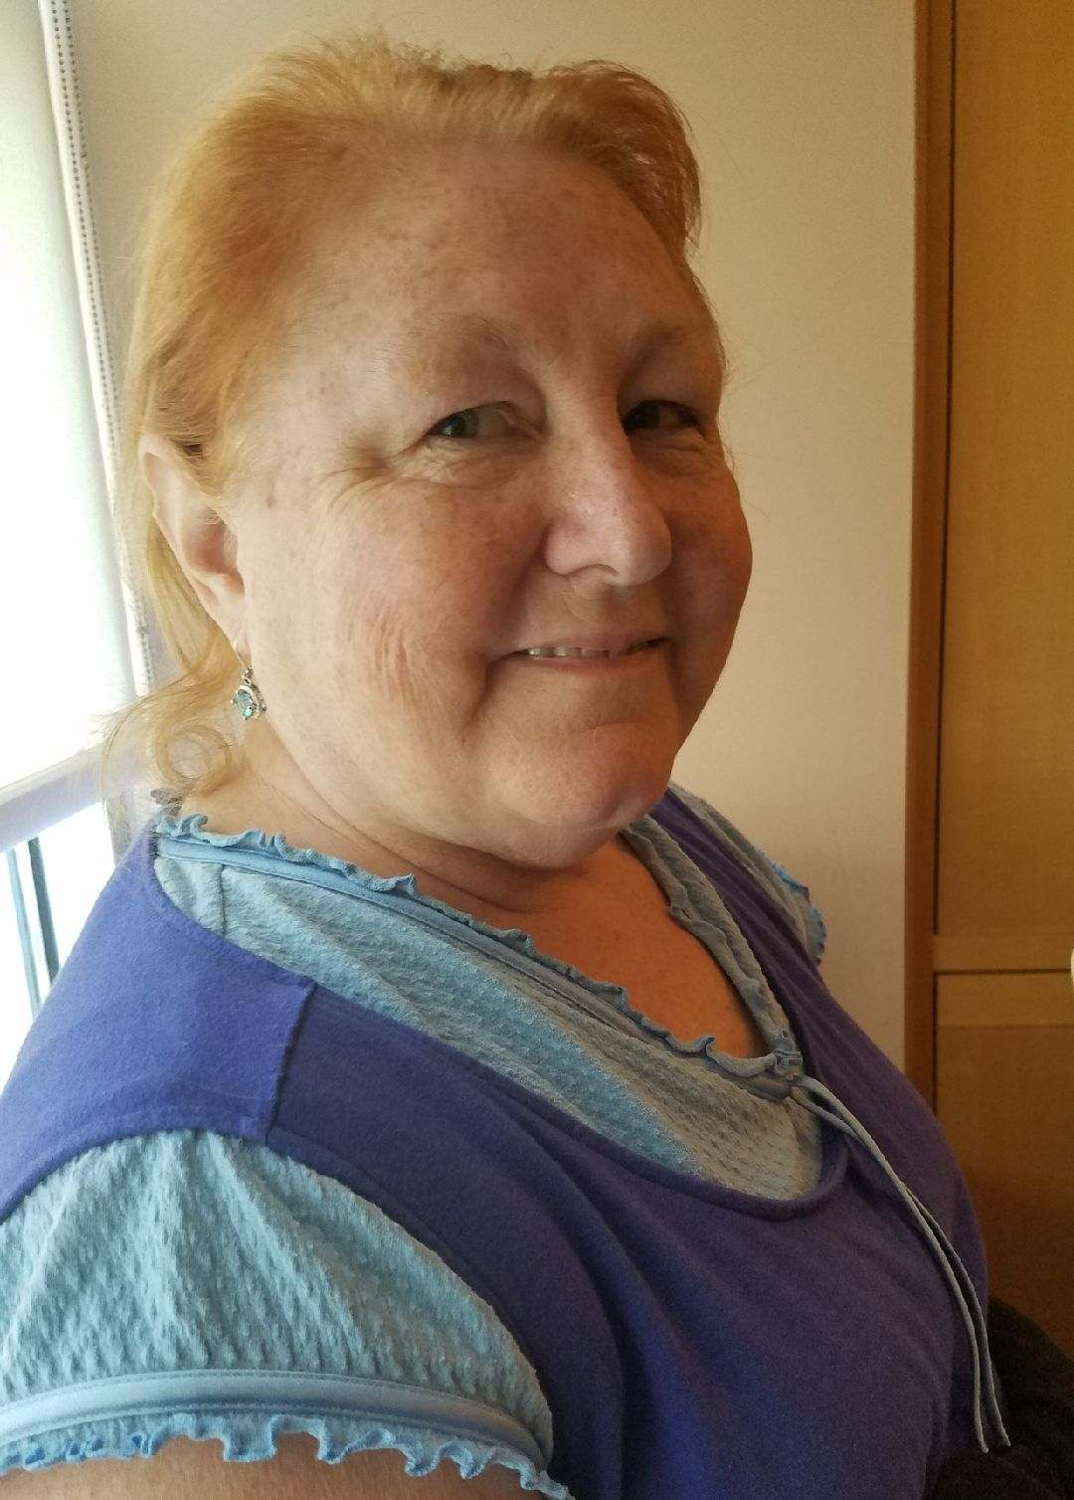
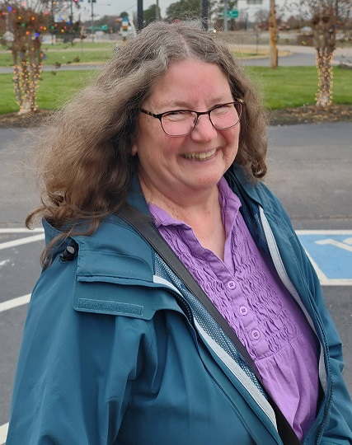
INTRO
Notes:
Images: L-R: Author’s Mom, Mary Morrison, Author’s Mother-in-Law, Susan Krizer
Intro
Each Lord’s Day we gather together to remember the death of Jesus, the greatest sacrifice of all, and learn how we can be better fathers, mothers, grandparents and children, and how better to serve God! In May we honored our mothers and grandmothers on Mother’s Day.

Slide 3
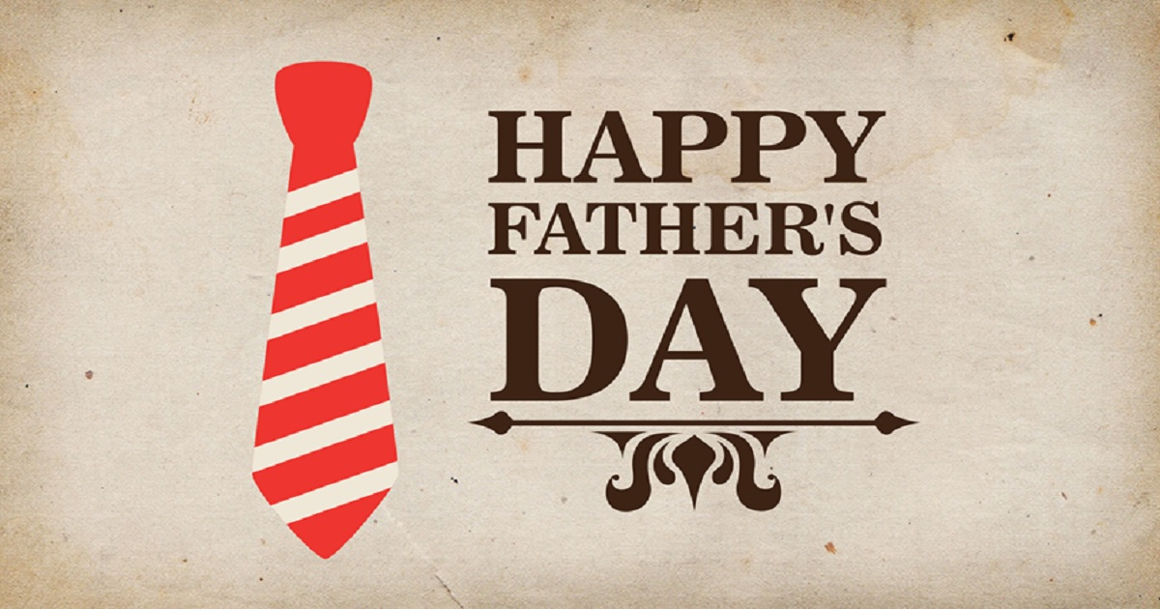
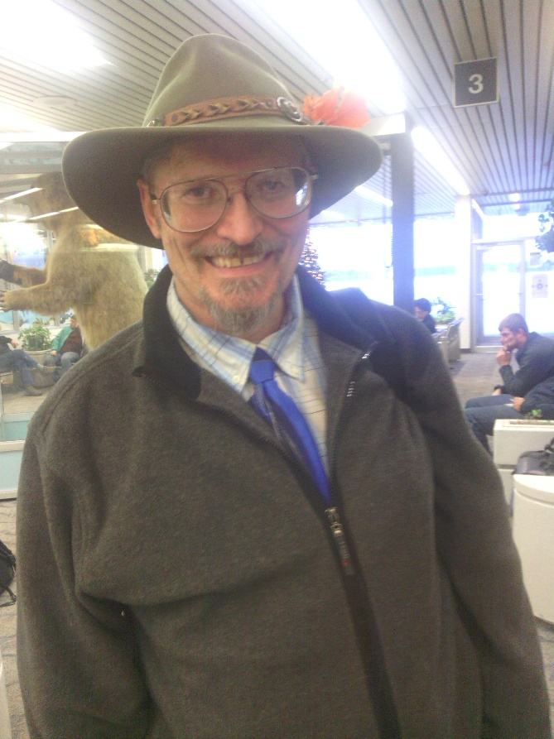
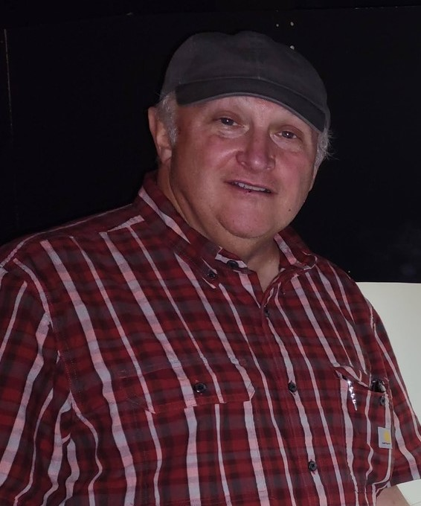
INTRO
The Month of June!
A time when we reflect on and honor our fathers
Let us take a look at a godly father from Scripture this morning
Father’s Day is a special one-time event each year, but we should all honor our fathers on a daily basis – especially those who are faithful to God!
Notes:
Images: L-R: Author’s Dad, Loren “Mo” Morrison; Author’s Father-in-Law, Mark Krizer
INTEGRITY: THE LEGACY OF A LOVING FATHER
June 10, 2020, by Norma Gail
Integrity, love, and faith were the legacy of my father. Integrity is a sorely lacking trait in our world. Politicians, businessmen, educators, even some in the ministry handle the truth like a novel where the readers write their own ending.
“Do the right thing and you’ll never have to apologize,” my father drilled into us from an early age. Right wasn’t some nebulous concept based on popular perception, convenience, or individual circumstances. Daddy saw the world in black and white when it came to right and wrong, truth, and lies. The harshest punishment meted out in our home resulted from the failure to be honest and kind. Although, his honesty was questioned at one point.
Integrity Questioned
As if it were yesterday, I remember men in business suits gathered around our dinner table when examiners from the insurance company where my father was an agent came to investigate some missing money. As a high school student, I was aware of the tension that buzzed like electric current under the surface of the conversation. These men had the power to take my father’s job and forever change our family.
A few days prior, Daddy explained that a large amount of money was missing from his office. A secretary who moved out of state embezzled from premiums paid in cash, crediting only partial payment to the customers. She couldn’t be held accountable because she couldn’t be found. The men combed through records for days to ascertain my father’s innocence.
Integrity Proven
In order to set things right, he repaid every cent. I learned that integrity and reputation are treasures to be guarded and cherished. He believed Proverbs 22:1 and expected his children to live the same. “A good name is more desirable than great riches; to be esteemed is better than silver or gold.”
Sometime later, my father located his former secretary. Though she never repaid everything, he accepted partial payment and forgave what almost cost his reputation. Daddy’s mercy and grace provided a powerful example on how to treat others. “A man’s wisdom gives him patience; it is to his glory to overlook an offense.” (Proverbs 19:11) By the same token, he expected nothing less from his children. Our most severe punishments stemmed from lies.
Because of his example, my father’s teaching on integrity colors my attitude to this day. Honesty is not an option but a necessity. As King David prayed, “I know, my God, that you examine our hearts and rejoice when you find integrity there.” (1 Chronicles 29:17 NLT)
A Father’s Legacy
This mindset is uncommon in our world today. How different our world would be if people treated each other with integrity and mercy. Mudslinging and lies would vanish. Justice would be assured. We could trust those in power because clear principle, humility, and gentleness would be their hallmarks. All people would receive fair treatment in spite of skin color, socioeconomic standing, or educational level.
“A good man leaves an inheritance for his children’s children…” (Proverbs 13:22) I was privileged to be raised by a man who left a legacy of faith, love, and integrity. Likewise, I rejoice when my children display these traits. May we, as Christians honor our Lord in the current climate of societal unrest by treating others the way that honors our heavenly Father.
Whoever walks in integrity walks securely, but whoever takes crooked paths will be found out. Proverbs 10:9

Slide 4
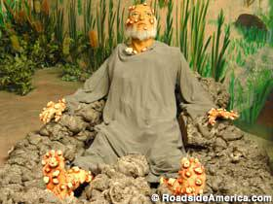
Intro
When we think of Job, we think of TRIALS!
James 5:11: “We count those blessed who endured. You have heard of the endurance of Job and have seen the outcome of the Lord's dealings, that the Lord is full of compassion and is merciful.”
But there is another lesson that we learn from Job: Job is an example of a godly father that courageously led his family!

Slide 5
Job’s Character
Job 1:1: “There was a man in the land of Uz whose name was Job; and that man was blameless, upright, fearing God and turning away from evil”
Blameless (Proverbs 13:6)
Upright (Proverbs 2:6-9)
Feared God (Proverbs 1:7)
Turned away from evil (Proverbs 16:6)

Slide 6
Job’s Character
Job feared God and lived a righteous life and that was his foundation to face trials!

Slide 7
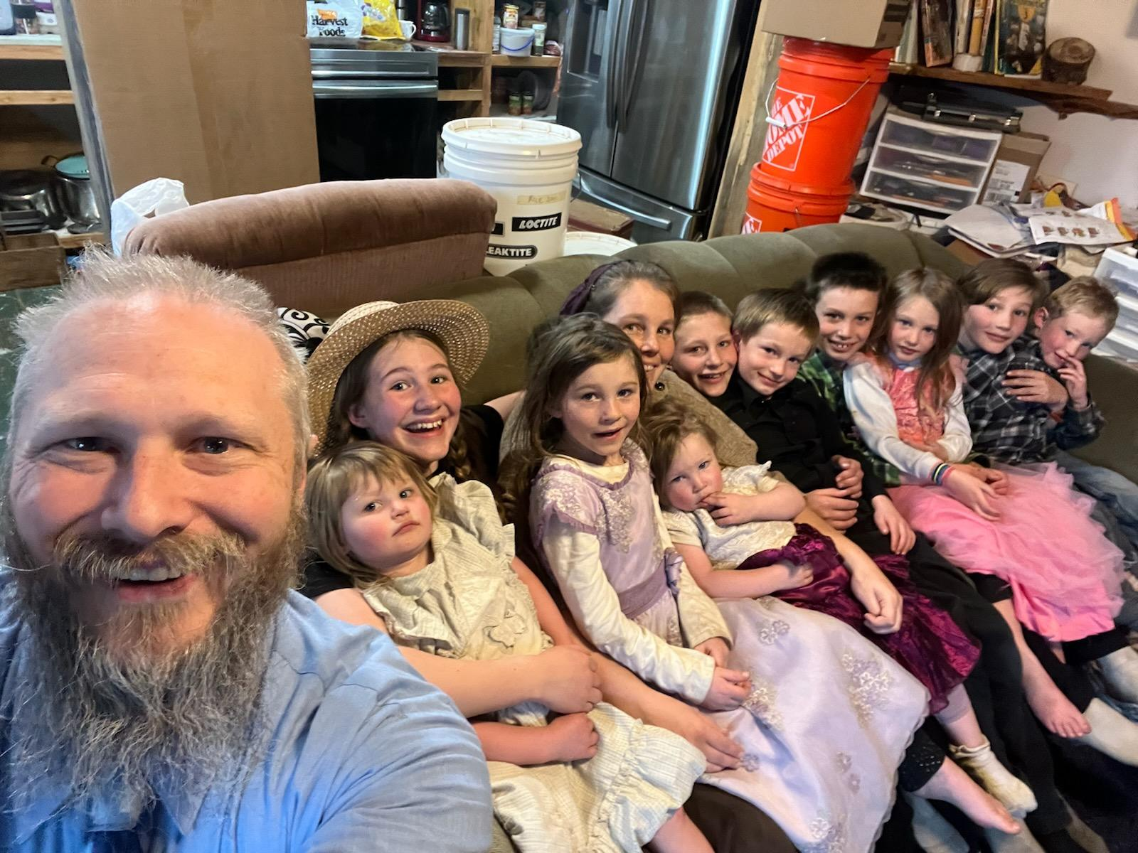
Job’s Family
Job 1:2: “Seven sons and three daughters were born to him”
Job had ten children: 7 Sons and 3 Daughters
They all liked each other! It is implied they were adults in their own homes as they would invite each other over to their homes for dinner regularly (Job 1:4)
“His sons used to go and hold a feast in the house of each one on his day…” (Job 1:4)
Whatever that meant, it shows they all got along with each other!
Job would intercede to God for his children (Job 1:5). They were the first thing on his mind in the morning.
Notes:
Image: Author’s brother Lee, his wife, and their ten children!

Slide 8
Job’s Family
Job, a God-fearing man, loved his children and prayed for them!
Notes:
Image: Author’s brother Lee, his wife, and their ten children!

Slide 9
Job’s Possessions
Job 1:3: “His possessions also were 7,000 sheep, 3,000 camels, 500 yoke of oxen, 500 female donkeys, and very many servants; and that man was the greatest of all the men of the east”
Job was not only the head of a large family but he was a very wealthy man!
In those days, wealth was measured in land, animals and servants. Job was blessed with all three. He was the richest of the rich!
Lamentations 4:21 tells us Uz is in the land of Edom, which means in the land of the descendants of Esau (Genesis 36:8).
To get that wealthy Job overcame many temptations to keep himself blameless and upright before God!

Slide 10
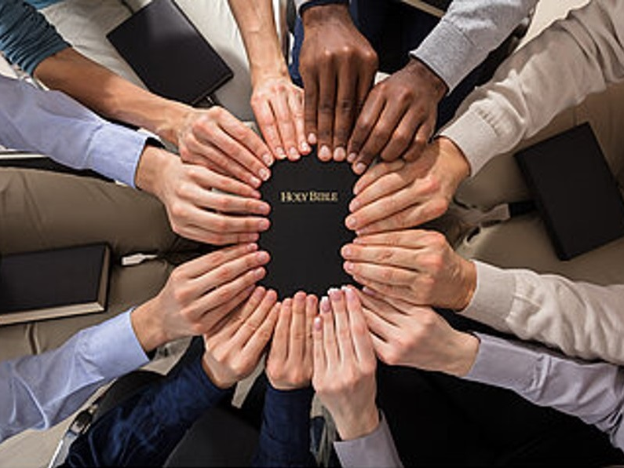
Job’s Character, Family, Possessions: Application
Job had things in proper order:
First, 1st thing recorded about Job is his relationship with God (Job 1:1).
Second, relationship to family (Job 1:2).
Third, relationship to things, material wealth (Job 1:3).
Jesus later teaches His followers that God must come first in all things: Matthew 6:33: “But seek first His kingdom and His righteousness, and all these things will be added to you.”

Slide 11
Job’s Possessions
Job had the proper perspective: God first!

Slide 12
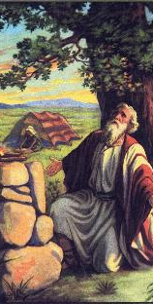
Job Prayed For His Children
Job 1:5: When the days of feasting had completed their cycle, Job would send and consecrate them, rising up early in the morning and offering burnt offerings according to the number of them all; for Job said, “Perhaps my sons have sinned and cursed God in their hearts.” Thus Job did continually.
This further tells us that Job lived during the patriarchal period before the Law of Moses, because he acted as priest for his family.
Under the Law that came later only the Levites could offer sacrifices to God.
Job “had them purified.”
Job 1:4-5 tells us that Job made routine sacrifices for his children. The end of verse 5 tells us that this was his regular custom.

Slide 13
Job Prayed For His Children: Application
We can learn a lesson from Job. Job loved them all; Job provided for them all; Job prayed for them all; Job did this continually!

Slide 14
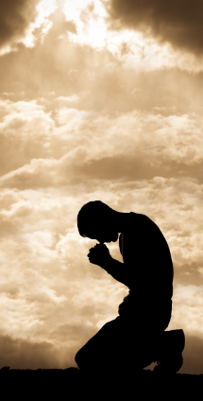
Job Prayed For His Children
What should we pray about for our children?
Pray for character. Job walked with God & prayed for his children (Job 1:1-5).
Pray for God’s will. Job practiced and lived in faith (Job 1:21-22; 2:10).
Pray for salvation. Job knew his relationship with God (Job 1:1; 2:3, 10).

Slide 15
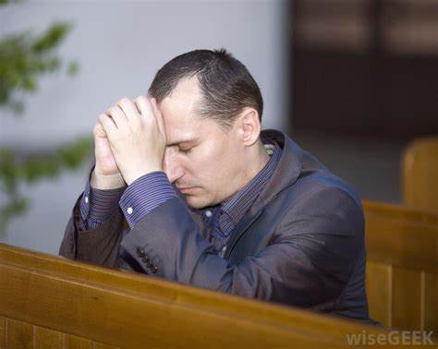
Job Prayed For His Children
On a routine basis, Job is constantly before his children demonstrating to them the importance of fearing God and turning away from evil!

Slide 16
Three Lessons from Job’s Prayer for His Children
Don’t allow God’s blessings to lead you away from God
You can’t control your children but you can pray for them and influence them with your godly example
Prayer doesn’t always work the way we want it to (God doesn’t always answer us the way we want!)

Slide 17
A lesson from China
In ancient China, the people wanted security against the barbaric people to the north, the Mongols.
They built walls so high that no one could climb over it and built so thick that no one could break it down. So they settled back to enjoy their security.
During the first 100 years of building the walls, China was invaded three times. How?
The gates were left open! The enemy had bribed the gatekeepers. The Chinese spent all their time building a wall, but they neglected on building character and integrity in their children.
Notes:
A lesson from China:
In ancient China, the people wanted security against the barbaric people to the north, the Mongols.
So they built walls to keep them out (Begun in 220 B.C. through A.D. 1644). These walls were built so high that no one could climb over it and built so thick that no one could break it down. So they settled back to enjoy their security.
It is told that during the first 100 years of building the walls, China was invaded three times. How?
The gates were left open. The enemy had bribed the gatekeepers. The Chinese spent all their time building a wall, but they neglected on building character and integrity in their children.
https://www.farmvilleherald.com/2016/04/gatekeepers-and-integrity/

Slide 18
Three Lessons from Job’s Prayer for His Children: Application
May we never become so pre-occupied with providing for the financial, athletic, and academic security of our children that we neglect to teach integrity and righteousness!

Slide 19
Three Lessons from Job’s Prayer for His Children
Job prayed for his children: Fathers, teach & pray for your children that they may turn their hearts to God and be people of integrity!

Slide 20
Conclusion
Job is a great example in the Scriptures of a godly father
His story is included to instruct us concerning the reason for suffering and how to suffer in a godly way (James 5:11).
But at the heart of the story is a picture of a man who feared God, turned from evil and prayed for his children.
On this Father’s Day I encourage each of us to follow his example!

Slide 21
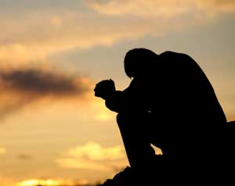
Conclusion
Bring your cares and concerns to God in prayer!
Philippians 4:6
Be anxious for nothing, but in everything by prayer and supplication with thanksgiving let your requests be made known to God.

Slide 22
Conclusion
Let us thank God for godly fathers and grandfathers who have helped guide us to God!
Notes:
Images:
Top: Author’s Dad, Loren “Mo” Morrison
Bottom: Author’s Father-in-Law, Mark Krizer

Slide 23
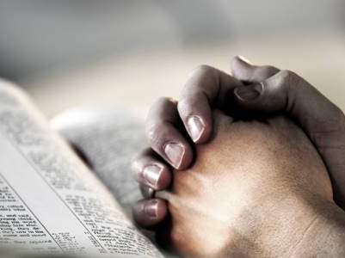
Conclusion
Pray for your children, no matter what their age or where they live!

Slide 24
“What Must I Do To Be Saved?”
Hear The Gospel (Jn. 5:24; Rom. 10:17)
Believe In Christ (Jn. 3:16-18; Jn. 8:24)
Repent Of Sins (Lk. 13:3-5; Acts 2:38)
Confess Christ (Mt. 10:32; Rom. 10:10)
Be Baptized (Mk. 16:16; Acts 22:16)
Remain Faithful (Jn. 8:31; Rev. 2:10)
For The Erring Saint:
Repent (Acts 8:22), Confess (I Jn. 1:9),
Pray (Acts 8:22)

